Slide 1
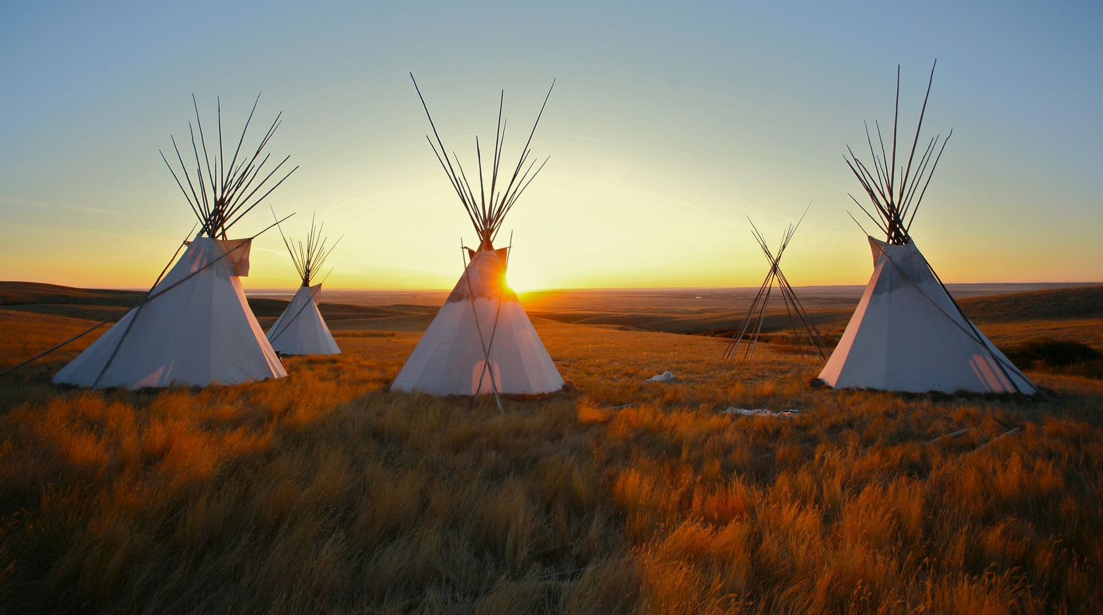
Native American Cultures
1491-1607
Notes:
Native American Cultures (1491-1607)
AP US History
NOTE: 1491 is a generic designation for Native American tribes before European contact and 1607 is the date of the first permanent English settlement at Jamestown. Neither of these dates are exactly literal but denote that the subject of this presentation is to introduce students to Native American culture groups as they existed at the time of European contact and how the lifestyles of some tribes were altered by European contact.

Slide 3
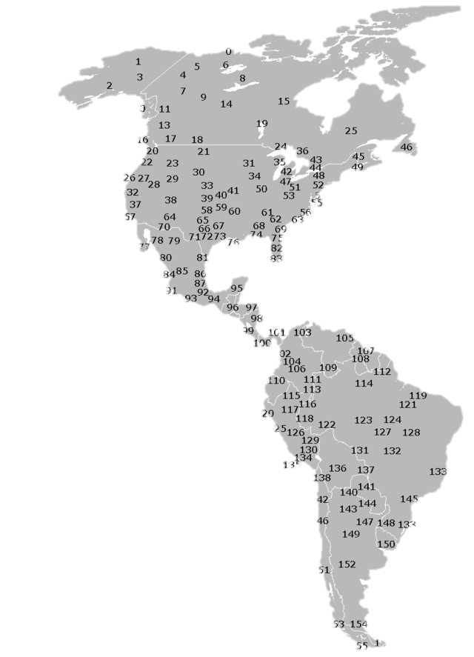
DIVERSITY
156 Distinct Ethnic Groups
Map Credit: KVDP
Notes:
It is important that students understand that Native American tribes were diverse. There were 156 distinct ethnic groups in North and South America prior to European contact.

Slide 4
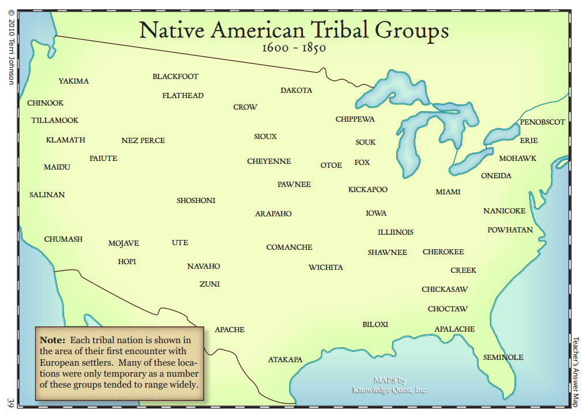
© Terri Johnson
Used with Permission
knowledgequestmaps.com

Slide 5
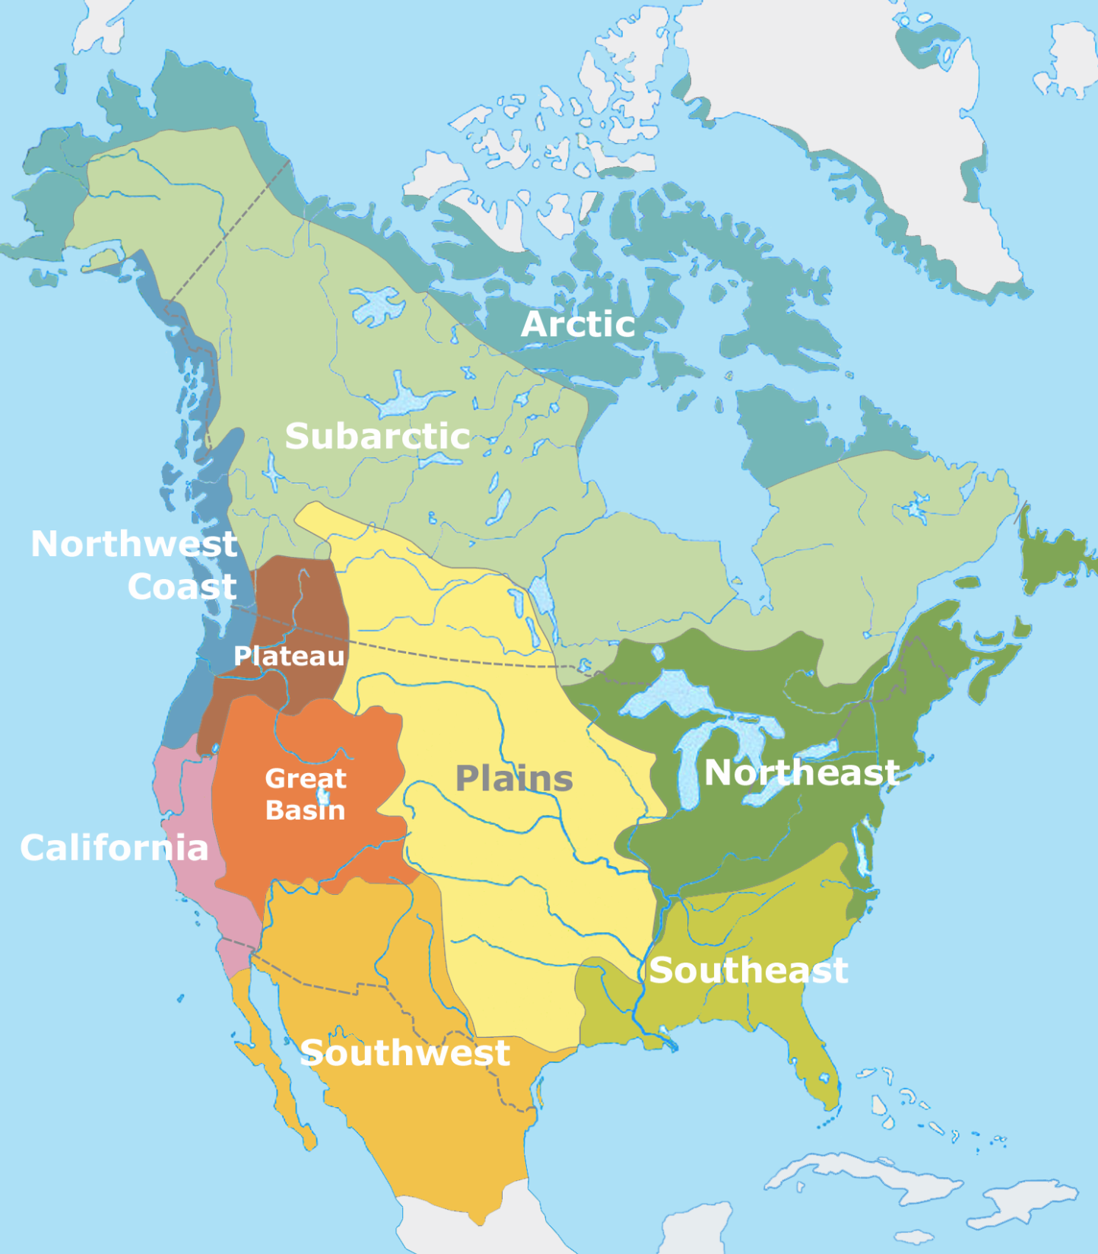
CULTURE GROUPS
Cultural areas of North America at time of European contact
Public Domain Map by Nikater

Slide 6
FISHING
HUNTING
Notes:
While Indians in the Arctic and Subarctic regions subsisted exclusively on hunting, gathering, and fishing, this was not true for all tribes.

Slide 7
HUNTING
&
FARMING
FISHING
HUNTING
FARMING
&
HUNTING
FARMING
Public Domain Map by Nikater
Notes:
Agriculture was an important part of the lifestyles of many Native American tribes, many of whom were settled and hunted and gathered only to supplement a predominantly agricultural diet.

Slide 8
AMERICAN INDIAN Culture Groups
Arctic (Eskimo, Inuit)
Plains Indians (Sioux, Comanche, Wichita)
Northeast / Great Lakes (Iroquois, Algonquin)
Southwest (Hopi, Pueblo)
Southeast (Cherokee, Creek)

Slide 9
AMERICAN INDIAN Culture Groups
Arctic (Eskimo, Inuit) | Hunting, Gathering, and Fishing
Plains Indians (Sioux, Comanche, Wichita)
Northeast / Great Lakes (Iroquois, Algonquin)
Southwest (Hopi, Pueblo)
Southeast (Cherokee, Creek)
Notes:
Arctic tribes, such as the Eskimo and the Inuit, subsisted exclusively by hunting, gathering, and fishing.

Slide 10
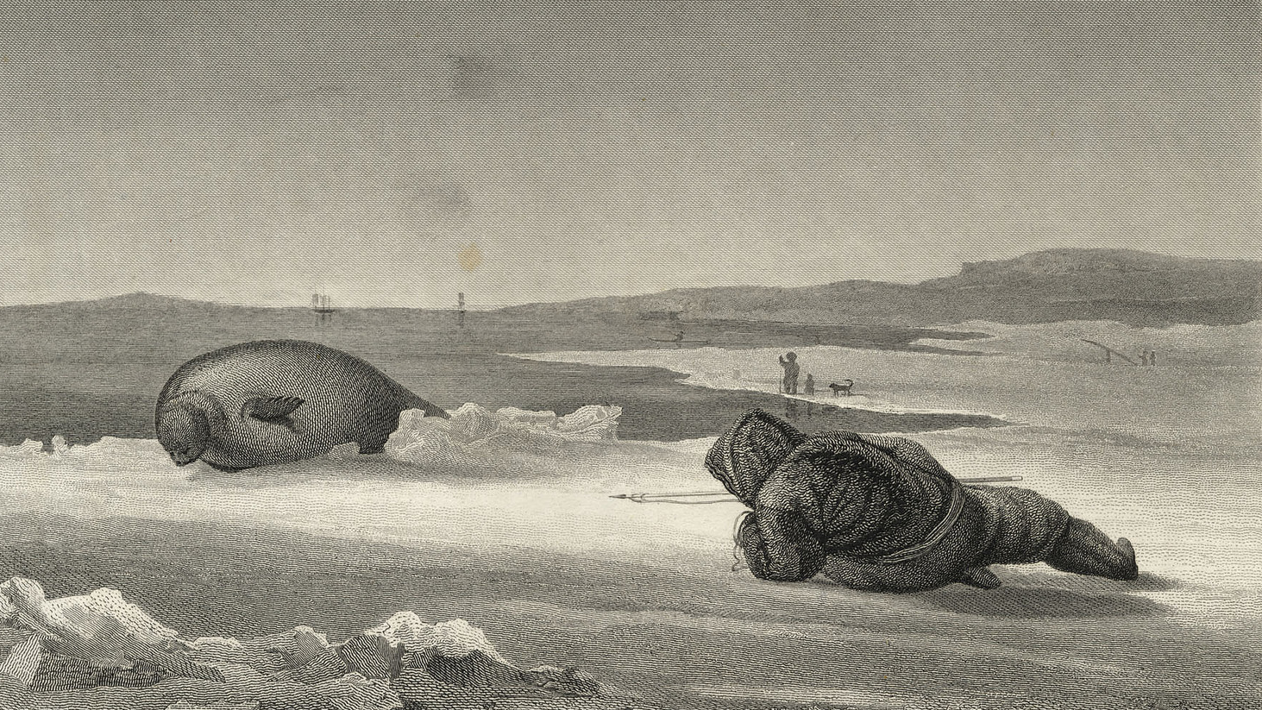
Eskimo Seal Hunter
Special Collections, Toronto Public Library

Slide 11
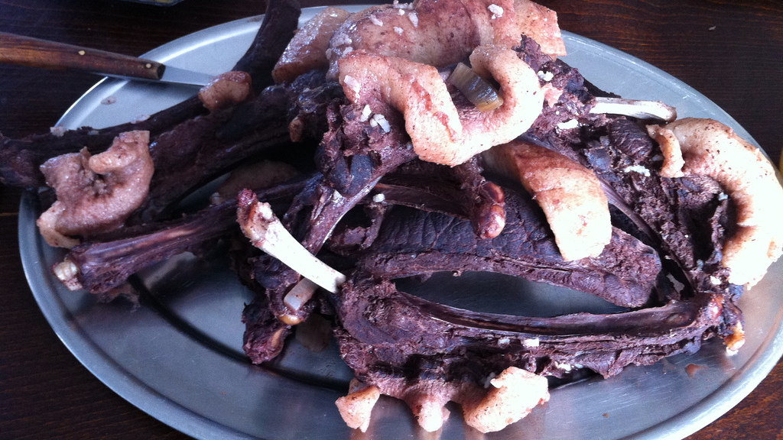
Seal Meat
Photo by Thomas Woodtli
Notes:
Seal meat is very high in fat – a necessity for human beings who live in cold climates. This was the predominant food source for many Arctic and Subarctic tribes.

Slide 12
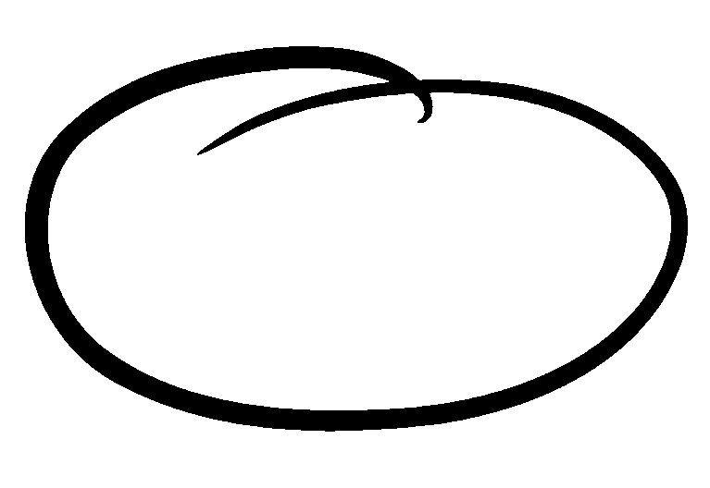

Slide 13
AMERICAN INDIAN Culture Groups
Arctic (Eskimo, Inuit) | Hunting, Gathering, and Fishing
Plains Indians (Sioux, Comanche, Wichita) | Bison Hunters - Migratory (Teepees) Horses (introduced from Europe)
Northeast / Great Lakes (Iroquois, Algonquin)
Southwest (Hopi, Pueblo)
Southeast (Cherokee, Creek)
Notes:
The Plains Indians were bison hunters who lived a largely nomadic existence. The stereotypical teepee was most common in this area. Bison hunting was supported by the introduction of horses from Europe, which drastically altered the lifestyles of the Plains Indians.

Slide 14
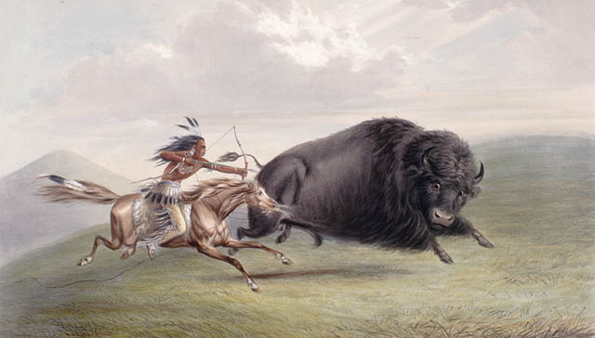
Plains Indian Bison Hunt
Source: Library and Archives Canada
Artist: George Catlin (d. 1872)

Slide 15
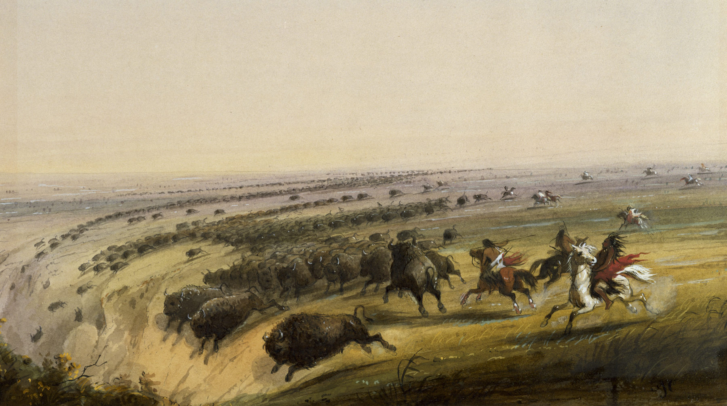
GERONIMO!!!

Slide 16
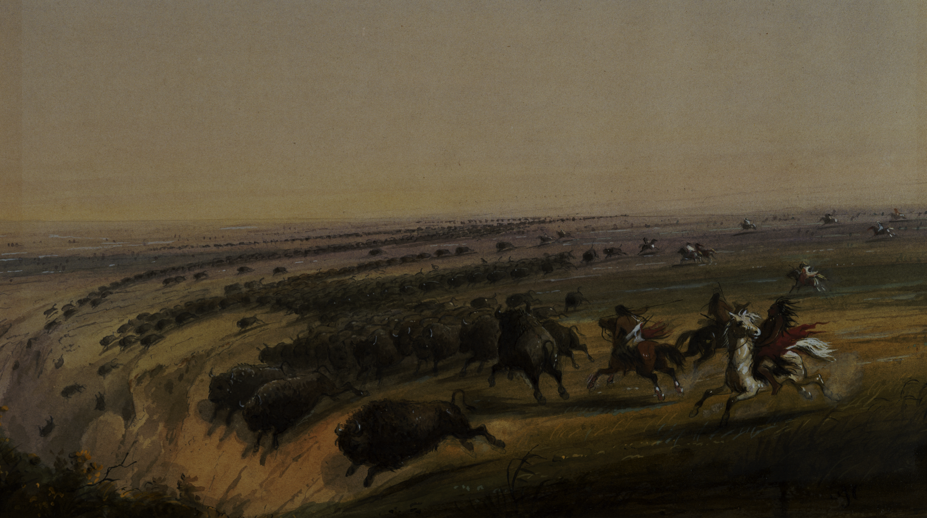
Yes, I know Geronimo wasn’t a Plains Indian.

Slide 17
Nomadic Lifestyle

Slide 18
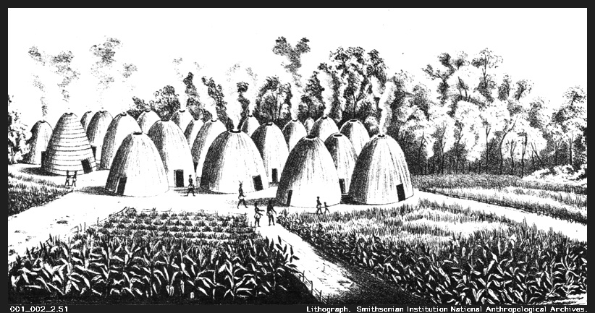
Wichita Tribe (Agriculture & Trade)
Notes:
Some Plains Indian tribes, such as the Wichita, practiced settled agriculture and traded with nomadic tribes, such as the Comanche, for bison meat.

Slide 19
© Terri Johnson
Used with Permission
knowledgequestmaps.com

Slide 21
AMERICAN INDIAN Culture Groups
Arctic (Eskimo, Inuit) | Hunting, Gathering, and Fishing
Plains Indians (Sioux, Comanche, Wichita) | Bison Hunters - Migratory (Teepees) Horses (introduced from Europe)
Northeast / Great Lakes (Iroquois, Algonquin) | Hunting and Gathering Slash and Burn Agriculture “Three Sisters” (Corn, Squash, Beans) Longhouses (Iroquois)
Southwest (Hopi, Pueblo)
Southeast (Cherokee, Creek)

Slide 22
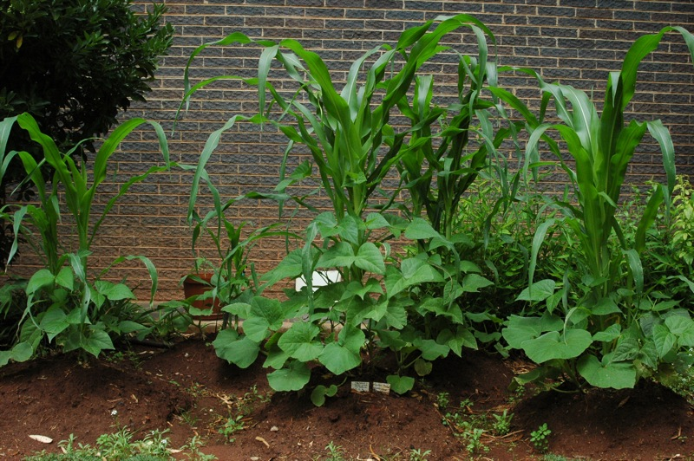
“Three Sisters”
Squash
Corn
Beans
Photo by Abri le Roux

Slide 23
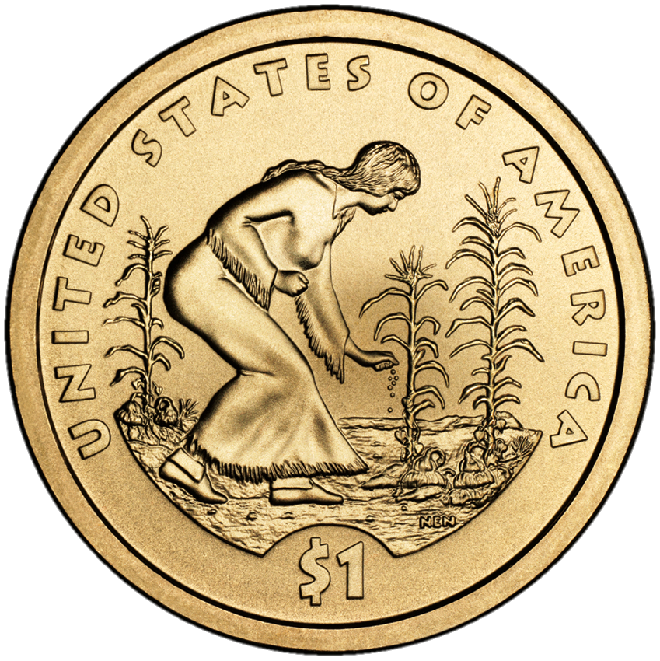

Slide 24
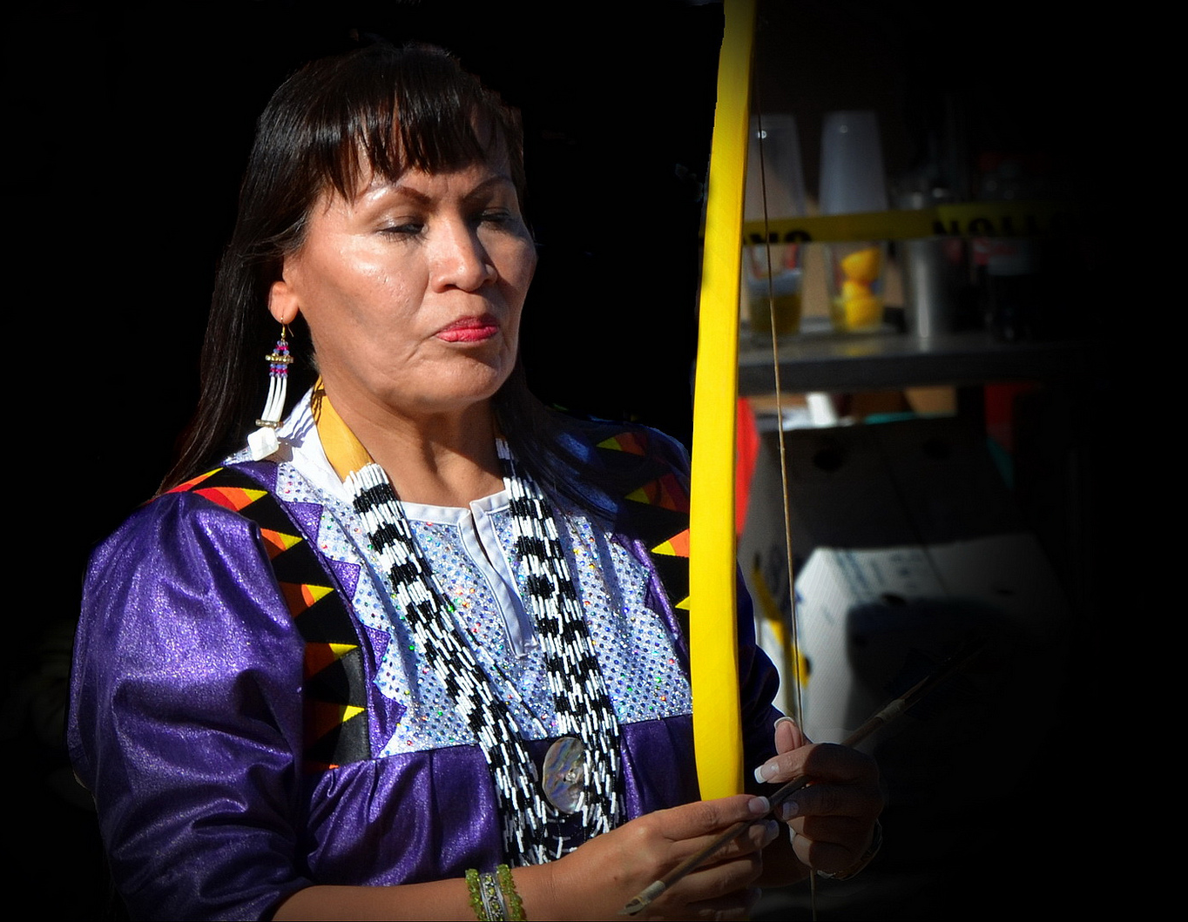
Gender Roles
Women generally shared in labor, except for hunting.
Photo by marksonto

Slide 25
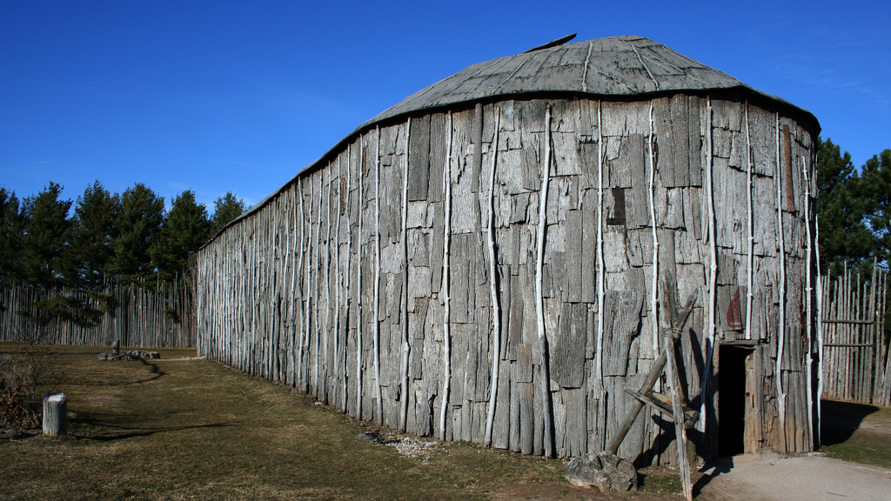
Longhouse
Photo by Perry Quan

Slide 26
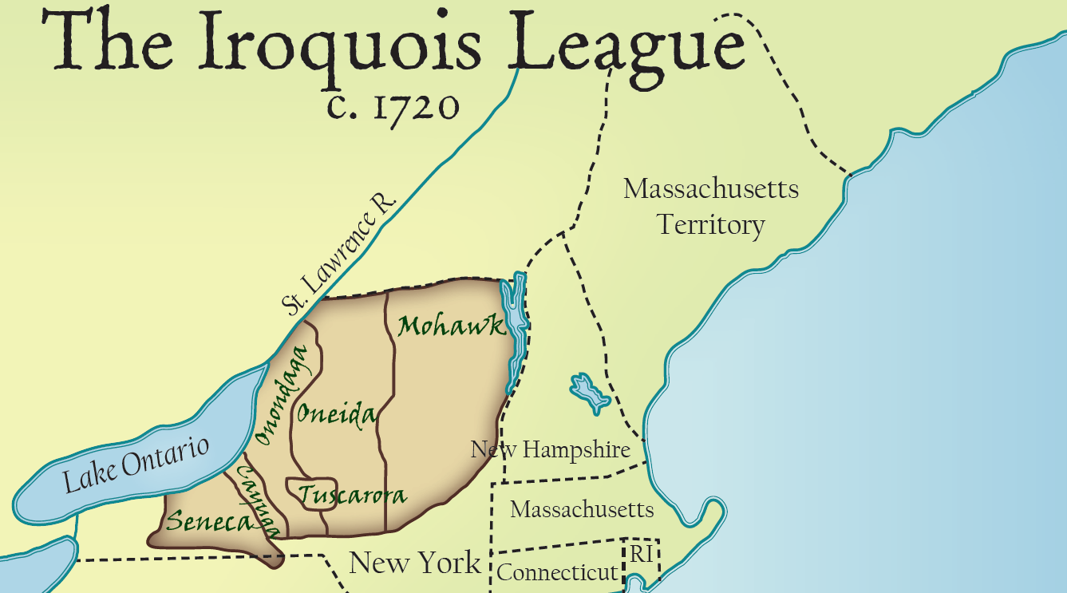
knowledgequestmaps.com
© Terri Johnson
Used with Permission

Slide 27
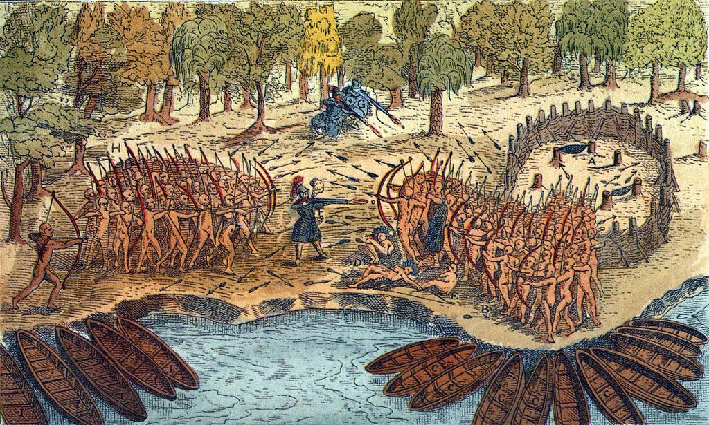
Inter-Tribal Warfare

Slide 29
AMERICAN INDIAN Culture Groups
Arctic (Eskimo, Inuit) | Hunting, Gathering, and Fishing
Plains Indians (Sioux, Comanche, Wichita) | Bison Hunters - Migratory (Teepees) Horses (introduced from Europe)
Northeast / Great Lakes (Iroquois, Algonquin) | Hunting and Gathering Slash and Burn Agriculture “Three Sisters” (Corn, Squash, Beans) Longhouses (Iroquois)
Southwest (Hopi, Pueblo) | Clay Houses / Cliff Dwellings Maize (Corn) Agriculture
Southeast (Cherokee, Creek)

Slide 30
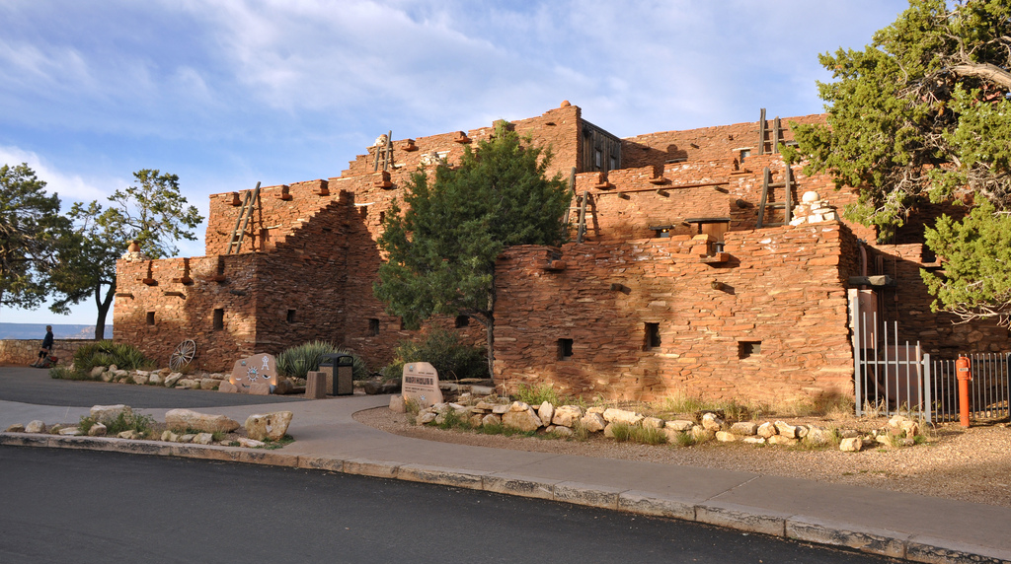
Hopi Apartment Complex
Photo by Grand Canyon National Park

Slide 31
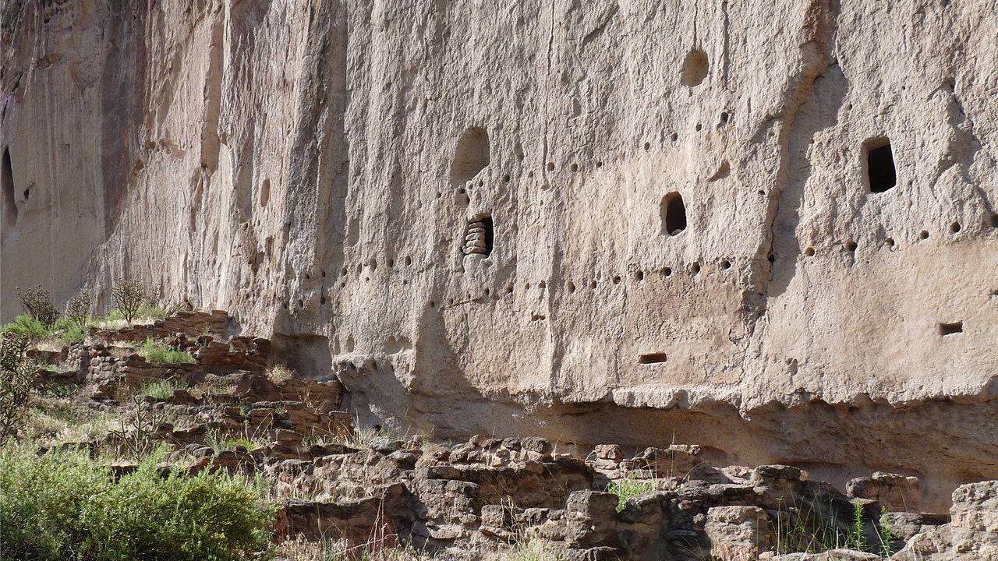
CLIFF DWELLINGS

Slide 32
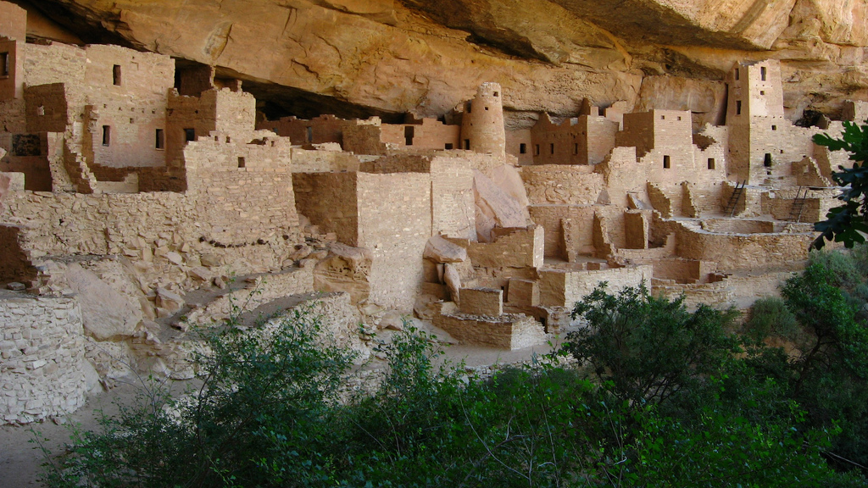
Cliff Palace Mesa Verde National Park
Photo by Ken Lund

Slide 34
AMERICAN INDIAN Culture Groups
Arctic (Eskimo, Inuit) | Hunting, Gathering, and Fishing
Plains Indians (Sioux, Comanche, Wichita) | Bison Hunters - Migratory (Teepees) Horses (introduced from Europe)
Northeast / Great Lakes (Iroquois, Algonquin) | Hunting and Gathering Slash and Burn Agriculture “Three Sisters” (Corn, Squash, Beans) Longhouses (Iroquois)
Southwest (Hopi, Pueblo) | Clay Houses / Cliff Dwellings Maize (Corn) Agriculture
Southeast (Cherokee, Creek) | Agriculture / Settled Communities Mississippian Culture (Cahokia, Mounds)

Slide 35
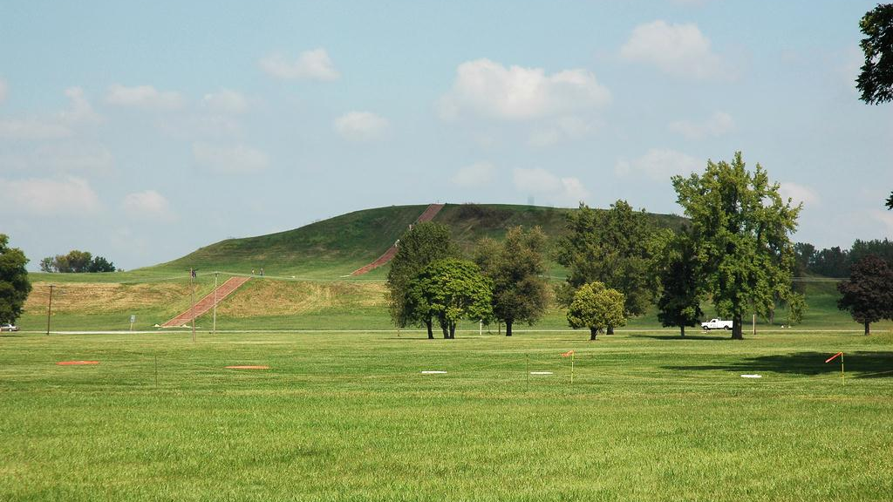
Cahokia Mounds
Outside St. Louis
Photo by Michael Dolan

Slide 36
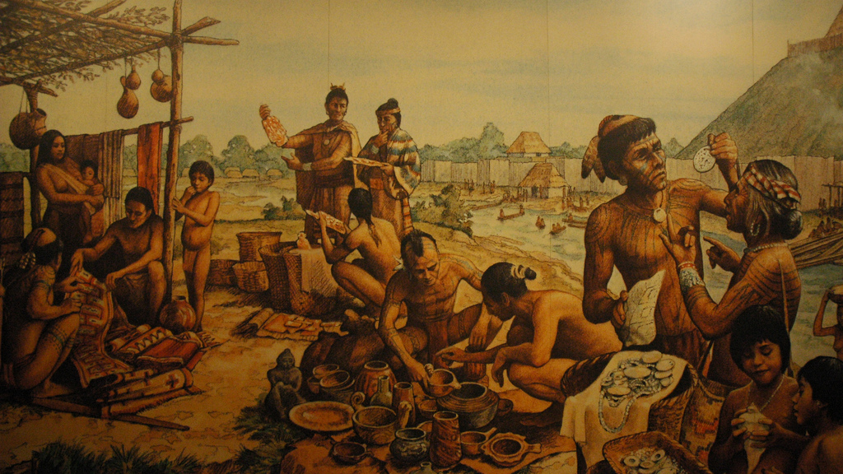
SETTLED communities
Photo by Michael Dolan

Slide 37
AMERICAN INDIAN Culture Groups
Arctic (Eskimo, Inuit) | Hunting, Gathering, and Fishing
Plains Indians (Sioux, Comanche, Wichita) | Bison Hunters - Migratory (Teepees) Horses (introduced from Europe)
Northeast / Great Lakes (Iroquois, Algonquin) | Hunting and Gathering Slash and Burn Agriculture “Three Sisters” (Corn, Squash, Beans) Longhouses (Iroquois)
Southwest (Hopi, Pueblo) | Clay Houses / Cliff Dwellings Maize (Corn) Agriculture
Southeast (Cherokee, Creek) | Agriculture / Settled Communities Mississippian Culture (Cahokia, Mounds)

Slide 38
LEARNING. DELIVERED.

