Slide 1
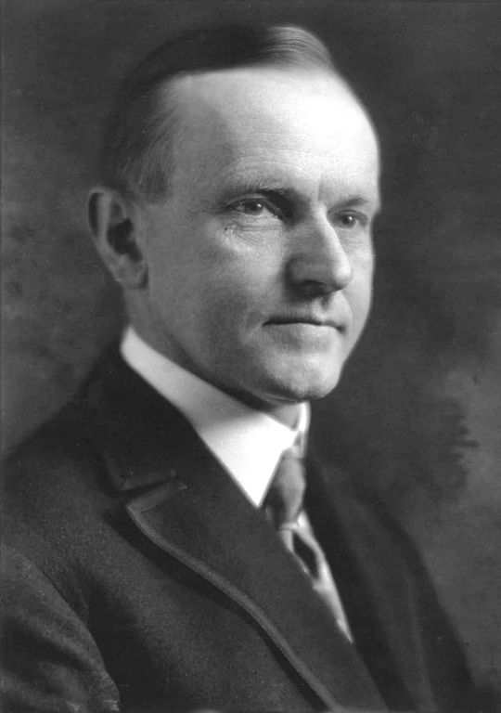
1920s
Politics, Taxes, & Foreign Policy

Slide 2
Objective
Analyze the United States rejection of internationalism, including postwar disillusionment, the Senate’s refusal to ratify the Versailles Treaty, the election of 1920, and the role of the United States in international affairs in the 1920s.

Slide 3
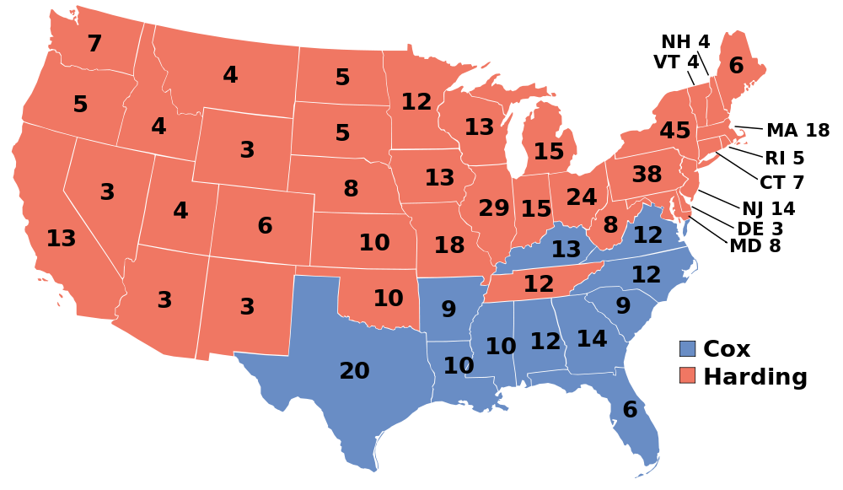
1920 Presidential Election
1920
1924

Slide 4
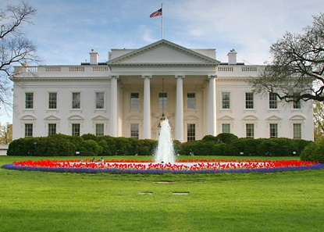
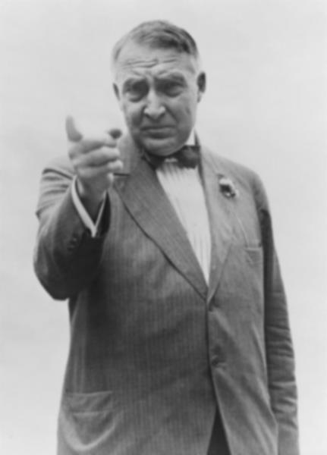
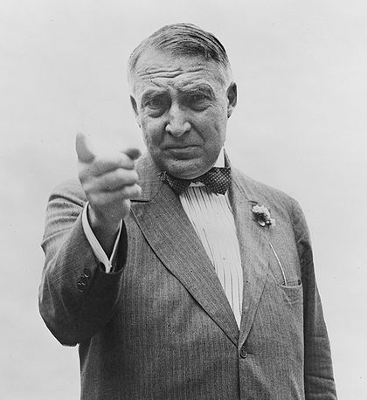
Warren G.
Harding
(R-OH)
29th POTUS
1921-1923
MORE INFO

Slide 5
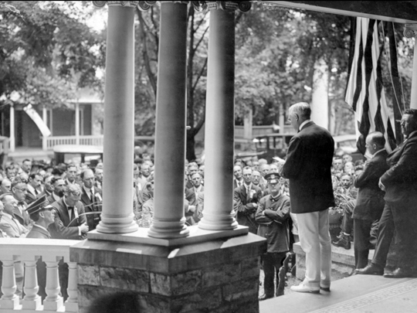
Front Porch Campaign

Slide 6
Return to Normalcy

Slide 7
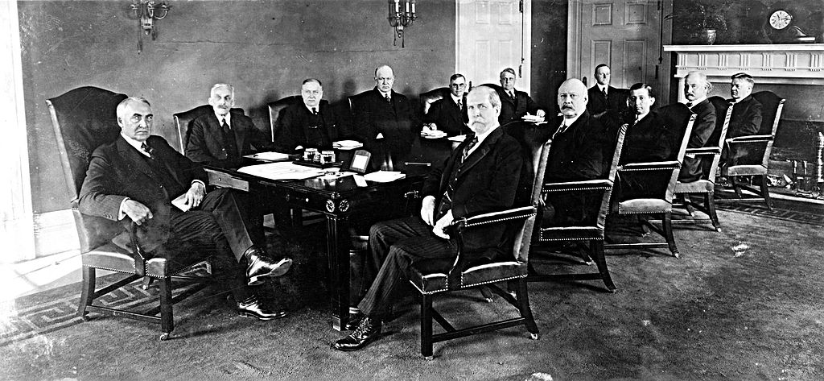
Harding’s Cabinet

Slide 8
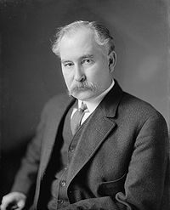
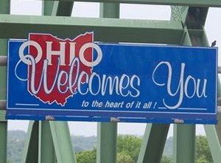
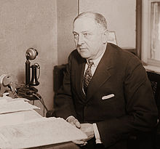
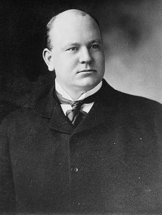
The Bad
Harding’s Cabinet
The “Ohio Gang”

Slide 9


“The Shack”
VISIT THE SHACK!

Slide 10
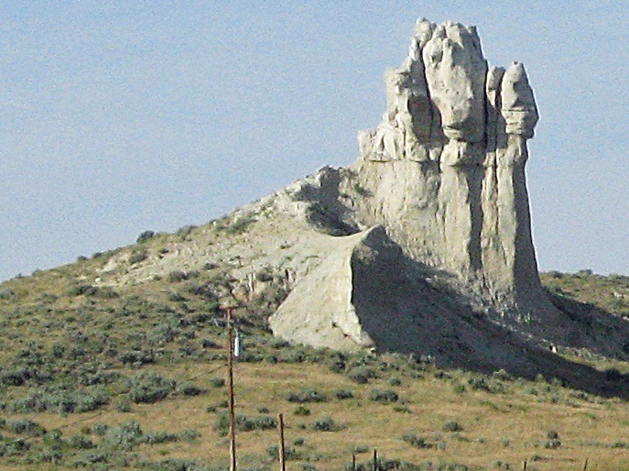
Teapot Dome Scandal
Oil companies bribed government officials for prime oil leases on government land.
Photo by Wvbailey

Slide 11


The “Fall Guy”
Albert Fall, the Secretary of the Interior, served a short, stout sentence in prison for accepting bribes.

Slide 12
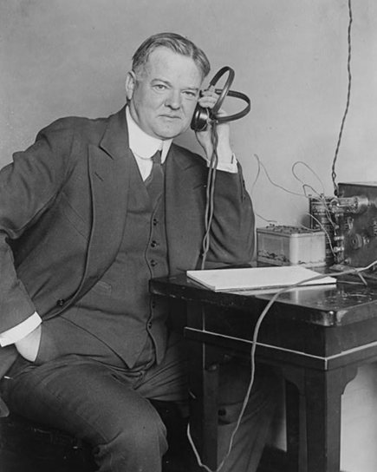
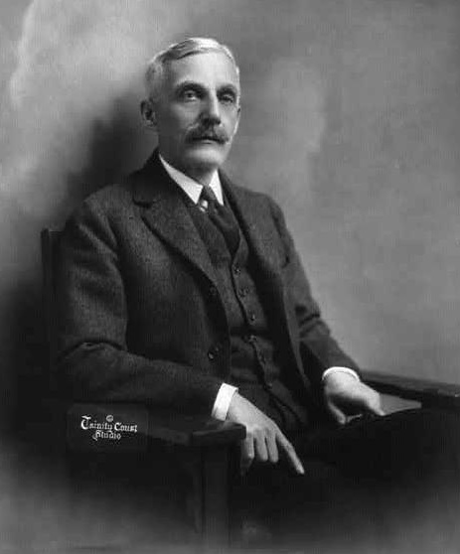
The Good
Harding’s Cabinet
Herbert Hoover
Secretary of Commerce
Andrew Mellon
Secretary of THE Treasury

Slide 13
The Good
Harding’s Cabinet
Successful Businessman
TAX
CUTTER
Andrew Mellon
Secretary of THE Treasury

Slide 14

War Debt
Photo by Andres Rueda

Slide 15
Lower Taxes
More Revenue
It may not make sense to you, but...

Slide 16
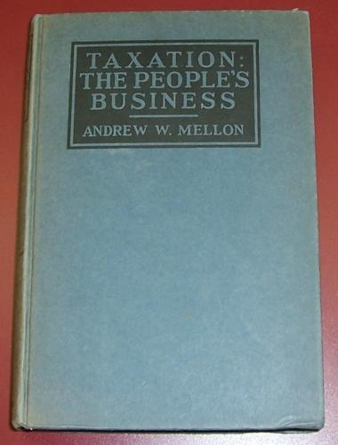
A Mellon Maxim
“The history of taxation shows that taxes which are inherently excessive are not paid.”
-- Andrew Mellon
Taxation: The People’s Business

Slide 17
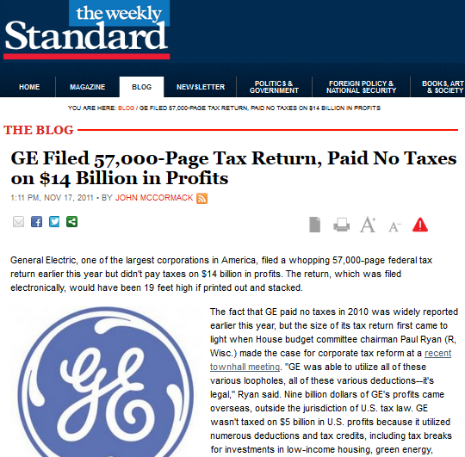
LINK

Slide 18

MYTH
Andrew Mellon
“cut taxes for the rich” as Treasury Secretary.
Photo by zoomar

Slide 19

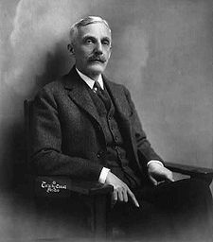

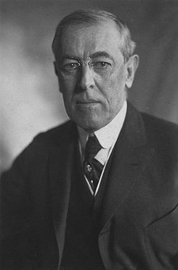
Mellon’s Tax Cuts
Mellon
WWI
Tax cuts for the rich???
Wilson

Slide 20
Mellon’s Tax Cuts
Mellon
WWI
Tax cuts for the rich???
Wilson

Slide 21
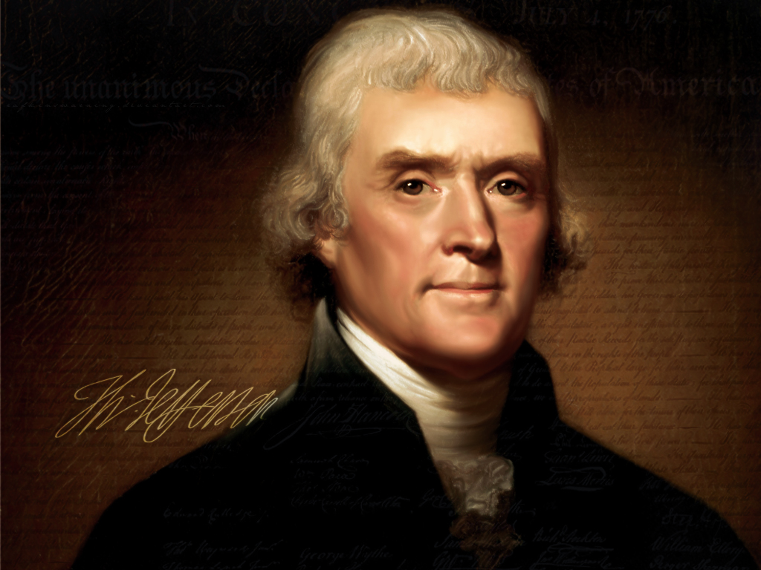
“It may be the pleasure and pride of an American to ask, what farmer, what mechanic, what laborer, ever sees a tax-gatherer of the United States?”
Notes:
http://rafkinswarning.deviantart.com/art/Thomas-Jefferson-191054235

Slide 22
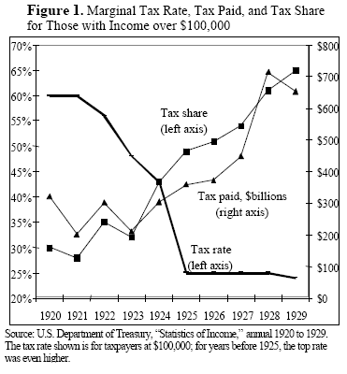
Source: Cato Institute

Slide 23
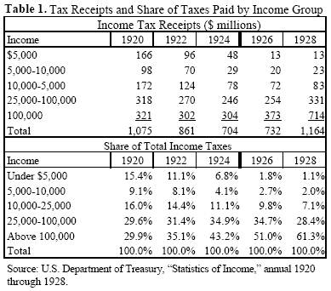
Source: Cato Institute

Slide 24
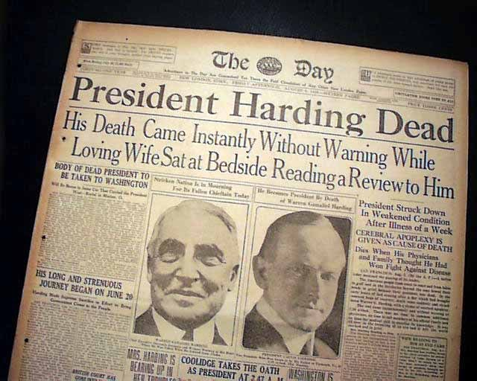

Slide 25
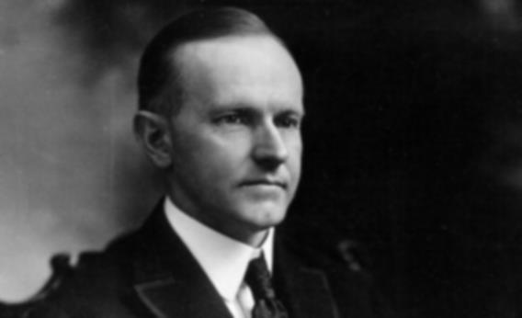

Calvin Coolidge
(R-VT)
30th POTUS
1923-1929
MORE INFO

Slide 26
“The business of the American people is business…”

Slide 27
“He who builds a factory builds a temple. He who works there worships there.”

Slide 28
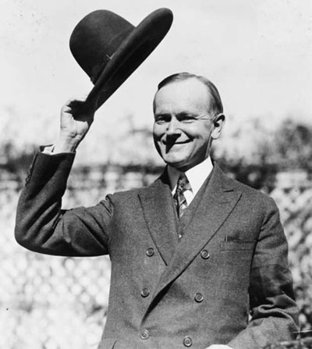
“Coolidge Prosperity”
Low Taxes
Balanced Budgets
Robust Economy

Slide 29
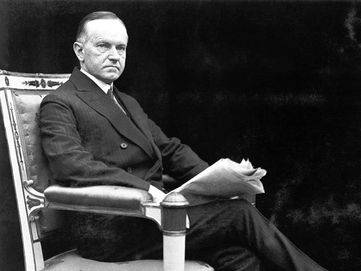
“Silent Cal”
"Mr. Coolidge, I've made a bet against a fellow who said it was impossible to get more than two words out of you."

Slide 30
“You lose.”

Slide 31
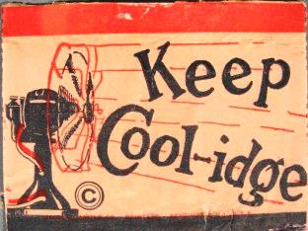

Slide 32
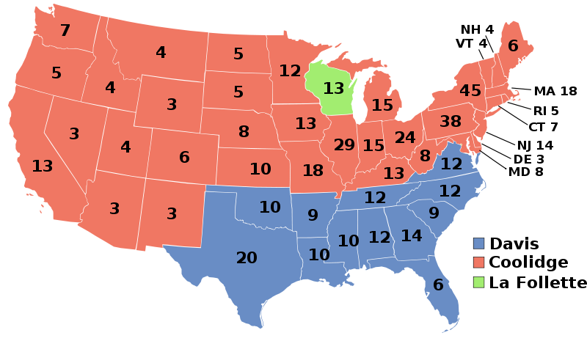
1924 Presidential Election
1920
1924

Slide 33
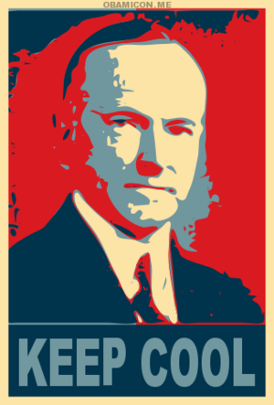

Slide 34
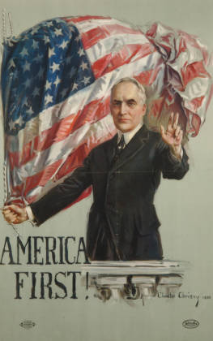
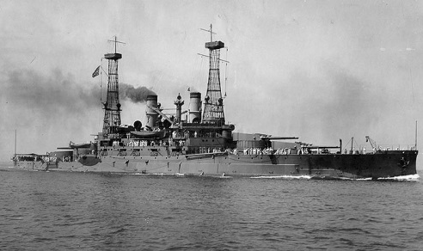
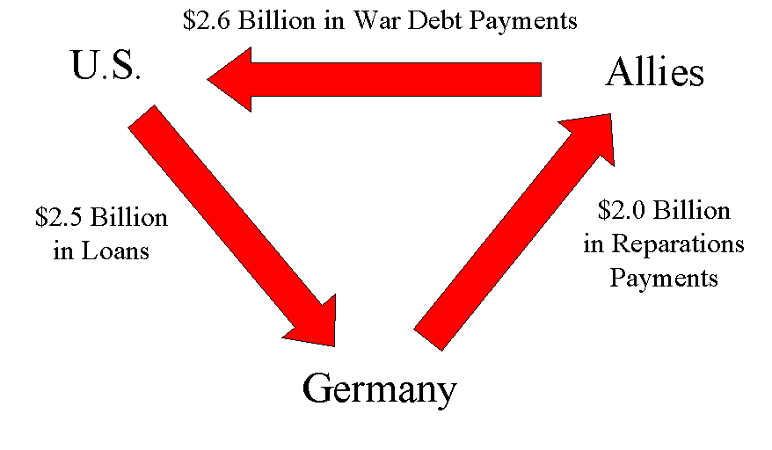
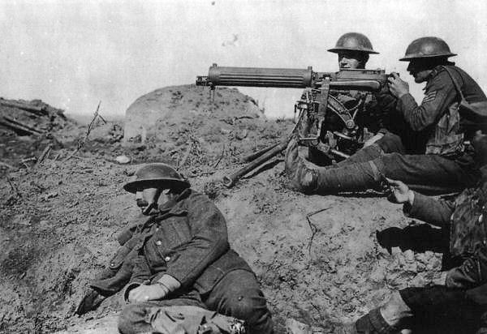
1920s
Foreign Policy

Slide 35
Americanism
Call it the selfishness of nationality if you will. I think it's an inspiration to patriotic devotion
to safeguard America first,
to stabilize America first,
to prosper America first,
to think of America first...
Let the internationalist dream, and the Bolshevist destroy... we proclaim Americanism...
-- Warren G. Harding
Campaign Speech (1920)

Slide 36

MYTH
U.S. foreign policy was isolationist during the 1920s.

Slide 37
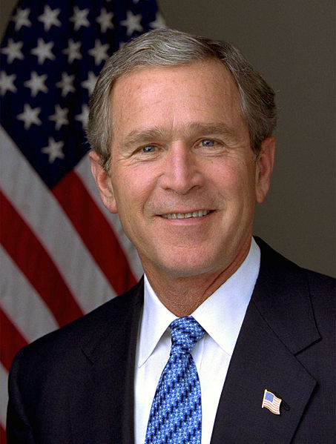
The Isolationism Myth
"What's interesting about our country, if you study history, is that there are some 'isms' that occasionally pop up. One is isolationism... So if you study the '20s, for example, there was an American-first policy that said, 'Who cares what happens in Europe?’”
-- George W. Bush

Slide 38
Isolationism
“It will be well not to be too much disturbed by the thought of either isolation or entanglement of pacifists and militarists. The physical configuration of the earth has separated us from all of the Old World, but the common brotherhood of man… has united us by inseparable bonds with all humanity.”
-- Calvin Coolidge
Inaugural Address (1925)

Slide 39

America: World Leader
Washington Naval Conference
Dawes Plan
Kellogg-Briand Pact

Slide 40

Washington
Naval Conference
(1921)
Naval Arms Control
Avoid Arms Race
Photo by PIXNOIZE

Slide 41
Washington
Naval Conference
(1921)
RATIOS
Nation | Capital Ships | Aircraft Carriers
Britain | 5 | 5
U.S. | 5 | 5
Japan | 3 | 3
Photo by PIXNOIZE

Slide 42
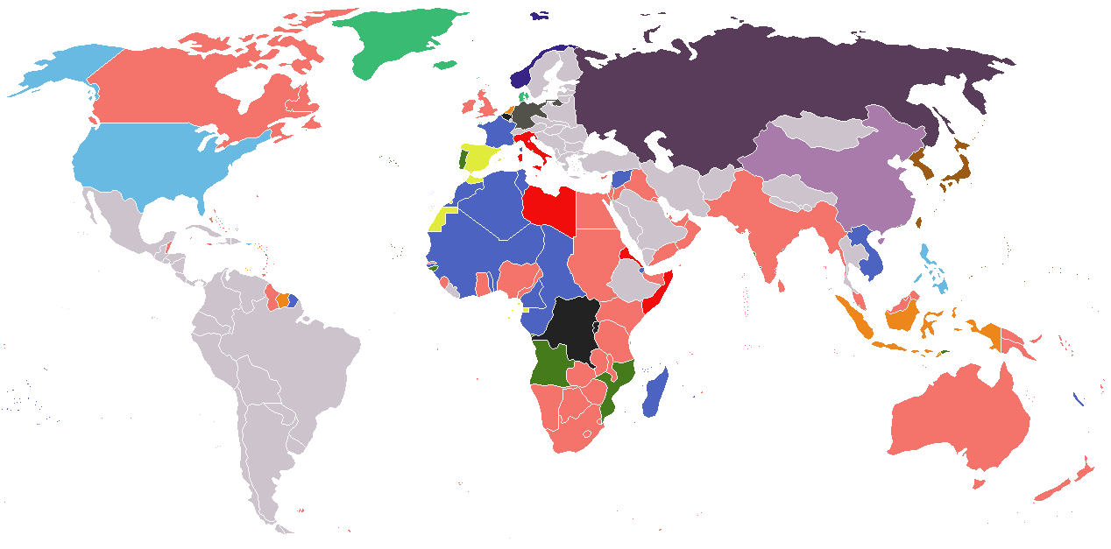
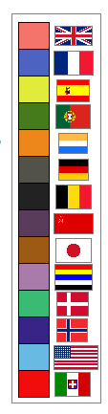
The Strategy of Ratios

Slide 43

U.S.S. South Carolina
DISMANTLED (1924)

Slide 44
Dawes Plan
NOTE: This is different from the Dawes Act (1887)

Slide 45
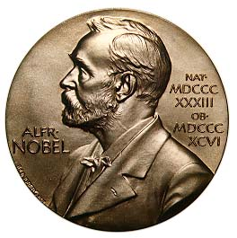
Dawes Plan

Slide 46

INGRATES
http://www.calvin.edu...posters1.htm
Notes:
This is a poster for the April 1929 provincial election in Saxony. The Dawes Plan was an international agreement dealing with the matter of German reparations payments from World War I. The caption reads: “Break the Dawes Chains.” Courtesy of Dr. Robert D. Brooks.

Slide 47
Kellogg-Briand Pact
(1929)
Renounced war as an “instrument of national policy”

