Slide 1
Do Now (5 Min)
Write this Objective in your notebook:
Assess the impact of artists, writers, and musicians of the 1920s, including the Harlem Renaissance, on American culture and values.
6.1D Grade 12 CPI 06.C
What is something about your parents Generation that you don’t Like? Write it in your notebook.
How do you try to be different from them?

Slide 2
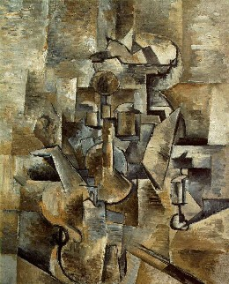
The Lost Generation
Buffalo Bill's defunct who used to ride a watersmooth-silver stallion and break onetwothreefourfive pigeonsjustlikethat Jesus he was a handsome man and what i want to know is how do you like your blueeyed boy Mister Death
From "Buffalo Bill's" (1920)
ee cummings
George Braque
Notes:
What do you notice about the poem on the left and the painting on the right?
They both seem to break conventional rules about how we think things should be organized.

Slide 3
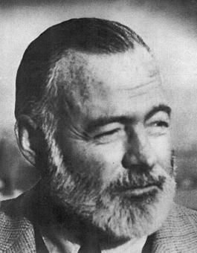
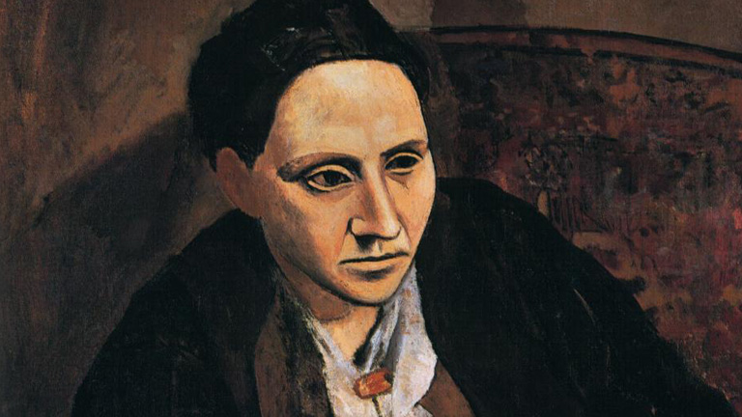
The Lost Generation
Ernest Hemingway
Gertrude Stein: “You are a lost generation”!
Notes:
In The Sun Also Rises, Hemingway gives two epigraphs, one from Gertrude Stein and one from Ecclesiastes.
Give the Quote from Ecc.

Slide 4
How did they get “Lost”?
The Horrors of World War
Rejection of Societies Values
Survivors of the War questioned the “Meaning of Life”.
Less “Happy Endings in Literature”.
Less structure and realism in Art.
Stein coined the term when waiting for gas. The workers were not helping her fast enough.
"You are all a "génération perdue."
People embraced Nihilism, Pessimism, Existentialism…
What do these terms mean?

Slide 5
“What profit hath a man of all his labour which he taketh under the sun? One generation passeth away, and another generation cometh: but the earth abideth for ever. The sun also ariseth, and the sun goeth down, and hasteth to his place where he arose...” -Ecclesiastes
You are all a lost generation- Gertrude Stein
Notes:
The "Lost Generation" defines a sense of moral loss or aimlessness apparent in literary figures during the 1920s.
World War I seemed to have destroyed the idea that if you acted virtuously, good things would happen.
Many good, young men went to war and died, or returned home either physically or mentally wounded (for most, both), and their faith in the moral guideposts that had earlier given them hope, were no longer valid...they were "Lost."

Slide 6
Harlem Renaissance
African Americans Also sought to break from the past- but in different ways!
sought a better standard of living and relief from the institutionalized Racism.
Harlem was a gathering place of the African American Middle Class.

Slide 7
Langston Hughes- Writer.
The night is beautiful, So the faces of my people. The stars are beautiful, So the eyes of my people Beautiful, also, is the sun. Beautiful, also, are the souls of my people.
—"My People" in The Crisis (October 1923)
from "The Negro Speaks of Rivers" (1920) ... My soul has grown deep like the rivers. I bathed in the Euphrates when dawns were young. I built my hut near the Congo and it lulled me to sleep. I looked upon the Nile and raised the pyramids above it. I heard the singing of the Mississippi when Abe Lincoln went down to New Orleans, and I've seen its muddy bosom turn all golden in the sunset. ...
—in The Weary Blues (1926)
Notes:
Hughes said Walt Whitman was a strong influence – He wanted African Americans to see themselves as Beautiful because of their history and phyusical characteristics.

Slide 8
Group Work Two Tasks !
Break into groups of Four
CREATE
FIRST- If you got to choose a name for YOUR generation, what would it be? Write it down.
Why? What is it about your generation that stands out?
How is this represented in our culture ?
Discuss how your generation is best represented on paper.
Poem
Song
Picture
Something else?

