Slide 1
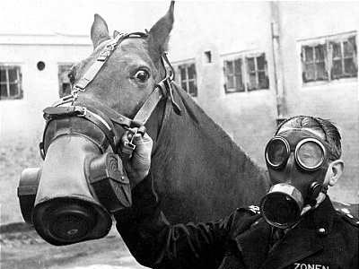
World War I

Slide 2
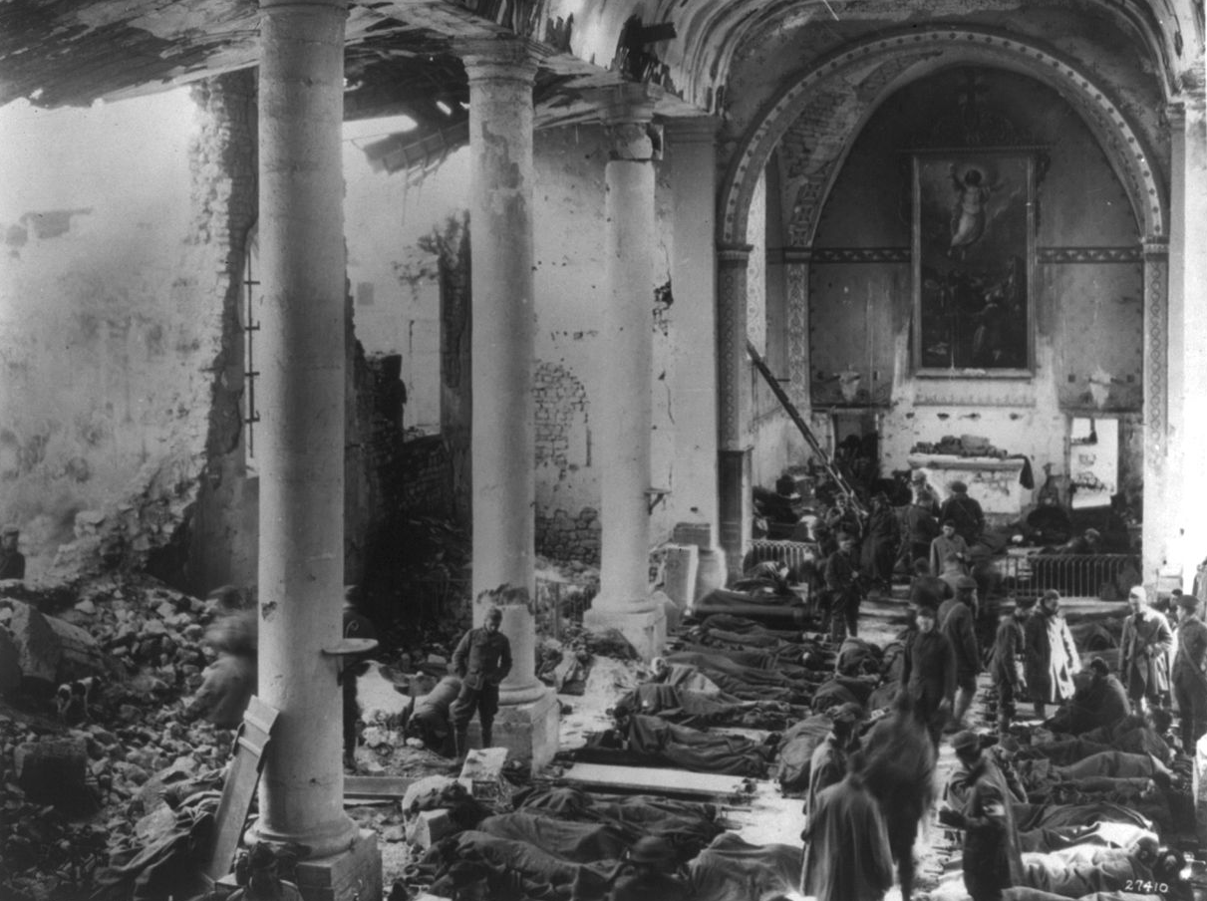
World War I Mr. Tuttle

Slide 3
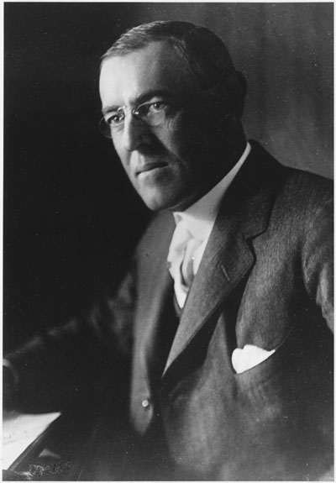
Objective
Discuss the causes and results of American intervention in Mexico and the Caribbean Identify and describe the causes for World War I, including imperialism, nationalism, militarism, and national alliances. Describe the reasons why the US entered the War

Slide 4
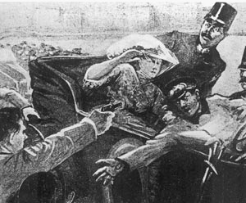
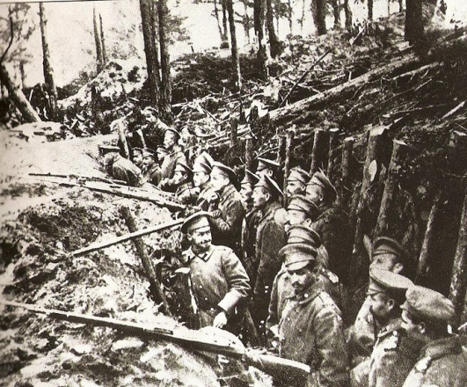
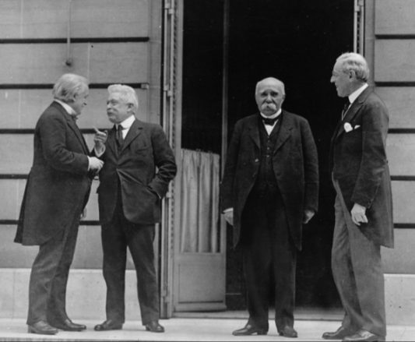
TABLE OF CONTENTS
PART I
PART III
PART III
Causes
Course
Consequences

Slide 5
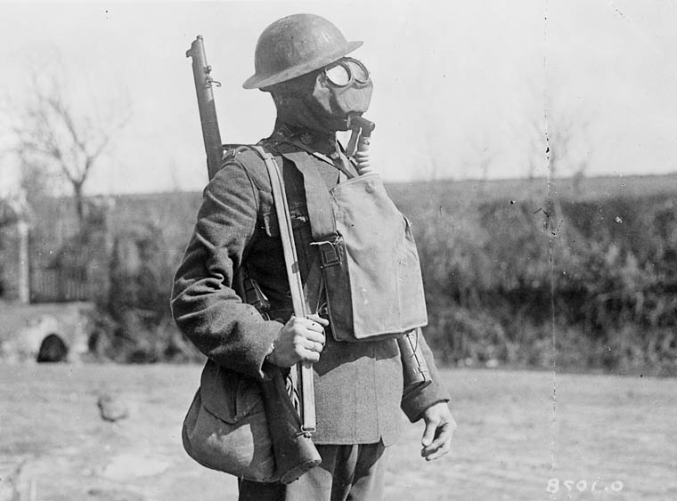
What started this mess?
Notes:
http://4acre.wordpress.com/2010/12/06/mustard-gas/

Slide 6
Causes of World War I
M
A
I
N
ILITARISM
LLIANCES
MPERIALISM
ATIONALISM

Slide 7
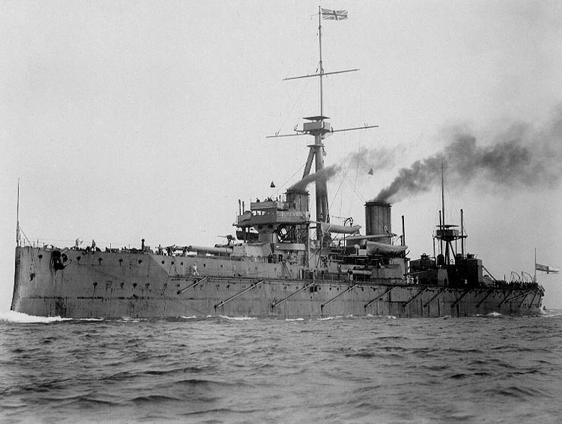
Militarism
H.M.S. Dreadnought

Slide 8
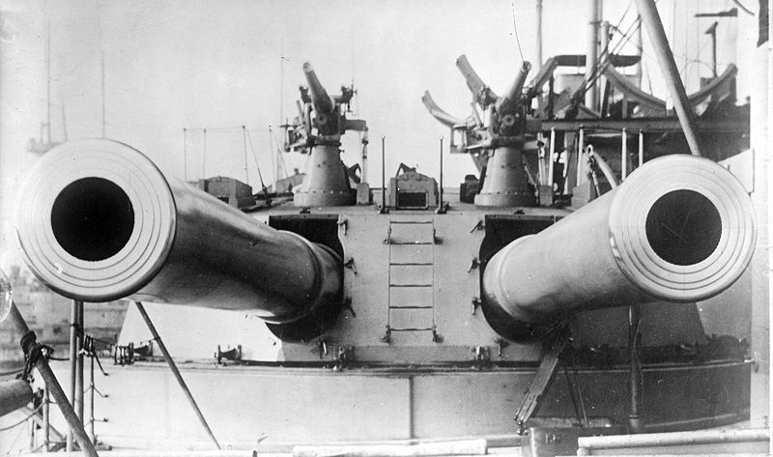
H.M.S. Dreadnought (1906)
12 in.

Slide 9
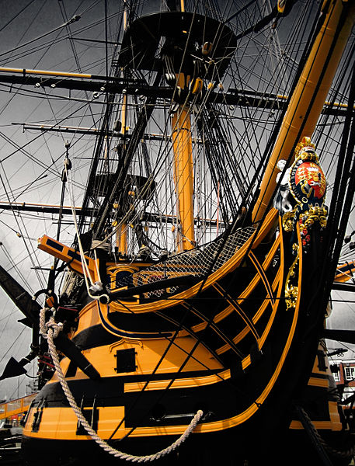
Royal Navy Ship Names
H.M.S. Arrogant
H.M.S. Gladiator
H.M.S. Unbeaten
H.M.S. Unbending
H.M.S. Unbroken
H.M.S. Undaunted
H.M.S. Valiant
H.M.S. Vampire
H.M.S. Vanquisher
H.M.S. Vehement
H.M.S. Vengeance
H.M.S. Victory
CLICK TO SEE MORE!
Credit: Jamie Campbell

Slide 10
Anglo-German Arms Race

Slide 11
Percentage Distribution of the World's Manufacturing Production
 | 1870 | 1913
USA | 23.3 | 35.8
Germany | 13.2 | 15.7
U.K. | 31.8 | 14.0
France | 10.3 | 6.4
Russia | 3.7 | 5.5
Italy | 2.4 | 2.7
Others | 15.3 | 19.9
Source: http://www.fordham.edu/halsall/mod/indrevtabs1.asp

Slide 12
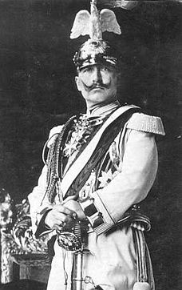
The Daily Telegraph Affair
LINK
Photo by @Doug88888
A PR move gone seriously wrong!
Wilhelm II “Kaiser Bill”

Slide 13
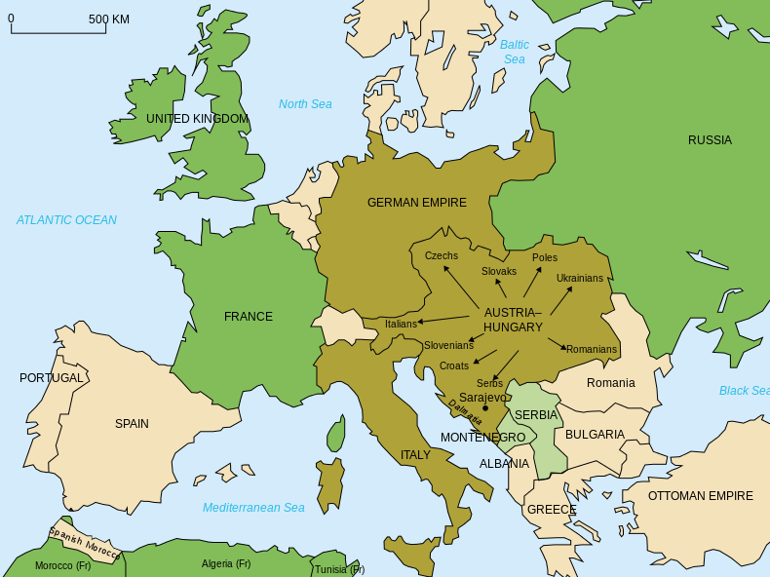
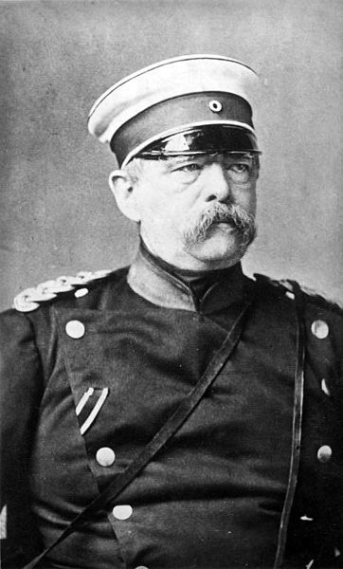
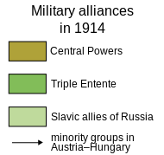
Alliances
ARCHITECT
Map Credit: historicair

Slide 14
Alliances
Triple Entente
Britain France Russia
Central Powers
Germany Austria-Hungary Italy Ottoman Empire
Map Credit: historicair

Slide 15
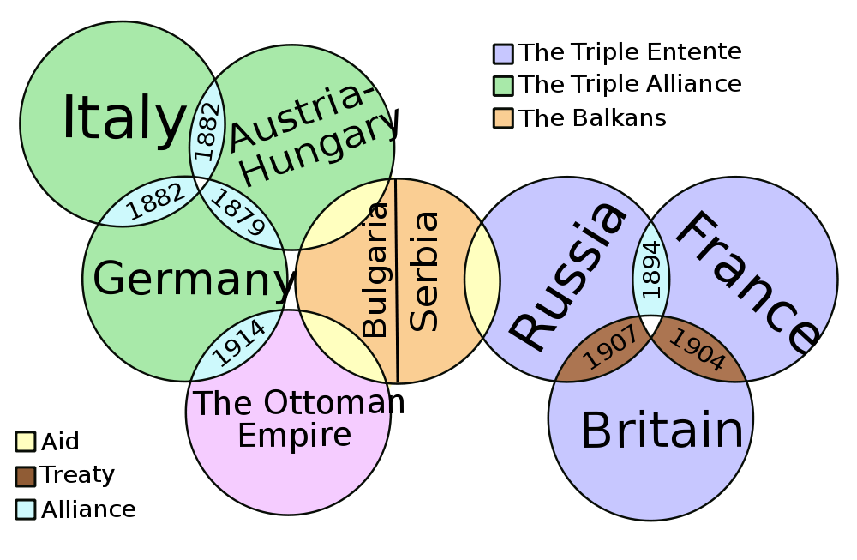
Alliances

Slide 16
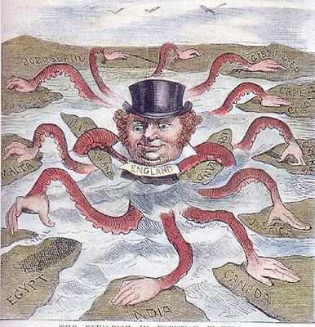
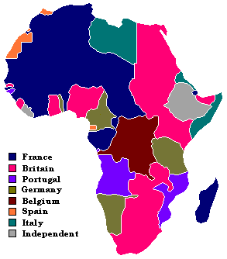
Imperialism

Slide 17
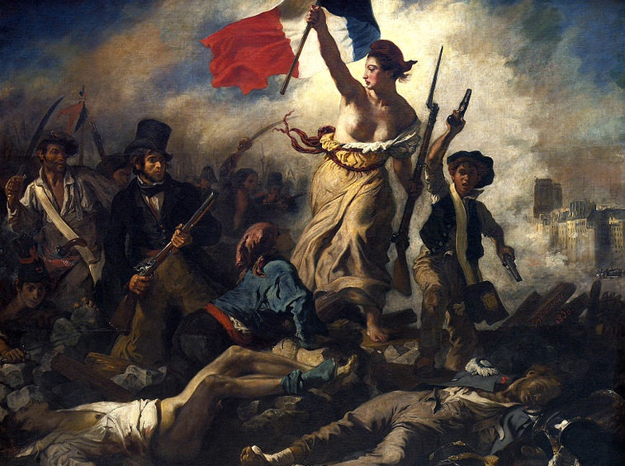
Nationalism
Liberty Leading the People (Eugène Delacroix, 1830)

Slide 18
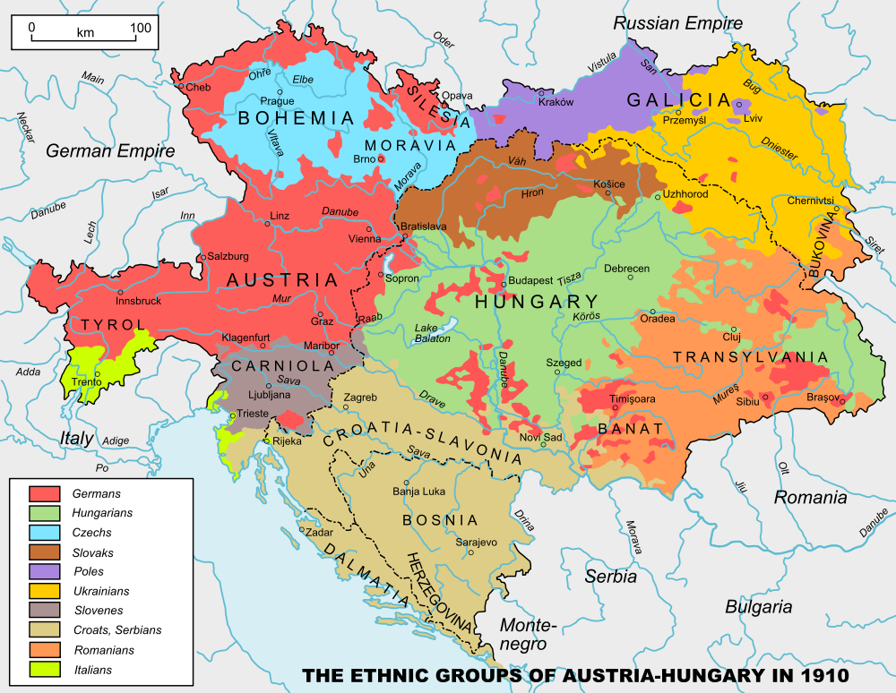

Slide 19
The Black Hand
Serbian Nationalists
Photo by FotoRita [Allstar maniac]

Slide 20
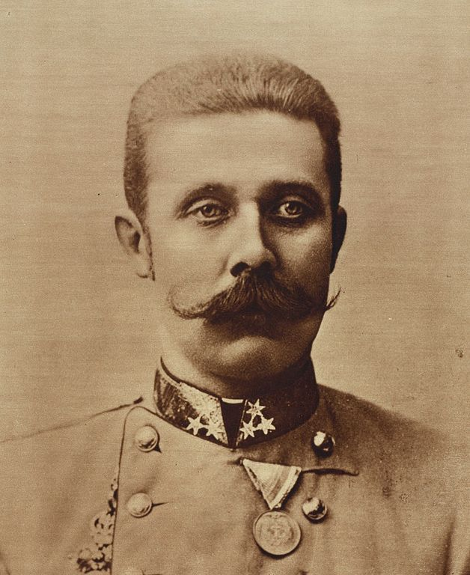
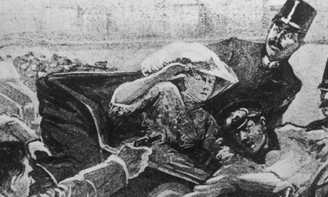
Assassination of Archduke Franz Ferdinand June 28, 1914
HEIR

Slide 21
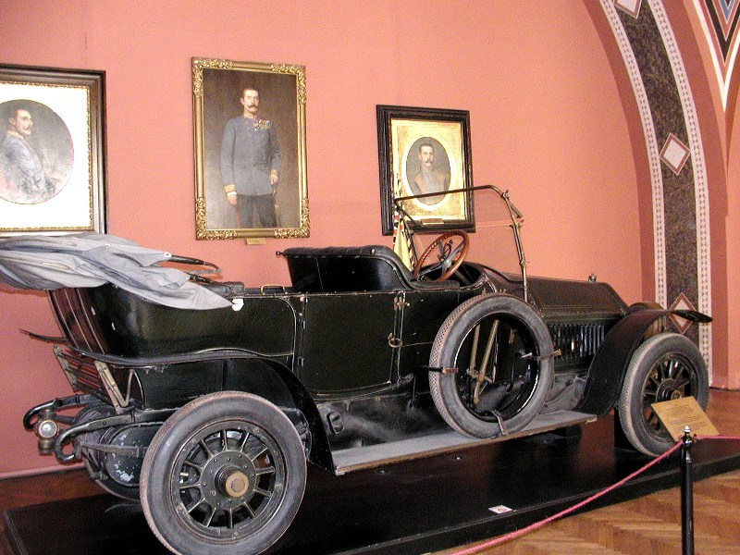
Photo by Alexf

Slide 22
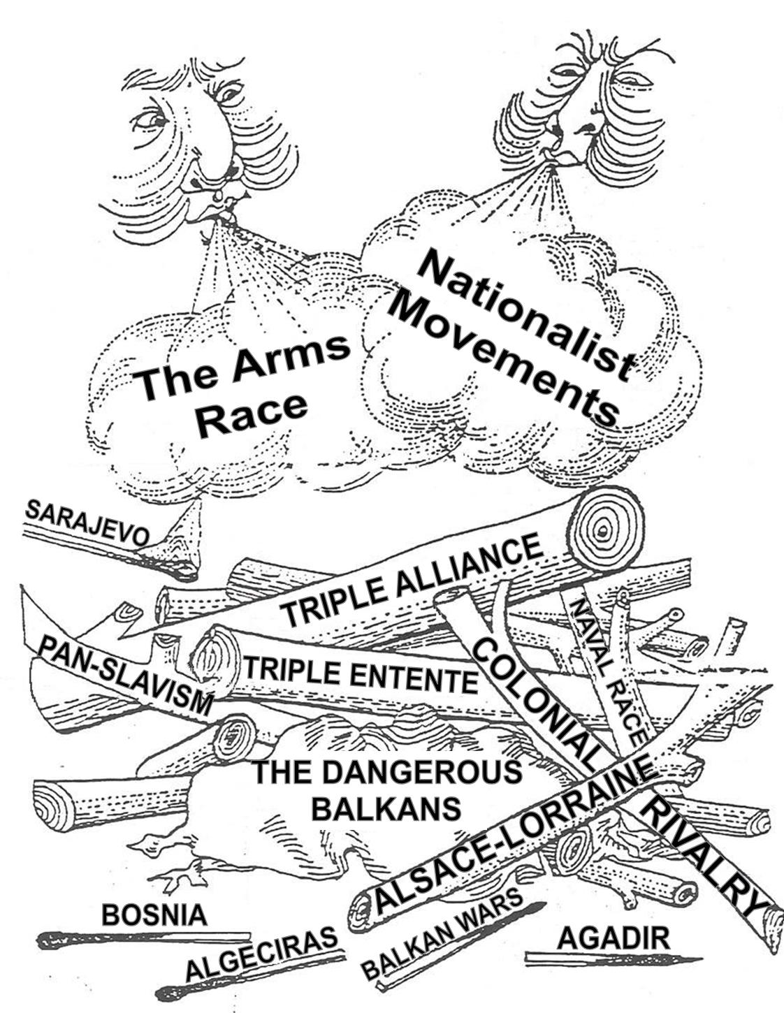

Slide 23
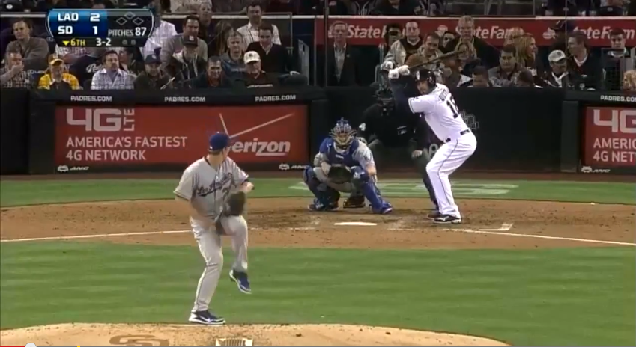
The Bench Clears…
http://www.youtube.com/watch?v=eZ3eA5ytOqg

Slide 24
Modern Warfare
The advent of World War I introduced several new military technologies that were used for the first time.

Slide 25
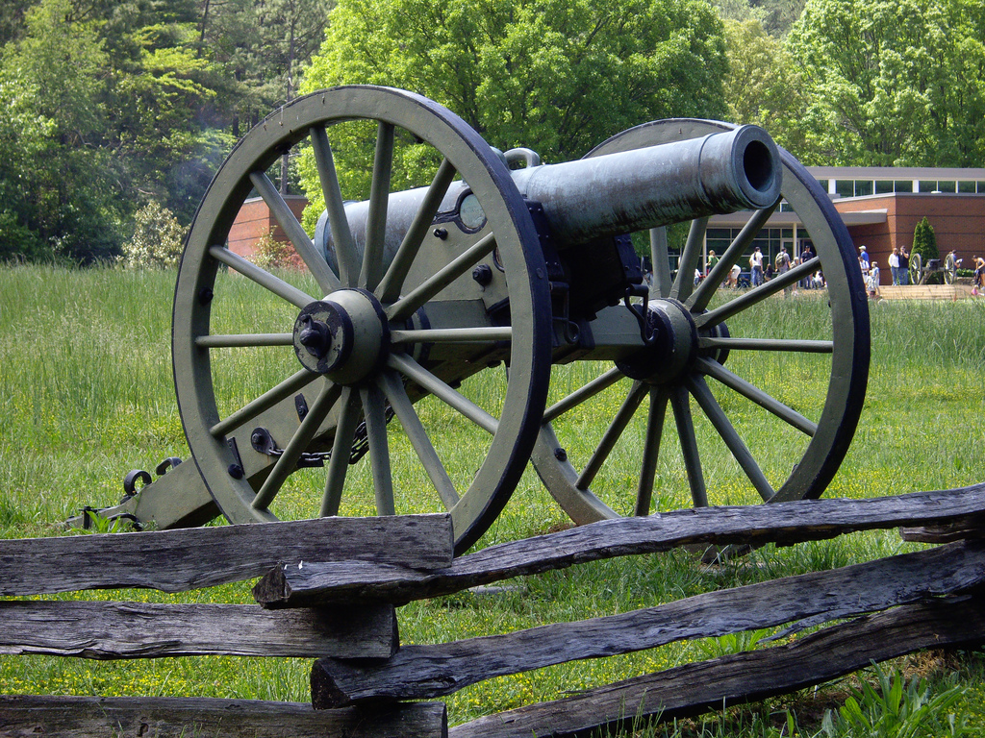
Civil War Cannon
Photo by terra2055

Slide 26
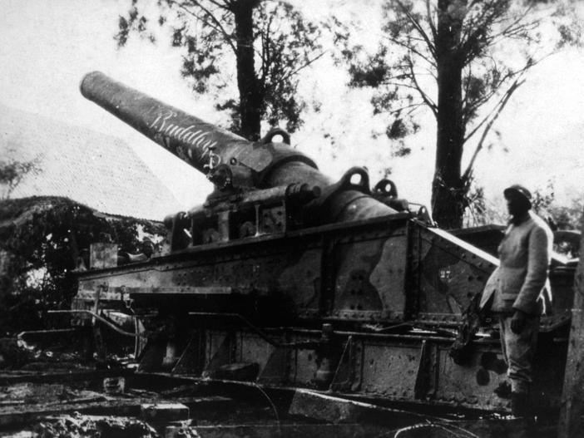
WWI Artillery Piece

Slide 27
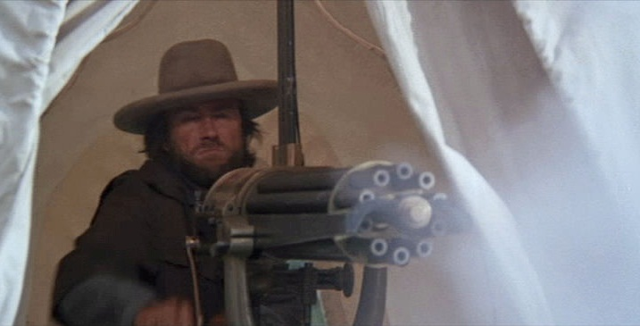
Civil War Gatling Gun
Screenshot from The Outlaw Josey Wales

Slide 28
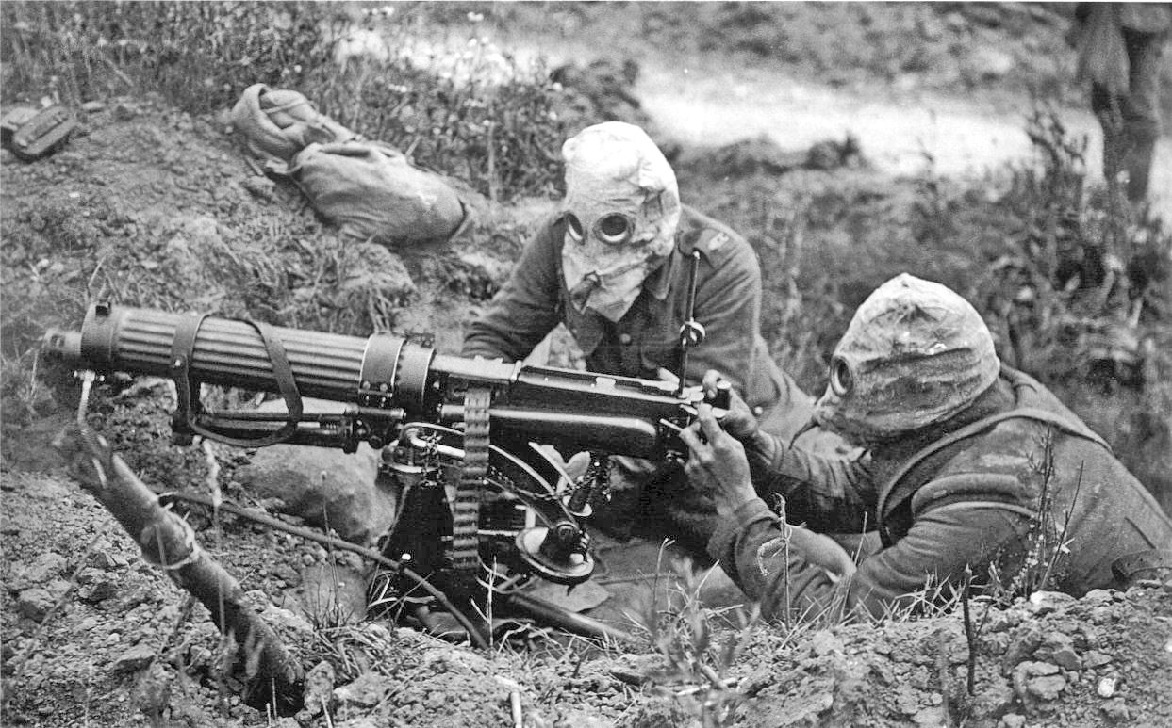
WWI Machine Gun

Slide 29
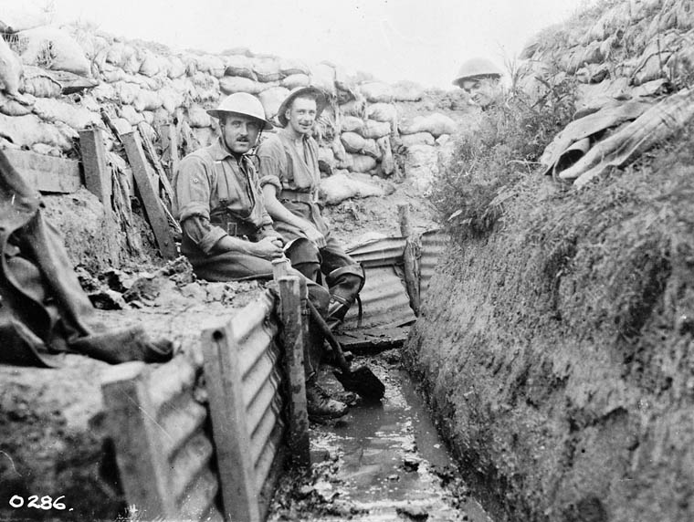
Trench Warfare

Slide 30
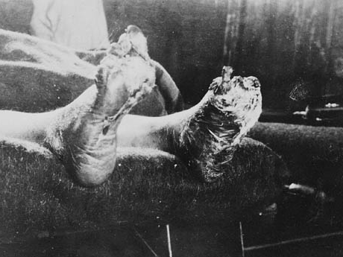
Trench Foot
Photo by BiblioArchives / LibraryArchives

Slide 31
STALEMATE

Slide 32
World War I was marked by prolonged battles that resulted in high casualties and little territorial gain.

Slide 33
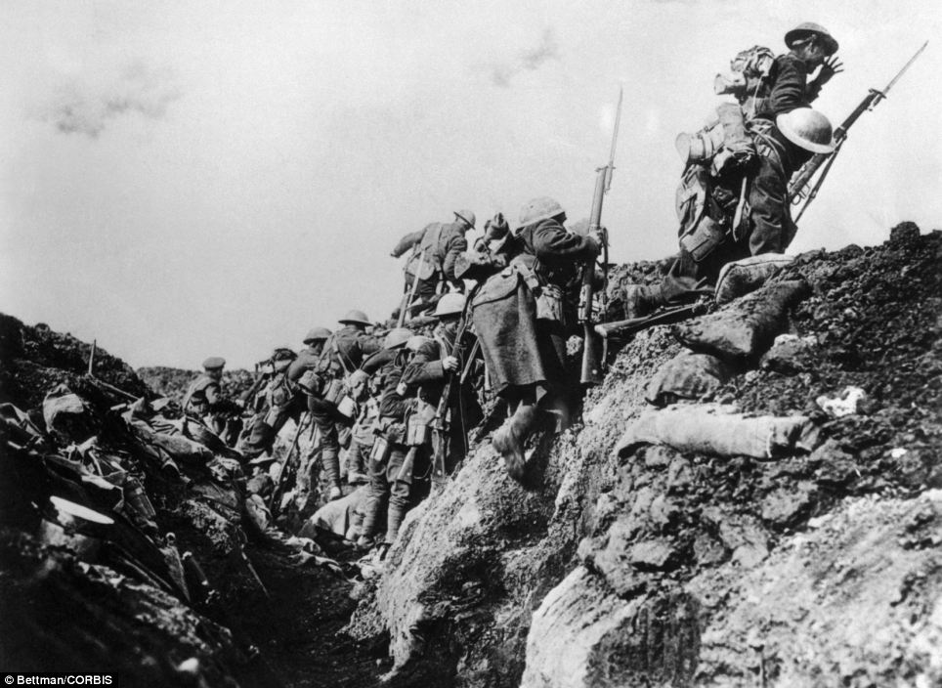
Over The Top

Slide 34
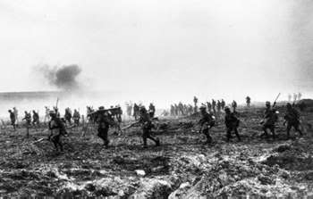
FUN!

Slide 35
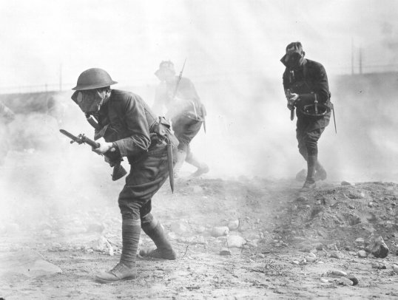
Mustard Gas

Slide 36
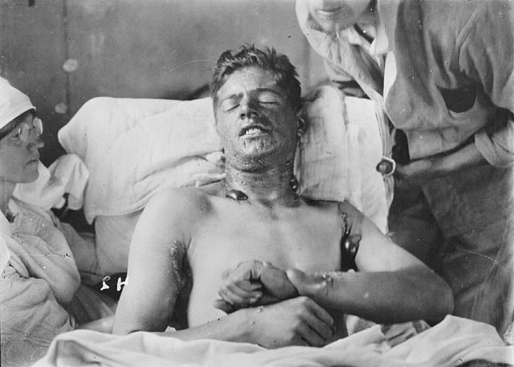
Should’ve worn my gas mask!

Slide 37
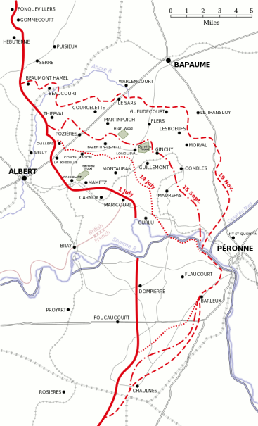
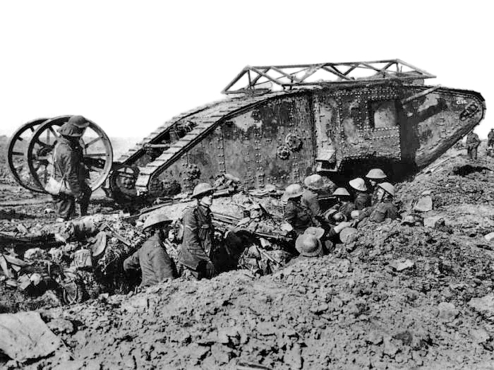
Battle of the Somme
July-November, 1916
Casualties (>1M)
Debut

Slide 38
The British Offensive
6
Miles

Slide 39
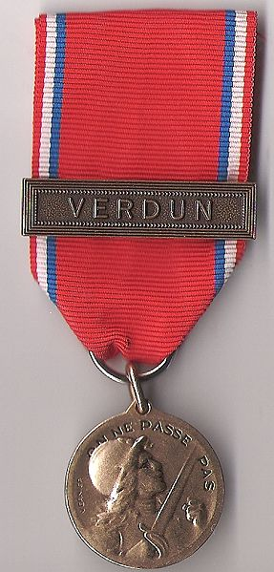
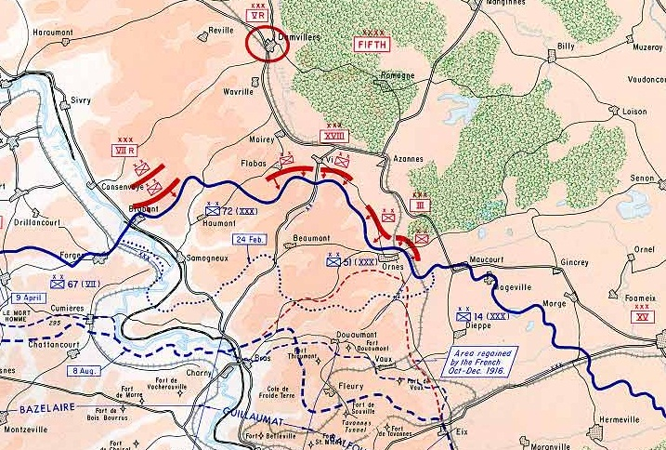
Battle of Verdun
February-December, 1916
The French repulse a German attack
> 700,000 Casualties

Slide 40
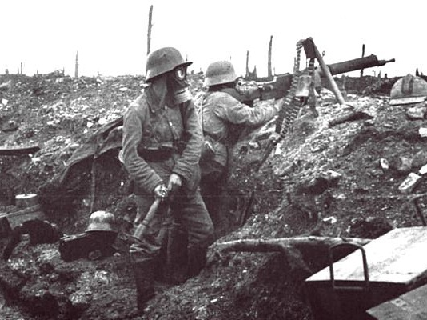
German Soldiers at Verdun

Slide 41
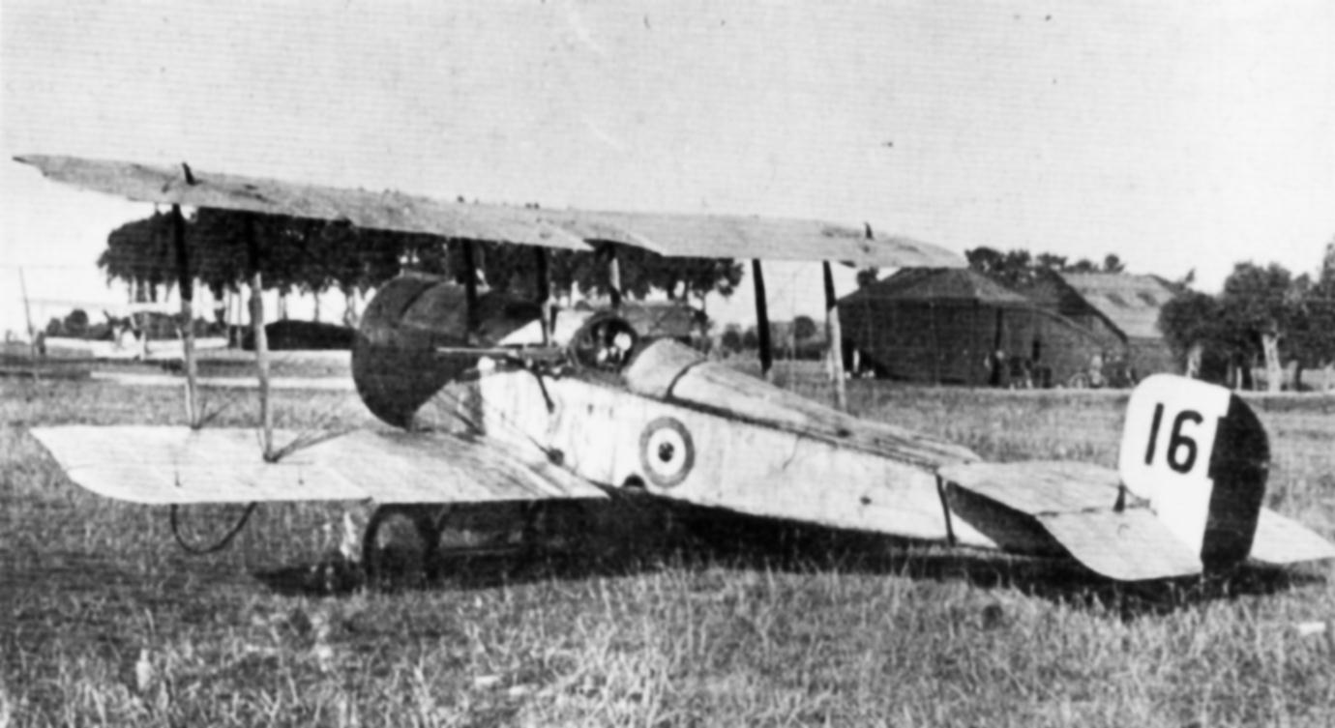
Aircraft in World War I

Slide 42
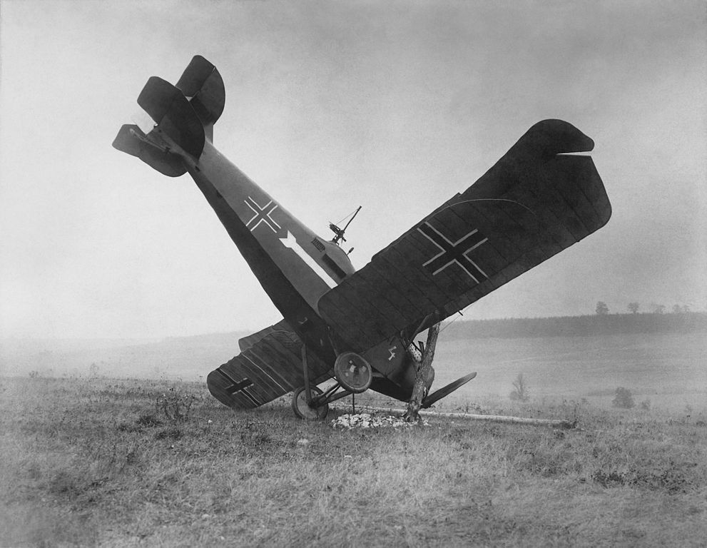
FAIL

Slide 43
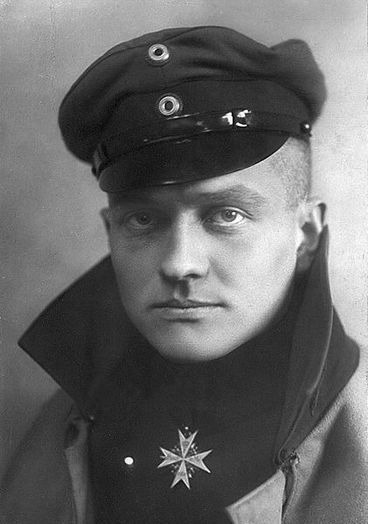
The Red Baron
80 Air Combat Victories
KIA 1918
Manfred Albrecht Freiherr von Richthofen

Slide 44
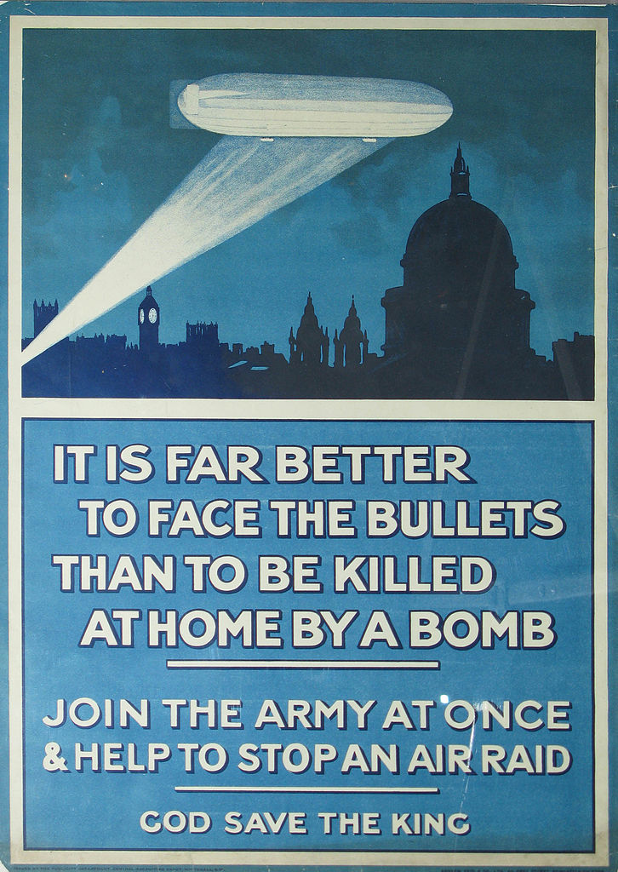
Zeppelin Raids
Germans used Zeppelins to bomb British cities.

Slide 45
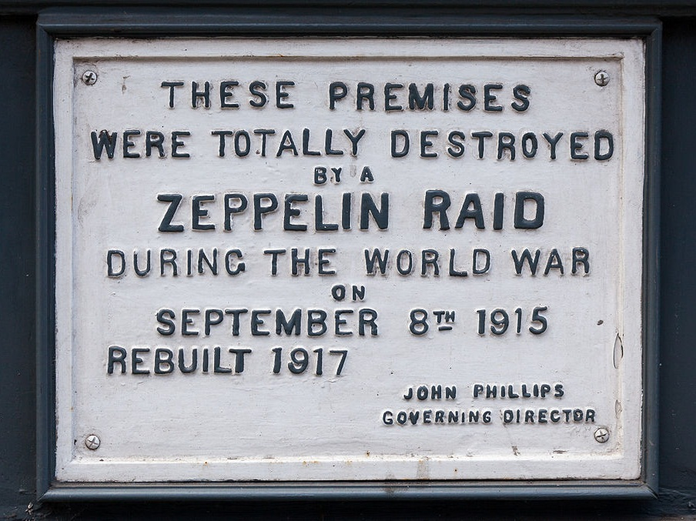

Slide 46
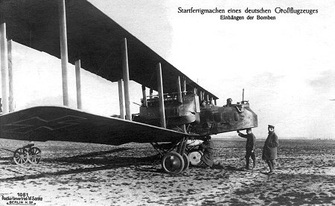
German Gotha G.V Bomber

Slide 47
RESPONSES to Total War

Slide 48
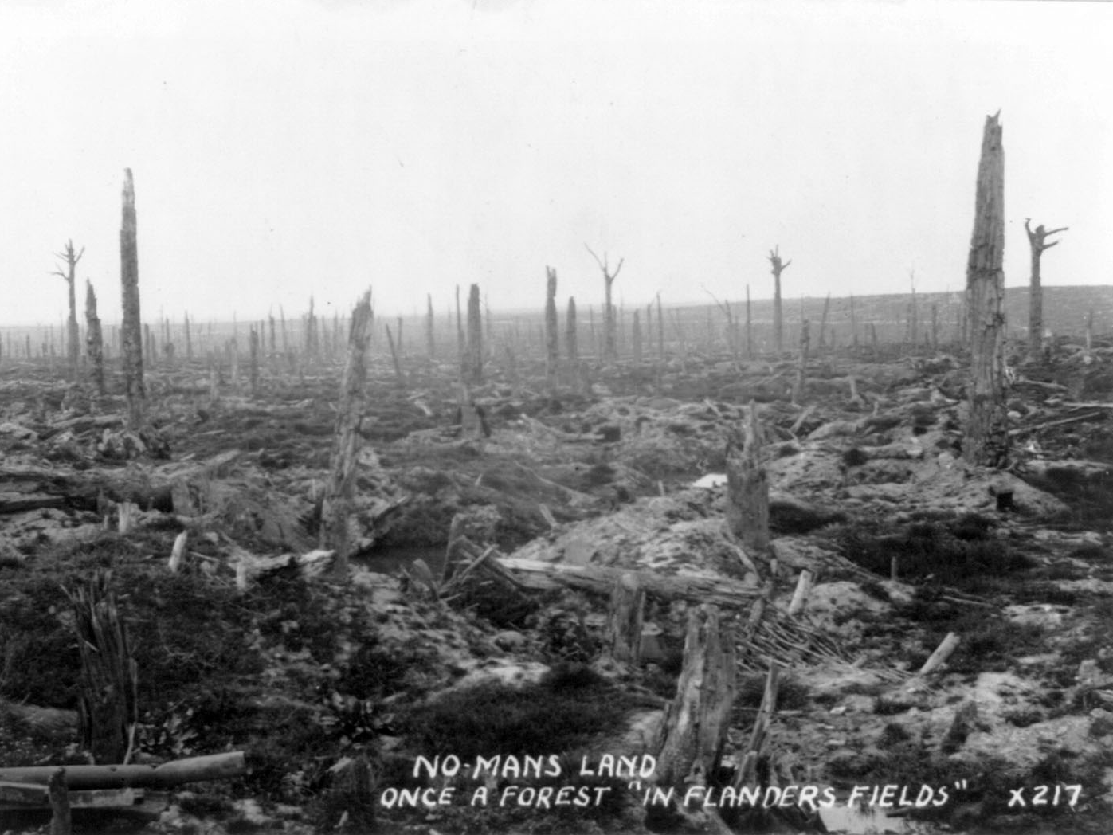
“I am staring at a sunlit picture of Hell.”
-- Siegfried Sassoon (British Poet)

Slide 49
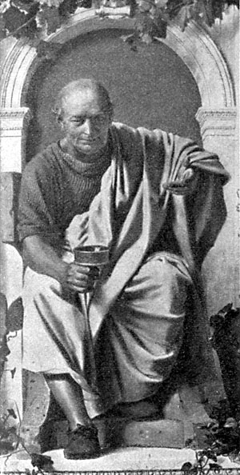
“Dulce et decorum est pro patria mori.” -- Horace

Slide 50
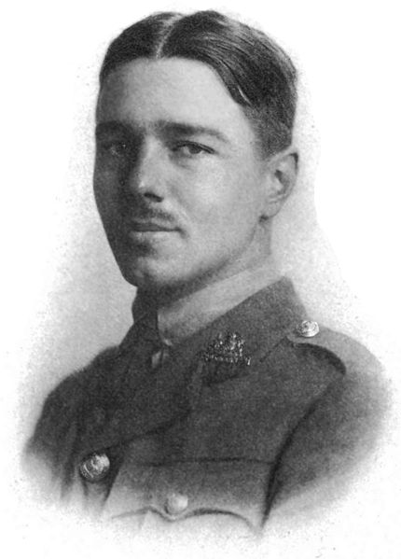
If you could hear, at every jolt, the blood Come gargling from the froth-corrupted lungs, Obscene as cancer, bitter as the cud Of vile, incurable sores on innocent tongues, My friend, you would not tell with such high zest To children ardent for some desperate glory, The old Lie; Dulce et Decorum est Pro patria mori.*
“Dulce et Decorum Est”
Wilfred Owen
1893-1918
*It is sweet and right to die for your country.

Slide 51
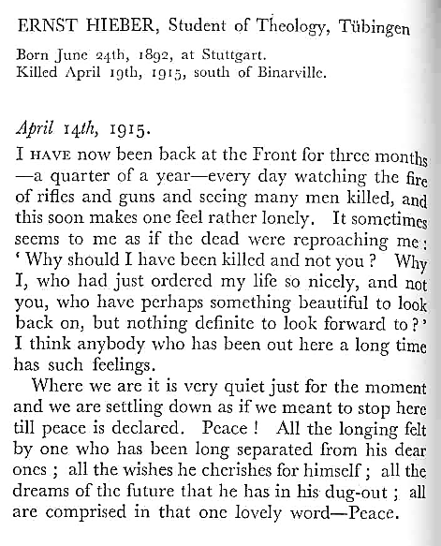
A German Soldier Writes Home
From German Students’ War Letters (Pine Street Books, 2002)

Slide 52
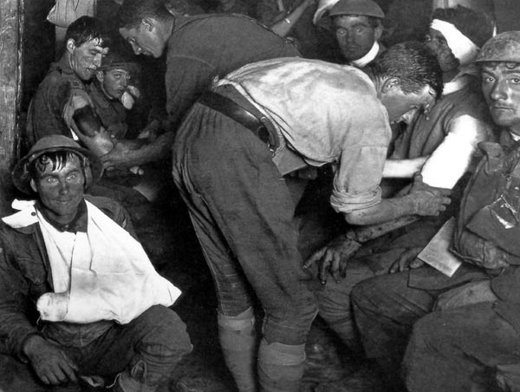
SHELLSHOCK
Psychological response to prolonged helplessness under artillery fire.
Further Reading
Shellshock vs. PTSD

Slide 53
The Thousand Yard Stare

Slide 54
The War at Home

Slide 55
Propaganda Campaigns
Both sides used war propaganda to motivate people to support the war effort.
CLICK HERE to see more posters.

Slide 56
Propaganda Campaigns
PURPOSES:
ENLIST
DEHUMANIZE the enemy
FINANCE the war
CONSERVE resources

Slide 57
Women and the War Effort
Women worked in munitions factories while men were at the Front.

Slide 60
Suffrage
The Legacy
1918 Germany
Austria
1919 Belgium
1920 Czechoslovakia
United States
1928 United Kingdom
Emmeline Pankhurst, a radical suffragette, is arrested in 1914

Slide 61
Russian Revolution
1917
Russian government pulls out of the war, then collapses.
Lenin and Stalin

Slide 62
Treaty of Brest-Litovsk
March, 1918
Russia cedes territory to Germany.

Slide 63
A German U-Boat

Slide 64
Sinking of the Lusitania
1915
Germany sparked an outrage by sinking a passenger ship (that was carrying armaments), killing British and American civilians.

Slide 65
Unrestricted Submarine Warfare
(1917)
A major factor leading to U.S. involvement in the war

Slide 66
The U.S. Enters the War
Fresh troops for the war-weary Entente Powers.

Slide 67
Armistice
11/11 (1918)
11:00 AM

Slide 68
The Treaty of Versailles
Photo by wallyg

Slide 70
Wilson’s Fourteen Points
PRINCIPLES:
Freedom of the Seas
Reduction of Arms
Open Treaty Negotiations
Self Determination of Peoples
League of Nations
14

Slide 71
PEACE Without Victory

Slide 72
Entente Military Deaths
More Info

Slide 73
Paris Peace Conference
“The Conference was an affair of three sides – the victors, the vanquished, and Wilson.”
-- Richard Hofstadter

Slide 74
“I was seated between Jesus Christ and Napoleon.”
David Lloyd George (British Prime Minister)

Slide 76
Article 231
The “War Guilt” Clause
Britain and France wanted Germany to claim responsibility for the war and pay reparations to the allies.

Slide 77
Wilson’s Fourteen Points
PRINCIPLES:
Freedom of the Seas
Reduction of Arms
Open Treaty Negotiations
Self Determination of Peoples
League of Nations
14

Slide 78
HOW
can the two ideas be reconciled???
14
231

Slide 79
EASY!!!
JUST USE BOTH!
14
231

Slide 80
LINK TO MAPS

Slide 81
LINK TO MAPS

Slide 82
LINK TO MAPS

Slide 83
LINK TO MAPS

Slide 84
Proclamation of the German Empire
18 January 1871

Slide 85
Signing of the Treaty of Versailles
June 28, 1919
Five years to the day of the assassination of Archduke Franz Ferdinand
Look Familiar???

Slide 86
League Membership
1920- 1946
Map Credit: Maps & Lucy
The United States never joined the League. Wilson’s mission to intimately involve the U.S. in global affairs was a failure.

Slide 87
decolonization

Slide 88
League of Nations Mandates
Former colonies administered by Britain and France
Notes:
Map: Geoffrey Gaudreault, NPR; Source: A History of the Arab Peoples by Albert Hourani
http://www.npr.org/news/specials/mideast/the_west/mandates_map.html

Slide 89
League of Nations Mandates
Former colonies administered by Britain and France
Map: Geoffrey Gaudreault, NPR; Source: A History of the Arab Peoples by Albert Hourani
Notes:
Map: Geoffrey Gaudreault, NPR; Source: A History of the Arab Peoples by Albert Hourani
http://www.npr.org/news/specials/mideast/the_west/mandates_map.html

Slide 90
1919
I went to Versailles and all I got was this lousy peace prize.

