Slide 1
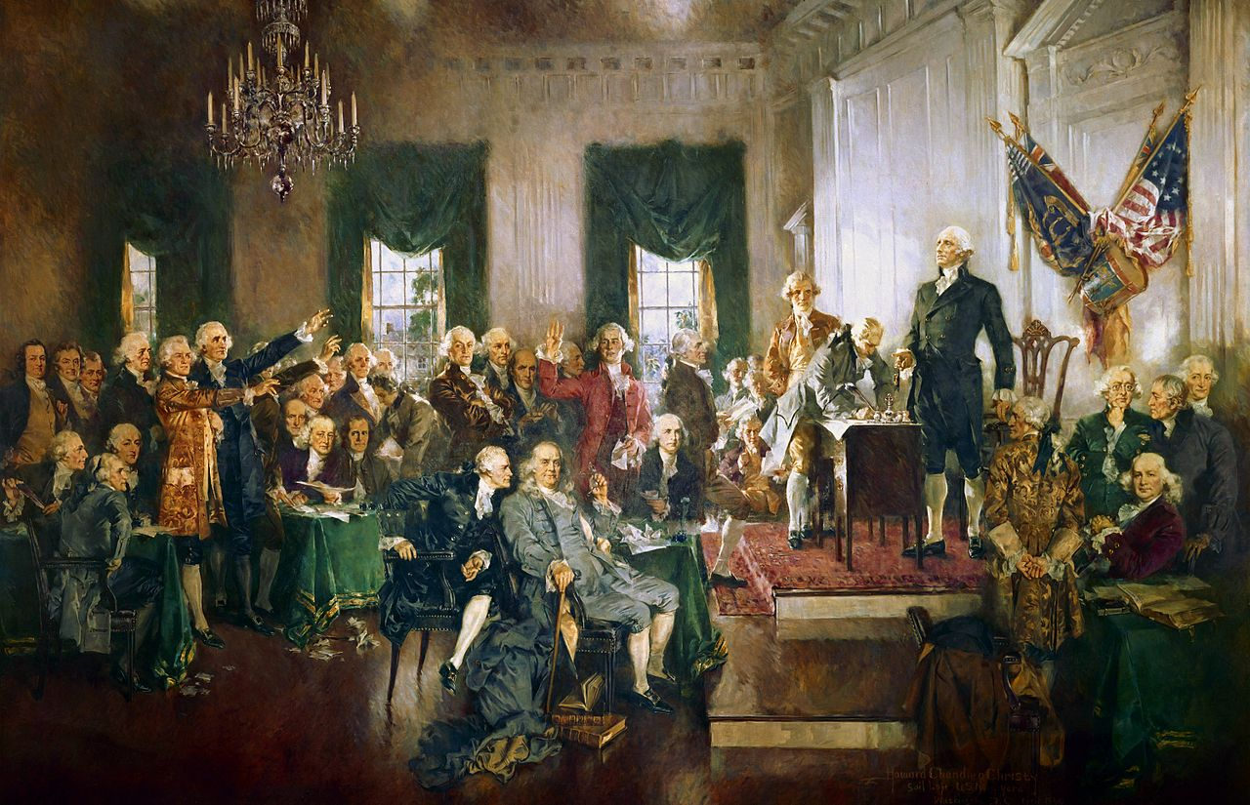
The Constitutional Convention
Howard Chandler Christy, Scene at the Signing of the Constitution of the United States (1940)

Slide 2
USHC 1.4
Analyze how dissatisfactions with the government under the Articles of Confederation were addressed with the writing of the Constitution of 1787, including the debates and compromises reached at the Philadelphia Convention and the ratification of the Constitution.

Slide 3
Elite Consensus:
20
The Articles aren’t working.
Photo by Nesster

Slide 4
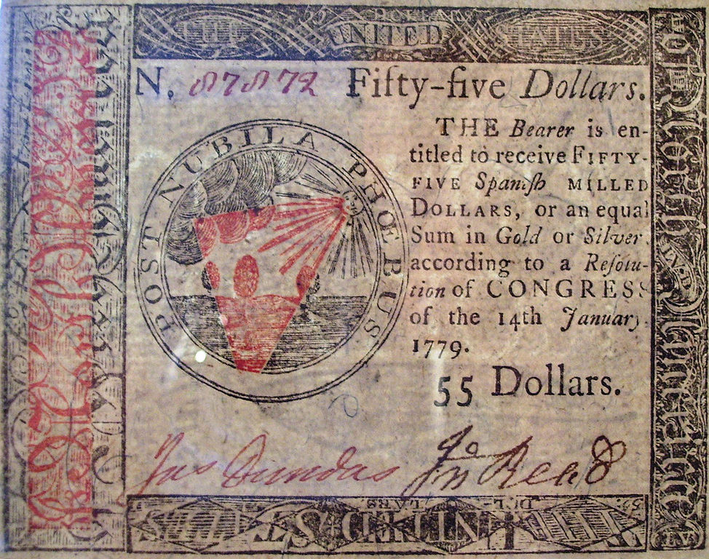
Bad Economy
Image by Beyond My Ken

Slide 5
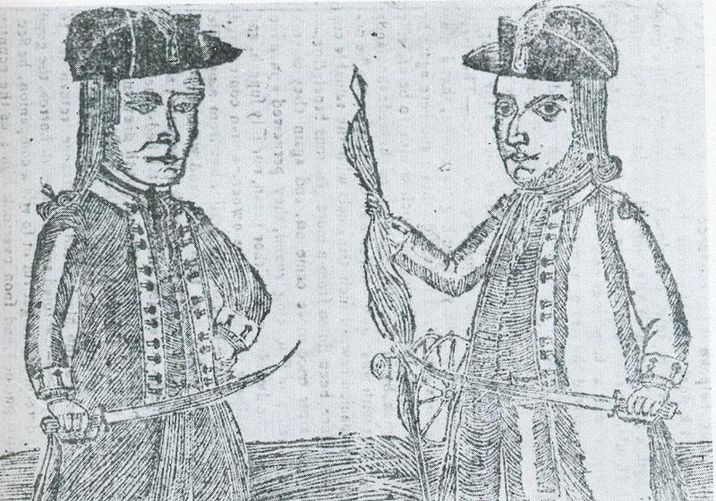
Rebellions

Slide 6
TRADE BARRIERS
Photo by Eddy Van 3000

Slide 7
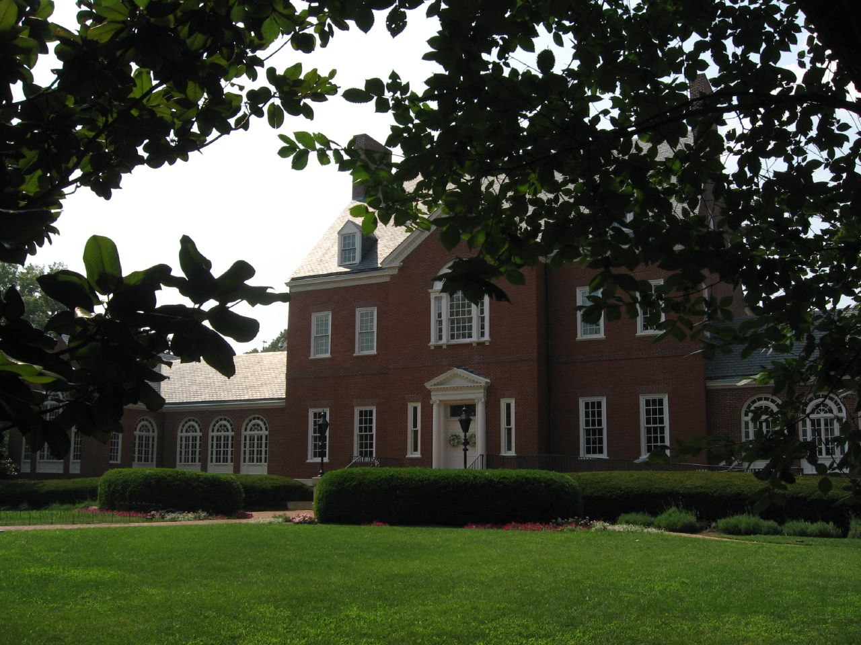
The Annapolis Convention 1786
Photo by Ken Lund

Slide 8
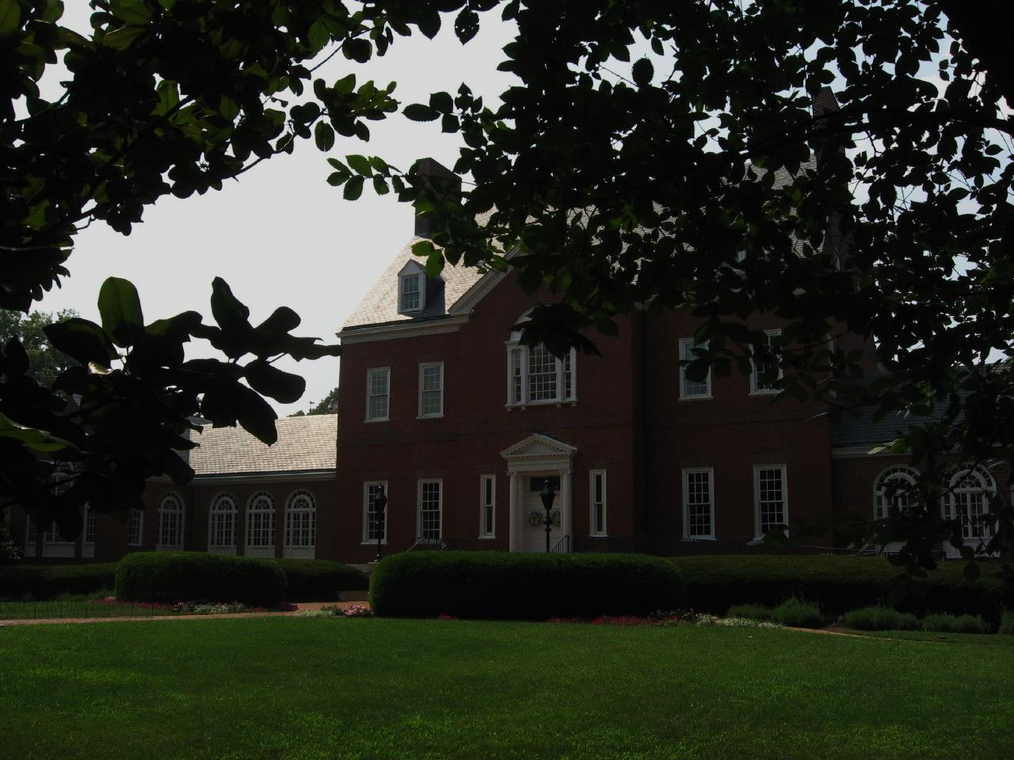
Let’s meet again.
Photo by Ken Lund

Slide 9
Let’s meet again. Next year.
Photo by Ken Lund

Slide 10
Let’s meet again. Next year. With more people.
Photo by Ken Lund

Slide 11
The Philadelphia Convention 1787

Slide 12
The Philadelphia Convention 1787
STATED PURPOSE:
Amend the Articles

Slide 13
LOL
They have no idea.

Slide 14
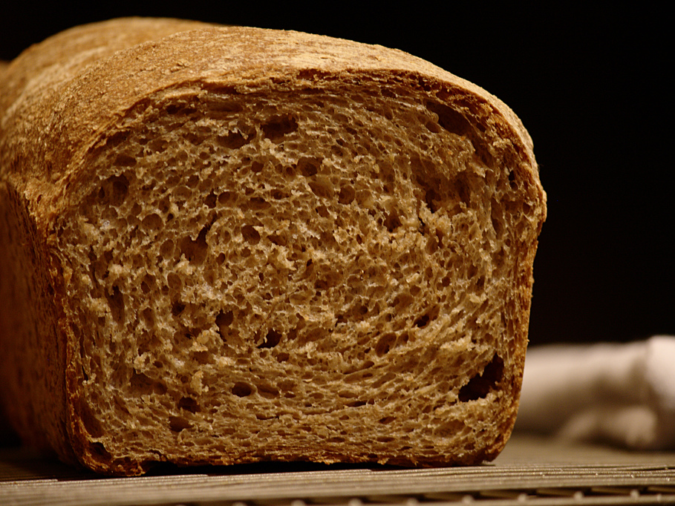
FROM SCRATCH
Photo by Mike McCune

Slide 15
LARGE STATE
small state
Slave State
Free State
State icons designed by Ted Grajeda from the Noun Project

Slide 16
Statistics From the 1790 Census
 | State Population | Percentage of Total | Regional Population |  |  | Number of Slaves | Percentage of Population
New Hampshire | 141,885 | 4% |  |  |  | 158 | 0%
Massachusetts | 378,787 | 10% |  |  |  | 0 | 0%
Connecticut | 237,946 | 7% |  |  |  | 2,759 | 1%
Rhode Island | 68,825 | 2% |  |  |  | 152 | 0%
NEW ENGLAND |  | 23% | 827,443
New Jersey | 184,139 | 5% |  |  |  | 11,423 | 6%
New York | 340,120 | 9% |  |  |  | 21,324 | 6%
Pennsylvania | 434,373 | 12% |  |  |  | 3,737 | 1%
MIDDLE STATES |  |  | 958,632
NORTH OF MASON/DIXON |  | 49% | 1,786,075 |  | Slaves (North) | 39,853 | 6%
Delaware | 59,096 | 2% |  |  |  | 8,887 | 15%
Maryland | 319,728 | 9% |  |  |  | 103,036 | 32%
Virginia | 747,610 | 20% |  |  |  | 293,427 | 39%
North Carolina | 393,751 | 11% |  |  |  | 100,572 | 26%
South Carolina | 249,073 | 7% |  |  |  | 107,094 | 43%
Georgia | 82,548 | 2% |  |  |  | 29,264 | 35%
SOUTHERN STATES |  | 51% | 1,851,806 |  | Slaves (South) | 642,280 | 94%
TOTAL POPULATION |  |  | 3,637,881 |  | SLAVE POPULATION | 681,833 | 15%
Sources: http://www.infoplease.com/ipa/A0004986.html http://manyeyes.alphaworks.ibm.com/manyeyes/visualizations/slave-population-of-us-states-and-te

Slide 17
LEGISLATIVE BRANCH

Slide 18
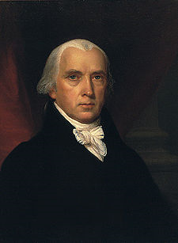
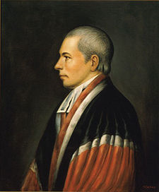
VIRGINIA PLAN
new jersey plan
JAMES MADISON
william paterson
BICAMERAL Legislature
unicameral legislature
Based on POPULATION
one vote
per state
View Census Data

Slide 19
How do we share?
Photo by Vegan Feast Catering

Slide 20
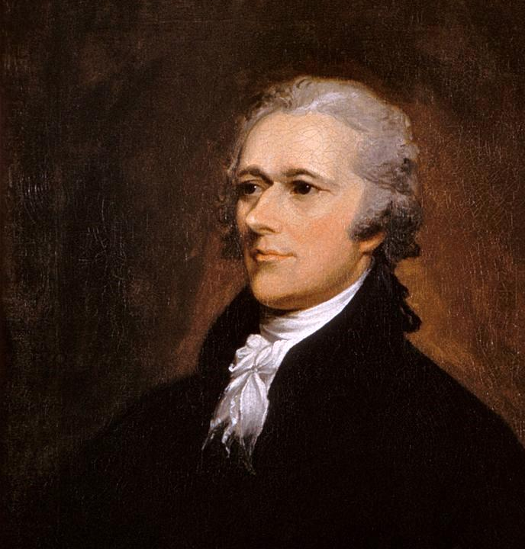
Hamilton’s Plan
for a national government
State Sovereignty

Slide 21
The convention heard Hamilton’s plan, but did not debate it.

Slide 22
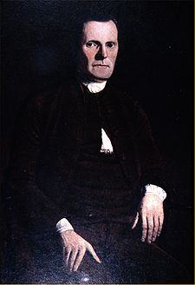
“GREAT COMPROMISE”
Roger Sherman (CT)
View Census Data
House of Representatives
Lower House
Senate
Upper House
Based on POPULATION
Two Votes Per State
Elected by Voters
(DIRECT)
Appointed by
State Legislatures (INDIRECT)

Slide 23
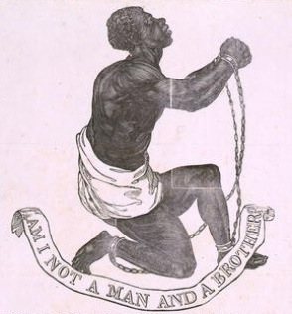
QUESTION:
Should slaves be counted for purposes of representation in the lower house of Congress?
Consider the interests of your assigned state when answering.
View Census Data

Slide 24
The “Three-Fifths” Compromise
FOR THE SOUTH | FOR THE NORTH
For representation in Congress, slaves counted as 3/5 of a person. | After 20 years, Congress has the power to regulate (or outlaw) the international slave trade.
3/5

Slide 25
The “Three-Fifths” Compromise
FOR THE SOUTH | FOR THE NORTH
For representation in Congress, slaves counted as 3/5 of a person. | After 20 years, Congress has the power to regulate (or outlaw) the international slave trade.
3/5

Slide 26
EXECUTIVE BRANCH

Slide 28
ELECTORAL

Slide 29
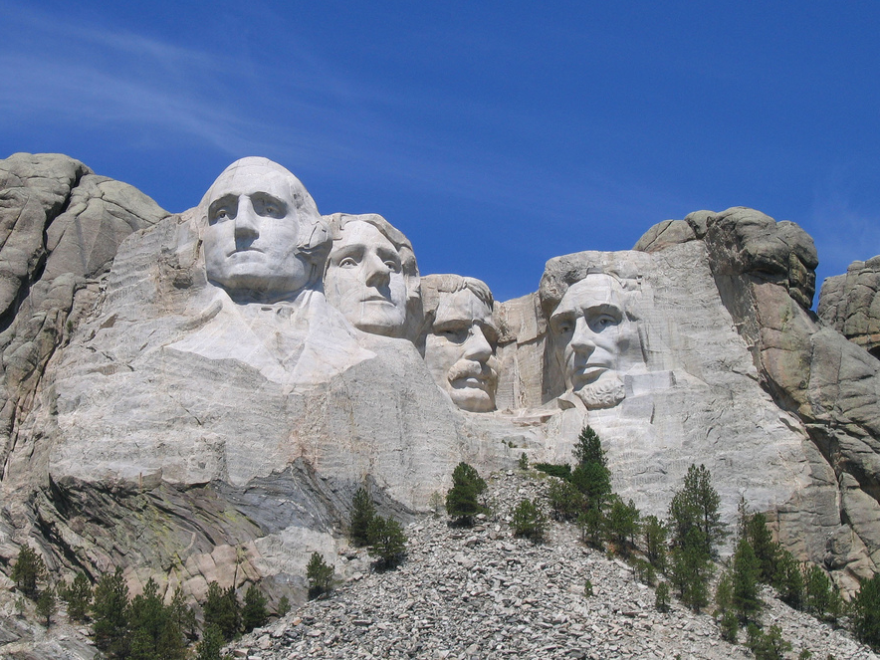
ELECTORAL COLLEGE
Photo by Liz Lawley

Slide 30
ELECTORAL COLLEGE
Each state will send electors to cast votes for President.
Photo by Liz Lawley

Slide 31
ELECTORAL COLLEGE
# of ELECTORS =
# of Senators + Reps
Photo by Liz Lawley

Slide 32
The LARGE STATES get more electoral votes.
Photo by Tony Alter

Slide 33
The small states get a head start.
Photo by greg westfall

Slide 34
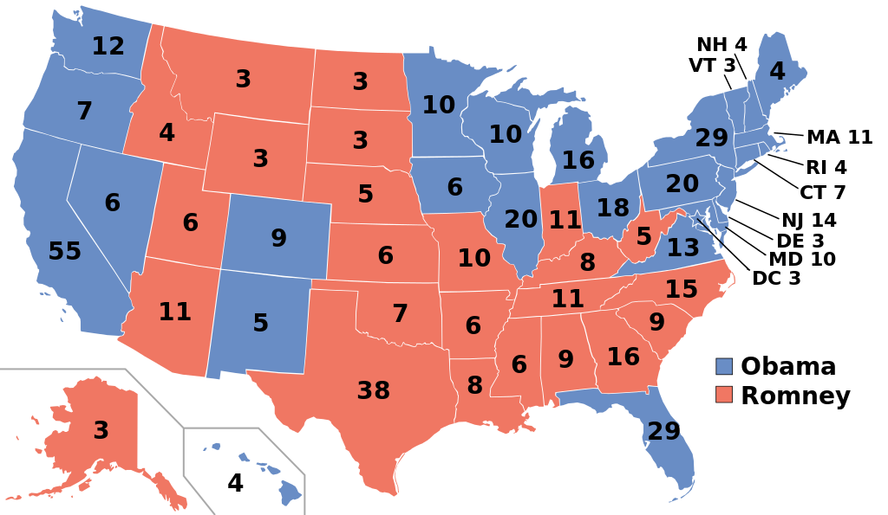
2012 Presidential Election

Slide 35
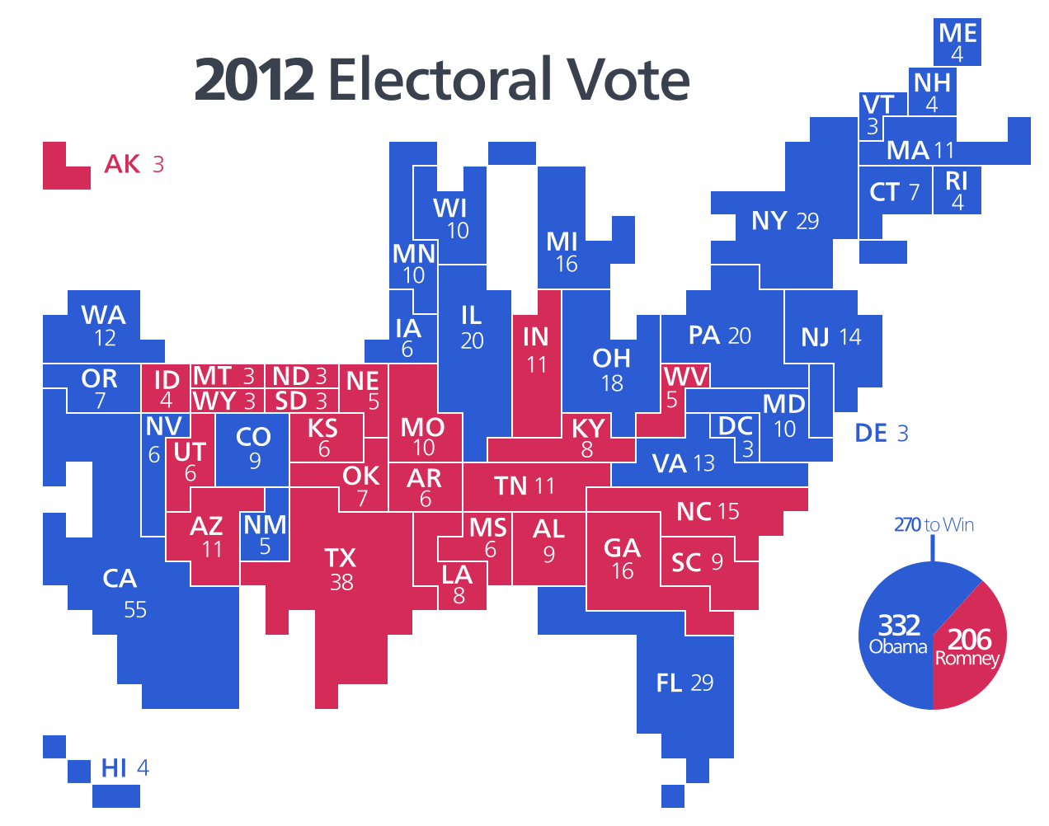
2012 Electoral Vote
Map Credit: Kelvinsong

Slide 36
JUDICIAL BRANCH

Slide 38
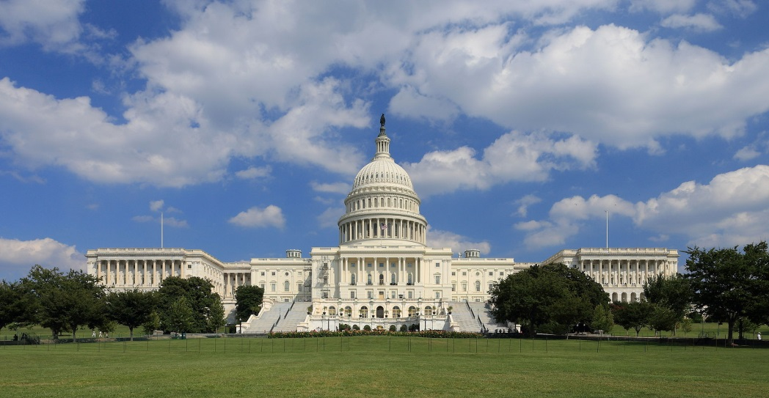
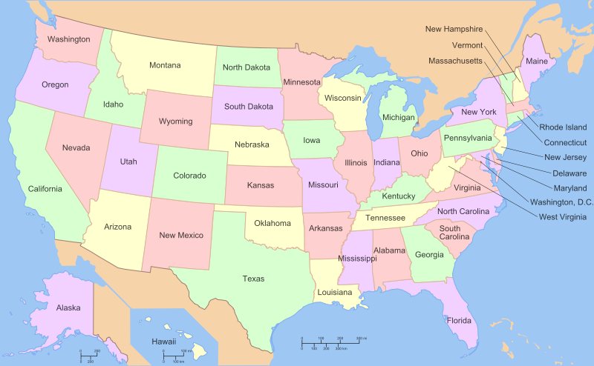
AMENDING THE CONSTITUTION
Photo by Martin Falbisoner
Map by ZooFari
2 3
3 4

Slide 39
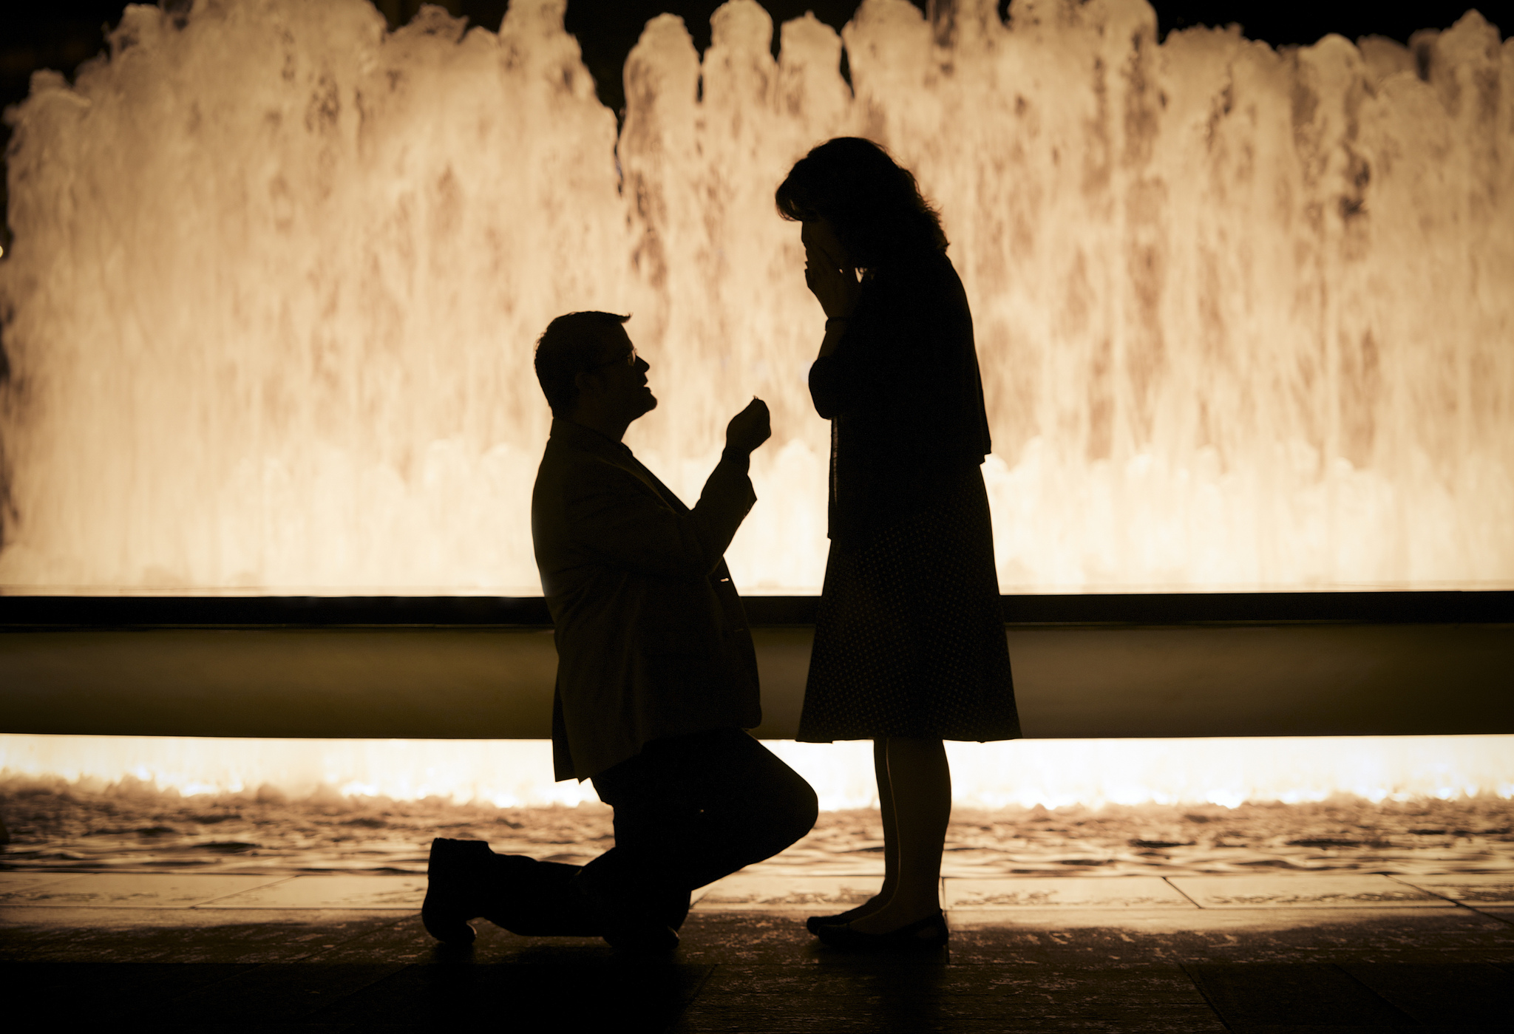
CONGRESS PROPOSES
Photo by Andrew Higgins

Slide 40
THE STATES RATIFY
OR REJECT
Photo by Andrew Higgins

Slide 41
Articles
A COMPARISON
Sovereignty?
Foreign Relations?
Taxation?
Commerce & Trade?
Representation?
To Legislate?
To Amend?
Constitution
States
SHARED
Federal
Federal
States
Federal & State
Federal (Interstate) State (Intrastate)
States
Proportional (House)
Two Each (Senate)
1 Vote Per State
2/3
Concurrent Majority + President’s Signature
UNANIMOUS
2/3 + 3/4

