Slide 1
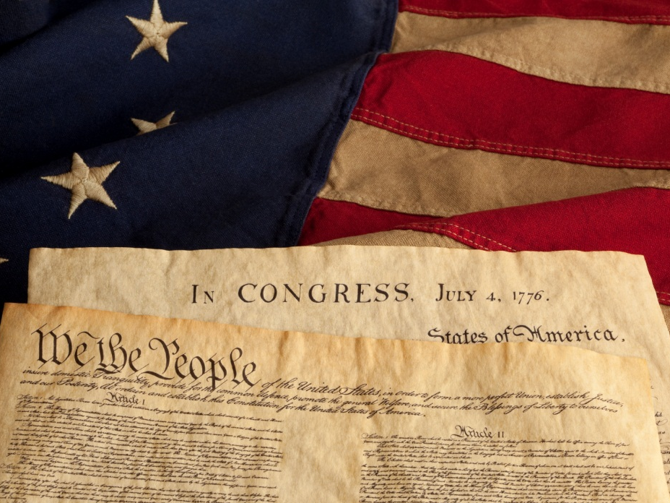
PRINCIPLES of the Constitution

Slide 2
Tyranny
No One Wants This.

Slide 3
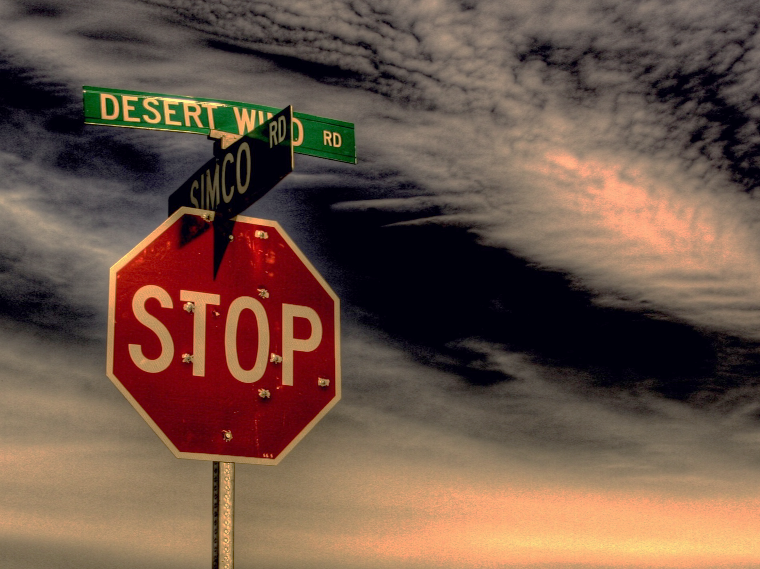
A Constitution LIMITS Government PREVENTS Tyranny
Photo by Chrishna

Slide 4
Limiting the Government
Federal
States
Federalism
The federal government has to share power with state governments.
Checks & Balances
Photo by Habibah Agianda
No one person or group within the federal government has complete control of the government.
The Bill of Rights
The scope of government is restricted to protect the rights of the people.

Slide 5
Federalism
Two Levels of Government that share power
Federal Government
State Governments

Slide 6
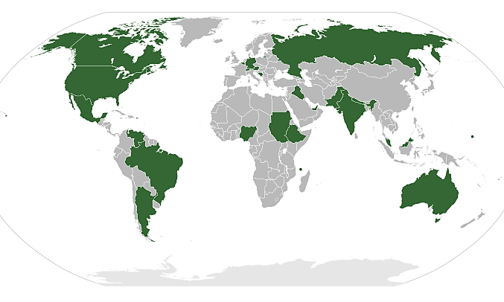
Federal States
What do all federal states have in common?
Map by Lokal_Profil

Slide 7
Federal States
Every federal government’s power is limited.
Map by Lokal_Profil

Slide 8
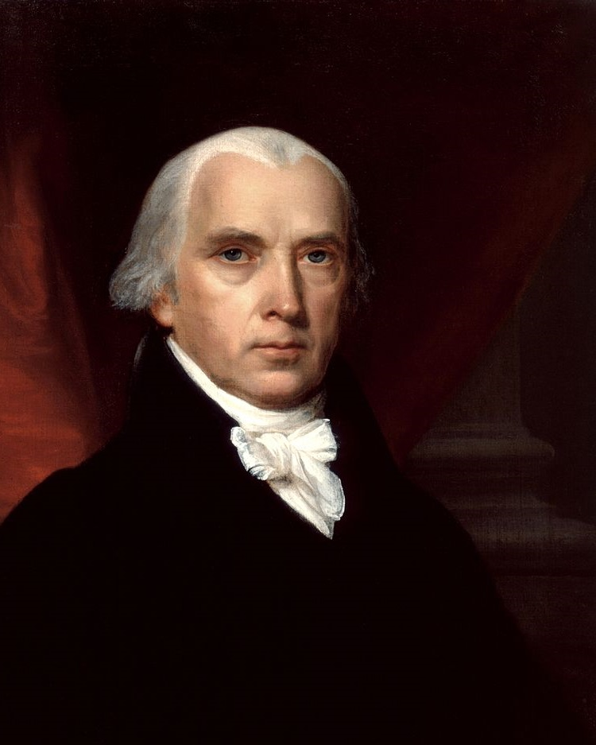
“The powers delegated by the proposed Constitution to the federal government, are few and defined. Those which are to remain in the State governments are numerous and indefinite.”
-- James Madison
Federalist No. 45
Source: http://www.constitution.org/fed/federa45.htm

Slide 9
FEDERALISM
Federal
State
Sovereignty is constitutionally divided between a central authority and states.
DELEGATED Powers | CONCURRENT Powers | RESERVED Powers
Powers given to the Federal Government
Powers shared by both levels of Government
Powers kept by the states and people

Slide 10
Federalism
Delegated
Reserved
Admit New States
Education
Coin Money
Collect Tariffs
Establish Local Governments
Declare War
Establish Courts
Foreign Policy
Weights and Measures
Army and Navy
& Everything Else
Organize and Maintain Militia
National Defense
Punish Treason
Concurrent
Taxation
Immigration and Naturalization
Ratify Constitutional Amendments
Propose Constitutional Amendments
Regulate Foreign Trade
Marriage Laws
Regulate
Interstate Commerce
Regulate
Intrastate Commerce

Slide 11
Federalist No. 39 (Madison)
“The Conformity of the Plan to Republican Principles”
Is the government created by the Constitution a national government or a federal government?
Source: http://www.constitution.org/fed/federa45.htm

Slide 12
Federalist 39 | NATIONAL | FEDERAL
Ratification
Congress
Electoral College
Powers of the government
Operation of the government
Amendments
X
House
Senate
X
X
X
X

Slide 13
MADISON’S POINT:
Although the government created by the Constitution is national in some respects, it remains federal in most respects.
Source: http://www.constitution.org/fed/federa45.htm

Slide 14
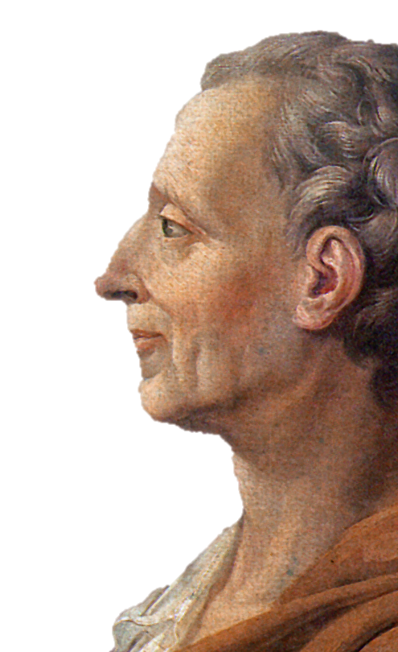
Separation of Powers
Montesquieu
French Philosopher
The Spirit of the Laws (1748)

Slide 15
Three Branches of Government
LEGISLATIVE | EXECUTIVE | JUDICIAL
(Congress) | (President) | (Supreme Court)
MAKES Laws
ENFORCES Laws
JUDGES Laws

Slide 16
Checks and Balances

Slide 17
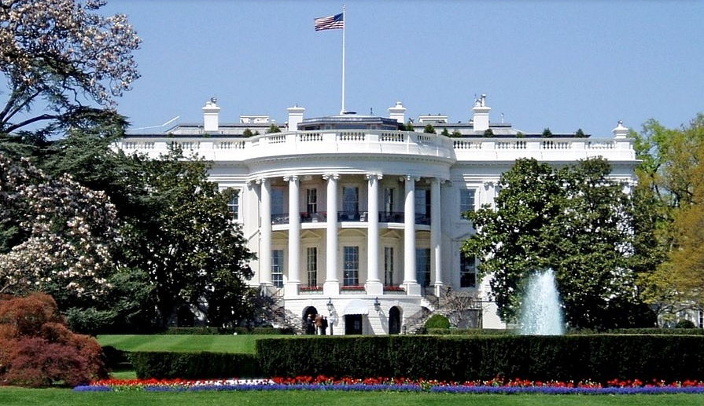
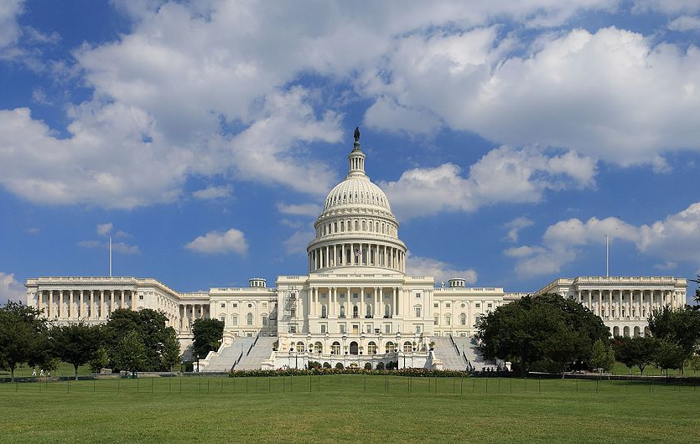
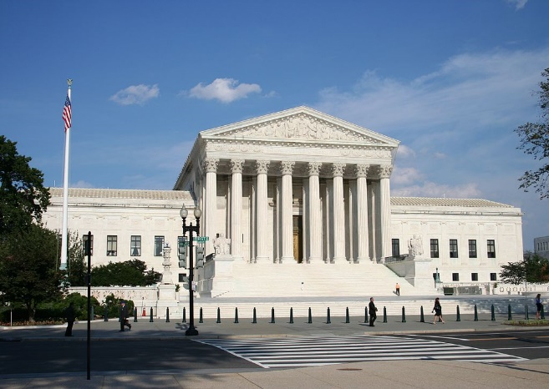
Checks and Balances
Each branch has “checks” that help it to “balance” its power with the other branches.
#REKT
Photo by UpstateNYer
#REKT
This keeps any branch from becoming dominant over the others.
#REKT
Photo by Martin Falbisoner
Photo by 350z33

Slide 18
The Veto
Photo by UpstateNYer
President checks Congress’ legislative power
From Latin: “I Forbid”
2/3 Vote of Both Houses to Override
1845 – First Veto Overridden
For more info on presidential vetoes
CLICK HERE

Slide 19
Confirmation Hearings
The Senate must confirm all presidential appointments of cabinet members, federal judges, foreign ambassadors, and other high officials.

Slide 20
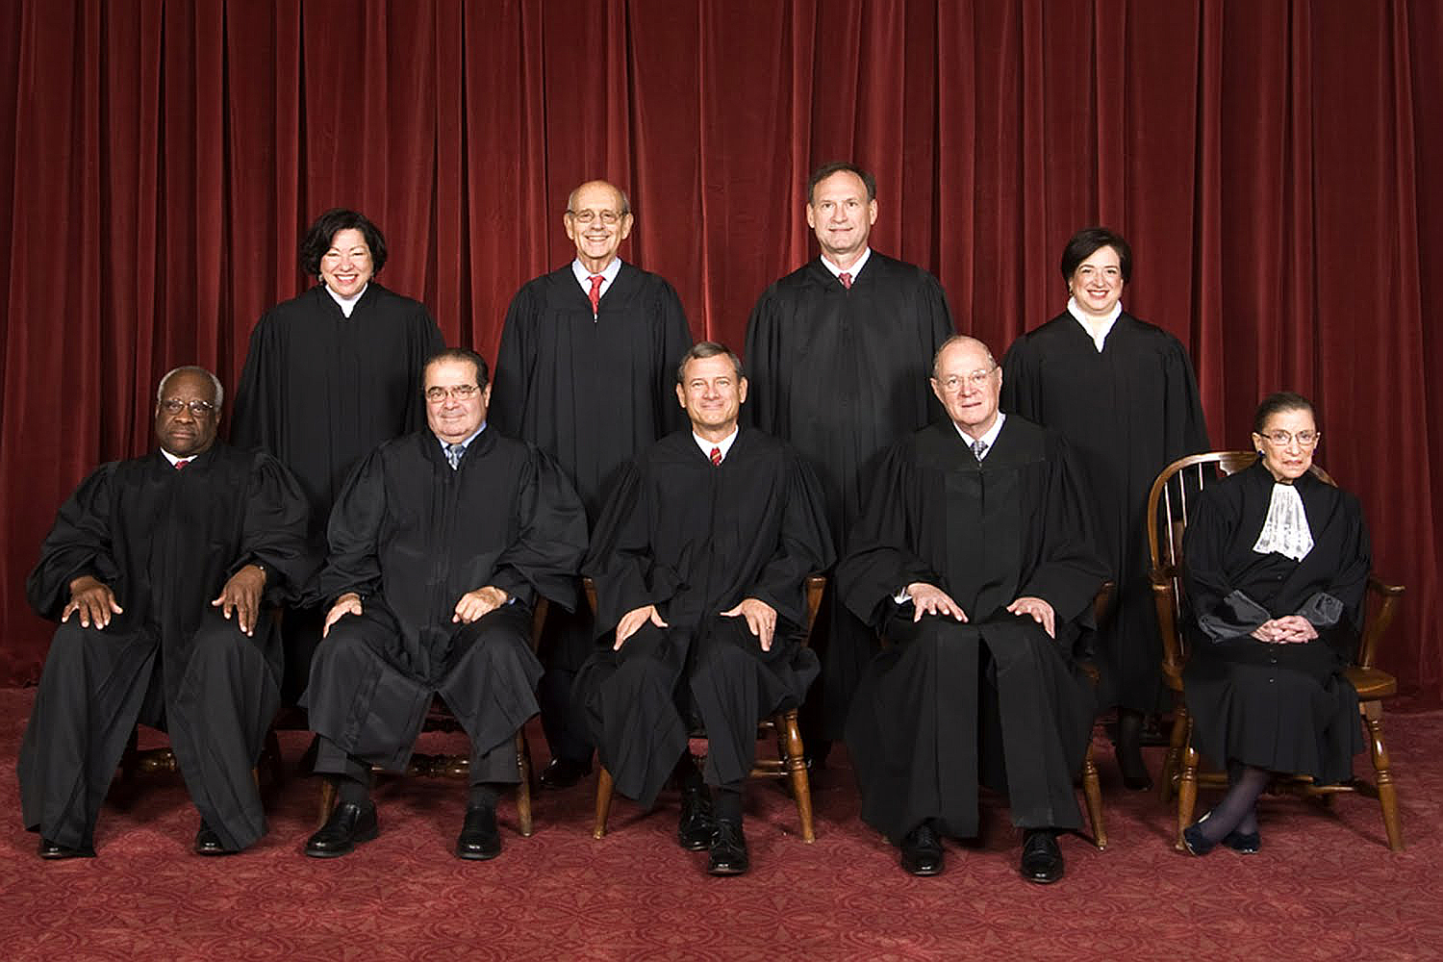
LIFERS
With the power to decide what the Constitution says.

Slide 21
Powers of the Government | Which Branch Has The Power? | Branch(es) Checked (Could be more than one)
Create and pass legislation.
Veto bills.
Ratify treaties.
Appoint Federal judges.
Impeachment of federal officials.
Confirm presidential appointments.
Declare laws unconstitutional.
Override Presidential Vetoes.
Judges are appointed for life.
Appropriate Money.
Legislative
Executive / Judicial
Executive
Legislative
Legislative
Executive
Executive
Judicial
Legislative
Executive / Judicial
Legislative
Executive / Judicial
Judicial
Legislative
Legislative
Executive
Judicial
Executive / Legislative
Legislative
Executive

Slide 22
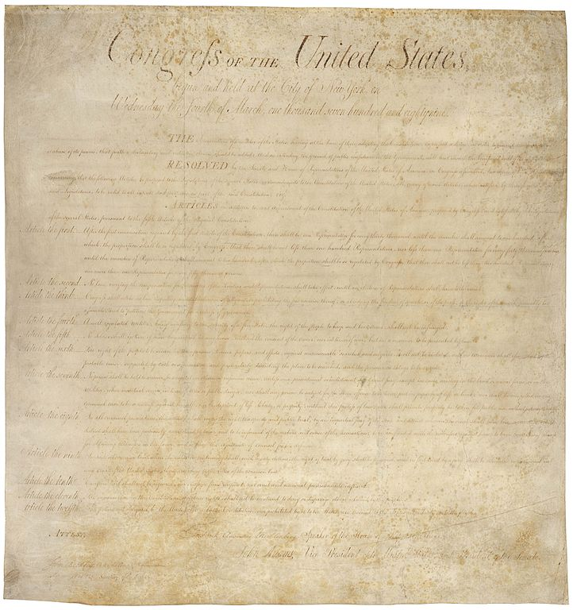
The Bill of Rights
The Bill of Rights was intended to protect the rights of the PEOPLE and the STATES from being violated by the federal government.

Slide 23
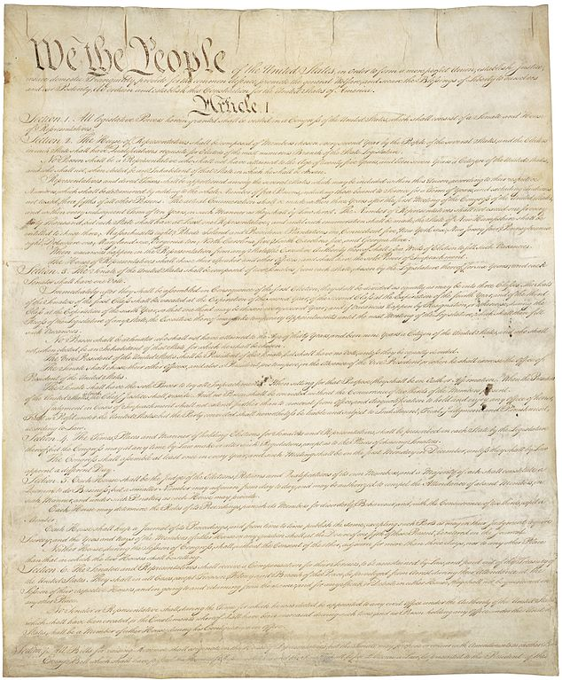
Amendments
The original constitution DID NOT include a Bill of Rights.

Slide 24
Amendment I
The Right to Free Expression
Congress shall make no law respecting an establishment of religion, or prohibiting the free exercise thereof; or abridging the freedom of speech, or of the press; or the right of the people peaceably to assemble, and to petition the Government for a redress of grievances.
Praying icon designed by Cristiano Zoucas from the Noun Project
Speaker icon designed by Magicon from the Noun Project

Slide 25
Amendment I
The Right to Free Expression
RELIGION
SPEECH
PRESS
ASSEMBLY
PETITION
icon designed byfrom the Noun Project

Slide 26
Amendment II
The Right to Keep & Bear Arms
A well regulated Militia, being necessary to the security of a free State, the right of the people to keep and bear Arms, shall not be infringed.
Pistol icon designed by Misha Petrishchev from the Noun Project

Slide 27
Amendment IV
Protection of Private Property
The right of the people to be secure in their persons, houses, papers, and effects, against unreasonable searches and seizures, shall not be violated…
Lock icon designed by Alexander Smith from the Noun Project

Slide 28
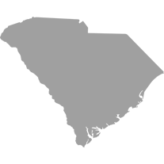
Amendment X
The Rights of the States
The powers not delegated to the United States by the Constitution, nor prohibited by it to the States, are reserved to the States respectively, or to the people.
State icons designed by Ted Grajeda from the Noun Project

Slide 29
Limiting the Government
Federal
States
What are the three ways in which the Constitution limits government?
Photo by Habibah Agianda

Slide 30
Limiting the Government
Federal
States
Federalism
The federal government has to share power with state governments.
Checks & Balances
Photo by Habibah Agianda
No one person or group within the federal government has complete control of the government.
The Bill of Rights
The scope of government is restricted to protect the rights of the people.

