Slide 1
Lyndon B. Johnson
1963 - 1968

Slide 2
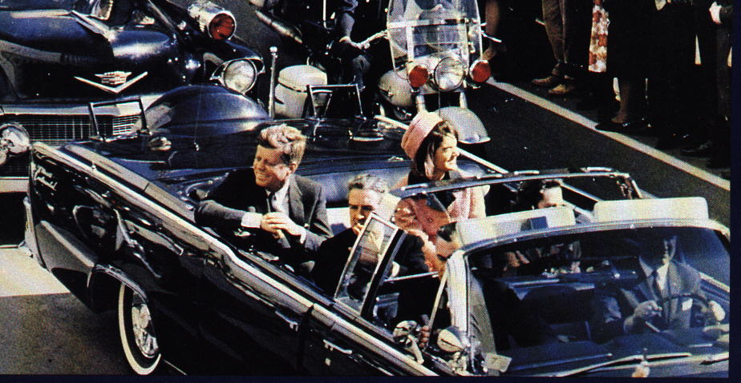
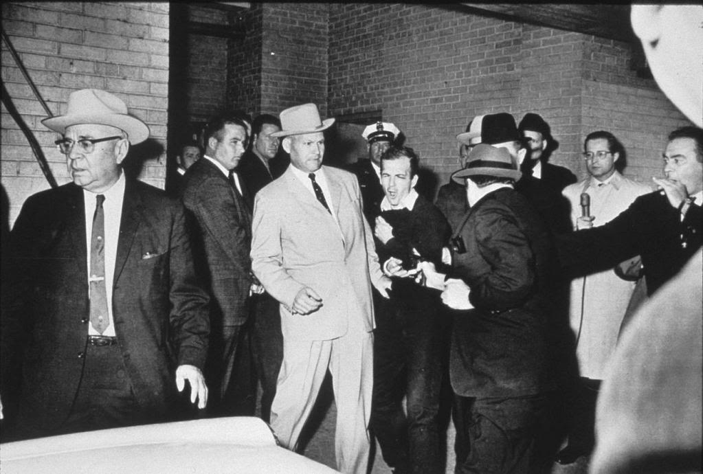
The Kennedy Assassination
Dallas, Texas
Many theories as to why he was killed
Hard to prove - Oswald killed before going to trial by Dallas nightclub owner Jack Ruby
November 22, 1963 – JFK assassinated by Lee Harvey Oswald

Slide 3
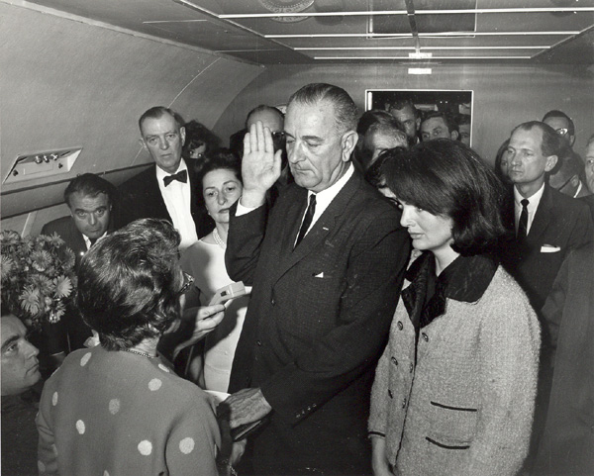
The Kennedy Assassination
Warren Commission – led by Chief Justice Earl Warren
Investigated killing – conclusion - Oswald acted alone
Later investigation shows possible conspiracy
Kennedy’s death stunned and saddened Americans
Vice-president Lyndon B. Johnson sworn in as president aboard Air Force One

Slide 4
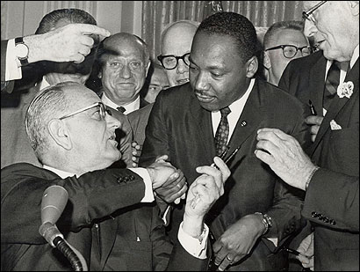
Lyndon Baines Johnson (D-TX)
Addressed Congress 5 days after JFK assassination
Confidently swore to continue JFK’s programs
His confidence & firmness helped reassure nation & ease shock of sudden change of leaders
An early victory - passage of Civil Rights Act of 1964
Enacts sweeping civil rights laws outlawing segregation

Slide 5
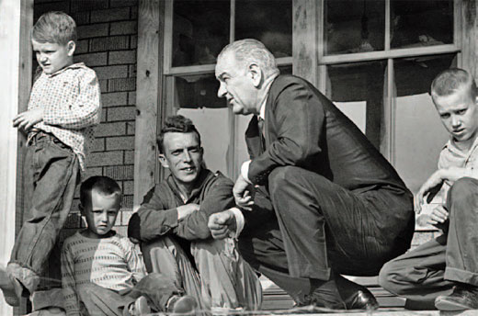
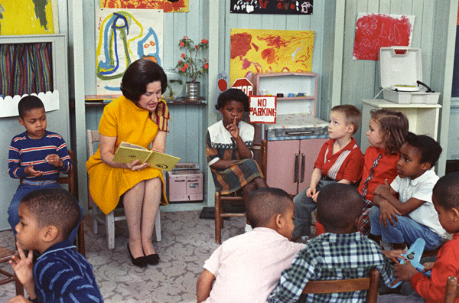
Top Priority - The War on Poverty
Economic Opportunity Act (1964)
Created Office of Economic Opportunity to direct anti-poverty campaign
Job Corps - trained young people in marketable skills
VISTA (Volunteers in Service to America)
a domestic Peace Corps
Project Head Start - educational aid to preschoolers from disadvantaged families

Slide 6
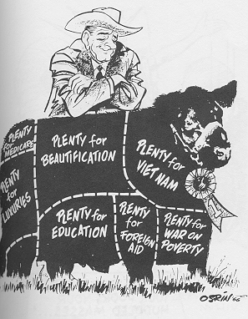
The Great Society
Johnson’s collection of domestic programs
Targeted health, education, conservation, the environment, and racial equality
Very successful in gaining passage of programs
Huge Proliferation of Govt. Programs
All manner of programs to deal with numerous social ills
Conservatives called it encroachment on basic American freedoms
American govt. too activist

Slide 7
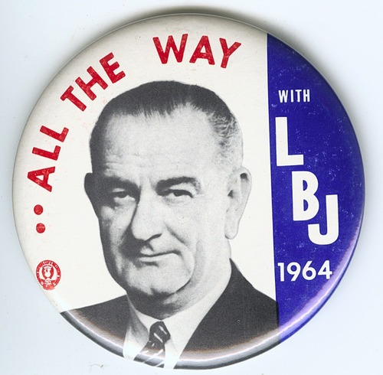
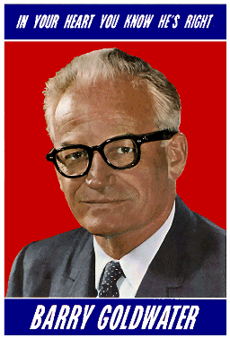
1964 Election
Johnson & V.P. Hubert Humphrey (D-MN)
Repubs. nominate Barry Goldwater (AZ)
Goldwater campaign offered “a choice, not an echo.”
“In your heart, you know he’s right” - slogan
Called for aggressive anti-Comm. policy
Promised smaller govt. than LBJ’s vision
Called federal action on civil rights unconstitutional - should be left to states

Slide 8
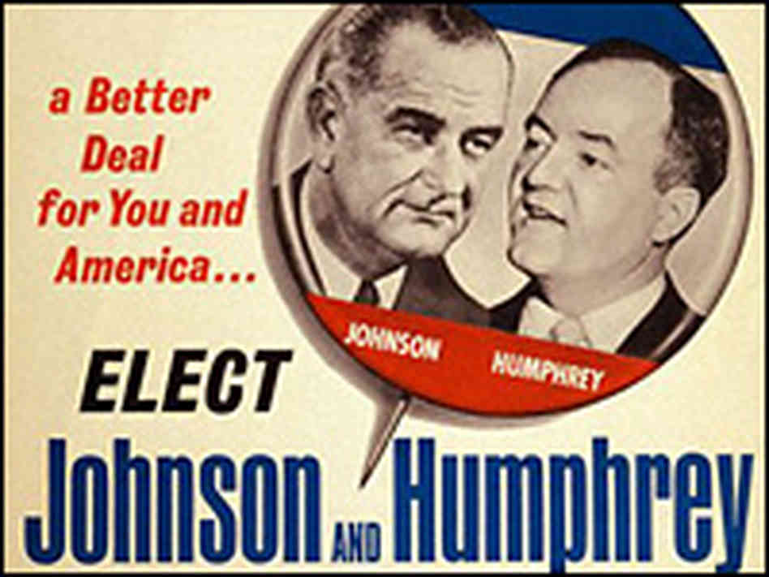
1964 Election
Johnson emphasized restrained & flexible foreign policy
to prevent nuclear war
Said prosperity in U.S. founded on federal programs in effect
pledged to continue course set by JFK
Johnson won by landslide
486 - 52 (all but six states) & 61% of vote

Slide 9
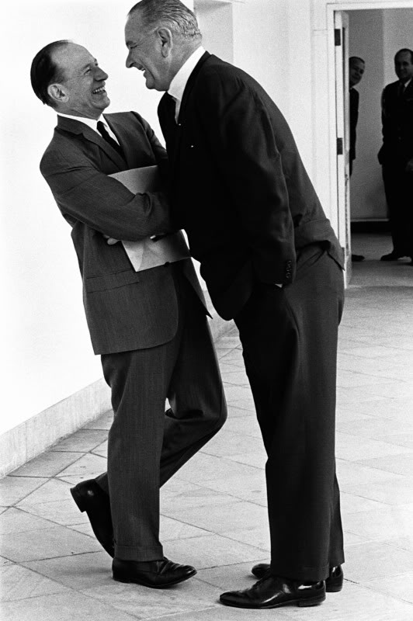
Liberalism Victorious
Liberal president in White House
Democratic dominated Congress
Johnson flooded Congress with Great Society programs (63 in 1965 alone) incl.:
Dept. of Housing & Urban Develop. (1965)
public housing, urban renewal
Medical Care Act (1965)
creates Medicare - insurance for elderly
Expensive programs would face competition with rising cost of war in Vietnam

