Slide 1
The Vietnam War
1955 – 1975

Slide 2
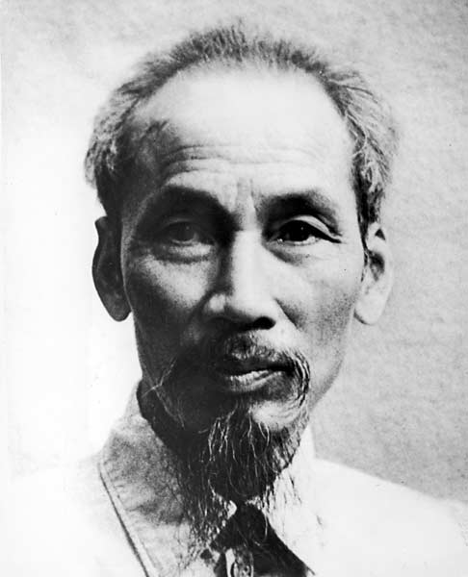
The Early Years
The Vietnamese resisted foreign influence (France, Japan, & U.S.) during World War II.
Used guerilla warfare
Ho Chi Minh - leader of the communist Vietminh
declared Vietnamese independence from France and Japan in 1945
President Truman tried to re-establish French rule in 1950
Granted $10 million in aid to French in Indochina

Slide 3
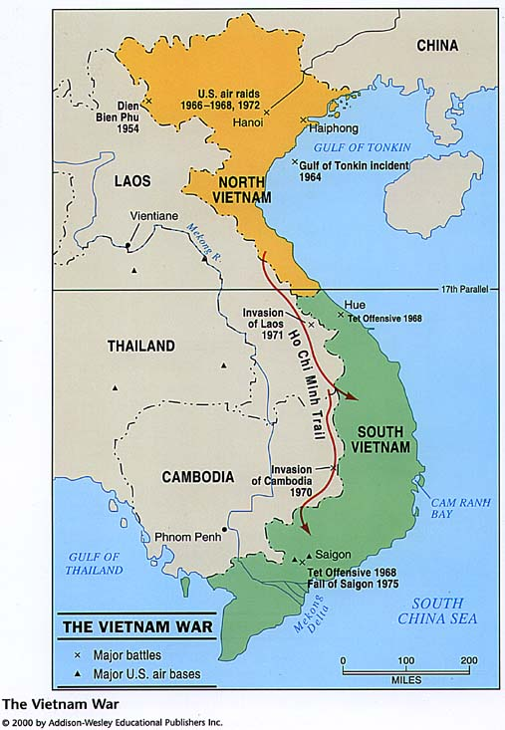
1954: French were defeated at Dien Bien Phu
Geneva Accords divided Vietnam at the 17th Parallel (1954)
North: controlled by Ho Chi Minh
South: controlled by anti-Communists:
1) Bao Dai
2)Ngo Dinh Diem
U.S. supported Diem

Slide 4
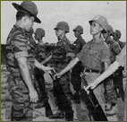
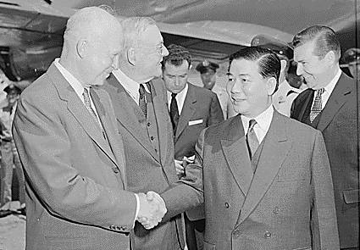
National Liberation Front (NLF): formed in South Vietnam in 1960
called the Vietcong (VC) by its enemies.
NLF’s goal: unseat the oppressive Diem govt
NLF was gaining support in the south.
President Eisenhower increased the number of American military advisors in South Vietnam
hoped to prop up the anti-Communist south

Slide 5
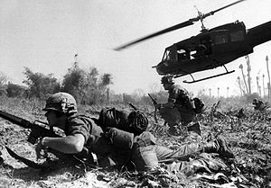
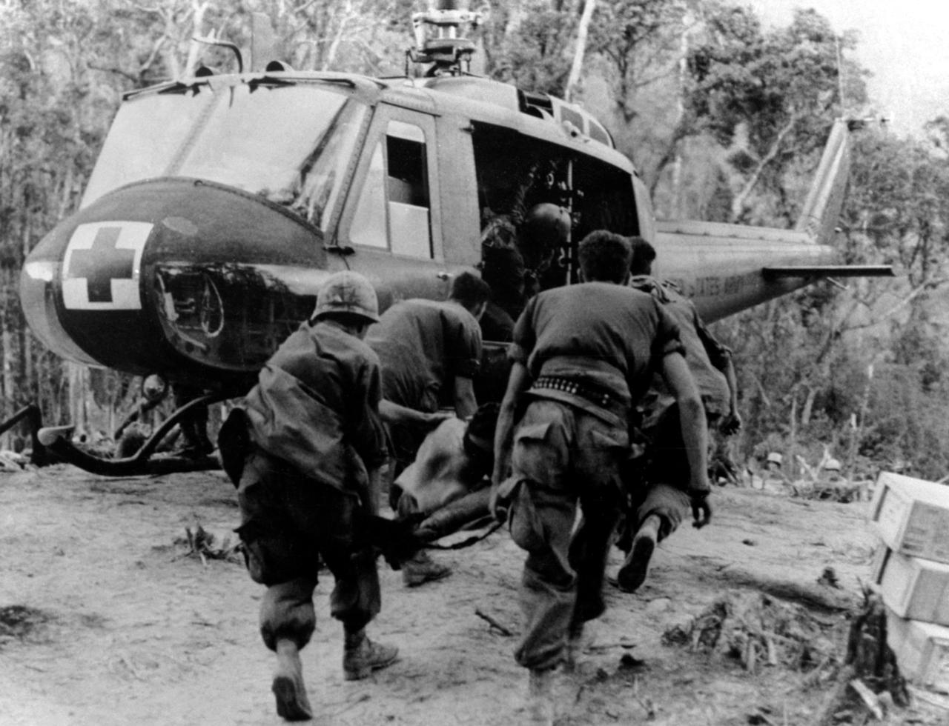
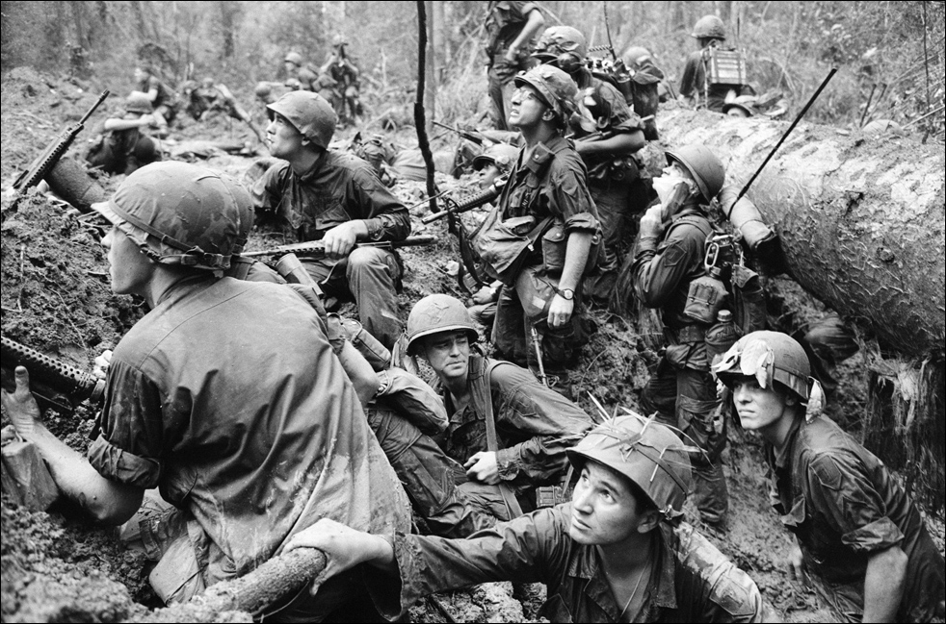
By 1961, a full-scale war was raging between the North and South in Vietnam

Slide 6
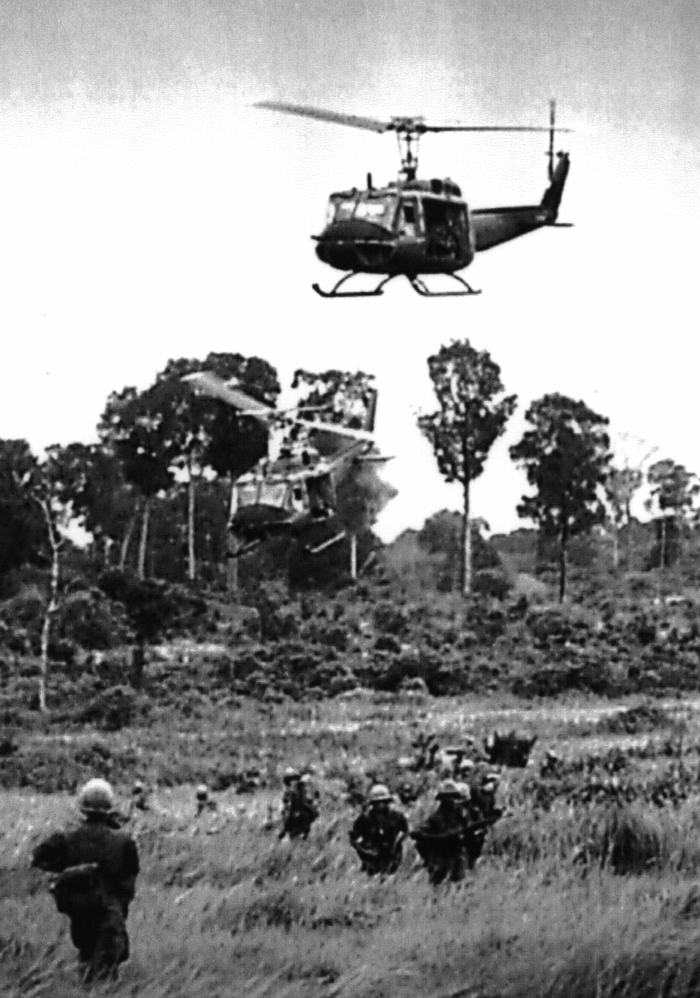
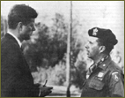
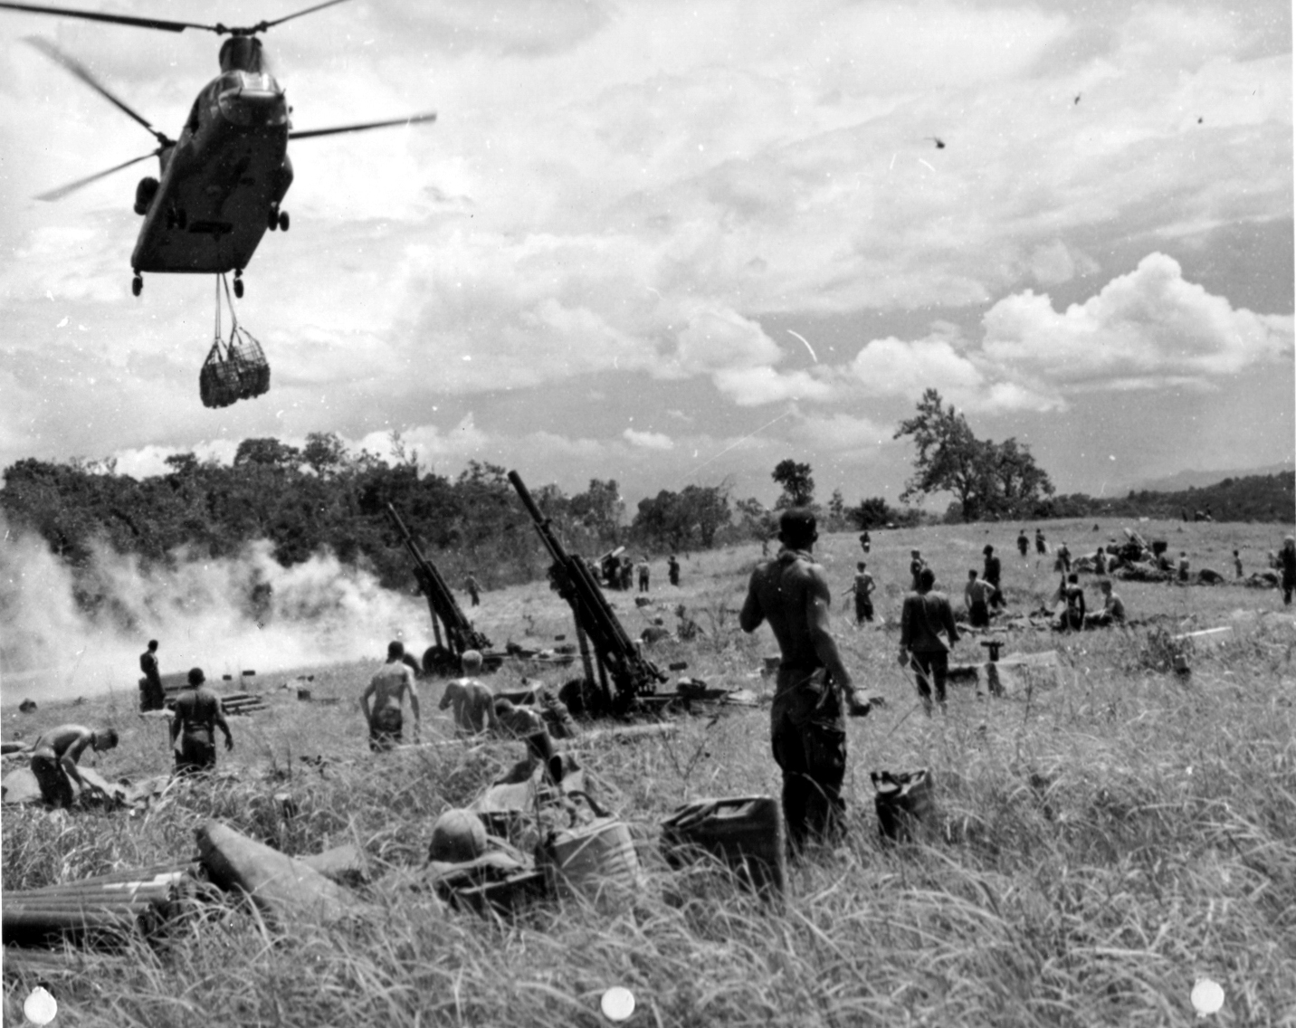
President Kennedy escalated the U.S. involvement
sent war equipment
increased number of advisors by 16,000
Intended to lead counter-attacks against the Vietcong

Slide 7
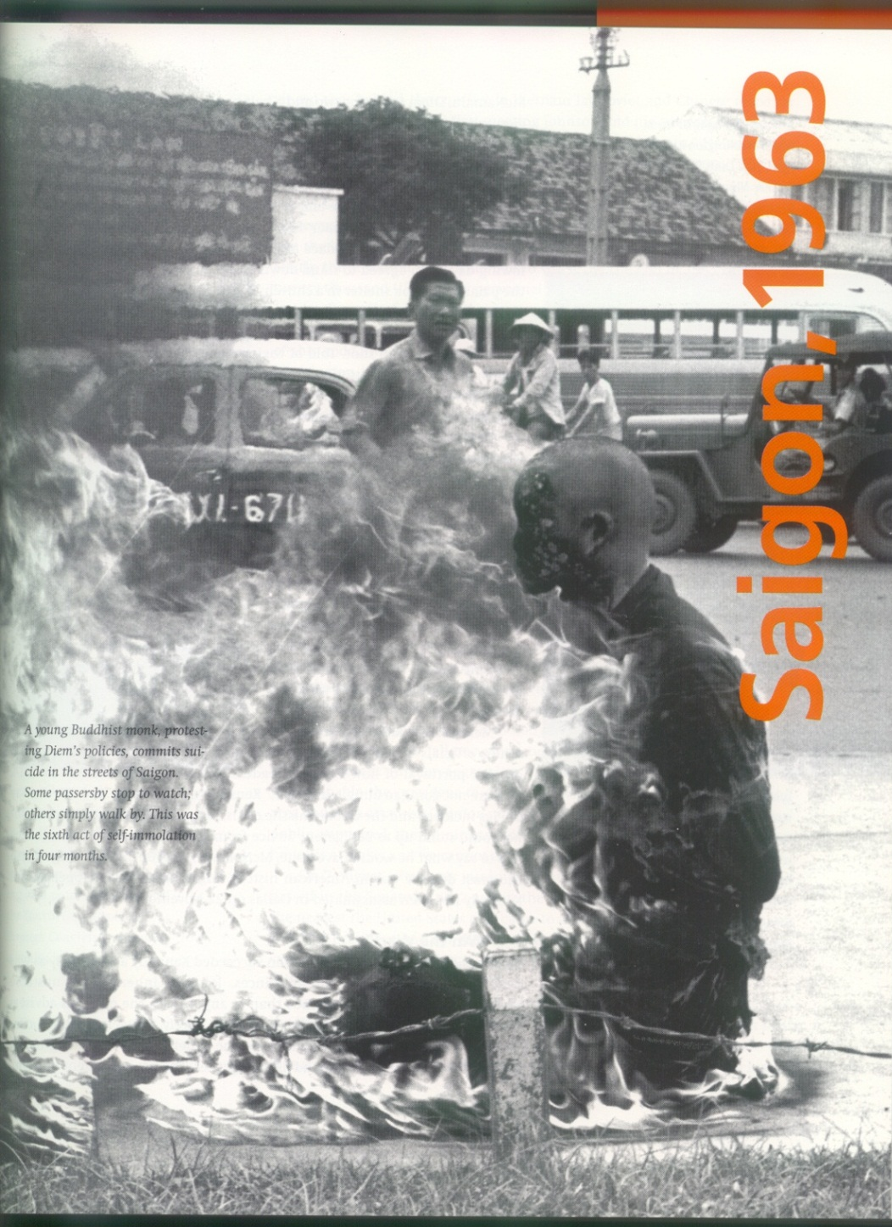
The U.S. supported a coup against Diem in Nov. 1963
CIA felt that Diem had become a liability
Diem led an oppressive government and suppressed Buddhism (major religion in Vietnam)
Severely diminished his popularity
U.S. supported the new leadership.
President Kennedy was assassinated shortly after

Slide 8
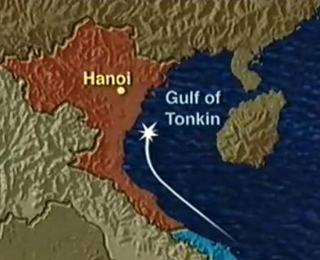
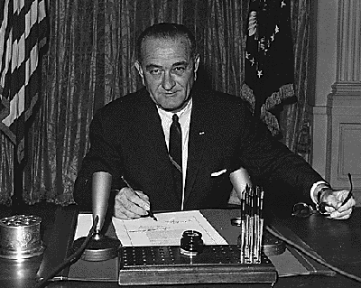
Gulf of Tonkin Resolution (1964)
Granted full war-making powers to president, not congress
Resulted from an alleged attack by N. Vietnamese gun boats on U.S. intelligence ship in Gulf of Tonkin
President Johnson used power to move U.S. into full-scale war in Vietnam
also sent additional troops

Slide 9
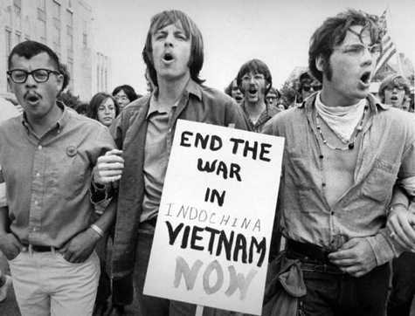
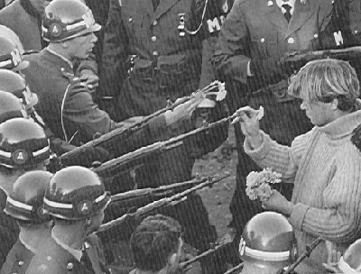
Opposition to the war heated up following the Tonkin Gulf Resolution. The issues included:
Increased bloodshed
Cost of the war
Ill-defined reasons for U.S. involvement

Slide 10
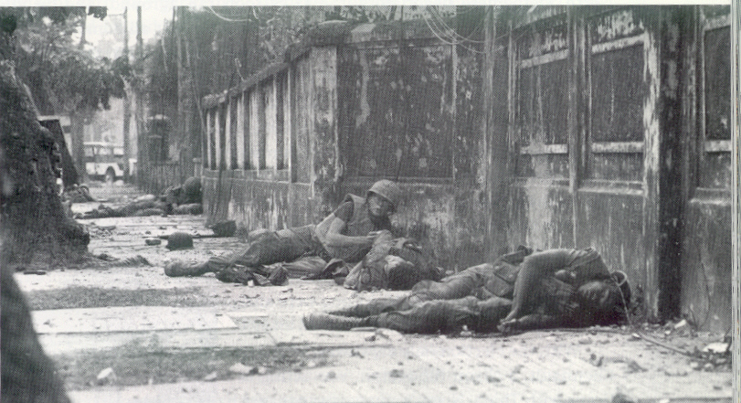
Tet Offensive (Jan. 1968)
Communist forces launched an offensive against virtually every city in the South
high cost in casualties on both sides
event outraged the American public
turning the tide of public opinion against the war

Slide 11
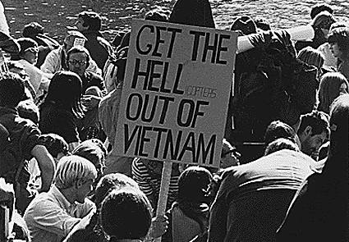
Johnson declined to run for another term in 1968
primarily because of the unpopularity of the war
War becomes a stalemate

Slide 12
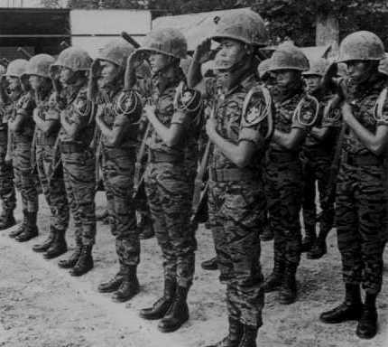
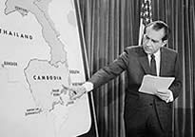
Nixon’s Vietnam Policy
Vietnamization- a de-scaling of troops without withdrawing support of anti-communist south
U.S. forces replaced by So. Vietnamese troops.
U.S. continued to send supplies and money
The Nixon Doctrine- We will assist, but not send troops.

Slide 13
My Lai Massacre
U.S. troops kill several hundred Vietnamese civilians (women, children, elderly) in small village of My Lai

Slide 14
Nixon orders invasion and bombing of neutral Cambodia
Trying to rid communists who were attacking South Vietnam from within Cambodia
using Ho Chi Minh Trail (a supply line for the Vietcong which ran through neutral countries)
Failed attempt in long run and caused further dissent at home
Students protesting bombing of Cambodia were fired upon by Ohio National Guard at Kent State University in Ohio.
4 anti-war demonstrators killed; several others wounded

Slide 15
The Closing Years: “Honorable Withdrawal”
Many failed peace talks
Henry Kissinger (U.S. Foreign Policy Advisor) participated in many of talks
Nixon sent Kissinger to negotiate secretly with North Vietnam (Le Duc Tho)
Wanted to force communists to compromise
Decline of U.S. troops in Vietnam
North Vietnamese troops continued to advance southward
Continued bombing of North Vietnam drew ire of all parties

Slide 16
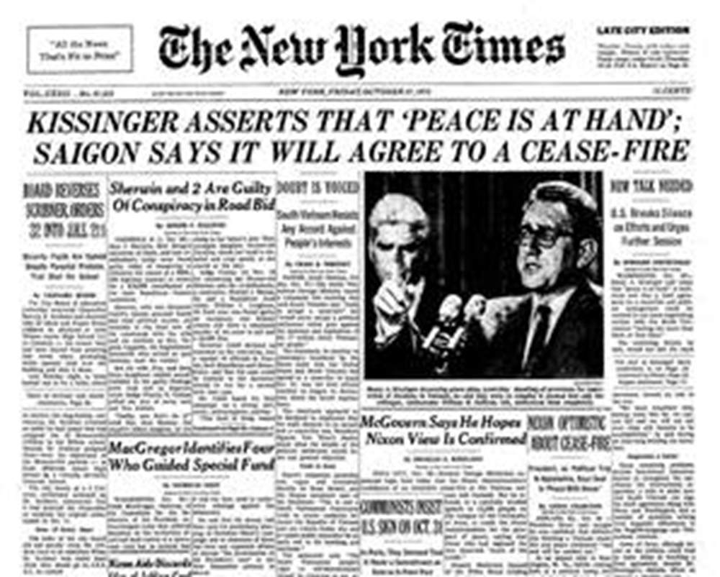
Paris Peace Agreement (1973)
Negotiated by U.S., North and South Vietnam, and Viet Cong
Provisions:
Withdrawal of troops and swap of prisoners
Removal of foreign troops from Cambodia and Laos
Peaceful unification with democratic elections deciding political future of South Vietnam
U.S. to aid in postwar reconstruction
March 29, 1973 – Last U.S. troops left Vietnam

Slide 17
Broken cease-fire agreement between North and South Vietnam
North launches full-scale invasion of South
U.S. refused to respond with troops
April 30, 1975 – Pull out of Saigon
U.S. embassy in Saigon
Desperate and frenzied exit from Vietnam
Officially ended our involvement there
Soon after U.S. pulled out, all of Vietnam fell to the Communists

Slide 18
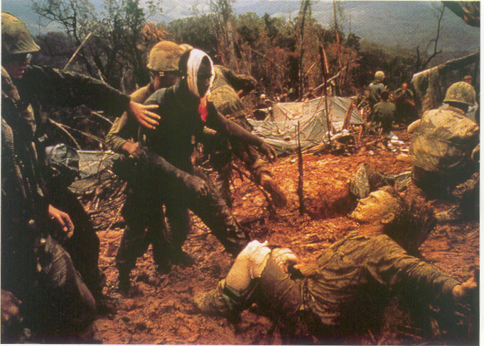
Final Statistics
Costs of the War
58K Americans dead
300K wounded
$110 -150 billion spent
America re-evaluates role in foreign affairs

