Slide 1
The Civil Rights Movement
“Eyes on the Prize”

Slide 2
Roots of the Movement
Earliest C.R. activists were the abolitionists
National Association for the Advancement of Colored People (1904)
W.E.B. Du Bois
By 1930’s – NAACP focused on equal educational opportunities
Challenged legality of “separate but equal” doctrine established in Plessy v. Ferguson (1896)
Notes:
Origins of the Civil Rights Movement
Earliest C.R. activists were the abolitionists
Fighting to win freedom for slaves
Later, the National Association for the Advancement of Colored People was formed (1904)
One founder – W.E.B. Du Bois
By 1930’s – NAACP focused on equal educational opportunities for African Americans
Sent several cases to court to challenge legality of “separate but equal” doctrine established in Plessy v. Ferguson (1896)
P v. F stated that blacks could be segregated from whites as long as the facilities were equal
NAACP philosophy was to make changes through the courts

Slide 3
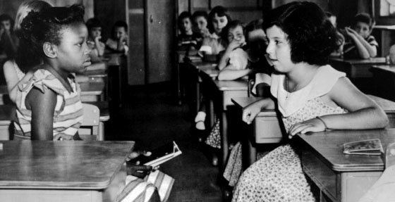
Brown v. Board of Education Topeka, KS - 1954
Court overturns Plessy decision (9-0)
Declares segregation unconstitutional
C.J. Earl Warren – “Separate educational facilities are inherently (basically) unequal
Landmark civil rights case in Supreme Court
Linda Brown – 8-year-old black girl denied admission to all-white school
NAACP lawyer in case – Thurgood Marshall
Will later become 1st black S.C. Justice
Notes:
1954 - Brown v. Board of Education of Topeka (Kansas)
Landmark civil rights case in Supreme Court
Lawsuit filed by parents of Linda Brown – 8-year-old black girl denied admission to all-white school
White school only blocks away – all-black school miles away
Parents argued that hardship of travelling so far to school made her education unequal to white children
NAACP lawyer in the case – Thurgood Marshall
Will later become 1st black Supreme Court Justice
S. Court unanimously rules in favor of Brown
Chief Justice Earl Warren – “Separate educational facilities are inherently (basically) unequal.”
Decision meant that schools would have to integrate

Slide 4
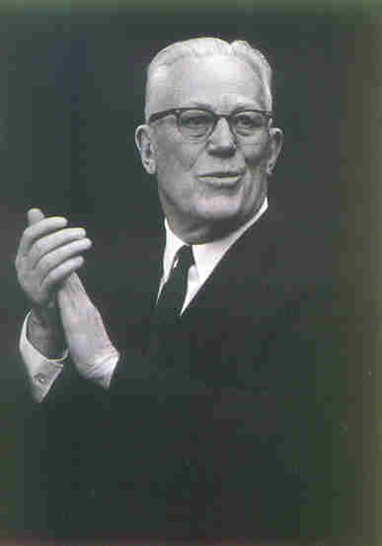
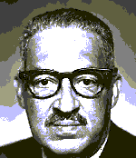
Chief Justice Earl Warren
Thurgood  Marshall

Slide 5
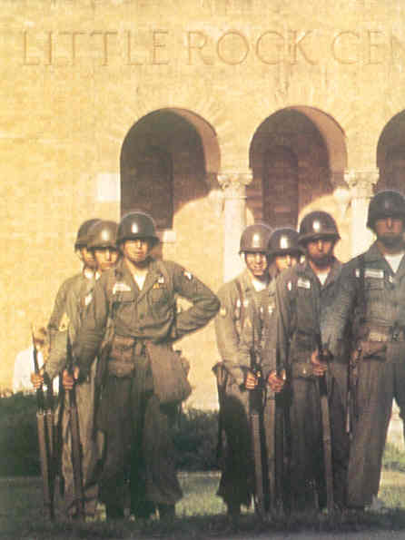
Little Rock (AR) Crisis at Central High School -1957
S.Court ordered integration “with all deliberate speed.”
Whites hostile to Brown Decision
Gov. Orval Faubus called out Natl. Guard to prevent integration.
Ike sends 101st Airborne to enforce ruling
Central High School is integrated.
Notes:
White Southerners hostile toward the decision
KKK popularity rose again
Many state governments defied the ruling
1957 - Arkansas Governor Orval Faubus called in AR National Guard to prevent 9 black students from entering Central High School
Fed. court ordered Natl. Guard to let them in
White mob then tried to stop the students
Known as the Little Rock Crisis
President Eisenhower ordered 101st Airborne to escort the students to the school
Eisenhower asserted fed power – said mob rule would not override SC rulings

Slide 6
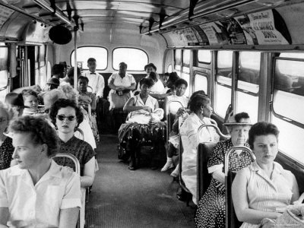
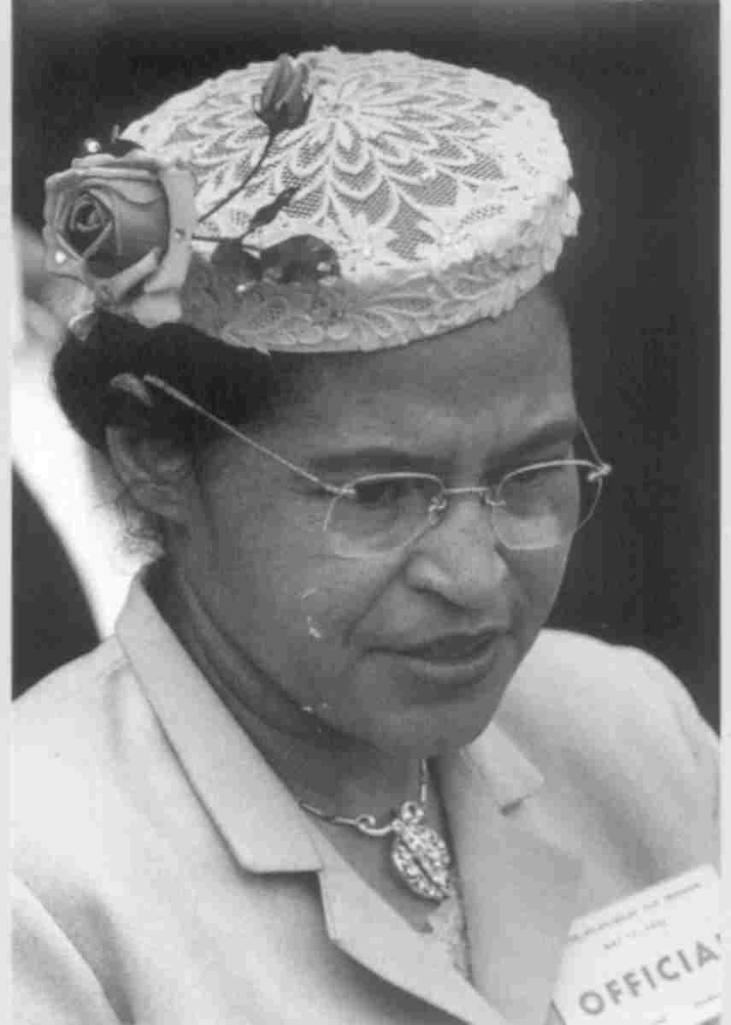
1955 Rosa Parks triggers Montgomery Bus Boycott
Parks refuses to give up seat to white man
Rev. Martin Luther King, JR. emerges as a Civil Rights leader
Heads the “Southern Christian Leadership Conference
Montgomery blacks boycott bus system
Buses are desegregated after a S.C. ruling
Notes:
Some black activists used direct action instead of using courts
According to Montgomery, Alabama law – black passengers had to give up bus seats to whites
1955 – Rosa Parks refuses to do so
Arrested and fined $10
Black community responded with Montgomery Bus Boycott
Blacks made up 75% of bus riders
Refused to ride until changes made in segregation policies – would drive bus co. out of biz
Boycott led by 26-year-old Martin Luther King Jr.
Believed in non-violent protests
Boycott lasted more than a year
Blacks rode bikes, walked, car pooled, etc.
S.C. ruled that segregation in public transportation, as in public education, violated 14th Amendment
All citizens supposed to have “equal protection under the law”
Montgomery Bus Boycott led to an end to segregation on buses within states
Also the beginning of King’s career as a civil rights activist

Slide 7
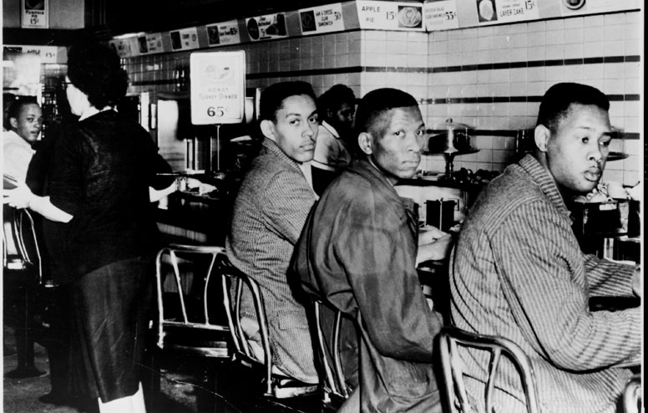
1960 Sit-in Demonstrations Greensboro, N.C.
Student Nonviolent Coordinating Committee (SNCC) formed by Stokely Carmichael to create other sit-ins
Applied Gandhi’s & Thoreau’s non-violent civil disobedience
4 black students sit at “whites only” counter in protest of segregation
Notes:
Up until 1955, the CRM was fought mainly in the courts
Court actions not bringing change fast enough
Shifted to direct nonviolent action
Violent white response to black nonviolent protest drove many more people to become sympathetic to the CRM
Sit-ins
Started in Feb. 1960
Blacks protesting segregated lunch counters
Protesters sat at the lunch counters until served
No violence, no loud speeches, just sitting
Branched out to other segregated facilities
Hotels, parks, beaches, libraries, etc
Led to formation of SNCC by Stokely Carmicheal. SNCC coordinated further sit-ins throughout the south.

Slide 8
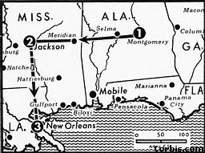
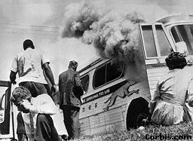
The Freedom Rides - 1961
Sponsored by Congress of Racial Equality (CORE)
Testing 1960 Sup. Ct. ruling on segregation in interstate travel
Freedom riders attacked in Alabama
Attn. Gen. Robert Kennedy sent federal marshals to protect riders
Called on I.C.C. to order integration of all transportation and related facilities
Notes:
Freedom Rides - 1961
Sponsored by Congress of Racial Equality (CORE)
Blacks & sympathetic whites rode buses, testing 1960 Sup. Ct. decision (Boynton v. Virginia) outlawing segregation in interstate travel
Freedom riders attacked in Alabama
Local police did nothing
Violence increased - Attorney General Robert Kennedy sent federal marshals to protect riders
Called on Interstate Commerce Commission to order integration of all transportation and related facilities
No more white/black only in transportation

Slide 9
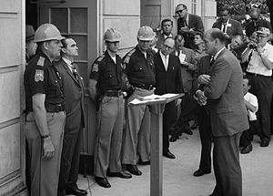
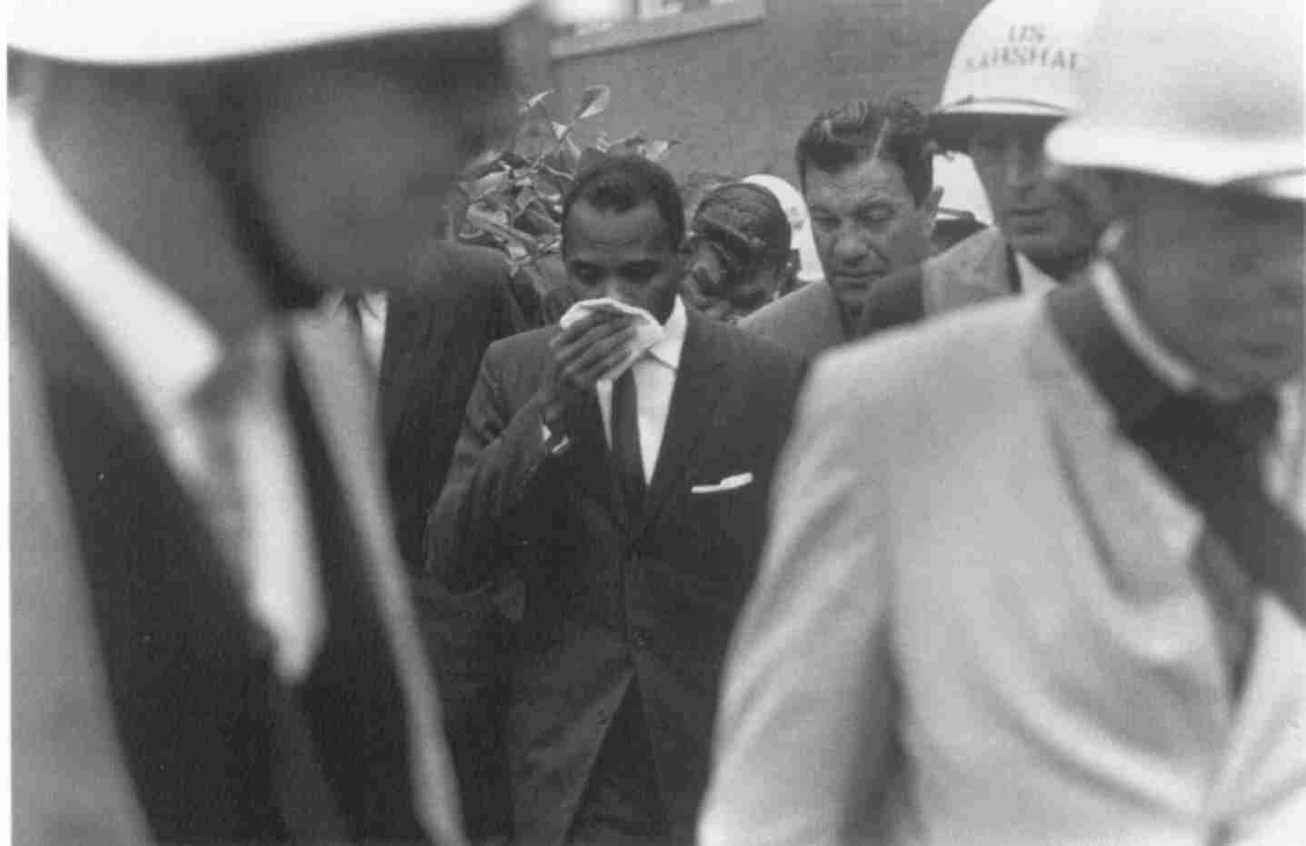
University Desegregation
James Meredith enrolls in U. of Miss.
Due to Oct. 62, fed. court order
Miss. Gov. Ross Barnett refused to enforce order
JFK sent troops to ensure compliance
Gov. George Wallace stood in doorway of U. of Alabama to bar black students
Federal marshals convince him otherwise!

Slide 10
1963 March on Washington
Over 250K blacks and whites
In support of JFK Civil Rights Bill
MLK speech before Lincoln Memorial
“I have a dream

Slide 11
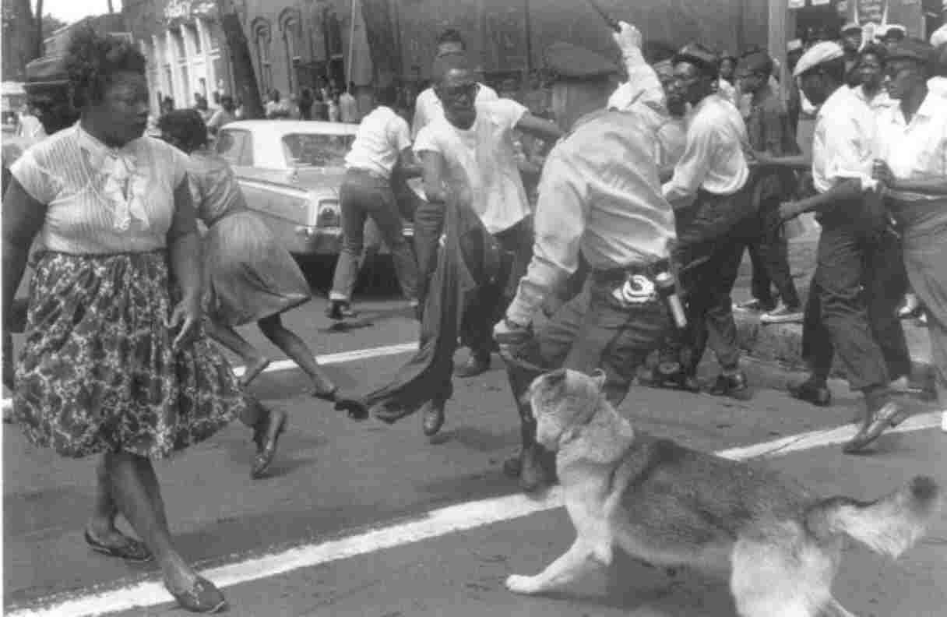
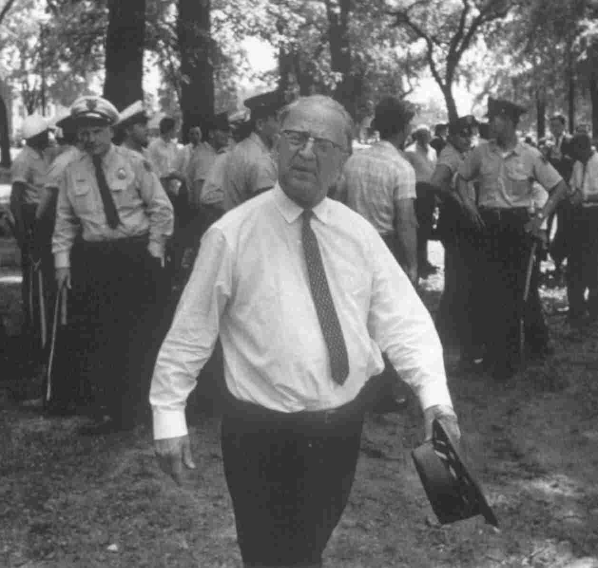
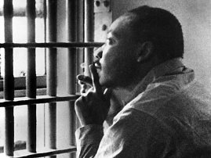
Birmingham
Scene of violent reaction to nonviolent protests led by SCLC
Police Chief Eugene “Bull” Conner reacted with dogs and fire hoses
International press covers events
King arrested
Letter from Birmingham City Jail
Call for more urgent action against violence and segregation against African Americans
Notes:
While blacks protested nonviolently – whites frequently reacted violently
Birmingham, Alabama the most notorious southern city
Police Commissioner T. Eugene “Bull” Conner forbid blacks from protesting in the city
When blacks marched, police used dogs and high pressure fire hoses on marchers
Violent response to peaceful, unresisting marchers was seen by millions on TV
Helped win more sympathy for the CRM
MLK among those arrested.
While in jail, MLK wrote a letter to local clergymen who were critical of King for creating disorder in the city
King’s letter argued that people had the moral responsibility to disobey unjust laws
Letter widely read - adds to King’s reputation as a great moral leader

Slide 12
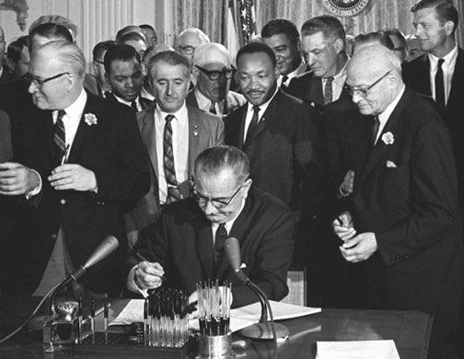
Kennedy on Civil Rights
Contributions were generally modest
Worried about political fallout in South
Actively enforced existing laws
Asked Congress to pass a civil rights bill
Passes (post mortem at urging of President Johnson) in 1964 as Civil Rights Bill of 1964
Turns out to be the most significant civil rights legislation of the movement
Notes:
At first, Kennedy made modest contributions to the CRM
March 1961 – established Committee on Equal Employment Opportunity
Encourage more hiring of African Americans
Called for an end to literacy tests and poll taxes
1962 – Congress passed 24th Amendment (Ratified in 1964)
Prohibits states from requiring citizens to pay poll tax
Nov. 1962 – issued executive order banning discrimination in federal housing
After the violence in Birmingham and other southern cities, JFK became more focused on federal civil rights laws
By October 1963, JFK introduced into Congress the Kennedy Civil Rights Bill
Following the death of JFK in Nov. 1963 – President Lyndon Johnson carried on the CRM
A southerner from Texas who promised to carry on with JFK’s civil rights work
Worked to secure passage of Kennedy Civil Rights Bill
Spring 1964 – Civil Rights Act of 1964 became law
Most significant legislation of the movement
Prohibited discrimination because of race, color, religion and national origin
Prohibited segregation
Outlawed different voting standards for whites and blacks
Prohibited discrimination in employment
Equal Employment Opportunity Commission

Slide 13
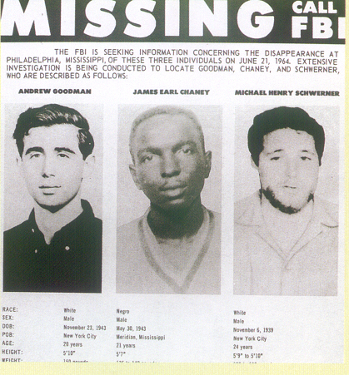
Freedom Summer - 1964
Major voter registration drive in South
Volunteers (white and black) subjected to threats & violence by southern whites
3 dead, 80 wounded by end of summer
80K black voters registered to vote
Notes:
Summer 1964 – Freedom Summer
White volunteers from north came to Mississippi to help register black voters
Volunteers subjected to threats and acts of violence by southern whites
Three volunteers (James Cheney, Andrew Goodman, and Michael Schwerner) disappeared from Phila. Miss. In June 1964.
Murdered by the KKK
Killers eventually caught and convicted
By end of summer – 3 dead, more than 80 wounded
80,000 African American voters registered

Slide 14
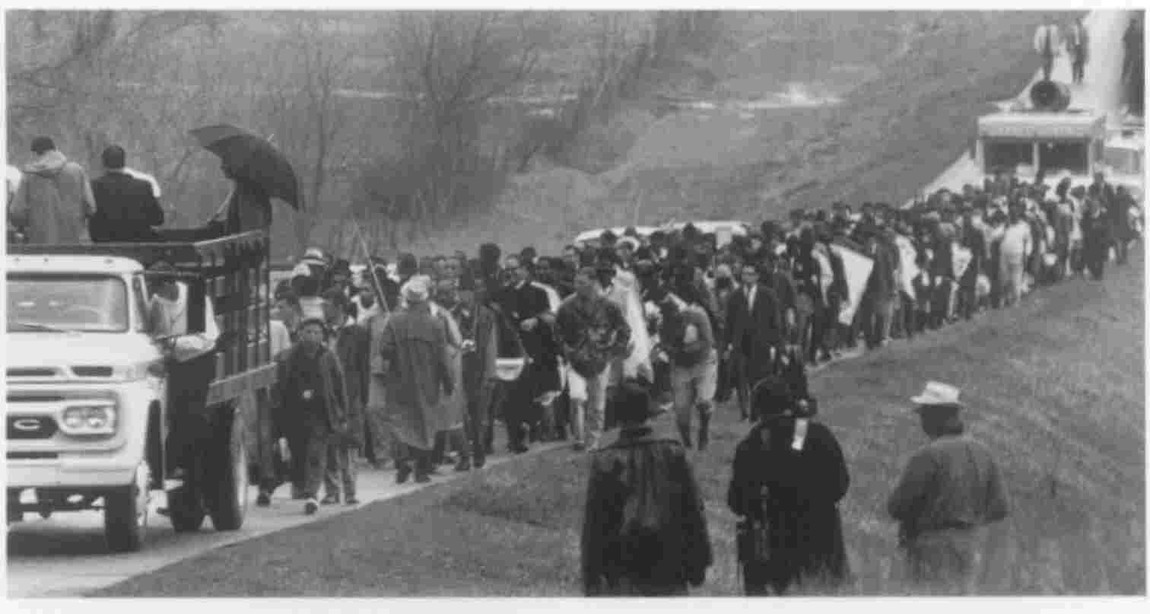
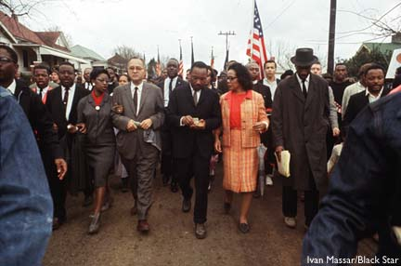
Selma, AL - 1965
January 1965 – MLK launched voter reg. drive in Alabama
To focus natl. attention on violations of Civ. Rights Act of 1964
5-day march w/ 100s of protesters from Selma to capital of Montgomery
Marchers assaulted by white police
Violent response by whites captured on TV – adds sympathy to marchers
Notes:
January 1965 – MLK launched registration drive in Alabama
Wanted to focus national attention on lack of rights there
Highlight – 5-day march with hundreds of protesters from Selma to capital of Montgomery
Marchers had to be protected by federal troops
Violent response by whites captured on TV – adds sympathy to the marchers

Slide 15
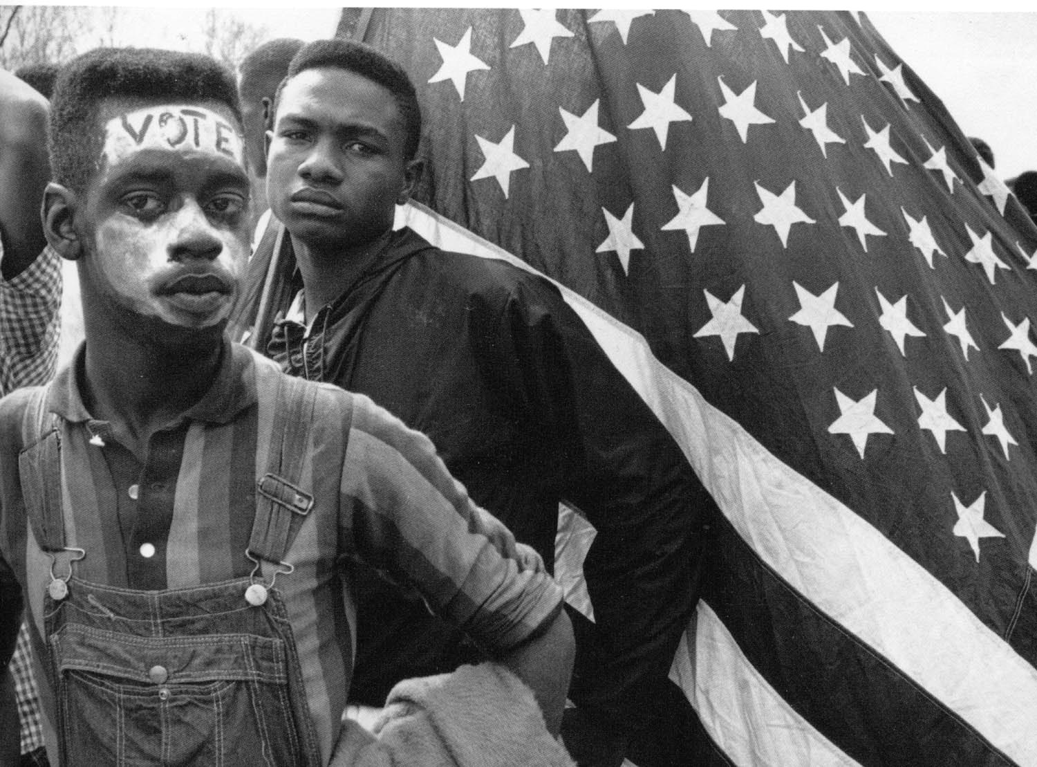
Voting Rights & Affirmative Action
August 1965 – Voting Rights Act
Eliminated literacy test and other voter qualifications in states and counties
Gave federal govt. power to register black voters in the states
Gave federal govt. power to investigate voting discrimination
Affirmative Action - 1965
Exec. Order calling for guarantee of minority representation in employment
Notes:
The term affirmative action was first used by President Lyndon B. Johnson in a 1965 executive order. This order declared that federal contractors should “take affirmative action” to ensure that job applicants and employees “are treated without regard to their race, color, religion, sex, or national origin.” While the original goal of the civil rights movement had been “color-blind” laws, simply ending a long-standing policy of discrimination did not go far enough for many people. As President Johnson explained in a 1965 speech, “You do not take a person who for years has been hobbled by chains and … bring him up to the starting line of a race and then say, ‘you are free to compete with all the others’ and still justly believe that you have been completely fair.”
President Richard Nixon was the first to implement federal policies designed to guarantee minority hiring. Responding to continuing racial inequalities in the workforce, in 1969 the Nixon Administration developed the Philadelphia Plan, requiring that contractors on federally assisted projects set specific goals for hiring minorities. Federal courts upheld this plan in 1970 and 1971.

Slide 16
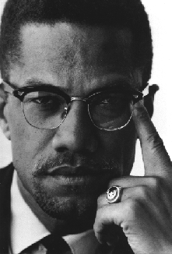
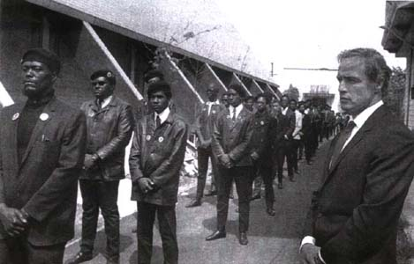
The Movement Becomes Militant
Malcolm X & the Black Muslim Movement
Black nationalist who favored separation
approach differed from MLK - violence okay
Malcolm X began moderating his views
Assassinated in 1965
Huey Newton & the Black Panthers
stressed “Black Pride”
Less whites in the militant movement
Notes:
A new leader emerged on the Civil Rights scene
Malcolm Little (AKA Malcolm X)
Early legal trouble put him in jail where he became involved in the Black Muslim movement, led by Elijah Muhammad
Believed in Black Nationalism
Blacks should separate themselves from whites
Integration would not work – blacks always lose
Blacks should have own businesses, political leaders and parties
Black Nationalists stressed African American pride
Most important difference from MLK – blacks should fight back if necessary
“Self defense is not violence; it’s intelligence”
The movement was popular in the urban north
In time, Malcolm X reevaluated his beliefs – began to see value of black/white cooperation
Angered radical members of Black Muslims
Malcolm X assassinated in February of 1965
Most likely by radical Black Muslims
The Black Panthers and Huey Newton
“Black Power” movement peaked in late 60’s
Black Panther Party formed in Oakland, CA
Believed in self-defense and political & economic independence
Concentrated on educating blacks, registering voters, running candidates for office
Also patrolled neighborhoods with weapons – resisting harassment by white police
BPP brought about positive change but always had the reputation as violent radicals

Slide 17
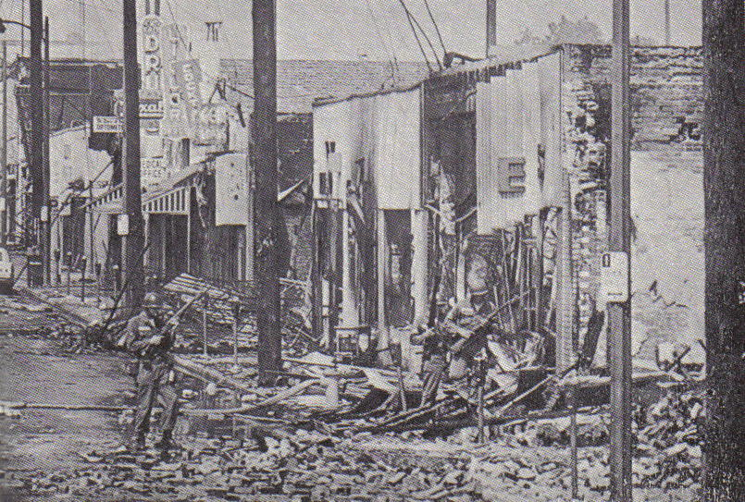
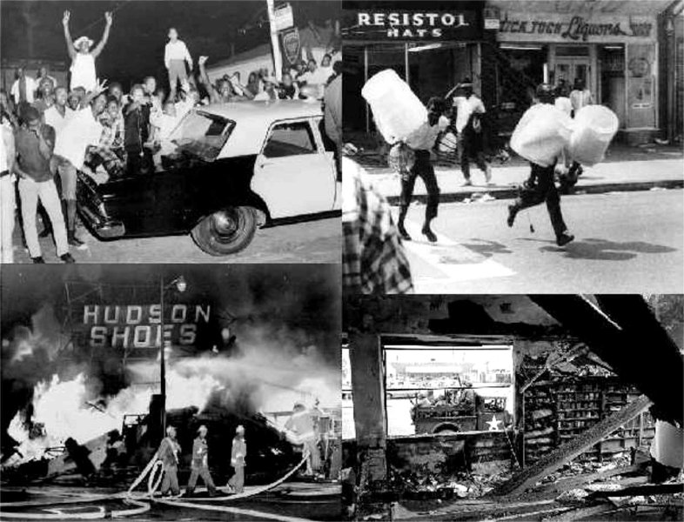
Urban Race Riots
Race riots erupted in U.S.
Bad conditions in cities = frustration & violence
August 1965 – Watts riot (Los Angeles) – 6 days of rioting, looting, violence
35 dead - $200 million in damage
Similar instances in other cities
1967–68 - 75 race riots in U.S.
Assassination of MLK led to 40 riots

