Slide 1
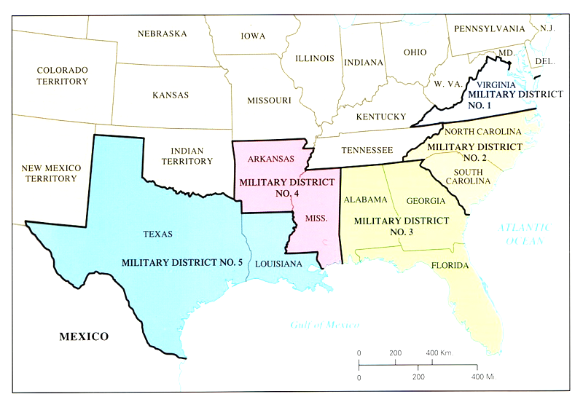
Radical Reconstruction
1867-1877

Slide 2
An Account of a Confederate Surrender
There was, as ever, a skeleton at the feast, in the person of a general officer who had recently left Germany to become a citizen and soldier of the United States. This person, with the strong accent and idioms of the Fatherland, comforted me by assurances that we of the South would speedily recognize our ignorance and errors, especially about slavery and the rights of States, and rejoice in the results of the war. In vain Canby and Palmer tried to suppress him...
Gen. Richard Taylor, CSA
(Son of President Zachary Taylor)

Slide 3
An Account of a Confederate Surrender
I apologized meekly for my ignorance, on the ground that my ancestors had come from England to Virginia in 1608, and, in the short intervening period of two hundred and fifty-odd years, had found no time to transmit to me correct ideas of the duties of American citizenship. Moreover, my grandfather, commanding the 9th Virginia Regiment in our Revolutionary army, had assisted in the defeat and capture of the Hessian mercenaries at Trenton, and I lamented that he had not, by association with these worthies, enlightened his understanding…
Gen. Richard Taylor, CSA
(Son of President Zachary Taylor)

Slide 4
Waving the “Bloody Shirt”
Someone has to be responsible...
...and the loser is a convenient culprit.
Photo Credit: Wendy Nelson Photography

Slide 5
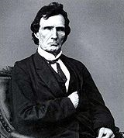
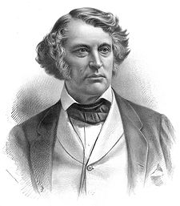
“Radical” Republicans
Thaddeus Stevens (PA)
HOUSE
Charles Sumner (MA)
SENATE

Slide 6
Conservatism vs. Radicalism
CONSERVATIVE | MODERATE | RADICAL
PRESERVE INSTITUTIONS Gradual Change (Reluctant) REFORM To improve and strengthen institutions | BALANCE | ADVANCE AGENDA Immediate Change (Enthusiastic) REFORM To maintain, modify, destroy, or replace institutions in order to advance agenda

Slide 7
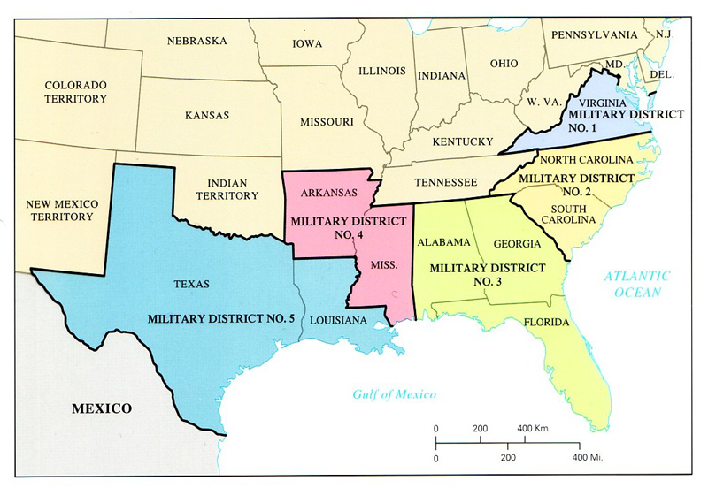
Conquered Provinces
The Radicals proposed dividing the former Confederate states (minus Tennessee) into five military districts.

Slide 8
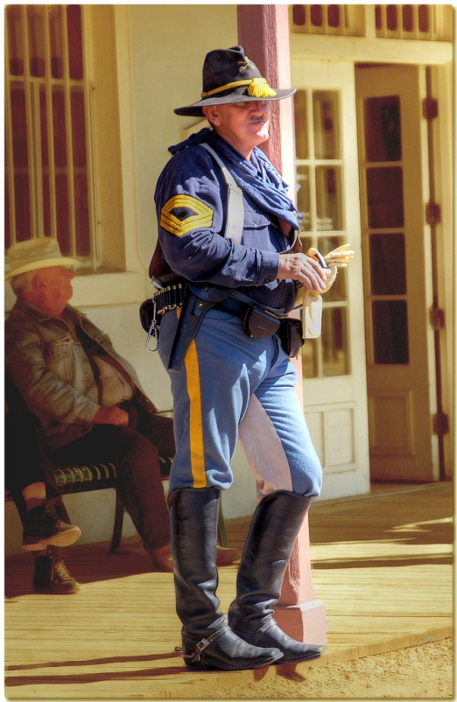
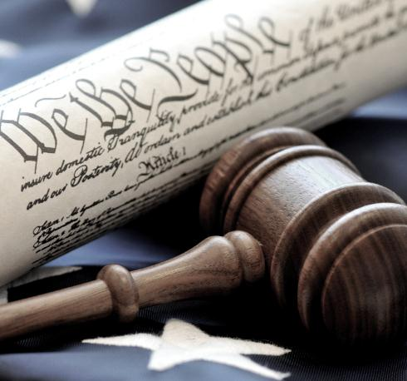
Reconstruction Acts
1867-1868
1
2
3
Military Occupation of the South
IMMEDIATE Suffrage
for African Americans
Forced Ratification
of the Fourteenth Amendment
Photo Credits: Peter Clark (soldier)
FutUndBeidl (ballot box)

Slide 9
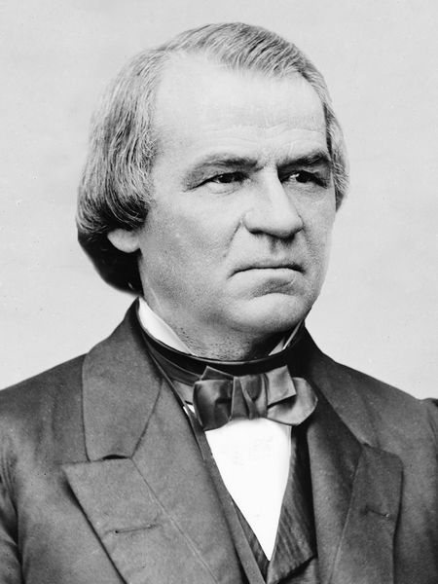
An Exercise in Futility
Congress overrode all of Johnson’s vetoes of the Reconstruction Acts.

Slide 10
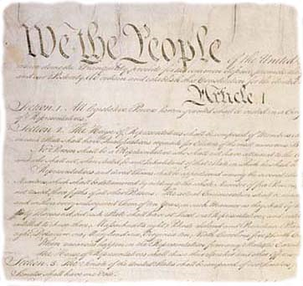
Fourteenth Amendment
Ratified July 9, 1868
Section 1. All persons born or naturalized in the United States… are citizens of the United States and of the State wherein they reside. No State shall make or enforce any law which shall abridge the privileges or immunities of citizens of the United States; nor shall any State deprive any person of life, liberty, or property, without due process of law; nor deny to any person within its jurisdiction the equal protection of the laws.
RECONSTRUCTION AMENDMENTS:
13
14
15

Slide 11
Fourteenth Amendment
Ratified July 9, 1868
Section 2. …when the right to vote at any election for the choice of electors for President and Vice President of the United States… is denied to any of the male inhabitants of such State, being twenty-one years of age, and citizens of the United States, or in any way abridged, except for participation in rebellion, or other crime, the basis of representation therein shall be reduced in the proportion …
RECONSTRUCTION AMENDMENTS:
13
14
15

Slide 12
Fourteenth Amendment
Ratified July 9, 1868
Section 3. No one shall be a Senator or Representative in Congress, or elector of President and Vice President, or hold any office, civil or military, under the United States, or under any State, who, having previously taken an oath, as a member of Congress, or as an officer of the United States, or as a member of any State legislature, or as an executive or judicial officer of any State, to support the Constitution of the United States, shall have engaged in insurrection or rebellion against the same, or given aid or comfort to the enemies thereof. But Congress may by a vote of two-thirds of each House, remove such disability.
RECONSTRUCTION AMENDMENTS:
13
14
15

Slide 13
Fourteenth Amendment
Ratified July 9, 1868
Section 4. The validity of the public debt of the United States, authorized by law, including debts incurred for payment of pensions and bounties for services in suppressing insurrection or rebellion, shall not be questioned. But neither the United States nor any State shall assume or pay any debt or obligation incurred in aid of insurrection or rebellion against the United States, or any claim for the loss or emancipation of any slave; but all such debts, obligations and claims shall be held illegal and void.
RECONSTRUCTION AMENDMENTS:
13
14
15

Slide 14
Fifteenth Amendment
Ratified February 3, 1870
Section 1. The right of citizens of the United States to vote shall not be denied or abridged by the United States or by any State on account of race, color, or previous condition of servitude.
RECONSTRUCTION AMENDMENTS:
13
14
15

Slide 15
Reconstruction Amendments
THIRTEENTH
FOURTEENTH
1.
2.
3.
FIFTEENTH
Abolition of Slavery
1. Birthright Citizenship
2. Equal Protection
3. Punish Confederates
Black [Male] Suffrage
RECONSTRUCTION AMENDMENTS:
13
14
15

Slide 16
Impeachment
Photo Credit: Nancy Lehrer

Slide 17
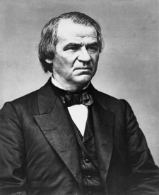
IMPEACHMENT
Tenure of Office Act of 1867
Passed over Veto
Johnson fired Sec. of War
Impeached for violating TOA
35-19 vote in Senate to remove from office
How many would it have taken?
Johnson

Slide 18
IMPEACHMENT
By the Numbers
2 – 1 – 0

Slide 19
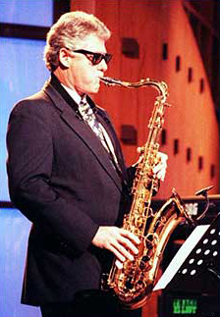
2
Presidents have been impeached by Congress.
Photo Credit: Nancy Lehrer

Slide 20
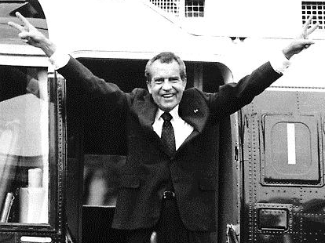
1
President has resigned from office.

Slide 21
0
Presidents have been removed from office.
Notes:
Photo accessed at http://andrewejenkins.wordpress.com/2012/06/08/the-bible-may-be-the-best-truth-we-are-ignoring/ Copyright Unknown

Slide 22
GENERAL AMNESTY
Christmas, 1868
Johnson issued a blanket pardon to Confederates as a lame duck.

Slide 23
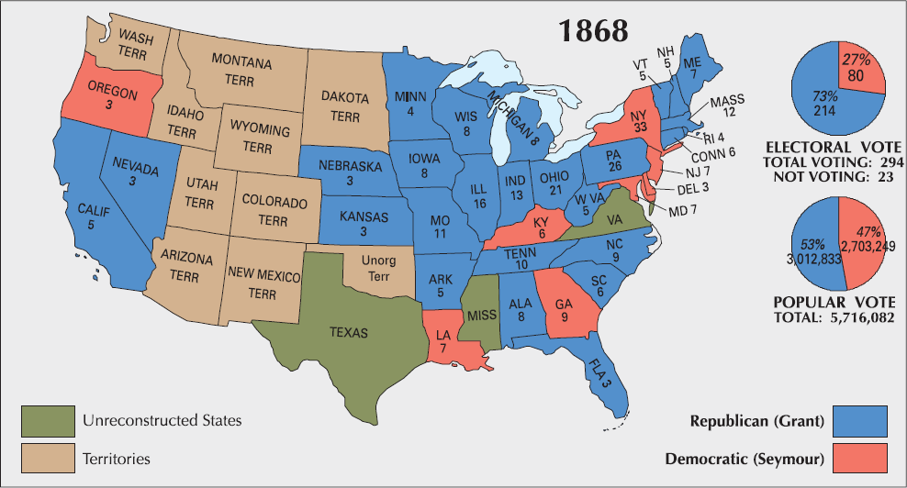
1868 Presidential Election
Democratic Platform
1868
1872
1876
Republican Platform

Slide 24
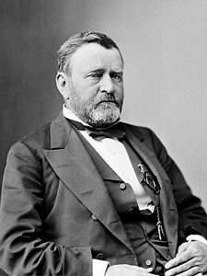
Ulysses S. Grant (R-OH) Eighteenth President of the U.S. 1869-1877
Civil War Hero
Administration’s Legacy:
CORRUPTION
Grant Administration Scandals
Supported Radical Reconstruction Policies
Click for Bio

Slide 25
A Cooperative President
The election of Grant ended the tension between the President and Congress over Reconstruction policy.

Slide 26
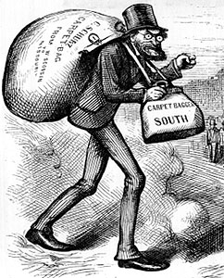
Reconstruction in the South
NEXT UP:
1867-1877

