Slide 1
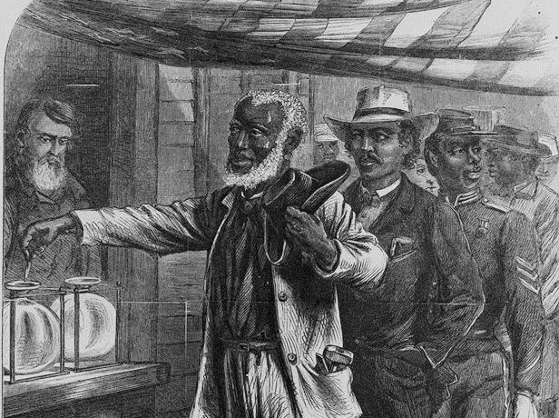
Reconstruction
Goes South
1867-1877

Slide 2

Summarize the end of Reconstruction, including the role of anti–African American factions and competing national interests in undermining support for Reconstruction; the impact of the removal of federal protection for freedmen; and the impact of Jim Crow laws and voter restrictions on African American rights in the post-Reconstruction era.
USHC 3.4

Slide 3
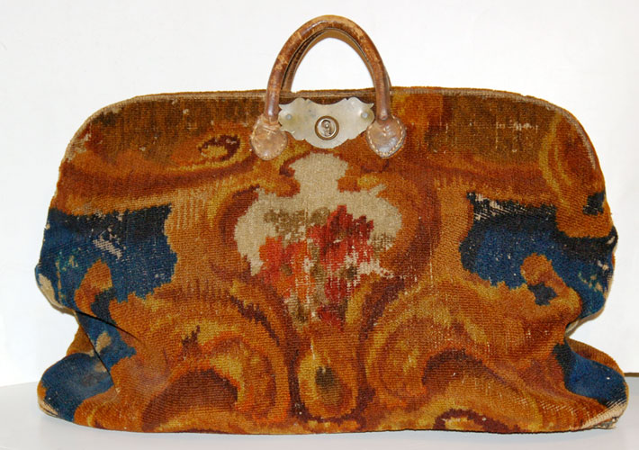
Carpetbag

Slide 4
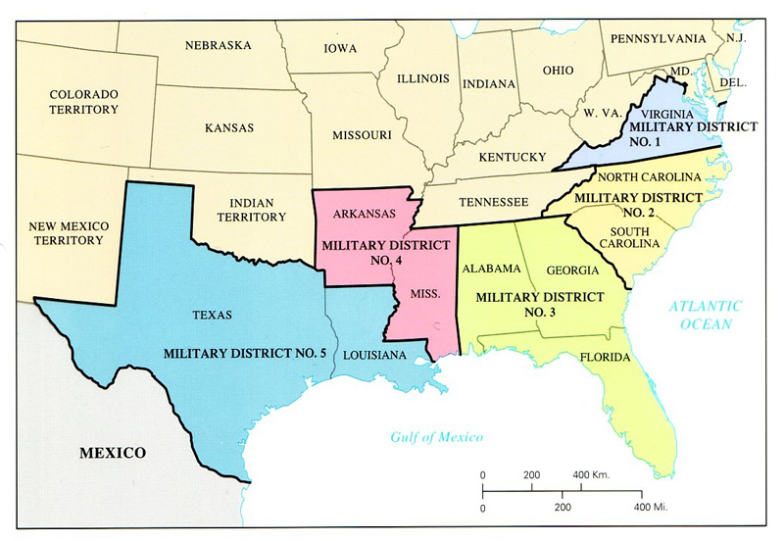
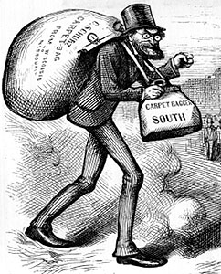
“Carpetbaggers”
Nickname applied by Southern whites to people who migrated South after the Civil War

Slide 5


The “Carpetbagger”
Stereotype
Click to play!

Slide 6
The Motives of the Carpetbaggers
Power
Opportunity
Wealth
Service

Slide 7
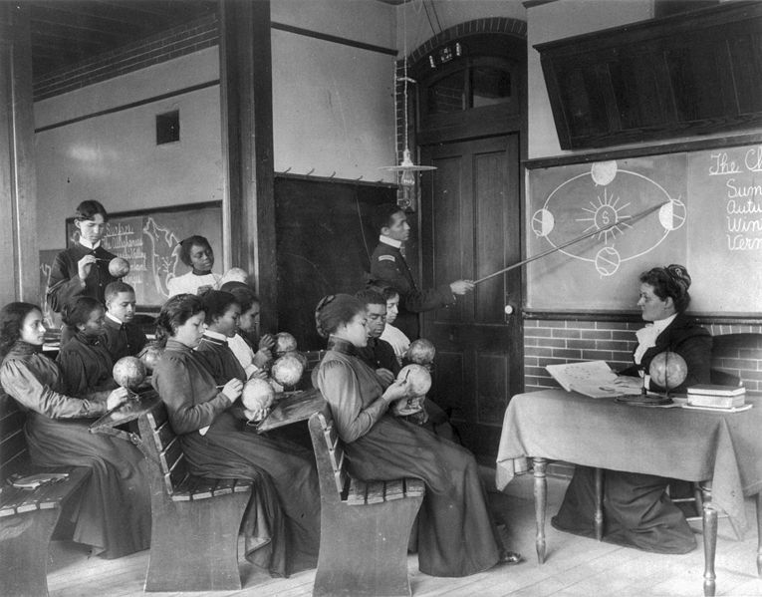
Educating Freedmen and Women
Although many carpetbaggers went South to seek fortune and political office, many went South to educate freedmen and women.
Hampton Institute (VA)
Late Nineteenth Century

Slide 8

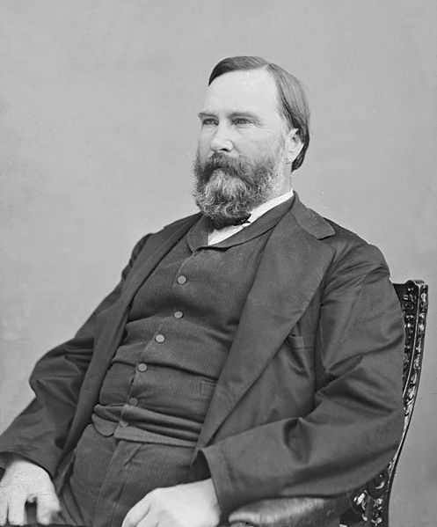
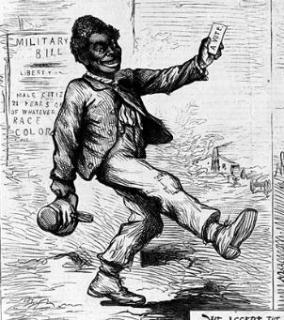
The Republican Coalition
in the South
“Carpetbaggers”
“Scalawags”
Freedmen

Slide 9
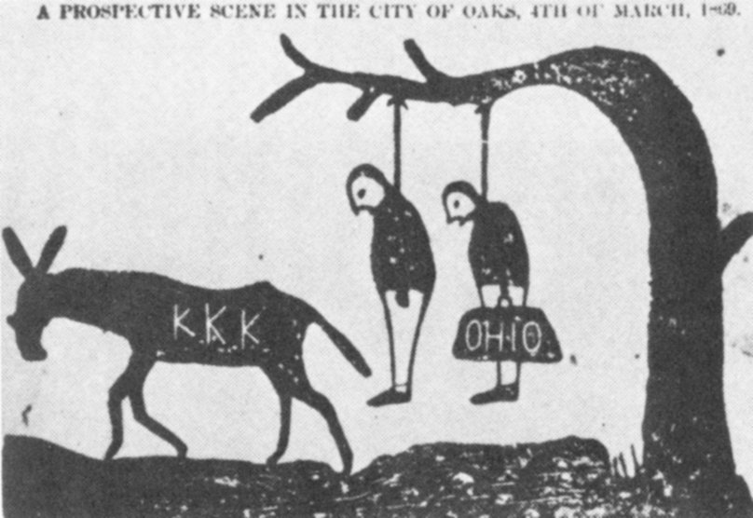
Resistance to Reconstruction

Slide 10
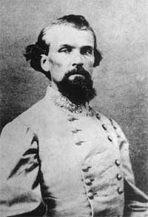
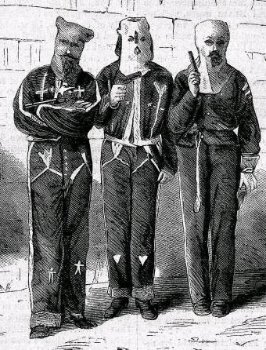
The (First) Ku Klux Klan
1865-1874
Gen. Nathan Bedford Forrest, CSA
Vigilantism

Slide 11
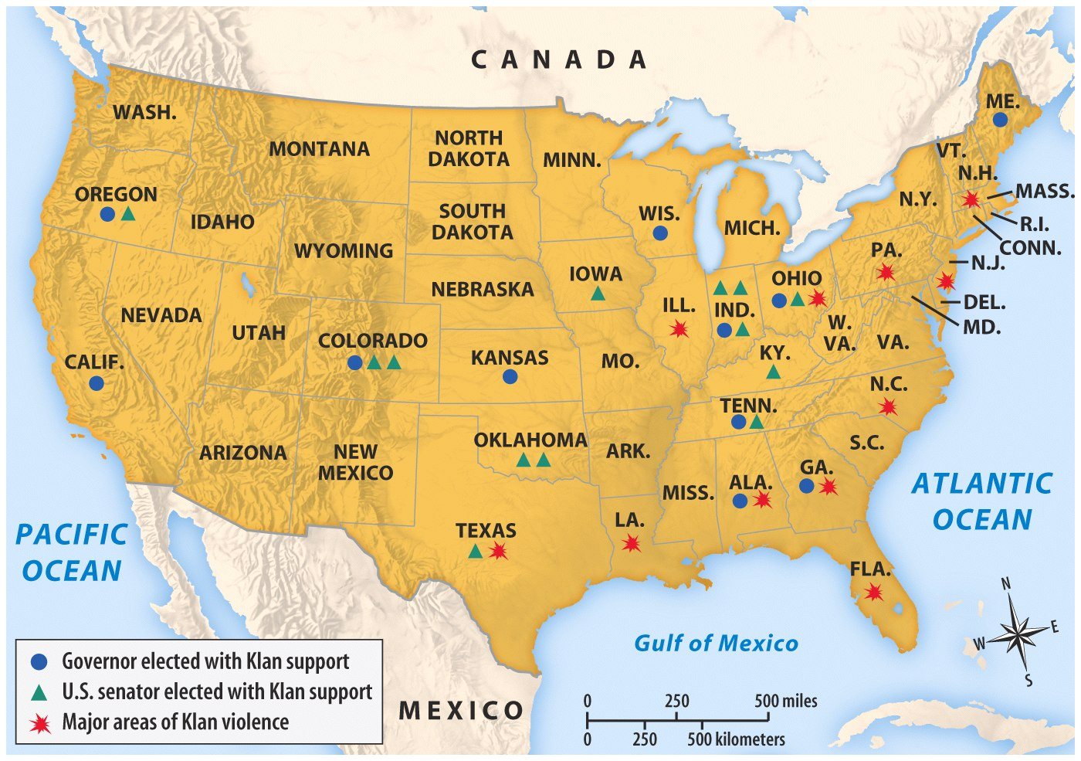
The Second Ku Klux Klan

Slide 12
The Two Klans “Kompared”
 | The First Ku Klux Klan | The Second Ku Klux Klan
Time Period | Reconstruction | 1920s
Regional Prevalence | South | Midwest, South
Purpose | Oppose carpetbagger governments | Oppose immigration, Catholicism, black migration
Methods | Intimidation & Violence

Slide 13
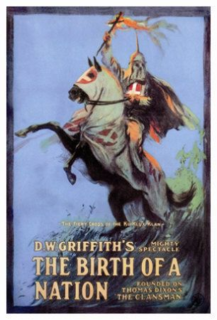
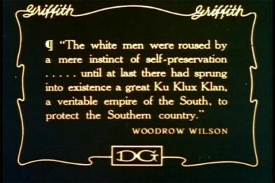
Birth of a Nation
(1915)
Highest grossing silent film EVER
Glamorized the KKK
  Responsible for rise of Second KKK?

Slide 14
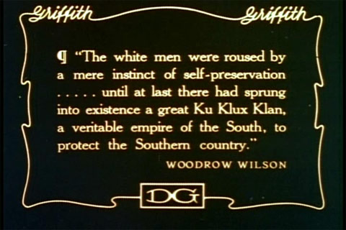
From Birth of a Nation

Slide 15
Birth of a Nation
(1915)
CLIP ONE
VIEW CLIP
NOTE: The inclusion of this video footage is for educational purposes and is not intended to endorse the views and perspectives contained therein.

Slide 16
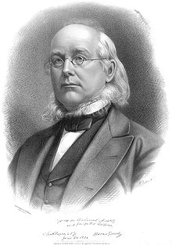
1872 Presidential Election
Republican Split
  Radicals vs. Moderates
Horace Greeley
  Liberal Republican party
    Opposed Radical Reconstruction and government corruption
    Democrats Back Greeley

Slide 17


Slide 18
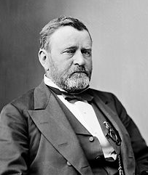
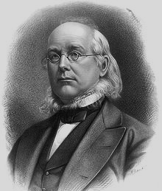
You Win.
You Die.

Slide 19
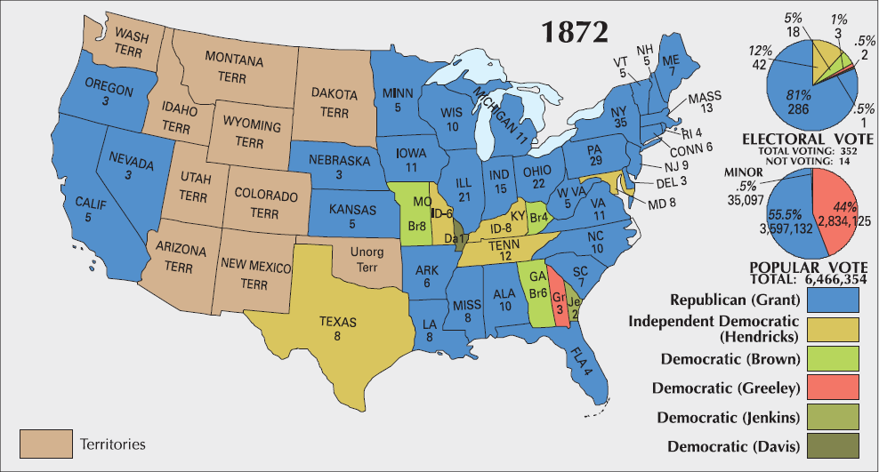
1872 Presidential Election
1868
1872
1876

Slide 20

Birth of a Nation
(1915)
CLIP TWO
NOTE: The inclusion of this video footage is for educational purposes and is not intended to endorse the views and perspectives contained therein.

Slide 21
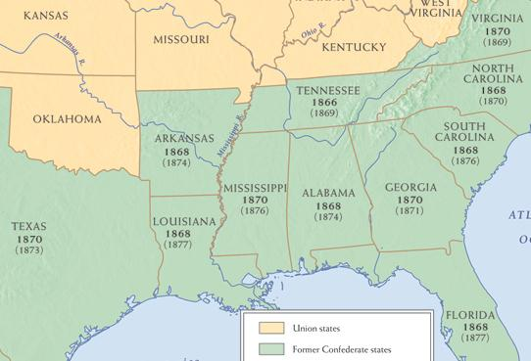
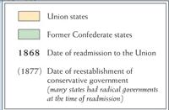

Restoration of Southern “Home Rule”
1869-1877
1869
1870
1869
1874
1877
1876
1874
1871
1873
1877
1877

Slide 22
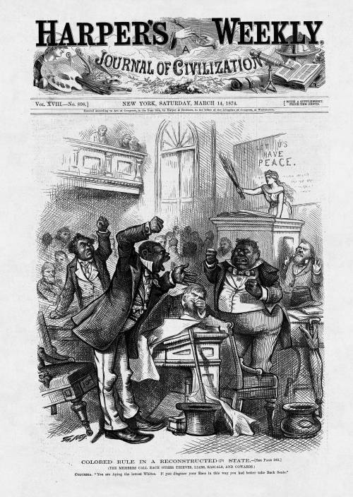
1874
Northern public opinion turns against Radical Reconstruction.
Perception of
“Colored Rule”
and corruption in the South under Carpetbag state governments
http://blackhistory.harpweek.com/7illustrations/reconstruction/coloredrule.htm

Slide 23
1874 Congressional Elections
U.S. House
of Representatives
VOTERS REACT TO:
Bad Economy
Political Corruption
Reconstruction Policy

Slide 24
Birth of a Nation
(1915)
CLIP THREE
NOTE: The inclusion of this video footage is for educational purposes and is not intended to endorse the views and perspectives contained therein.

Slide 25
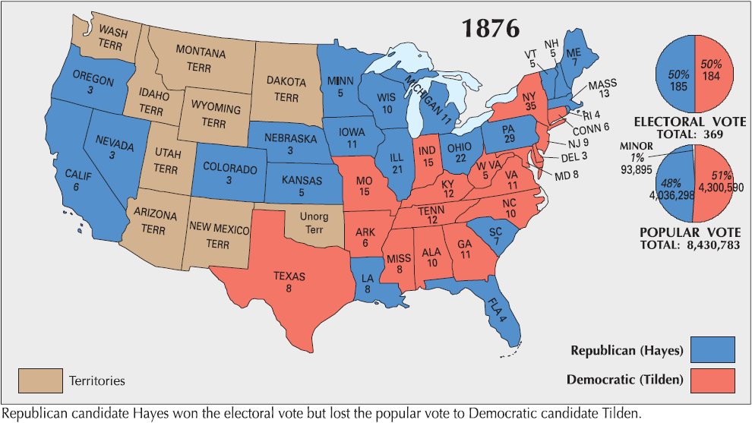
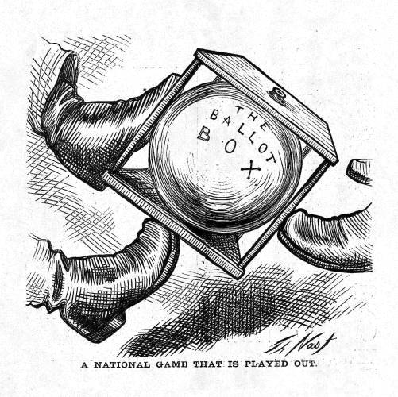
1876 Presidential Election
Tilden: 184
Hayes: 166
Disputed: 19
FTW: 185
Democratic Platform
Republican Platform
1868
1872
1876

Slide 26
http://elections.harpweek.com/controversy.htm

Slide 27
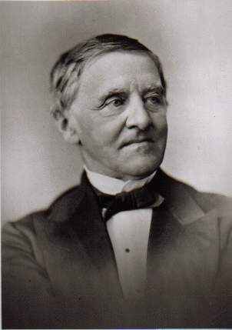
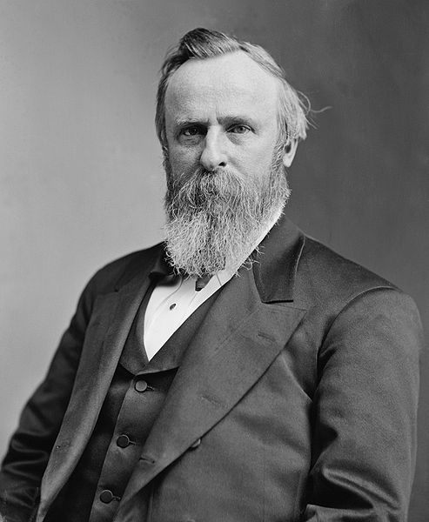
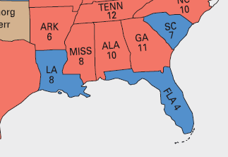

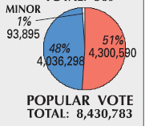

Compromise of 1877
DISPUTED ELECTION
184
166
Samuel Tilden
(D-NY)
Rutherford B. Hayes
(R-OH)
185
“Rutherfraud”
Notes:
By 1876, South Carolina, Louisiana, and Florida were the only states that still had garrisons of federal troops supporting the Republican state governments through force of arms. All three states had disputed election returns due to massive fraud by both parties. An Electoral Commission, voting on party lines, certified the election for Hayes, who had been twenty votes shy of victory (while Tilden had been only one vote shy). Democrats in Congress staged a filibuster in protest, but a compromise was reached in which the Democrats would accept the result in return for the removal of federal troops from the South and a promise from Hayes not to intervene in the Southern states’ internal politics (i.e., not enforcing the Fifteenth Amendment).

Slide 28
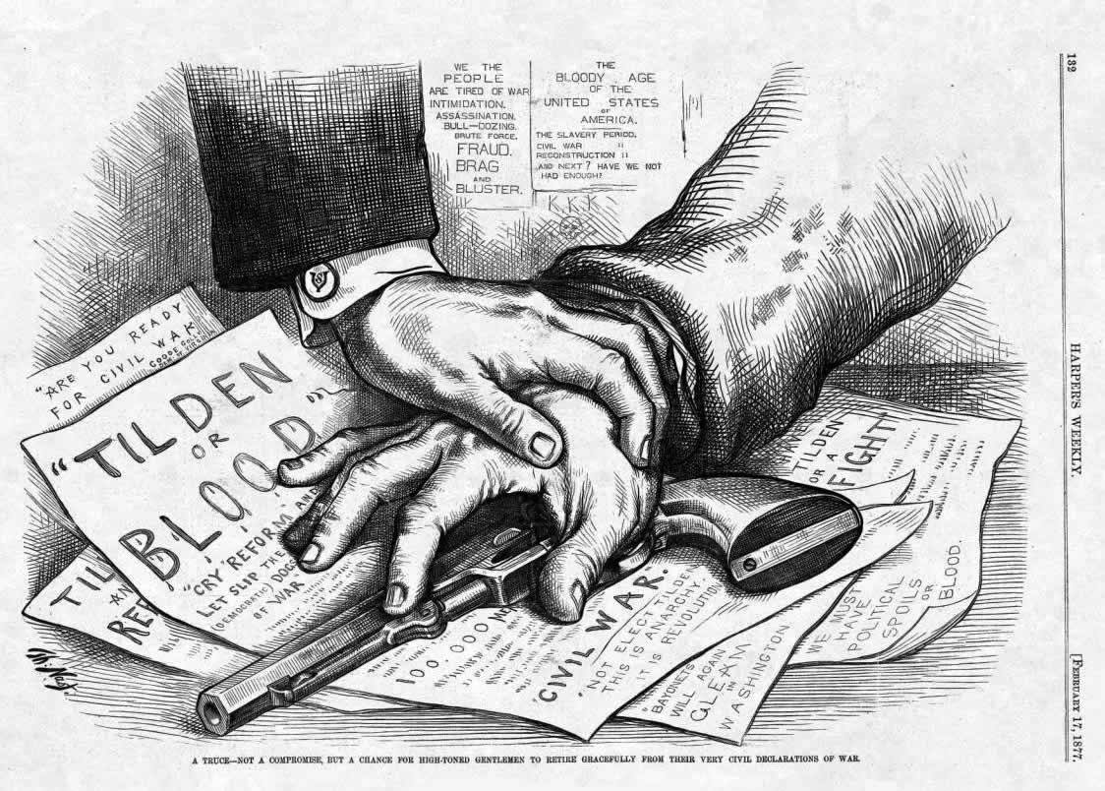

Slide 29
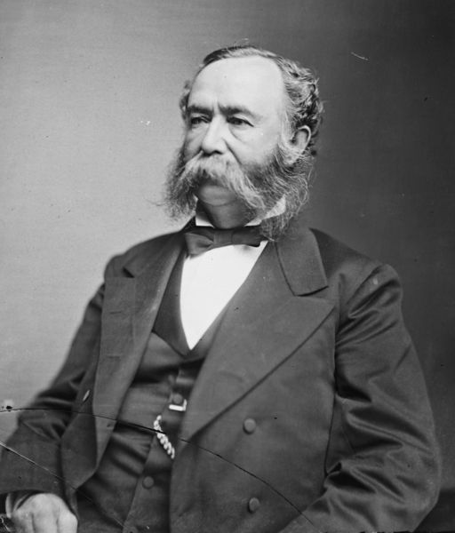
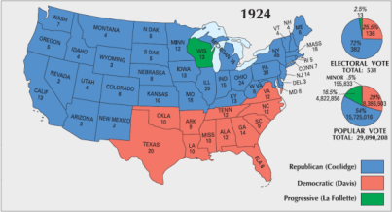
“Redeemer” Governments
Southern White “Bourbon” Democrats re-assert authority
“Solid South”
  DEMOCRATIC STRONGHOLD
    Republican Party a non-entity in Southern politics until the 1960s
Gov. Wade Hampton (SC)

Slide 30

The “Solid South”
Almost 50 Years Later

Slide 31
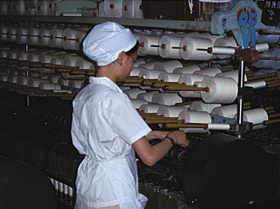
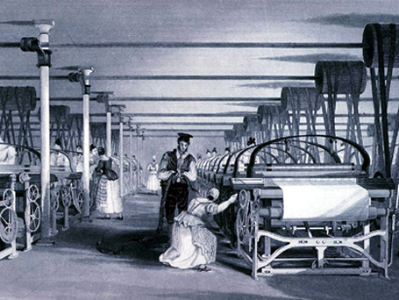
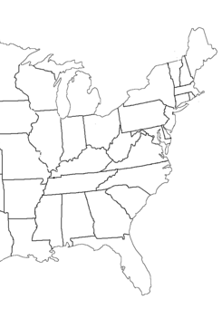
The Textile Industry
Moves South
CHEAP LABOR

Slide 32
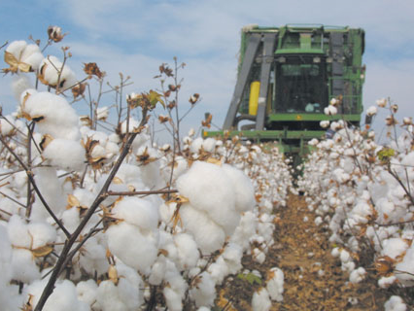
But the South was still primarily agricultural.

Slide 33
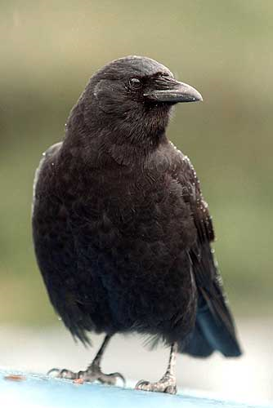
The “New South”
“Jim Crow” Laws
Racial Segregation
Literacy Tests
Poll Tax
Designed to keep Black citizens from voting
Grandfather Clause

Slide 34
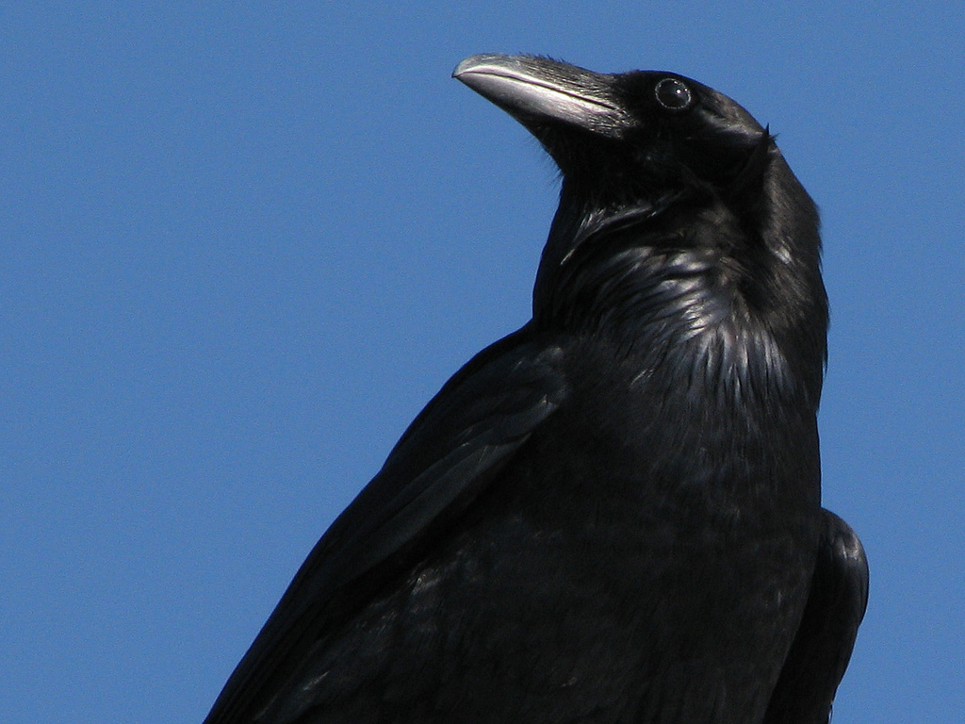
Jim Crow
Photo by stonebird

Slide 35
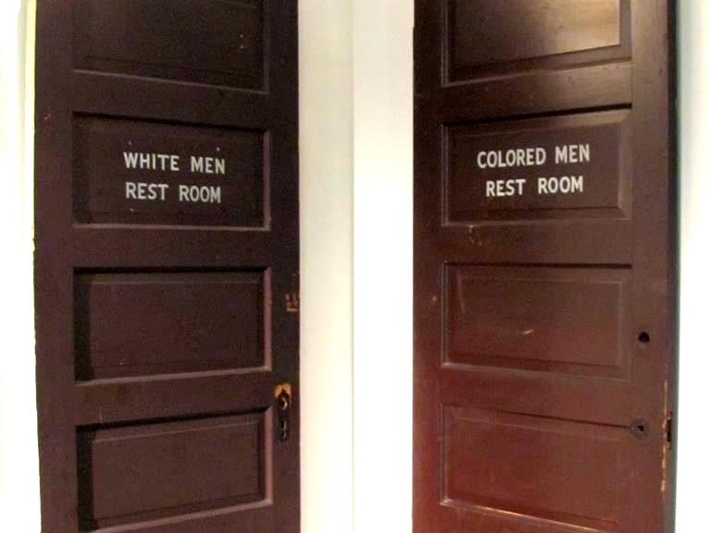
Segregation
Photo by Universal Pops

Slide 36
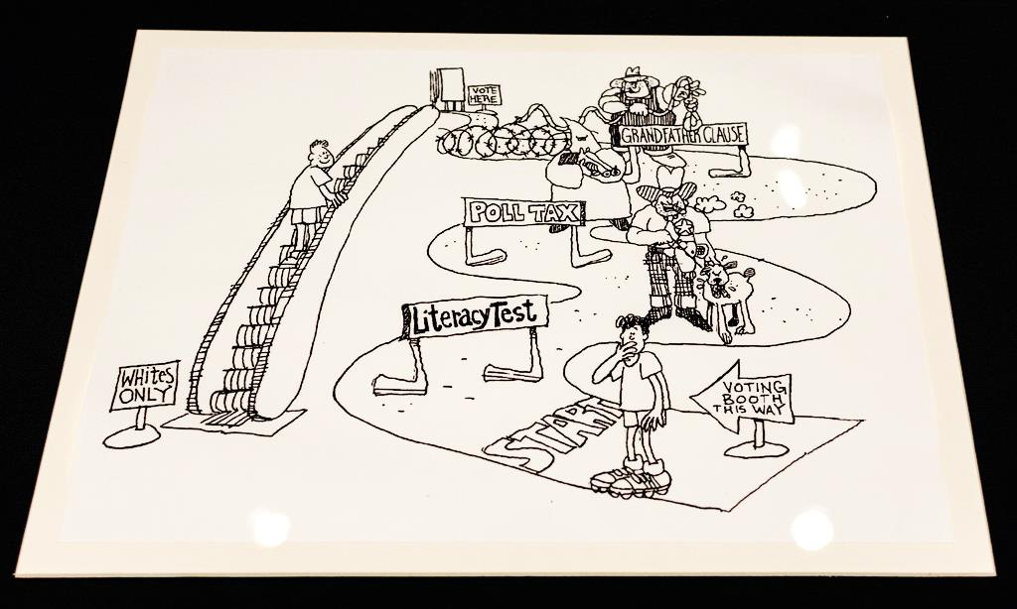
Photo by allesok

Slide 37

Grandfather Clause
Photo by Rene Bastiaanssen

Slide 38
If this guy could vote...
Photo by Rene Bastiaanssen

Slide 39


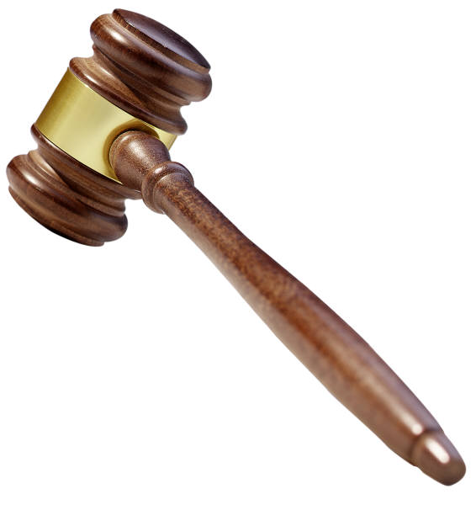
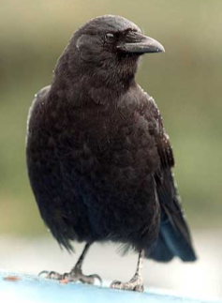

The Supreme Court and Civil Rights
(Late Nineteenth Century)
In the late 19th century, the Supreme Court upheld Jim Crow, as well as restrictions on voting (since these restrictions did not explicitly discriminate based on race).

Slide 40
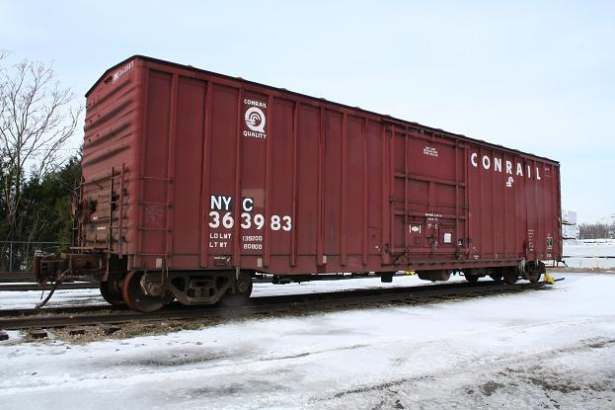
Plessy v. Ferguson
(1896)
Louisiana Racial Segregation Case
“Separate But Equal”
Overturned by Brown v. Board (1954)
14

Slide 41
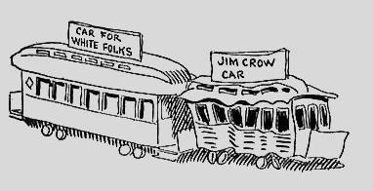
The Reality
1904 political cartoon by John T. McCutcheon

Slide 42








