Slide 1
The Nixon Presidency
1969 to 1974

Slide 2
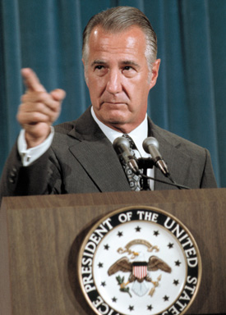
Nixon promises to bring Americans together but...
Vice President Spiro Agnew- attacks the media and the left
The Press:
“Nattering naybobs of negativism”
The Democrats:
“Sniveling hand-wringers”
Nixon thought both were out to get him
Media is off balance - afraid to be critical of Nixon
Notes:
8

Slide 3
Democrats control Congress.
Hard for Nixon to pass legislation
Nixon’s long term goal - make Republicans the majority party.
Notes:
9

Slide 4
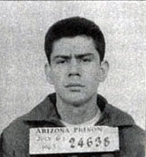
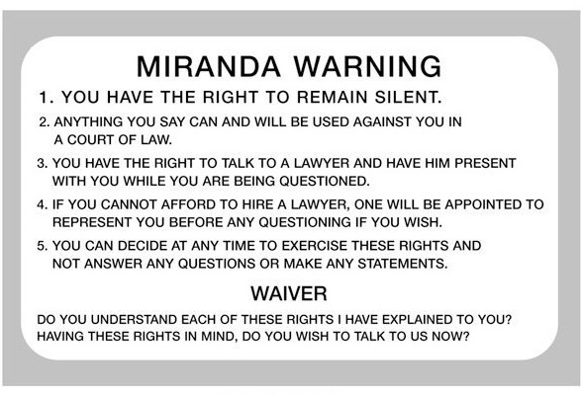
Supreme Court Opposition
Liberal Supreme Court
Led by Earl Warren
Miranda v. Arizona
Police advise a suspect of his/her right to remain silent and have an attorney present during questioning

Slide 5
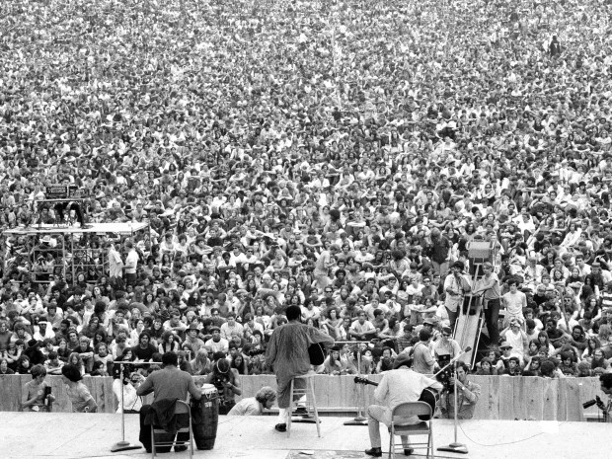
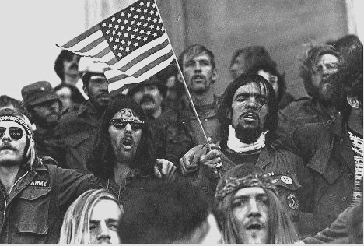
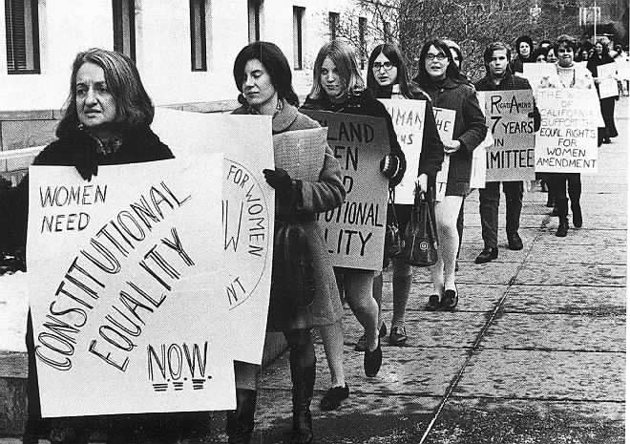
1960s Culture
Reaction against “conformity” of the 1950s
Betty Friedan
The Feminine Mystique
Addresses the myth that women find complete fulfillment staying at home and caring for the family
Counter Culture
Rejection of middle class values and attitudes

Slide 6
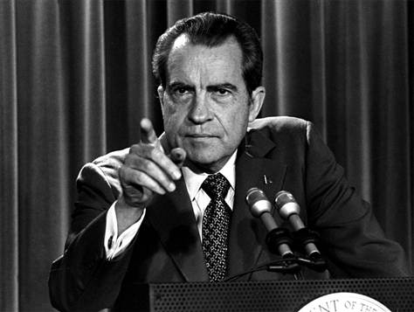
Nixon’s “Southern Strategy”
Turns back on black vote & courts Southern Whites
against extending Voting Rights Act, sought to slow desegregation, filed suits to end busing to deseg. schools
Attacks liberal Warren Supreme Court
Appoints conservative Federal judges.
Senate twice rejected nominees they considered too conservative
Notes:
10

Slide 7
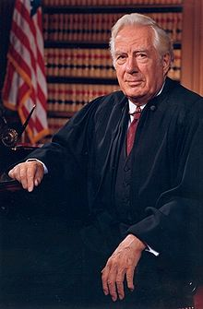
Nixon appoints…
Warren Burger (conservative to replace retiring Earl Warren)
Harry Blackmun (Roe v Wade)
Lewis Powell
William Rehnquist
Shifts court to center-right
Notes:
11

Slide 8
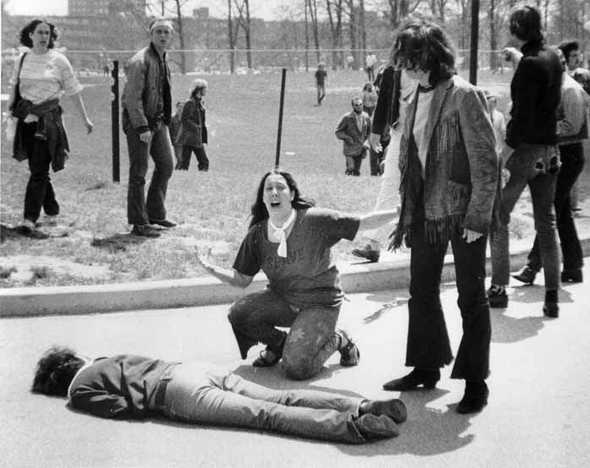
Campus Deaths
Protests at Kent State and Jackson State over Nixon’s decision to send troops into neutral Cambodia results in student deaths.
Notes:
13

Slide 9
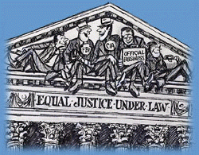
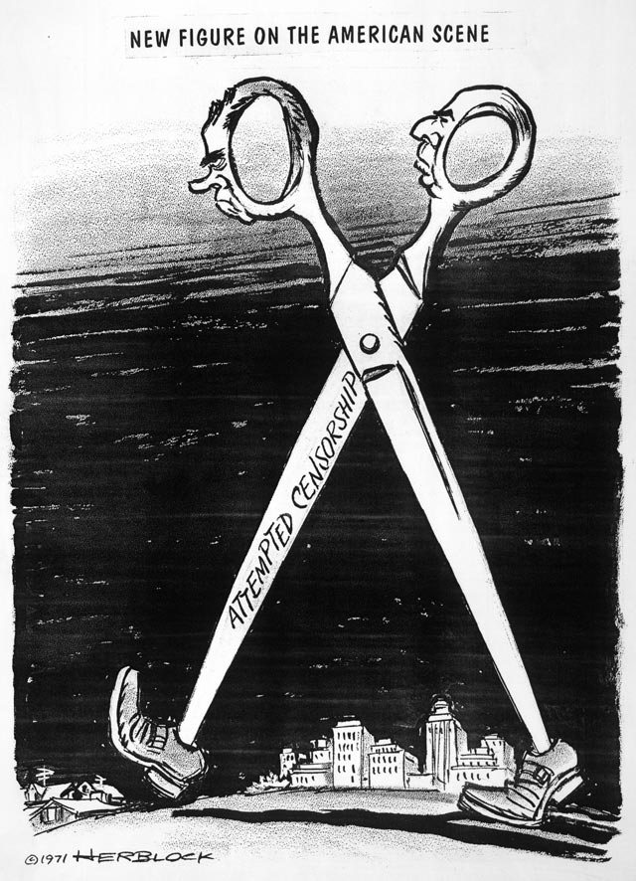
Leaking Files
June 1971 “The Pentagon Papers” published in NY Times
Leaked by Daniel Ellsberg - former Dept. of Defense analyst
Documentary history of U.S. involvement in Vietnam
Not damaging to Nixon but reveals string of U.S. govt. lies that could undermine public trust

Slide 10
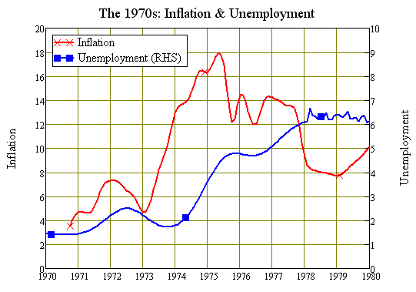
Nixonomics
Inherits cost of Vietnam War & Great Society
Causes “Stagflation” (inflation combined w/ high unemployment)
Fed raises rate to reduce $ in circulation
Inflation hits 5.6% - Nixon imposes wage/price freeze
Devalues the dollar internationally to encourage purchase of U.S. goods
Problems persist throughout 70s
Notes:
15

Slide 11
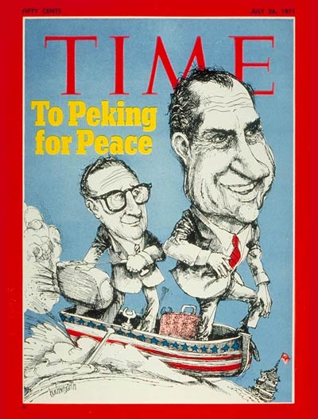
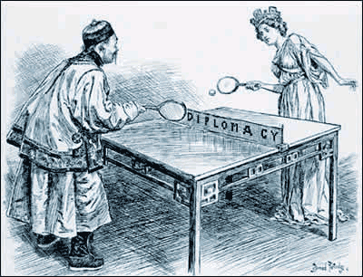
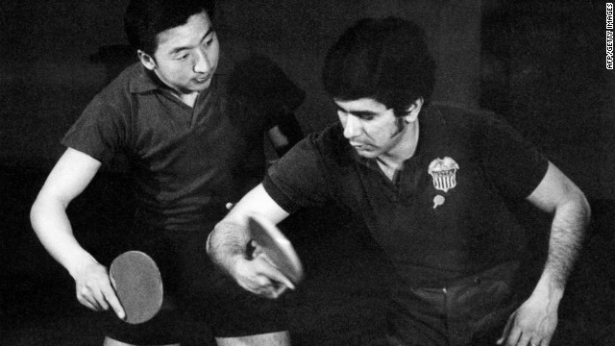
Nixon goes to China – July 1971
Ping Pong Diplomacy of 4/71
Henry Kissinger arranges trip
Nixon 1st sitting President to visit PRC
Nixon plays China off against Soviet Union
Historic opening of relations w/ China

Slide 12
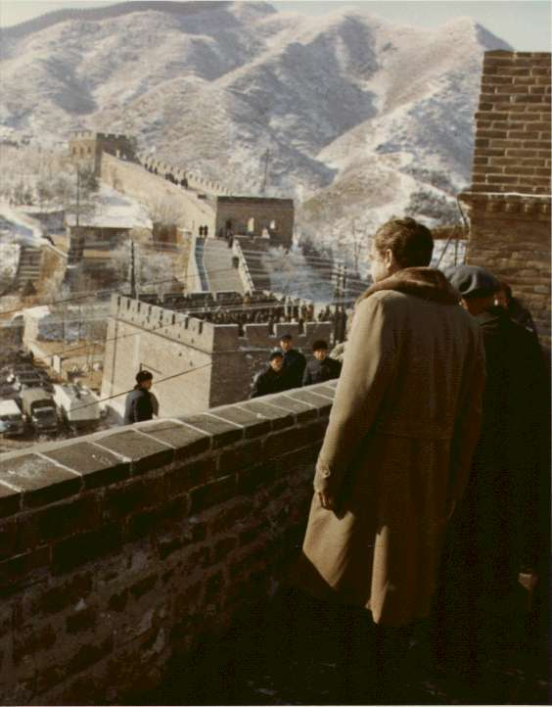
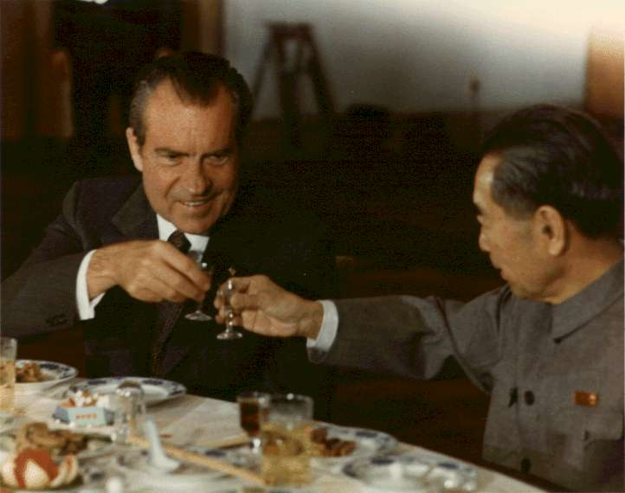
Left - Nixon tours Great Wall
Right - Nixon and Chinese Premier Zhou Enlai toast to improved Sino-American relations

Slide 13
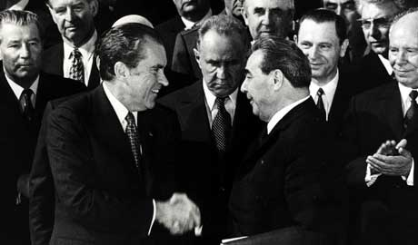
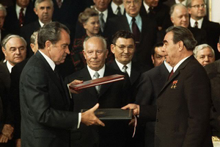
Nixon in the USSR
Nixon visits Moscow in 1972
Concludes agreements on trade (ag.), technological cooperation, and nuclear weapons
SALT I (Strategic Arms Limitation Treaty) (ratified 10/72) limits defensive missiles & freezes new offensive missile production for 5 years
Less defense = MAD

Slide 14
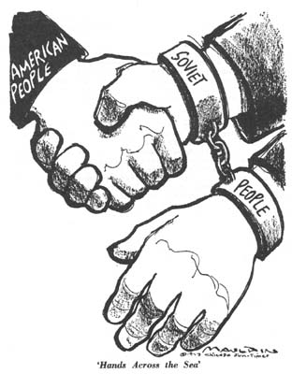
Détente
The easing of strained relations, especially in a political situation
New relationship created among U.S., Soviet Union, China

Slide 15
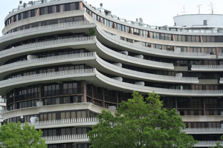
1972 Election
Nixon expected to win on Diplomatic Success, Law & Order policies & Southern strategy
Ran against George McGovern (D-SD)
Nixon painted him as New Left radical
CREEP formed to raise $ & spy on Dems.
Watergate break-in (June 17, 1972)
Foiled but temporarily covered up by POTUS
Nixon’s role in directing the cover up of the scandal ultimately led to his downfall

Slide 16
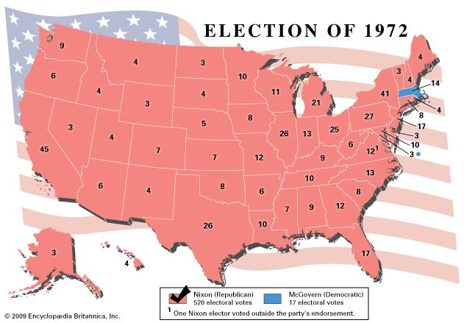
1972 Election
Nixon wins with 61% of pop vote
520 to 17
Low voter turnout (55%)
Dems hold Congress

Slide 17
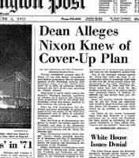
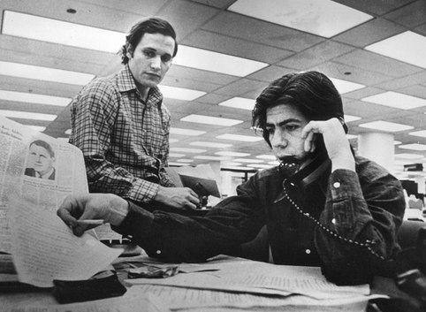
The Watergate Scandal Grows
Conspirators began talking - word of WH coercion spreading
Woodward & Bernstein - Washington Post
Nixon aide John Dean implicated Nixon in Cover-up
Senate investigation lead by Sam Irvin (D-NC)
White House tapes subpoenaed - Nixon refuses

Slide 18
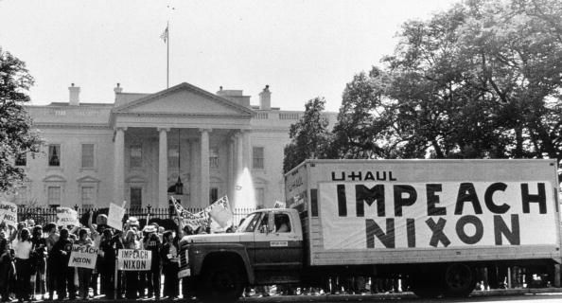
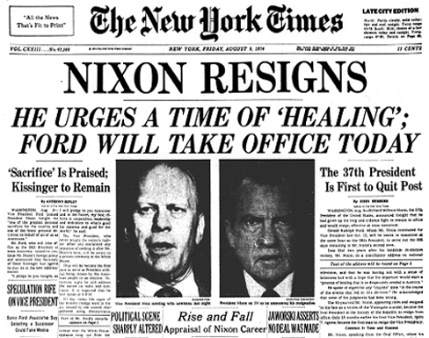
Watergate
7/30/74 - House voted for 3 Articles of Impeachment
Obstruction, abuse of power, subverting const.
8/5/74 - Nixon releases tapes by order of Supreme Court - reveals his participation
8/9/74 - Nixon resigns rather than face impeachment
Ford takes his place - pardons him a month later

Slide 19
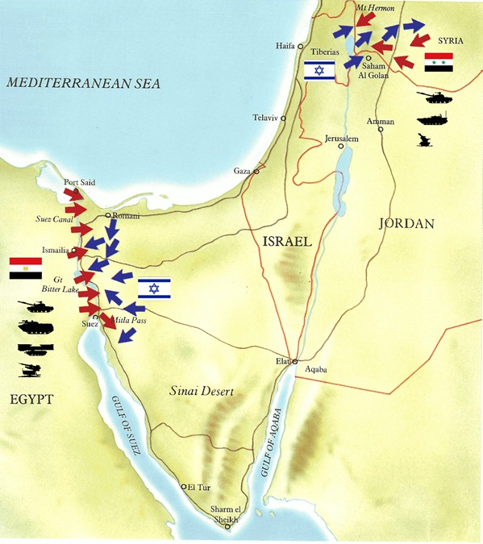
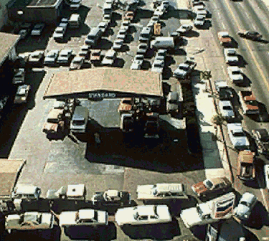
Yom Kippur War 1973
Arabs attack Israel
Nixon sends aid
OPEC imposes oil embargo 1974
Gas lines & high inflation
Notes:
16

