Slide 1
APUSH Review: The Presidency of Richard Nixon
www.Apushreview.com
Everything You Need To Know About The Presidency of Richard Nixon To Succeed In APUSH

Slide 2
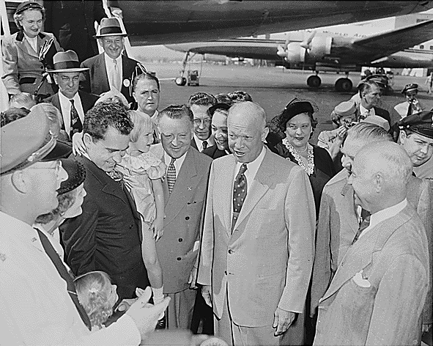
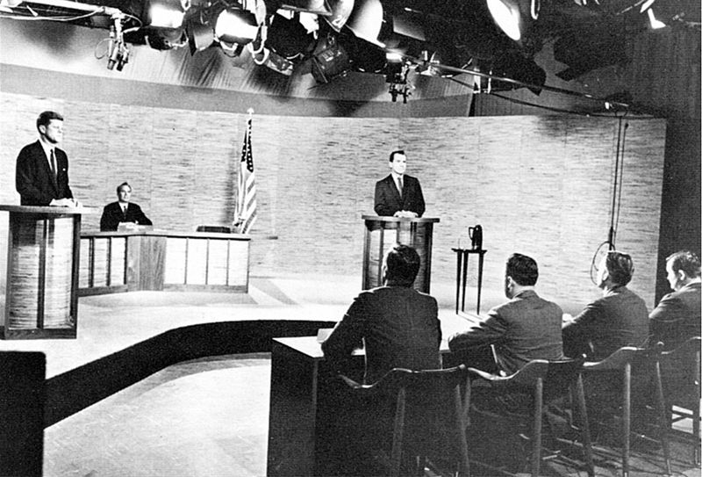
Background on Nixon
Communist Hunter
HUAC
Vice-President under Eisenhower
Lost the election of 1960

Slide 3
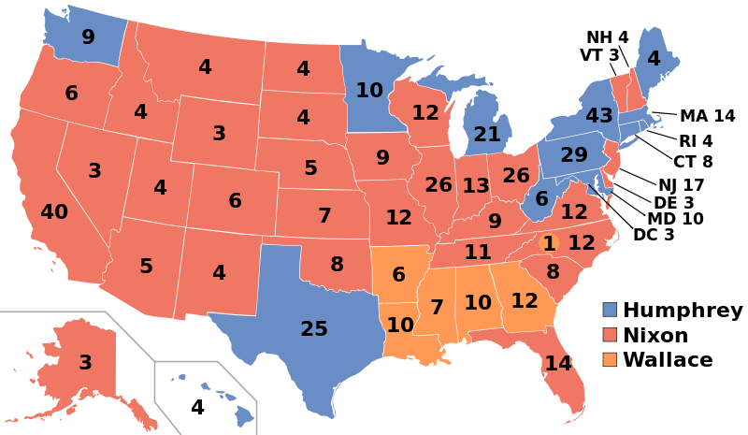
The Election of 1968
Republican Nominee:
Richard Nixon
Democratic Nominee:
Hurbert Humphrey (RFK assassinated in 1968)
American Independent Party:
George Wallace
Former governor of Alabama
Segregationist, disliked protestors
Advocated escalation in Vietnam
Close popular vote, electoral was 301 – 191 for Nixon

Slide 4
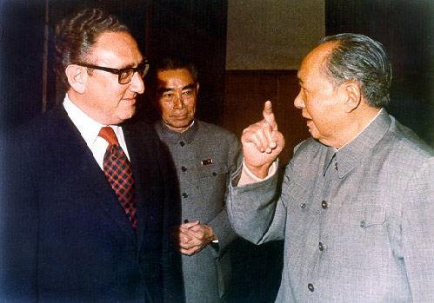
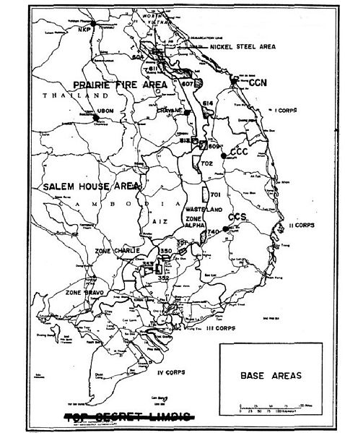
Nixon’s and Vietnam
Vietnamization:
Nixon’s plan to gradually withdraw troops from Vietnam, turn power over to the South Vietnamese
“Silent Majority”:
Nixon’s belief that most people were supportive of the Vietnam War, they just did not protest
Henry Kissinger:
Nixon’s National Security Adviser and Secretary of State
Bombing of Cambodia:
Nixon ordered the bombing of neutral Cambodia; claimed the North Vietnamese were using the country for supply routes
Kent State Massacre:
Student protests over the bombing of Cambodia and Vietnam War; 4 students died

Slide 5
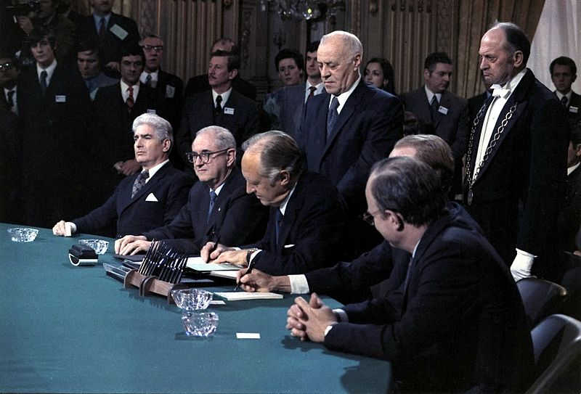
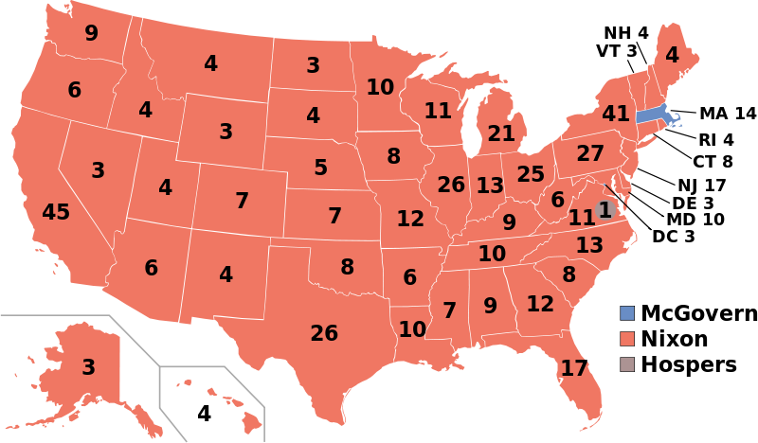
Nixon’s and Vietnam cont.
Pentagon Papers (1971):
Detailed the US’ involvement in Vietnam
Showed deceit by JFK and LBJ administrations regarding US involvement in Vietnam
1972 election:
“Peace at hand”
Paris Accords, 1973:
Ended direct US involvement in Vietnam
Cease-fire shortly after
US prisoners would be released within 60 days
Nixon claimed to have achieved “Peace with honor”

Slide 6
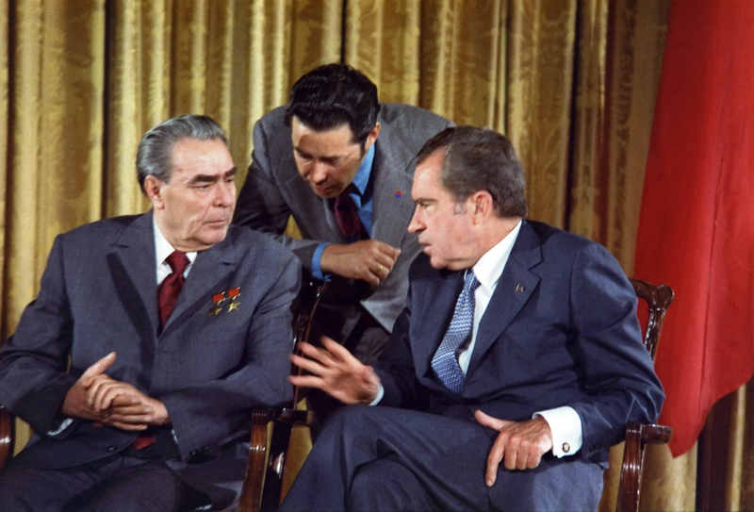
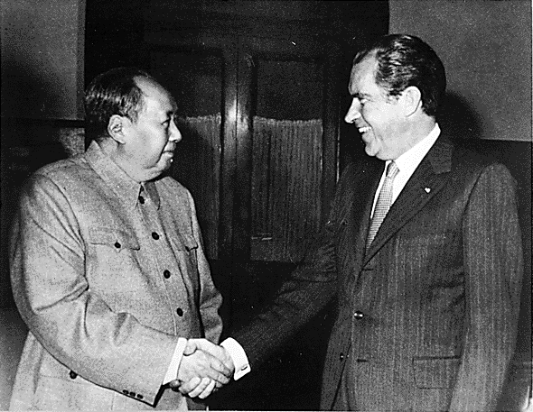
Foreign Policy Under Nixon
Nixon’s visit to China (February, 1972):
US relations with China improved
Soviet Union was concerned over US-Chinese relationship
Leads to……
Détente
Easing of Cold War Tensions
SALT (1972)
Agreement to limit nuclear weapons

Slide 7
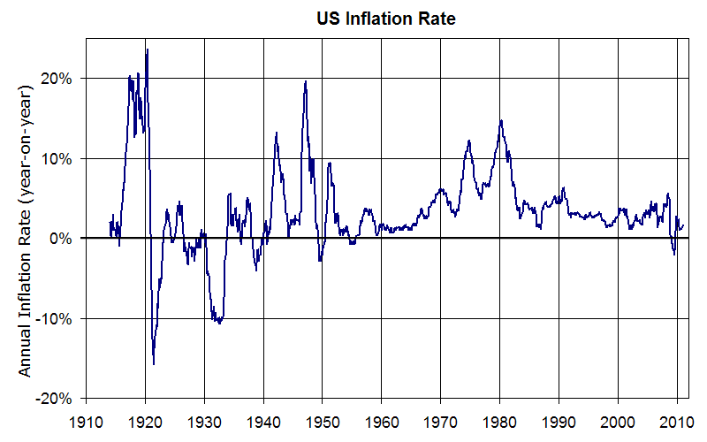
Domestic Issues Under Nixon
EPA:
Environmental Protection Agency
Created to protect the environment
Enforces Environmental laws and regulations
Increase in Social Security funding
Inflation increased during his administration
High cost of Vietnam/Great Society from LBJ
Watergate Scandal

Slide 8
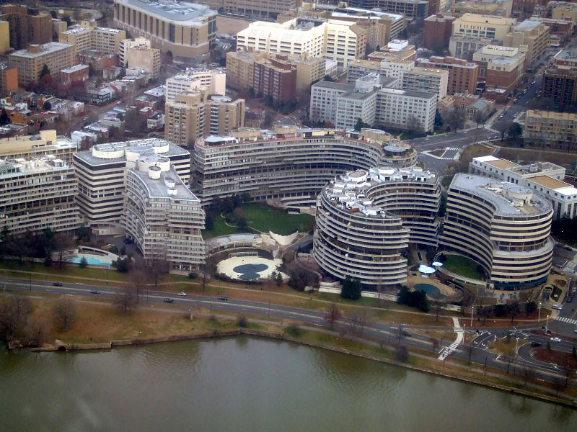
Nixon’s last years……
Election of 1972:
Nixon v. McGovern
Nixon wins in a landslide…… 520 - 17
Watergate Complex:
June 17, 1972:
5 men broke into Democratic headquarters in Watergate
War Powers Act (1973)
Essentially overturned “Gulf of Tonkin” Resolution
Limited the President’s involvement in wars
Must inform Congress within 48 hours of taking war actions
Nixon Resigns on August 9, 1974
Pardoned by Gerald Ford

Slide 9
Test Tips
Multiple-Choice Topics:
War Powers Act
EPA was influenced by Rachel Carson
Essay Topics:
Domestic and foreign issues under Nixon
How did he respond?
Was his response effective?
Good luck!

Slide 10
Thanks for watching!
Subscribe to my channel
Help spread the word
Questions? Comments?
Leave in comments
Once we limit those nukes, we will subscribe. Agreed?
Subscribe
Down here!

