Slide 1
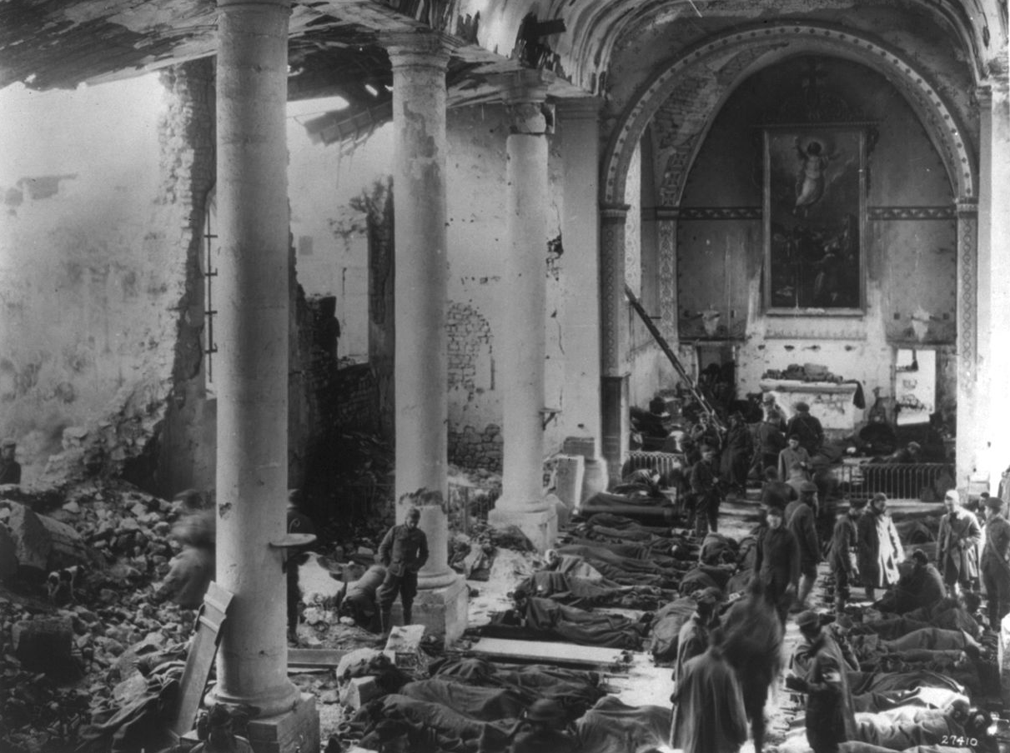
World War I
INTENSIVE REVIEW VERSION

Slide 2
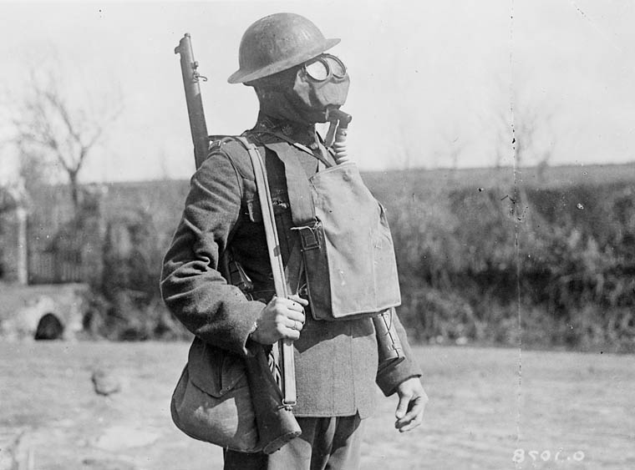
Causes of World War I
Militarism
Alliance System
Imperialism
Nationalism

Slide 3
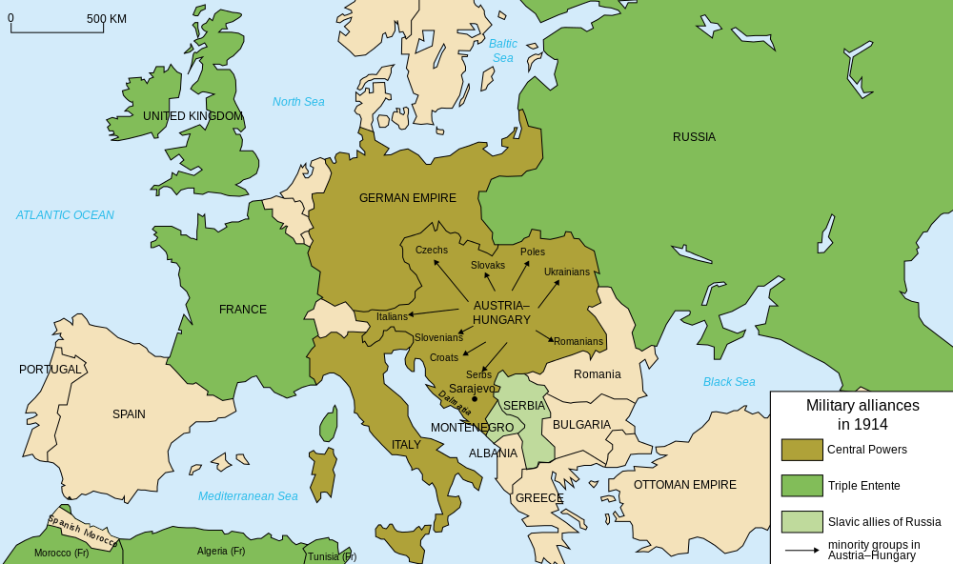
Alliances
Map Credit: historicair

Slide 4
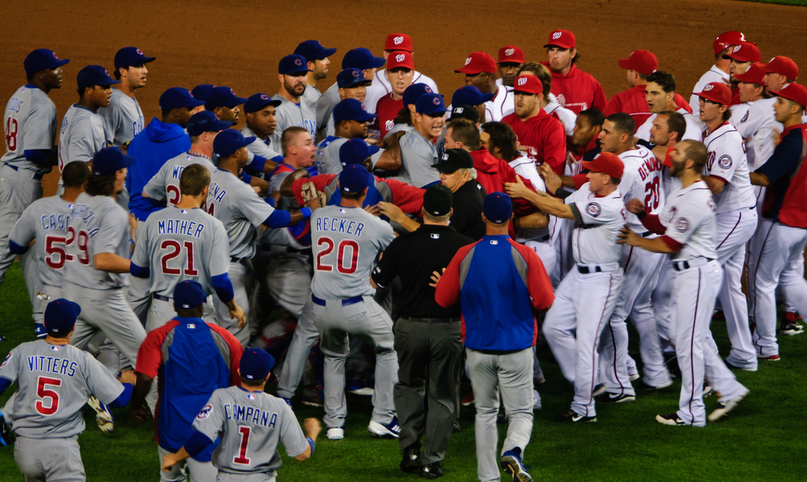
The Bench Clearing Effect
Photo by MudflapDC

Slide 5
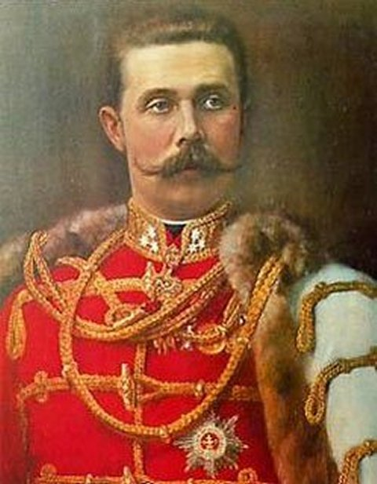
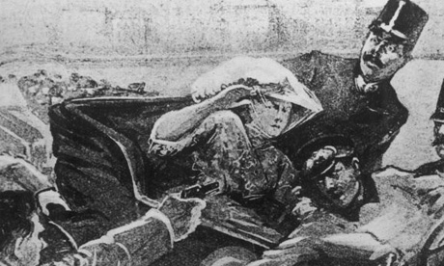
Assassination of
Archduke Franz Ferdinand
June 28, 1914

Slide 6
WAR
WAR
WAR
WAR
WAR

Slide 7

What does this have to do with US?
Notes:
http://4acre.wordpress.com/2010/12/06/mustard-gas/

Slide 8
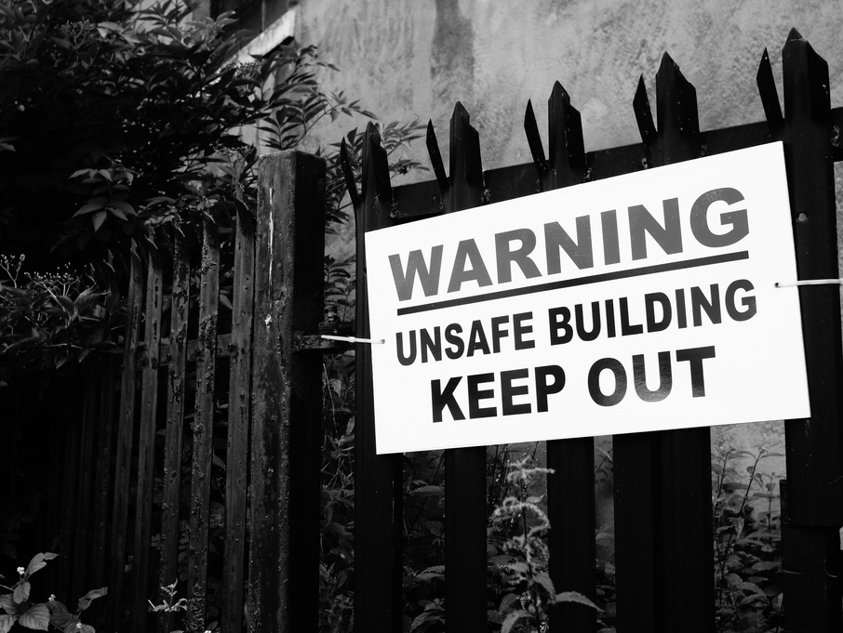
Photo Credit: Grey World

Slide 9
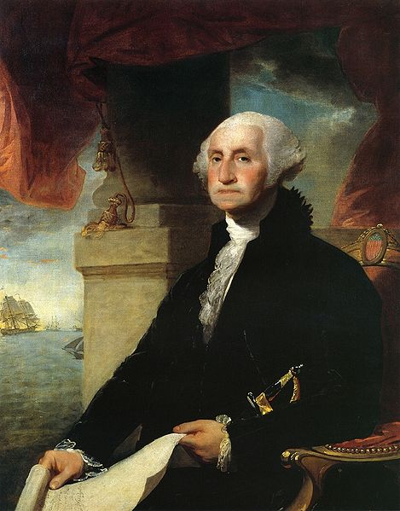
American Neutrality
“It is our true policy to steer clear of permanent alliances with any portion of the foreign world…”
-- Washington’s Farewell Address

Slide 10

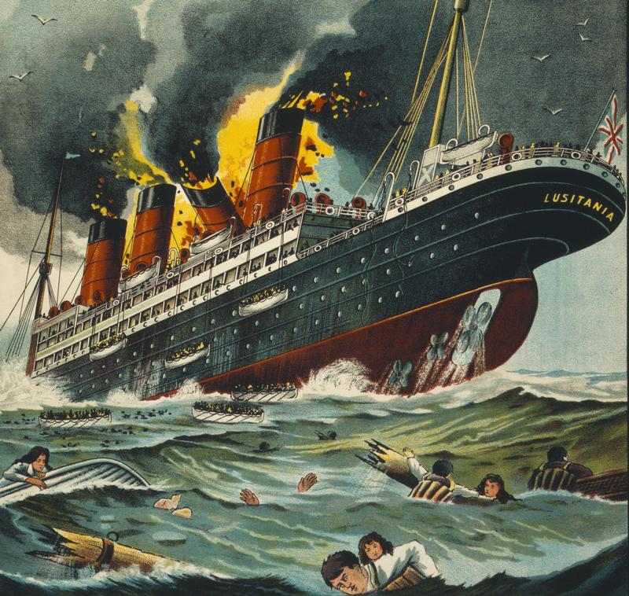
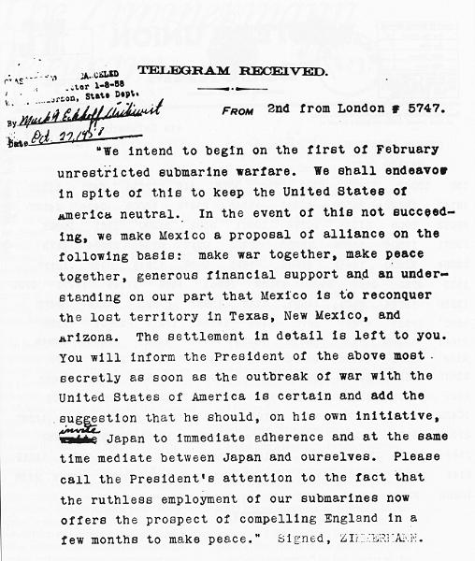
PROVOCATIONS
Dora Style
Where are we going?
* CLAP CLAP CLAP *
World War I!
Cruise Ship
Telegram
Press to
REPEAT
Submarine

Slide 11
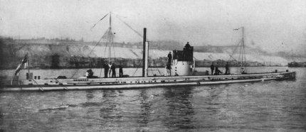
U-BOATS
German Submarines

Slide 12

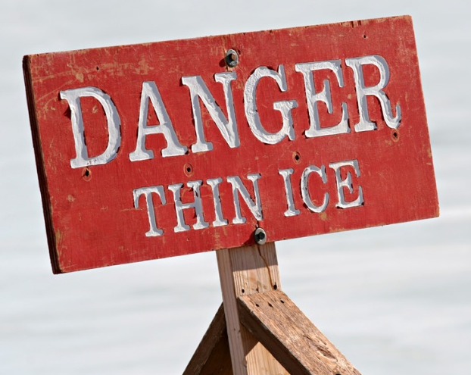

Sinking of the
Lusitania
May 7, 1915
British Luxury Liner
1,198 Dead
  128 Americans

Slide 13
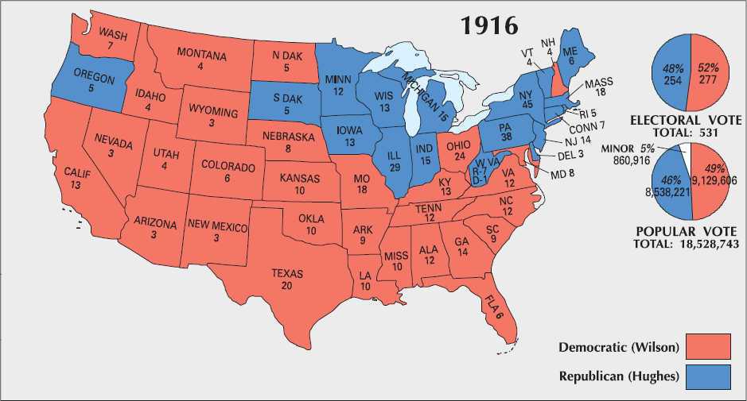
“He kept us out of war.”
-- Wilson Campaign Slogan

Slide 14
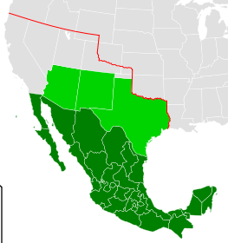
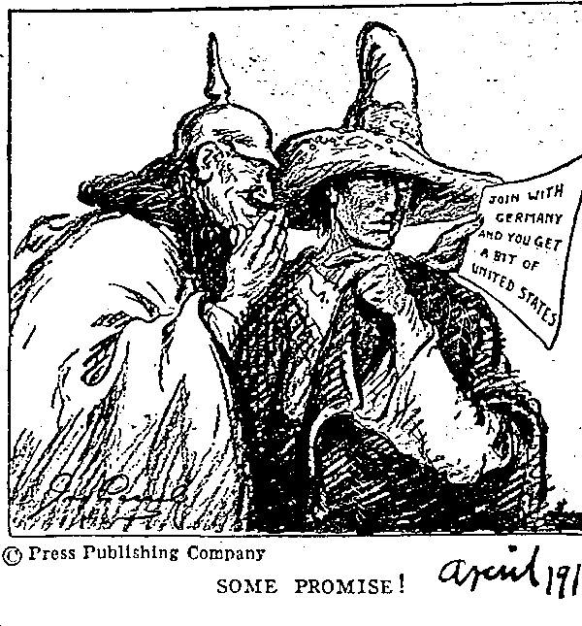
Zimmerman Note
(aka, Zimmerman Telegram)

Slide 16
PROVOCATIONS
Dora Style
Where are we going?
* CLAP CLAP CLAP *
World War I!
Cruise Ship
Telegram
Press to
REPEAT
Submarine

Slide 17
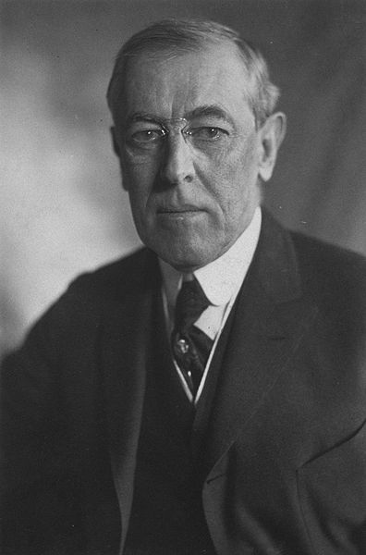
Wilson’s War Message
April,
1917
The Direct Cause:
German policy of Unrestricted Submarine Warfare
America’s Mission:
Make the world safe for democracy

Slide 18

Grab your gas mask…
Let’s go!

Slide 19
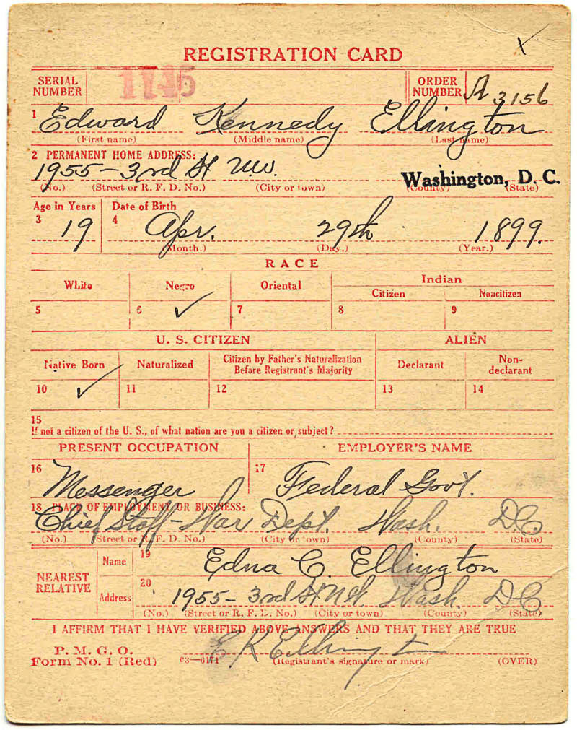
Selective Service Act (1917)
Draft Card →

Slide 20
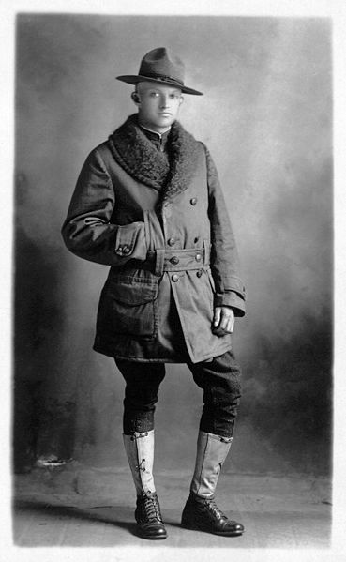


Doughboys

Slide 21
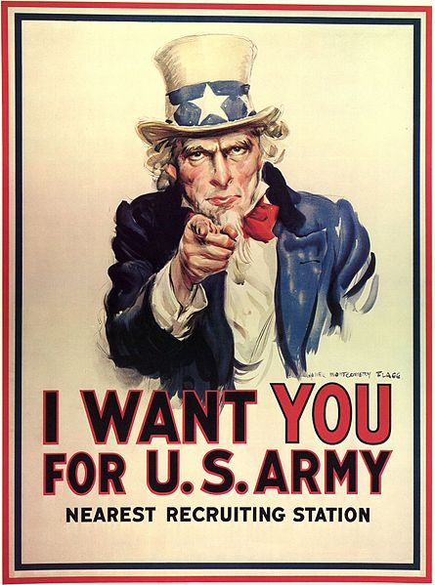
PROPAGANDA

Slide 22
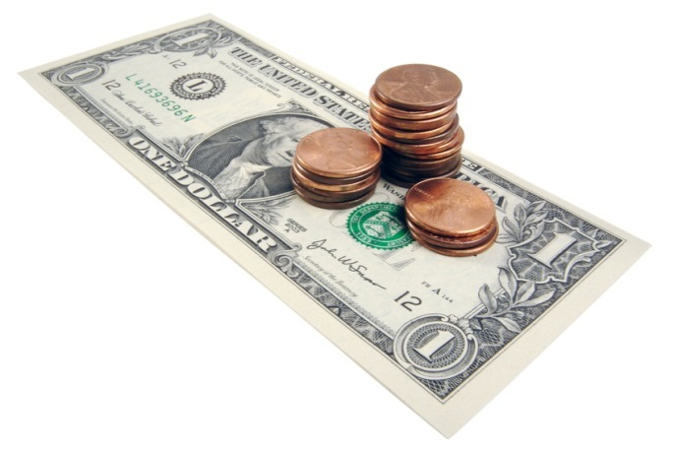
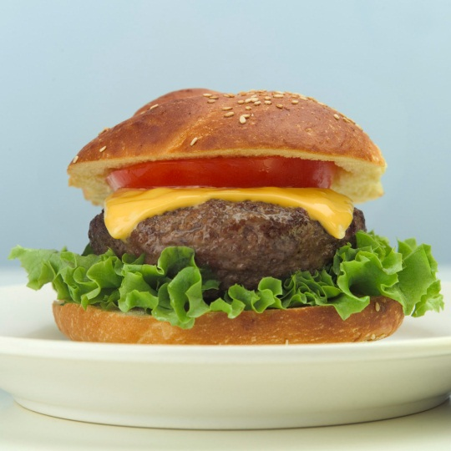
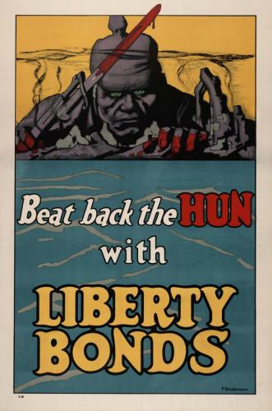
Propaganda Campaign
1. Recruitment
  Soldiers
  Sailors
  Nurses
4. Dehumanize the enemy
2. War Financing
3. Conserve Resources

Slide 23
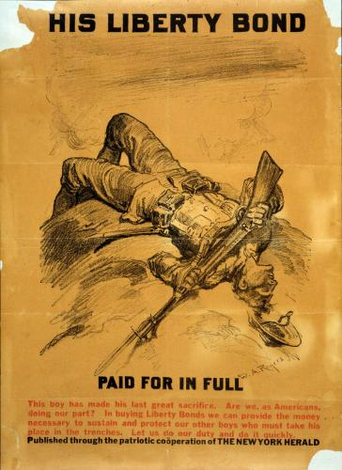

Slide 24


Slide 25
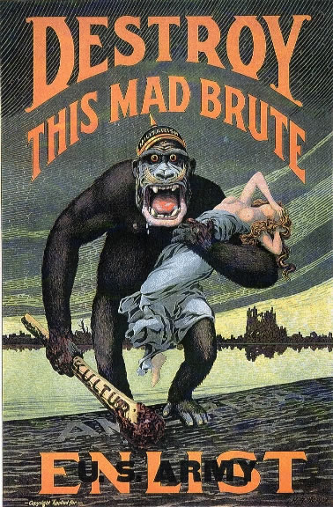

Slide 26
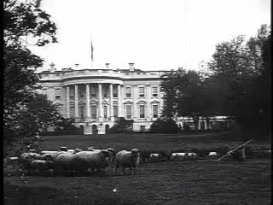

Slide 27
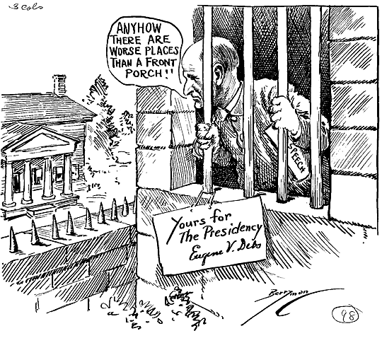
Eugene V. Debs, a socialist labor leader, was jailed for speaking out against the draft.

Slide 28

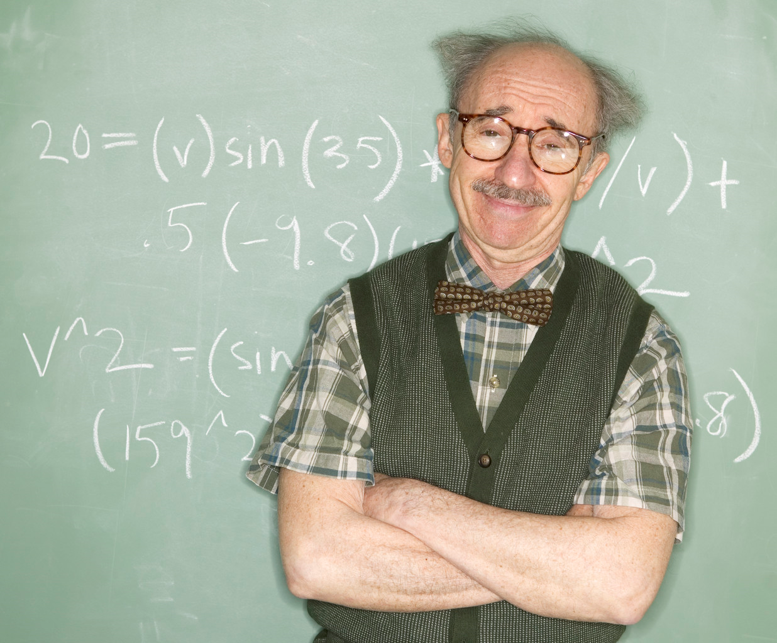
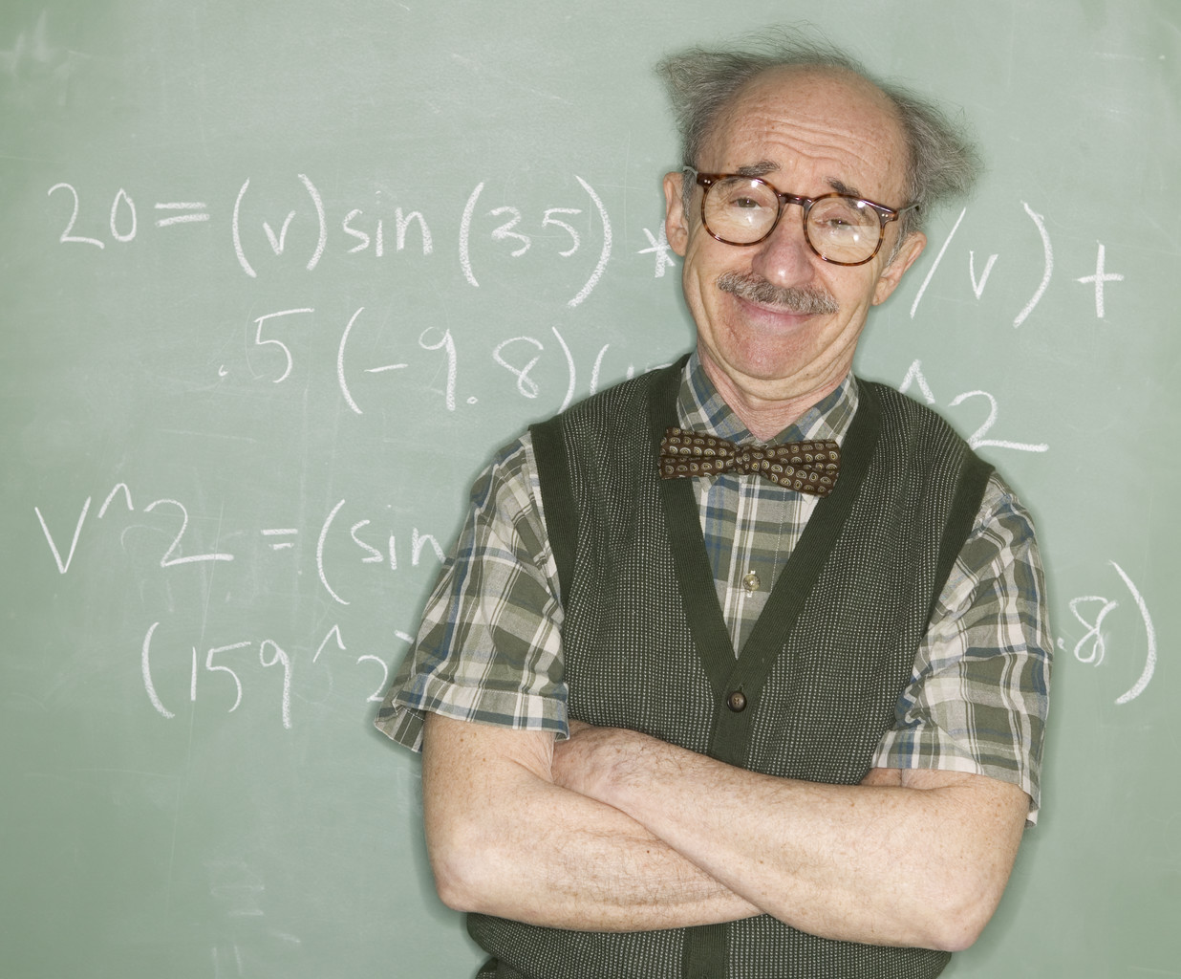
Notes:
Vocabulary changed. Sauerkraut came to be called "liberty cabbage",[22] German measles became "liberty measles", hamburgers became "liberty sandwiches"[22] and dachshunds became "liberty pups”.The response of German Americans to these tactics was often to Americanize names (e.g. Schmidt to Smith, Müller to Miller) and to limit the use of the German language in public places, especially churches.

Slide 29
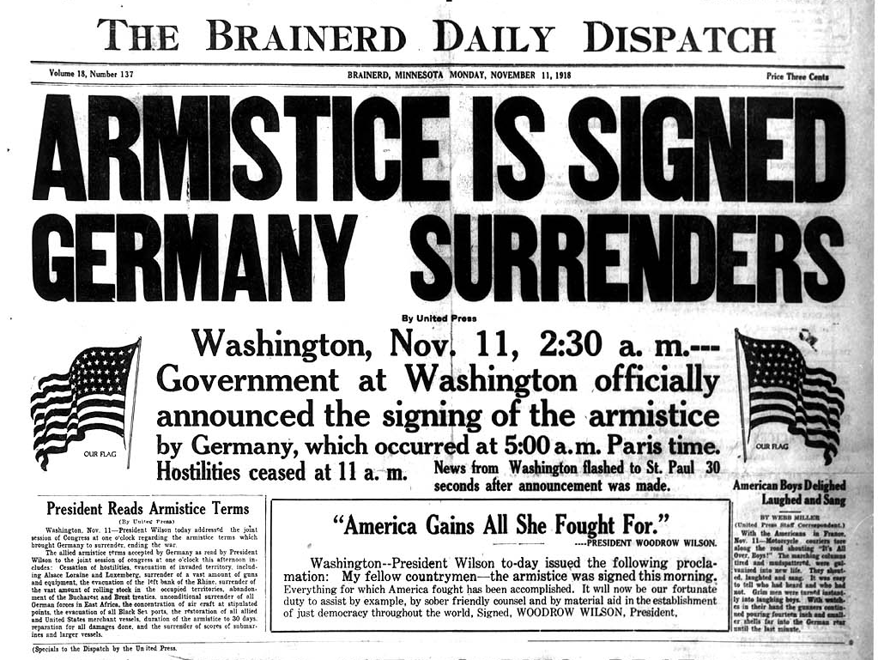

Slide 30

Armistice
11/11
1918
11:00 AM

Slide 31
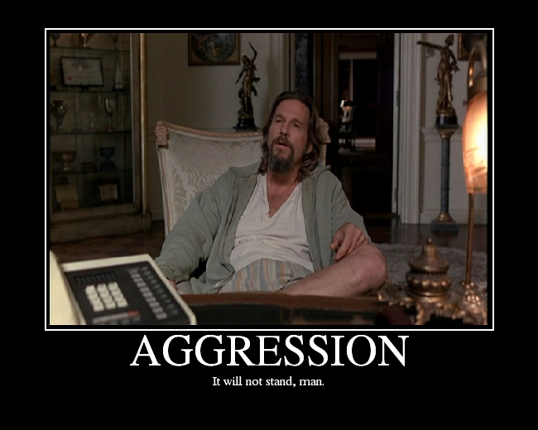

Slide 32
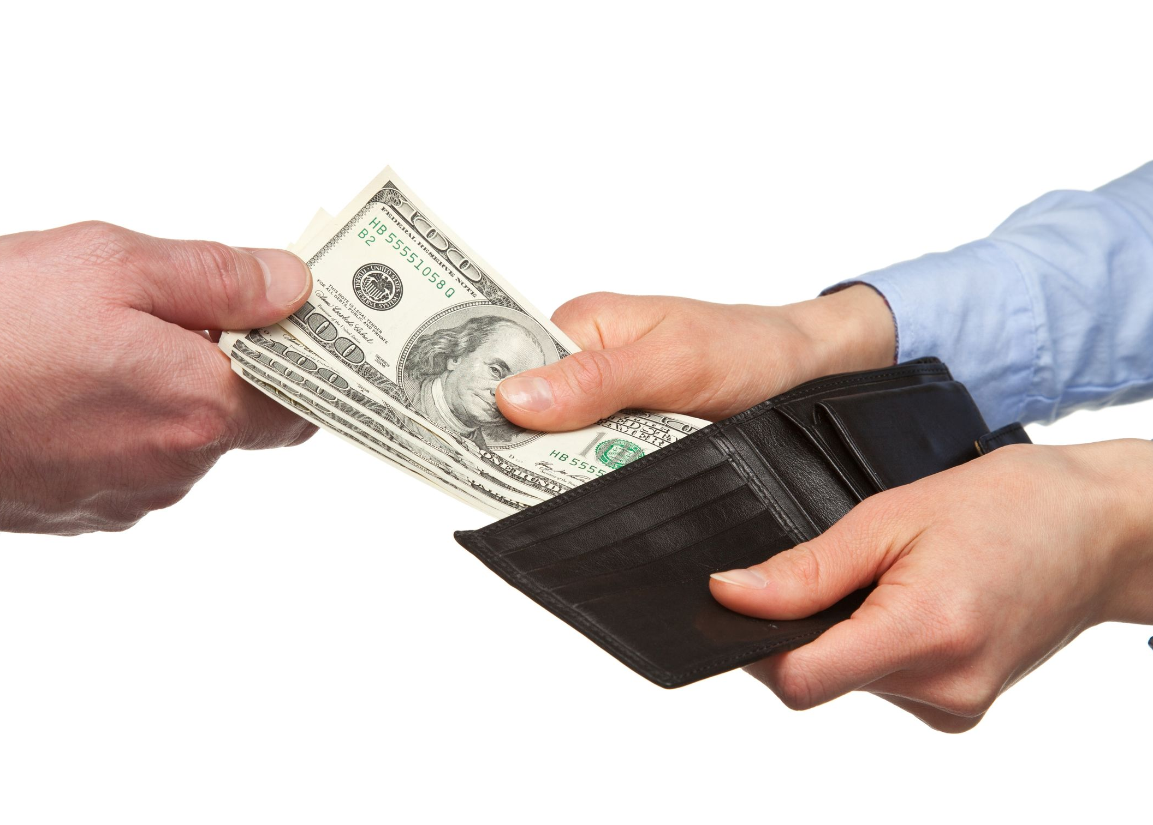
“War Guilt” Clause
Germany claims responsibility for
the war and agrees to pay reparations to the allies.

Slide 33

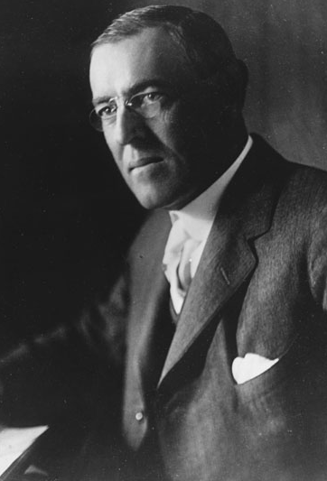
Wilson’s Fourteen Points
PRINCIPLES:
Freedom of the Seas
Reduction of Arms
Open Treaty Negotiations
Self Determination
of Peoples
League of Nations
14

Slide 34
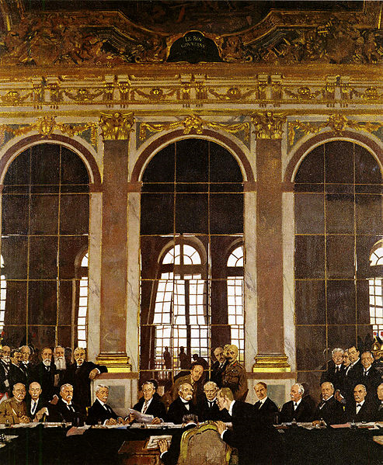
Signing of the
Treaty of Versailles
Wilson scores TWO big victories.

Slide 35
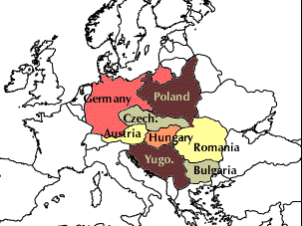
New National Borders
Re-drawn along ethnic lines
LINK TO MAPS

