Slide 1
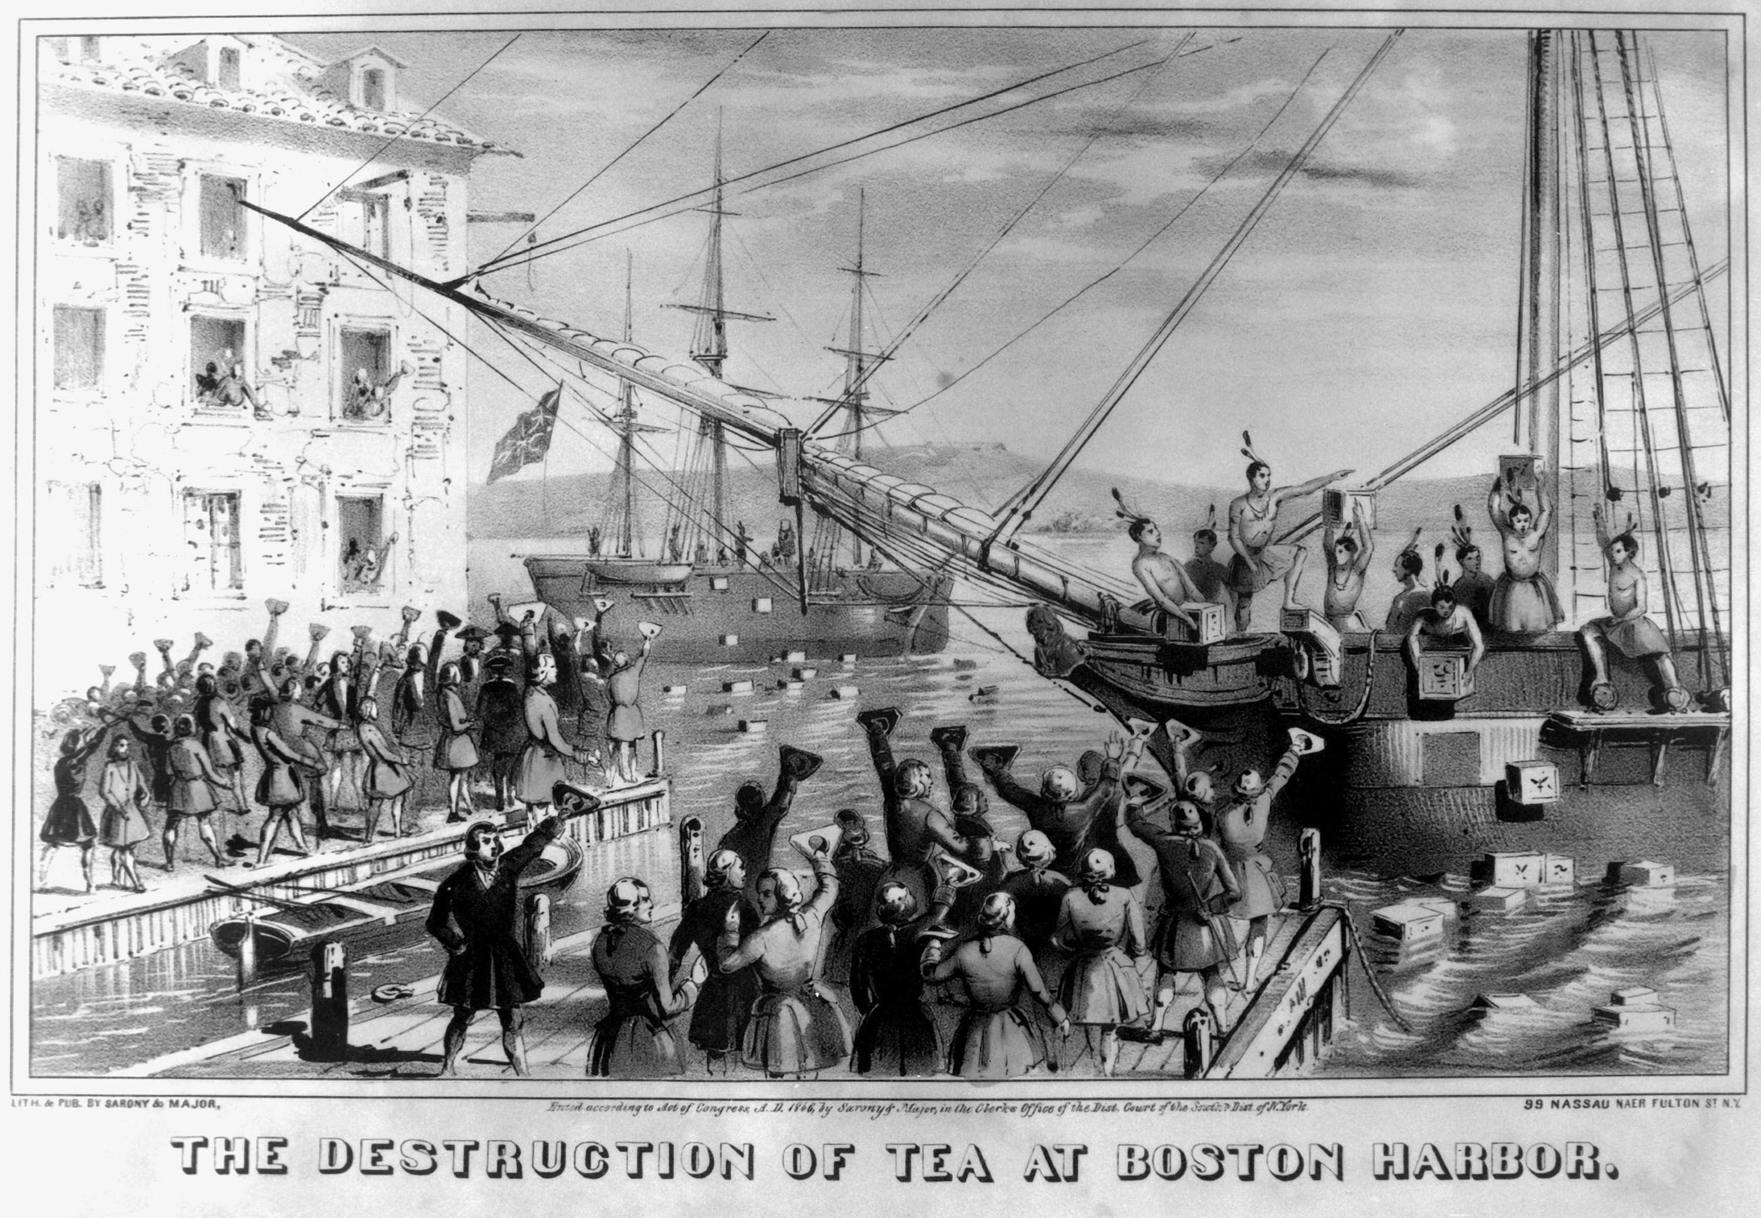
Boston Tea Party
December 16, 1773

Slide 2
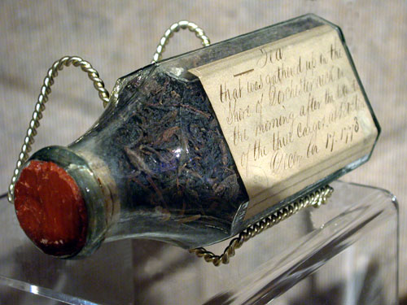
Causes of the Boston Tea Party
Under pressure, Parliament repealed the Townshend Acts
However, as a symbol of British authority, Parliament maintained the tax on tea
In 1773, the British Government passed the Tea Act, which gave the British East India Company a monopoly on tea sales by allowing them to sell tea at a lower price than their competitors
The theory was that the colonists would accept the tax more readily if they were able to get tea from the East India Company at a lower price
However colonial leaders in Boston protested, and cargoes of tea on ships were held in Boston Harbor
The captain of one of the ships, unable to unload, decided to go back to England, but the British officials refused to allow the ship to leave

Slide 3
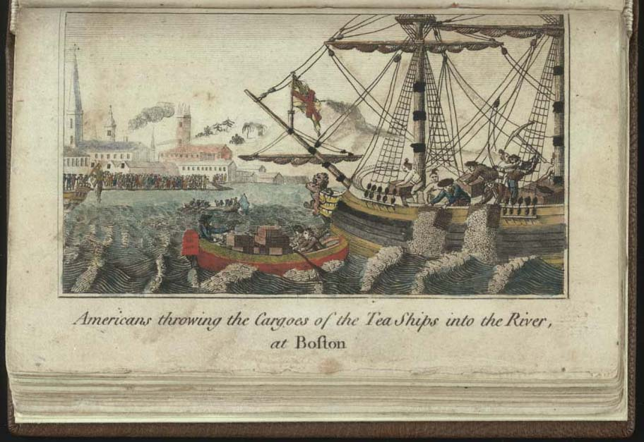
The Tea Party
After it became known that the tea would not be removed from Boston Harbor, 50 members of the Sons of Liberty, led by Samuel Adams, dressed up like Mohawk Indians and boarded the ships, removing 342 chests of tea and throwing it overboard into the Harbor. More than 10,000 pounds sterling worth of tea was destroyed.

Slide 4
An eyewitness account
“In about three hours from the time we went on board, we had thus broken and thrown overboard every tea chest to be found in the ship, while those in the other ships were disposing of the tea in the same way, at the same time. We were surrounded by British armed ships, but no attempt was made to resist us.
...The next morning, after we had cleared the ships of the tea, it was discovered that very considerable quantities of it were floating upon the surface of the water; and to prevent the possibility of any of its being saved for use, a number of small boats were manned by sailors and citizens, who rowed them into those parts of the harbor wherever the tea was visible, and by beating it with oars and paddles so thoroughly drenched it as to render its entire destruction inevitable."
George Hewes, Tea Party Participant

Slide 5
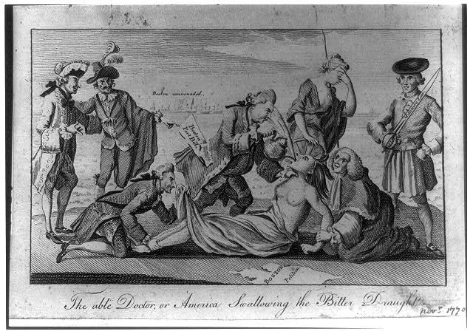
The Intolerable Acts
In this cartoon from London Magazine, Lord North, author of the Boston Port Act, forces the “tea” (the Intolerable Acts) down the throat of America while “Mother Brittania” weeps in the background. Paul Revere saw the effectiveness of the cartoon and distributed it widely in the colonies.
Notes:
In this cartoon, there are several instances of symbolism. Lord North is forcing the “tea” (the Intolerable Acts) down the throat of the colonies, while several other British officials, most notably, Lord Chief Justice Mansfield and Lord Sandwich, are shown in the cartoon as well.

Slide 6
Purposes of the Intolerable Acts
Passed in response to the Boston Tea Party by Parliament in 1774
Officially called the “Coercive Acts”, but they were nicknamed the “Intolerable Acts” in the colonies
They were designed to punish the colony of Massachusetts until the tea destroyed in the Boston Tea Party was paid for

Slide 7
The major laws considered “intolerable”
Boston Port Act: Closed the Port at Boston Harbor until the tea was paid for.
Quartering Act: Forced the citizens of Massachusetts to house and feed British soldiers in their homes.
Massachusetts Government Act: Suspended the Massachusetts Colonial Legislature until the tea was paid for.
Administration of Justice Act: Guaranteed that British officials would not be tried in colonial courts for capital crimes, but extradited to Britain. This meant local courts could not try British officials giving them free reign.

