Slide 1
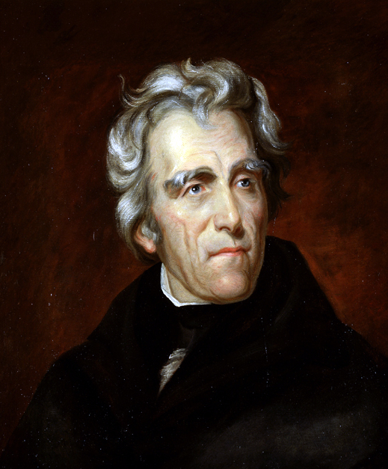
Chapter 8
The Spirit of
Reform

Slide 2
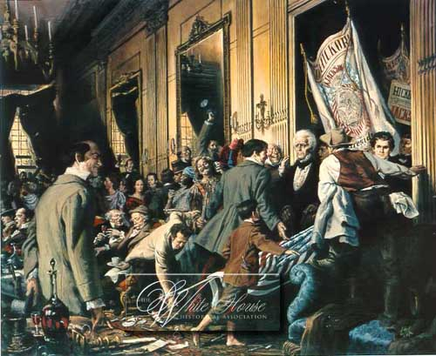
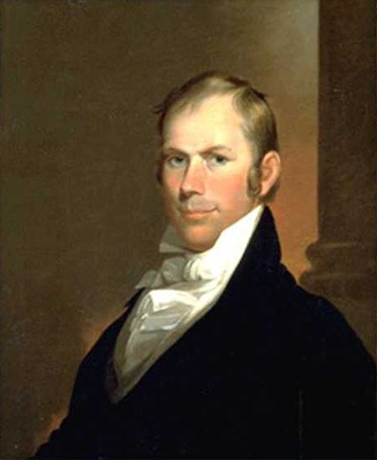
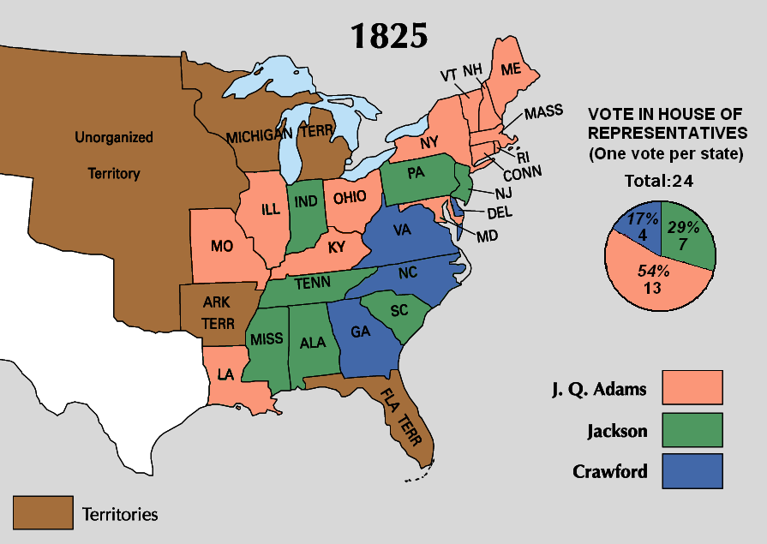
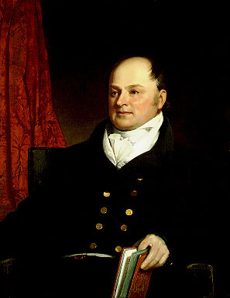
Jacksonian Democracy

Slide 3
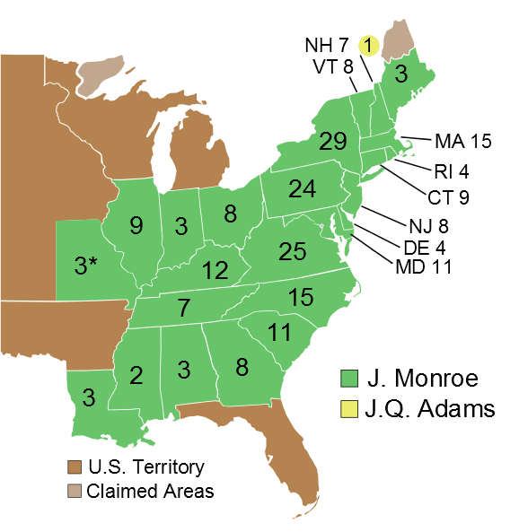

Washington
Adams
Jefferson
Madison
Monroe
1820
99.5%
Electoral Vote
1820
1824
1828
1832
1836
1840

Slide 4
Direct Balloting for President
President
The New System
Direct Election
(Democracy)
The Old System
Indirect Election
(Aristocracy)
Presidential Electors
By 1836, voters in all states except for South
Carolina were casting
direct ballots for presidential electors.
South Carolina continued to select electors indirectly until 1860.
State Legislature
Voters
Notes:
Which arrangements

Slide 5
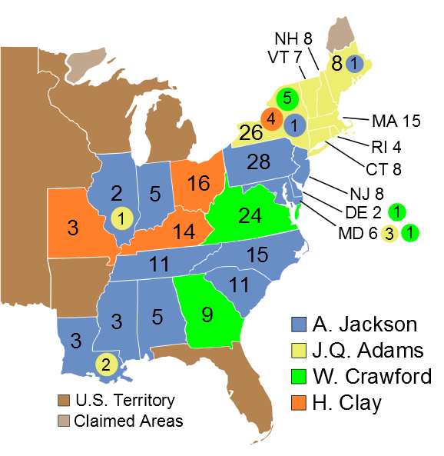


1824
13%
37
13%
99
41
43%
31%
84
Popular Vote
(356,038 Votes)
Electoral Vote
View Popular Vote
View Electoral Vote
HOUSE VOTE
1820
1824
1828
1832
1836
1840
Notes:
and if no person have such majority, then from the persons having the highest numbers not exceeding three on the list of those voted for as President, the House of Representatives shall choose immediately, by ballot, the President. But in choosing the President, the votes shall be taken by states, the representation from each state having one vote; a quorum for this purpose shall consist of a member or members from two-thirds of the states, and a majority of all the states shall be necessary to a choice.

Slide 6
12th Amendment
…and if no person have such majority, then from the persons having the highest numbers not exceeding three on the list of those voted for as President, the House of Representatives shall choose immediately, by ballot, the President. But in choosing the President, the votes shall be taken by states, the representation from each state having one vote; a quorum for this purpose shall consist of a member or members from two-thirds of the states, and a majority of all the states shall be necessary to a choice…

Slide 7
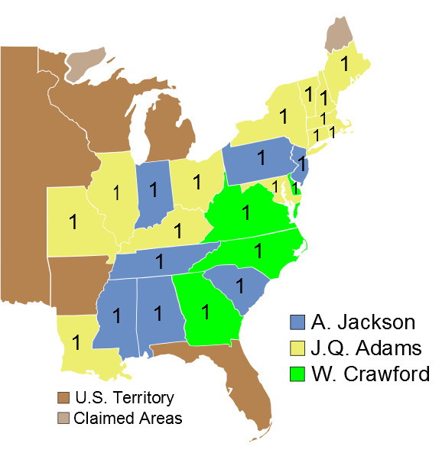

Washington
Adams
Jefferson
Madison
Monroe
ADAMS
1JQ825
4
7
13
ELECTORAL VOTE
1820
1824
1828
1832
1836
1840

Slide 8
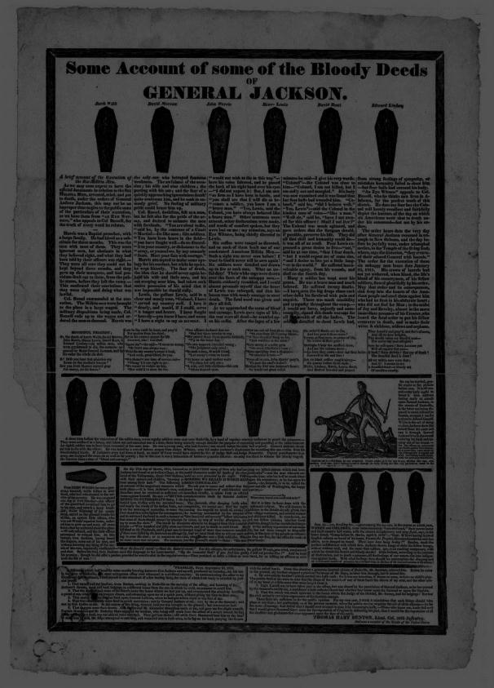
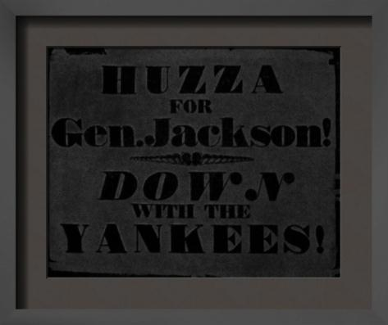
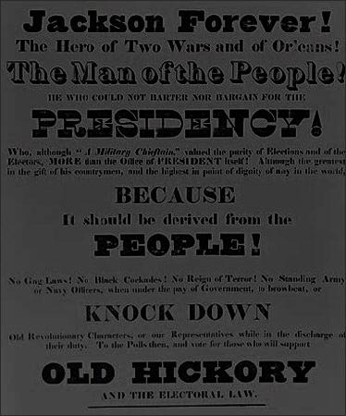
The 1828 Campaign
Candidate-centered
Negative Advertising
Just Plain Dirty
Sectionalism
Candidate
Promotion
Further Reading

Slide 9
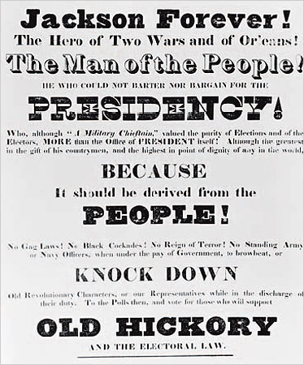
The People’s President
Jackson campaigned as a man of the people standing against “corrupt bargainers” like Adams.
OLD

Slide 10
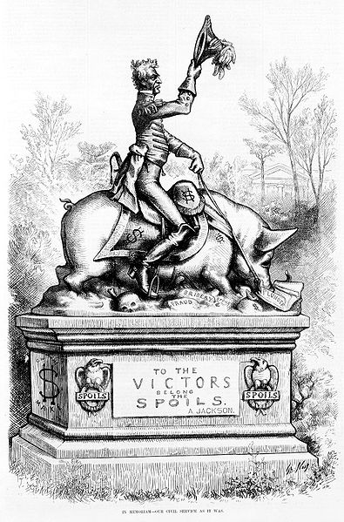

The
Spoils System
“To the victor belong the spoils…”
Political Patronage
Government offices given to political supporters
http://www.youtube.com
In memoriam--our civil service as it was, A Political cartoon by Thomas Nast showing statue of Andrew Jackson on pig, which is over "fraud," "bribery," and "spoils," eating "plunder." in Harper's Weekly, 1877 April 28, p. 325.

Slide 11
The Second Two Party System
1
1790-1816 | Federalists | Republicans
1816-1824 | “Republicans”
1828-1852
2
National Republicans
“Whigs”
Democratic Republicans
“Democrats”

Slide 12
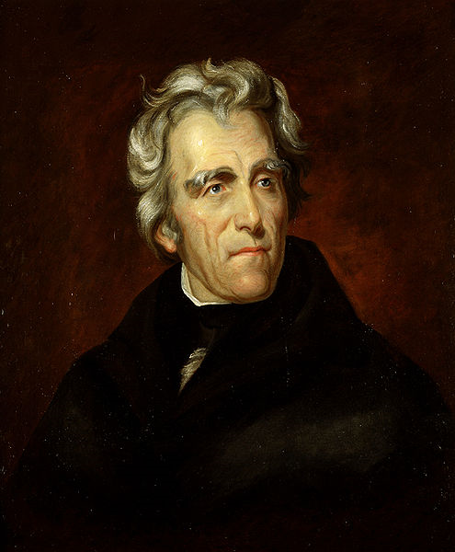
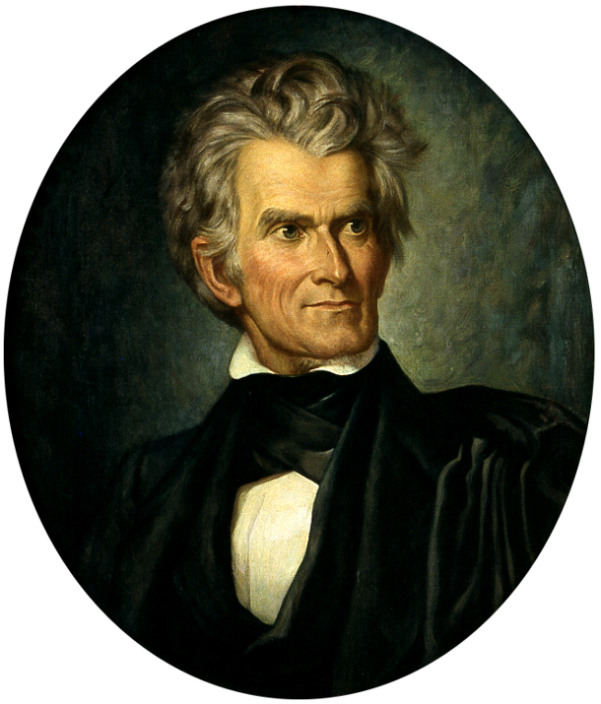
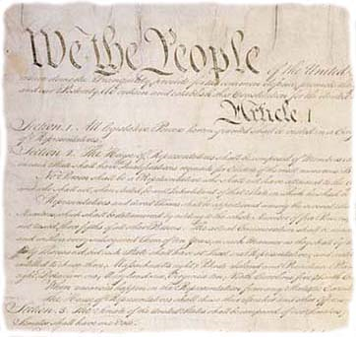
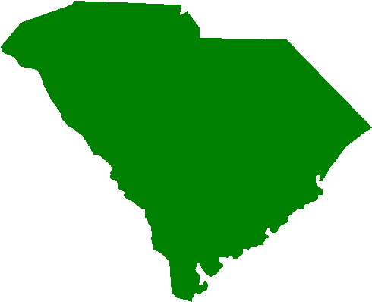
NULLIFICATION
Theory that States can declare a LAW invalid
1828-1833

Slide 13

The Tariff of 1828
The “Tariff of Abominations”
Highest tariff rates
ever passed by Congress
PROTECTIVE
  In excess of $$$ necessary to finance the government

Slide 14
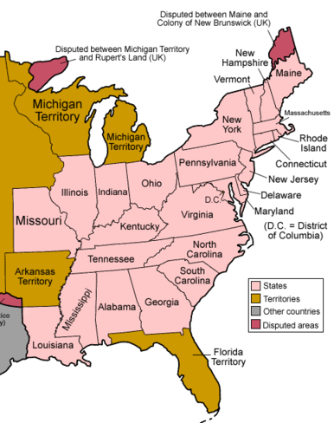
The Tariff of 1828
The “Tariff of Abominations”
House Vote on Tariff of 1828 | + | -
New England | 16 | 23
Middle States (Mid-Atlantic) | 57 | 11
West | 29 | 10
South | 3 | 50
Total | 105 | 94
Did the Tariff of 1828 provide for the general welfare?

Slide 15
Nullification
South Carolina threatened to nullify the Tariff of 1828
  Refused to collect the tariff within the state’s borders
The South Carolina Exposition [and Protest]
John C. Calhoun
Vice President

Slide 16


The Force Bill
1832
Congress authorizes Jackson to use force to collect the tariff in SC.
SC calls out militia

Slide 17
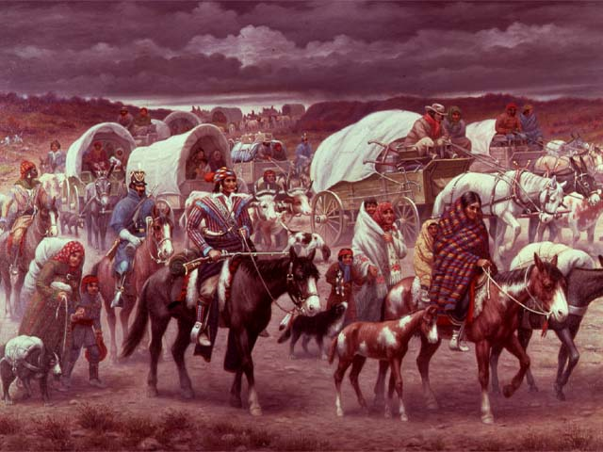

Slide 18
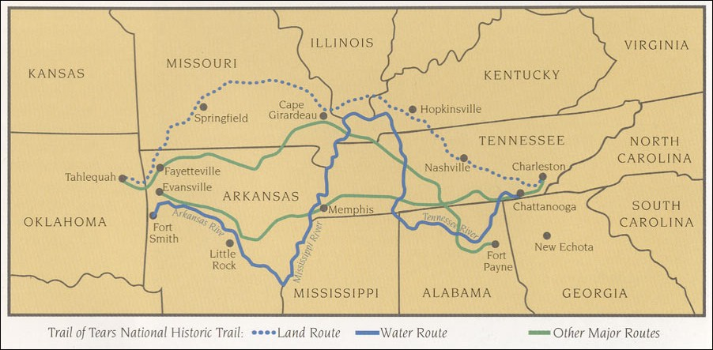
Indian Removal
Trail of Tears
Cherokee Tribe

