Slide 1
Chapter 9: Manifest Destiny
US History I
Mr. Tuttle
michael.tuttle@lodi.k12.nj.us

Slide 2
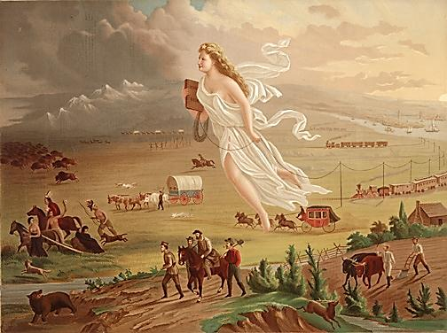
Chapter 9: Manifest Destiny and the
Mexican War
US History I
Mr. Tuttle
michael.tuttle@lodi.k12.nj.us

Slide 3
Objective:
Explain how the concept of Manifest Destiny affected the United States’ relationships with foreign powers, including the role of the United States in the Texan Revolution and the Mexican War.

Slide 4
John Gast, American Progress, 1872
Notes:
John Gast, American Progress, 1872

Slide 5
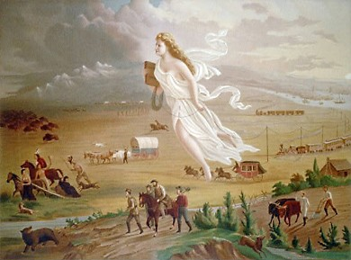
Manifest
Destiny
man⋅i⋅fest (adj)
evident; obvious; apparent; plain
des⋅ti⋅ny (n)
predetermined, usually inevitable or irresistible, course of events.

Slide 6
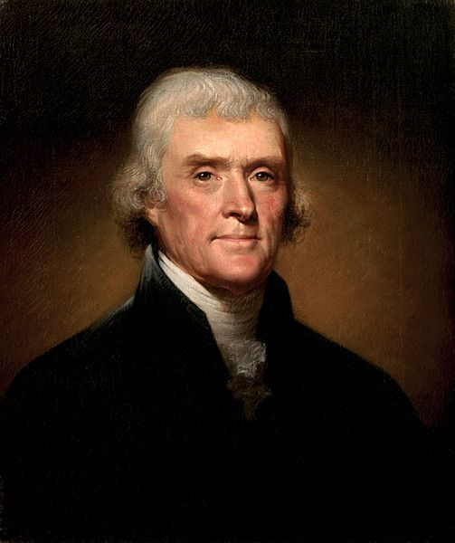
Manifest Destiny
“Kindly separated by nature and a wide ocean from the exterminating havoc of one quarter of the globe… possessing a chosen country, with room enough for our descendants to the thousandth and thousandth generation…”
-- Thomas Jefferson,
First Inaugural Address
March 4, 1801
Jefferson

Slide 7
Manifest Destiny
“I shall need, too, the favor of that Being in whose hands we are, who led our forefathers, as Israel of old, from their native land, and planted them in a country flowing with all the necessaries and comforts of life; who has covered our infancy with his providence, and our riper years with his wisdom and power…”
-- Thomas Jefferson,
Second Inaugural Address
March 4, 1805
Jefferson

Slide 8
WESTWARD EXPANSION:
A God-given Right
John Gast, American Progress, 1872
Notes:
John Gast, American Progress, 1872

Slide 9
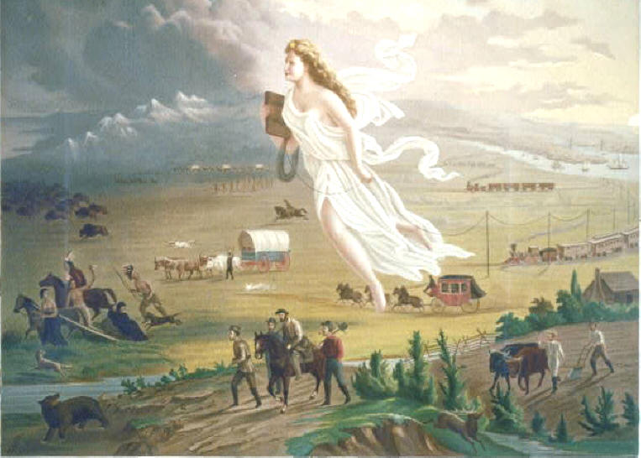
Heading Westward
Two reasons many Americans began to move westward:
  religious reasons
  opportunity to begin own farm
    Squatters
      Preemptive Act of 1830
      Invention of iron and steel bladed plows and mechanical reaper
      Jethro Wood, John Deere, and Cyrus McCormick
  followed John O’Sullivan’s concept of Manifest Destiny

Slide 10
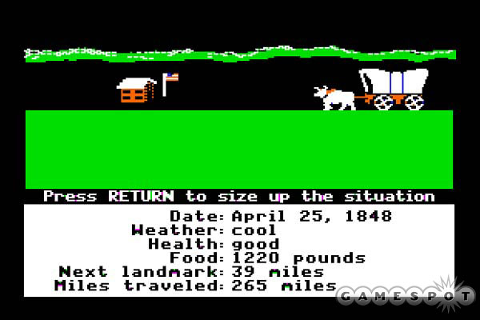
West Coast!
Missionaries began to settle in Oregon
John Sutter established Sutter’s Fort in California to attract more settlers
Trade routes made by mountain men helped settler travel through the wilderness
  Oregon Trail

Slide 11
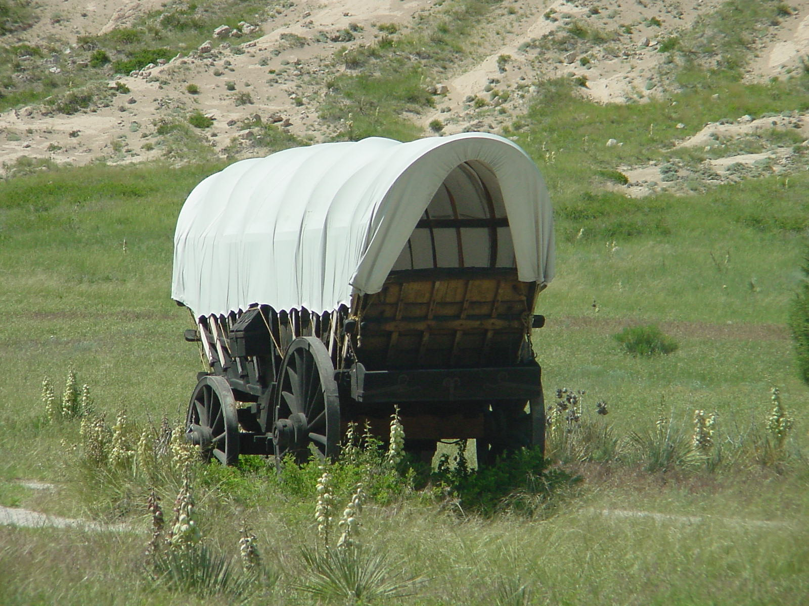
Settler Life
Emigrants made journey in covered wagons
  assembled trains in staging areas in towns, where they also exchanged information about routes and supplies
  hired mountain men to guide them, but once familiar with land, overlanders continued the journey with the help of guidebooks
    Sometimes were wrong (Donner Party)
Emigrant had little attacks from Native Americans
  Natives became angry over continued immigration
  Treat of Fort Laramie (1851)
    Agreed to specific geographical boundaries

Slide 12

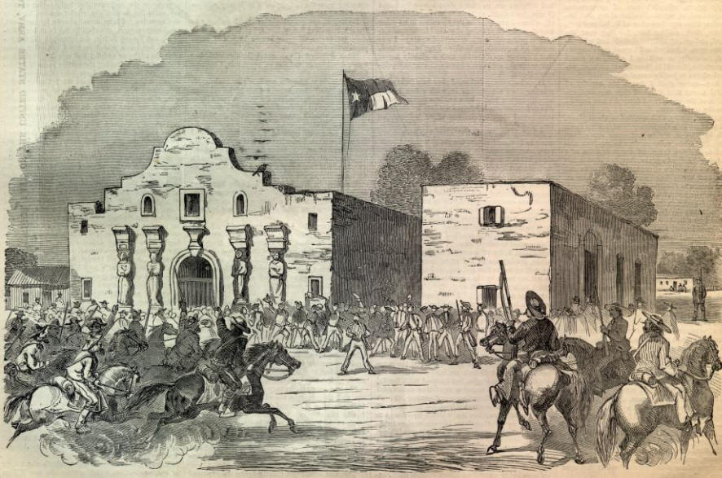
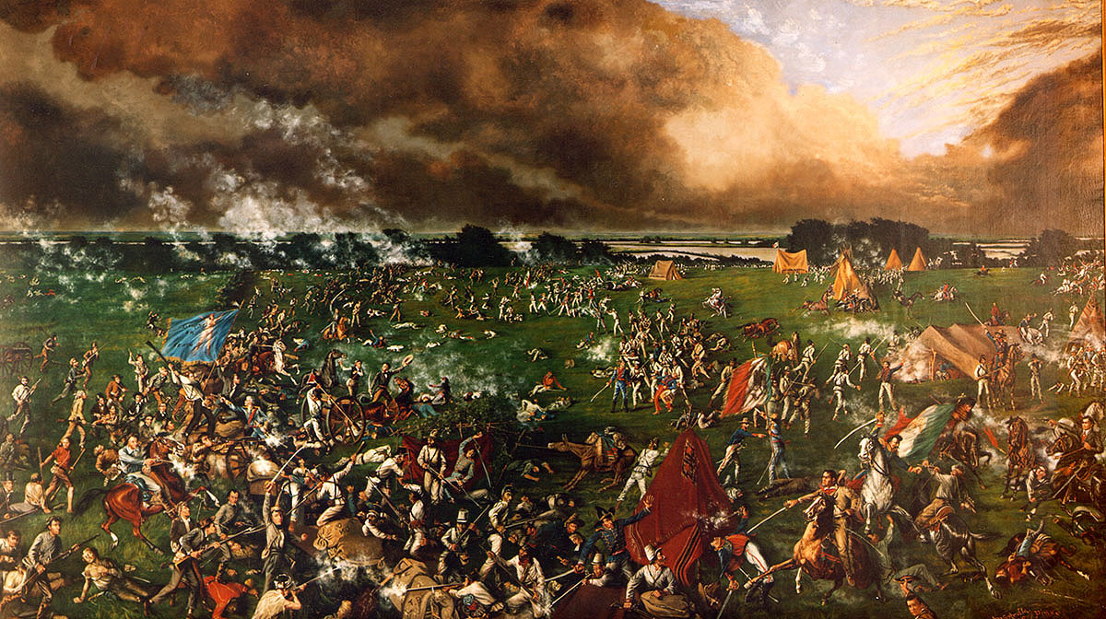
Texas War for Independence
1835-1836
The Alamo (1836)
San Jacinto (1836)
Outnumbered Texans defeated
Prisoners executed
DECISIVE Texas Victory
“Remember the Alamo!”

Slide 13
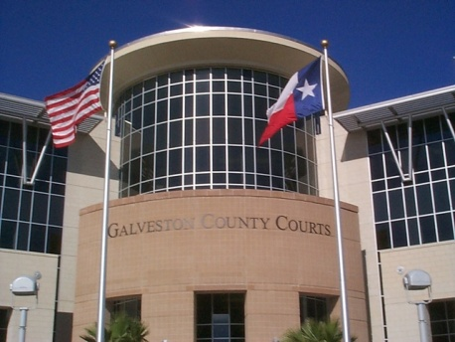
The “Lone Star” Republic

Slide 14
Opening Texas to America
Mexico gained control of Texas after achieving independence from Spain
  Inhabitants called Tejanos
Mexico decided to open up Texas to settlers from the U.S. granted land to immigrants, as long as they became Mexican citizens, obeyed Mexican law, and converted to Catholicism
Under the National Colonization Act, empresarios, or contractors, were granted large land grants in exchange to fill the land with a certain number of settlers

Slide 15
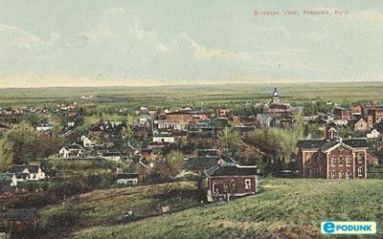
Distrust amongst empresarios
The Mexican government began to distrust the empresarios because they still had loyalty to the U.S.
  rebellion to establish “Fredonia”
In 1830, Mexico closed its borders to any additional immigration and placed taxes on foreign goods
  angered the settlers

Slide 16
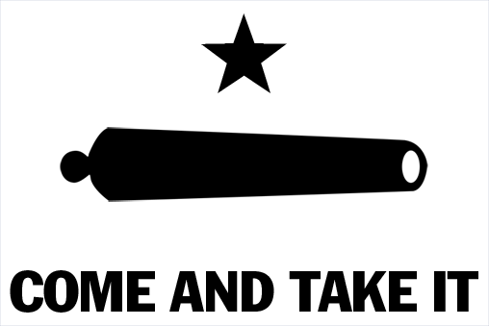
War…Texas style
Two conventions were held to negotiate with Mexico into opening borders
  Once President Antonio Lopez de Santa Anna became dictator, negotiations were useless and war was inevitable
Texas army, despite having men with little training, took early victories in Gonzalez and San Antonio

Slide 17
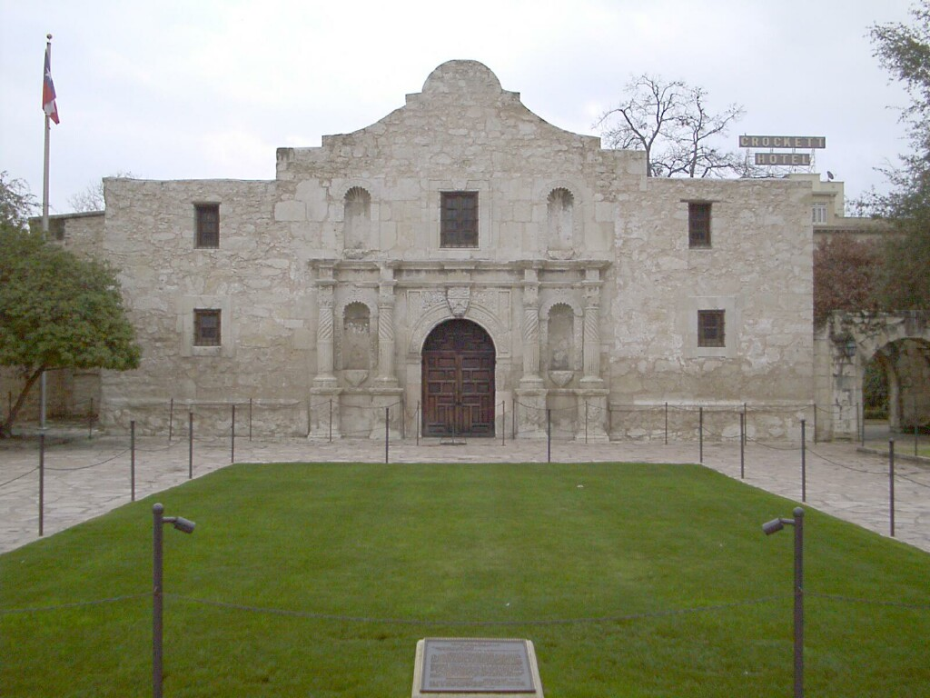
Mexico fights back, hardcore
Former governor Sam Houston took command of the Texas Army
Mexico raised 6,000 soldiers, and took victories at the Alamo and Goliad
  Angered Texas rebels and Americans due to the brutality of the sieges

Slide 18
Remember the Alamo and Goliad!
Houston waited until Santa Anna made a mistake
  San Jacinto: soldiers took afternoon nap, Houston attacked; took less than 20 minutes
  One of the captured was Santa Anna, who was forced to sign a treaty recognizing Texas as an independent state
Texas sought for annexation, or becoming part of the United States
  North refused because they thought it would be a slave state
  Jackson refused to recognize Texas as a nation until the last day of his presidency

Slide 19
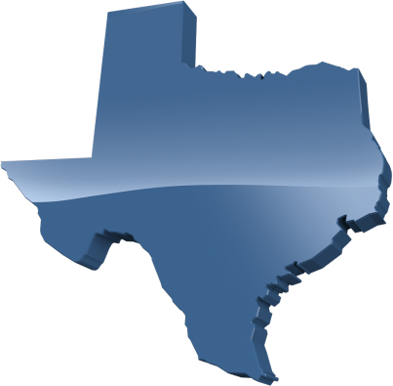
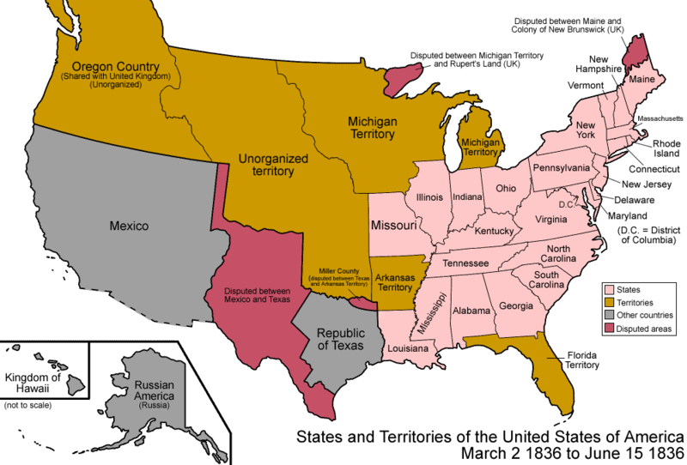
Annexation of Texas
1837 – Texas petitions the U.S. for annexation
United States: NO!
TWO REASONS:
Border Dispute
The Balance
of Power

Slide 20
Border Dispute
The Republic of Texas claimed the Rio Grande as its border with Mexico.
The government of Mexico didn’t recognize this border.
Annexation =
War with Mexico?

Slide 21
A Delicate Balance
Slave States | Year | Free States | Year
Delaware | 1787 | New Jersey | 1787
Georgia | 1788 | Pennsylvania | 1787
Maryland | 1788 | Connecticut | 1788
S. Carolina | 1788 | Massachusetts | 1788
Virginia | 1788 | New Hampshire | 1788
N. Carolina | 1789 | New York | 1788
Kentucky | 1792 | Rhode Island | 1790
Tennessee | 1796 | Vermont | 1791
Louisiana | 1812 | Ohio | 1803
Slave States | Year | Free States | Year
Mississippi | 1817 | Indiana | 1816
Alabama | 1819 | Illinois | 1818
Missouri | 1821 | Maine | 1820
Arkansas | 1836
Expansion = Internal Strife

Slide 22
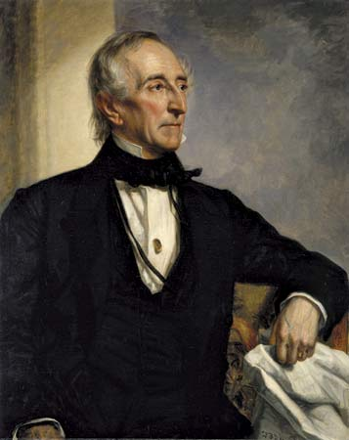
Issues with Texas
President John Tyler hoped to bring Texas into the Union, but opposition followed
  Texas supported slavery, so they would become a slave state
  Mexico never recognized Texas as a nation
  Included a letter from Calhoun that defended slavery, which angered Northerners
His efforts to annex Texas ruined his chances at a second term

Slide 23
Meanwhile…
John Gast, American Progress, 1872
Notes:
John Gast, American Progress, 1872

Slide 24
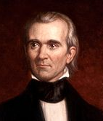
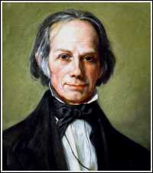
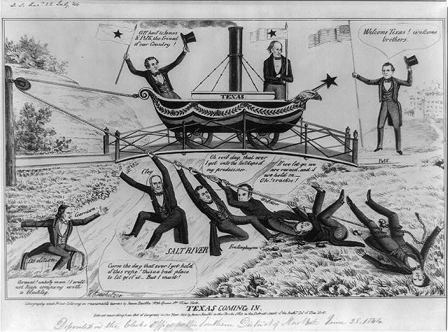
1844 Presidential Election
Main Issue:
Westward Expansion
vs.
James K. Polk
Democrat
Henry Clay
Whig
PRO-EXPANSION
ANTI-EXPANSION
Political Cartoon

Slide 25
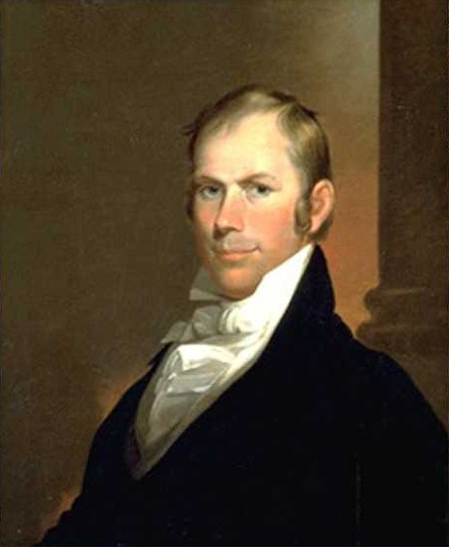
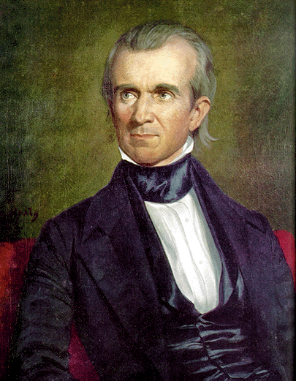
Election of 1844
Candidates:
  Henry Clay (Whig)
  James K. Polk (Democrat)
Tell me what each candidate promised, how they addressed the issue of Texas, and who won (pgs. 307-308)

Slide 27
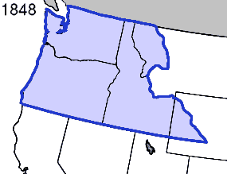
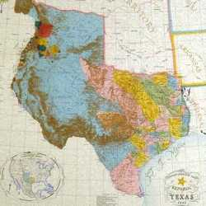
Annexing Oregon and Texas
President Polk took a strong stance on annexing the Oregon territory
  “Fifty-Four Forty or Fight!”
  agreed with Great Britain to take the territory up until Vancouver Island
Texas was annexed in 1845
  angered Mexicans and broke diplomatic relations
  Mexicans and Americans fought over border lines in the south-east

Slide 28
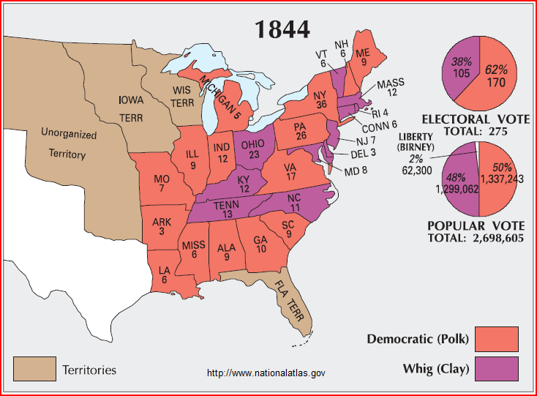
POLK WINS

Slide 29
ANNEXED
1845 by a joint resolution of Congress

Slide 30
The Mexican War

Slide 31
Cockiness leads to war in 1845
Polk sent John Slidell to Mexico City as an envoy to meet with Mexican President Jose Joaquin Herrera
  would not meet with him
Polk ordered troops, led by General Zachary Taylor, into Mexican territory to conjure the Mexicans into firing first
  they did
Polk persuaded Congress to declare war on Mexico
  they did

Slide 32
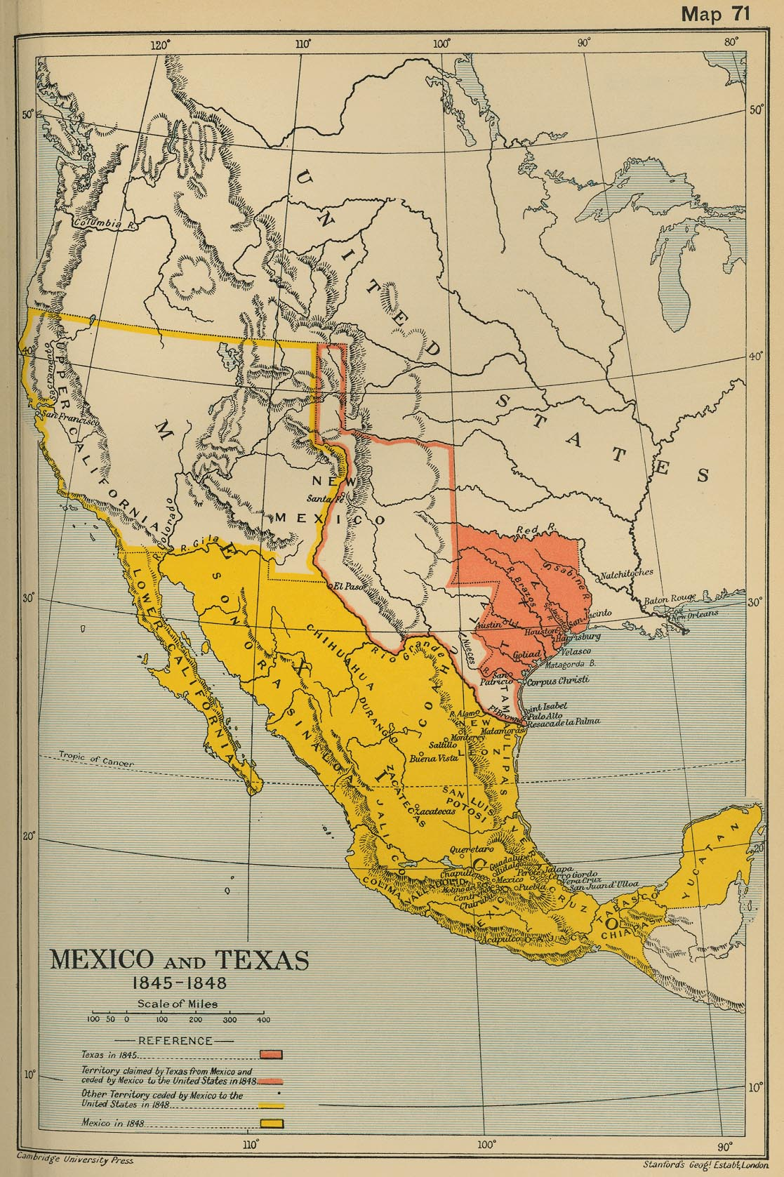
Fighting strategy
Polk and advisors devised a three-step plan to win the war
  One force would continue to move south
  Another force would capture Sante Fe, a major trading center, in the northwest
  All forces would advance and capture Mexico City
73,000 volunteers signed up to fight, but they were less than ideal

Slide 33
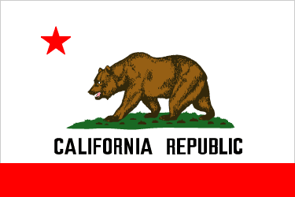
Not a complex war
From the beginning, the United States succeeded in its military strategy and began taking Mexican territory
John C. Fremont led a revolt in California against Mexico
  established the Bear Flag Republic, later acquired by the United States
Polk sent Gen. Winfield Scott to head the third phase of the war strategy
  Took Mexico City in 1847

Slide 34
Manifest Destiny
John Gast, American Progress, 1872
Notes:
John Gast, American Progress, 1872

Slide 35
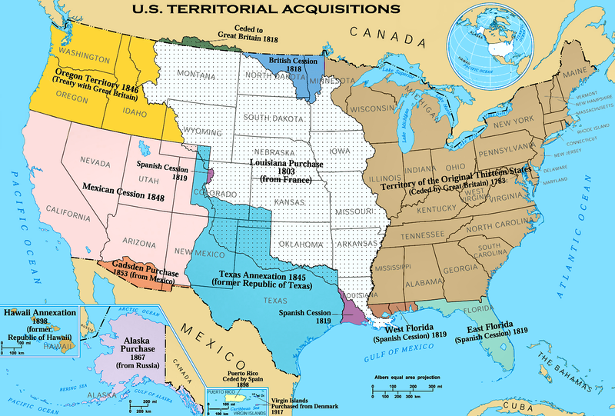

Almost There...
Oregon
Treaty
Louisiana Purchase
Texas
Annexation

Slide 36
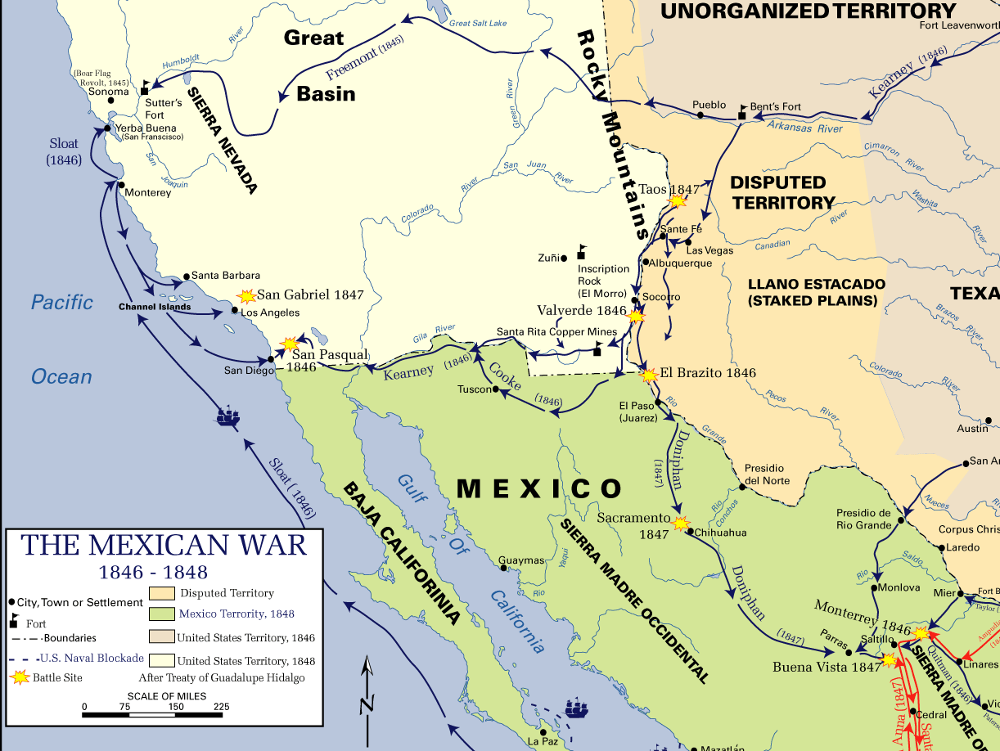
WAR!!!

Slide 37
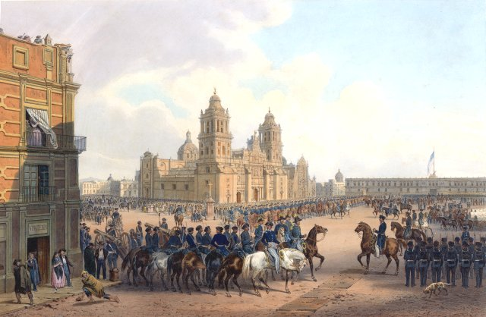
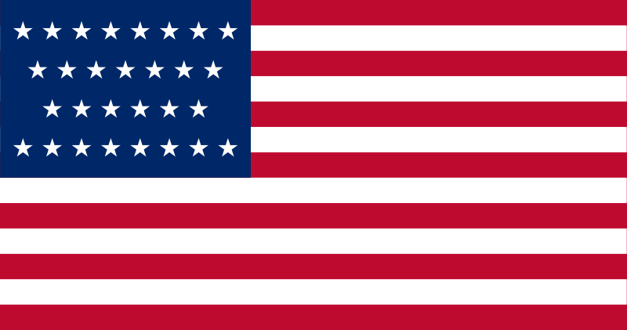
Occupation of Mexico City
BIG WIN
Painting by Carl Nebel

Slide 38
Not a complex war
From the beginning, the United States succeeded in its military strategy and began taking Mexican territory
John C. Fremont led a revolt in California against Mexico
  established the Bear Flag Republic, later acquired by the United States
Polk sent Gen. Winfield Scott to head the third phase of the war strategy
  Took Mexico City in 1847

Slide 39
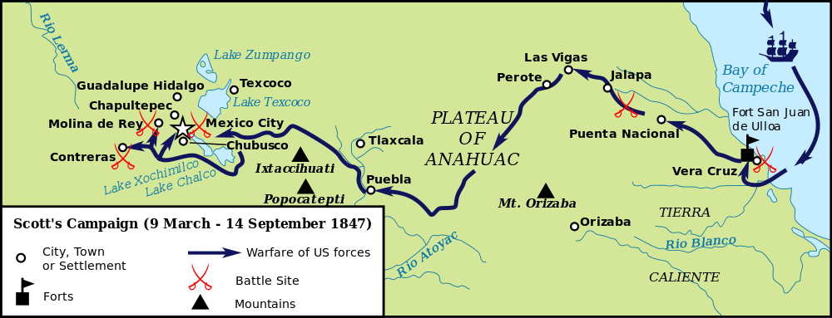
Gen. Scott’s Campaign

Slide 40
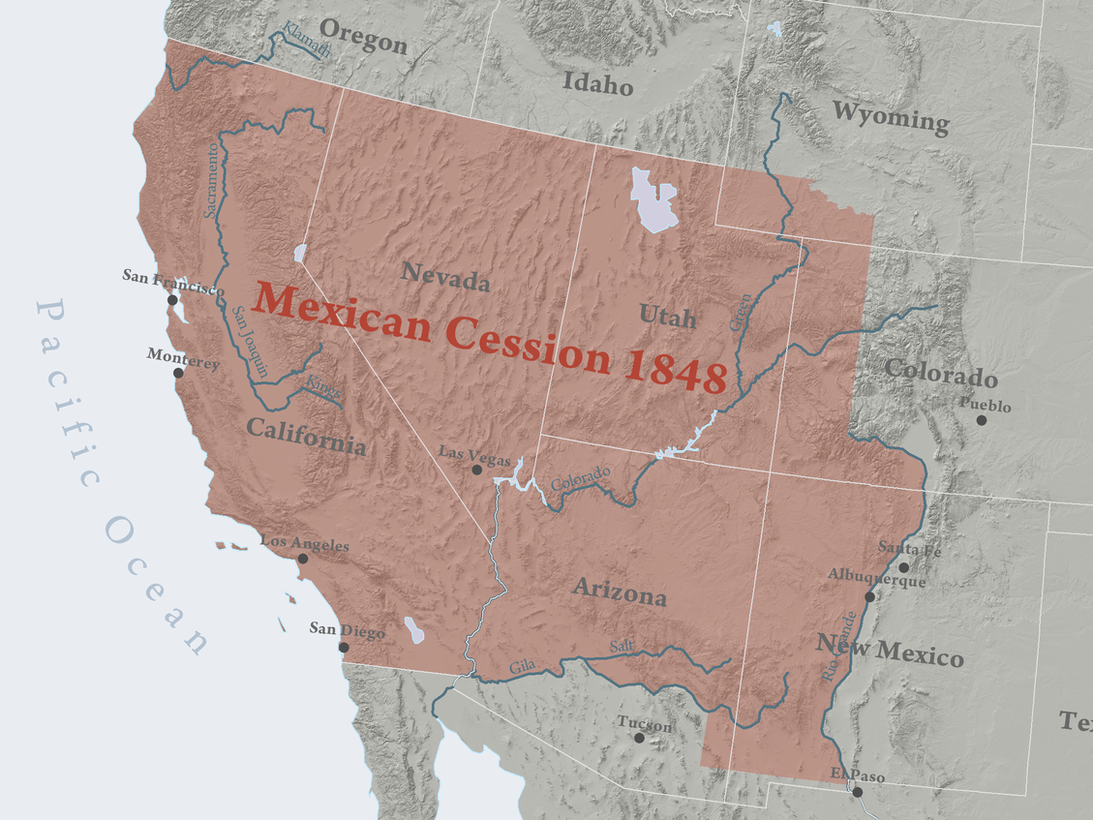
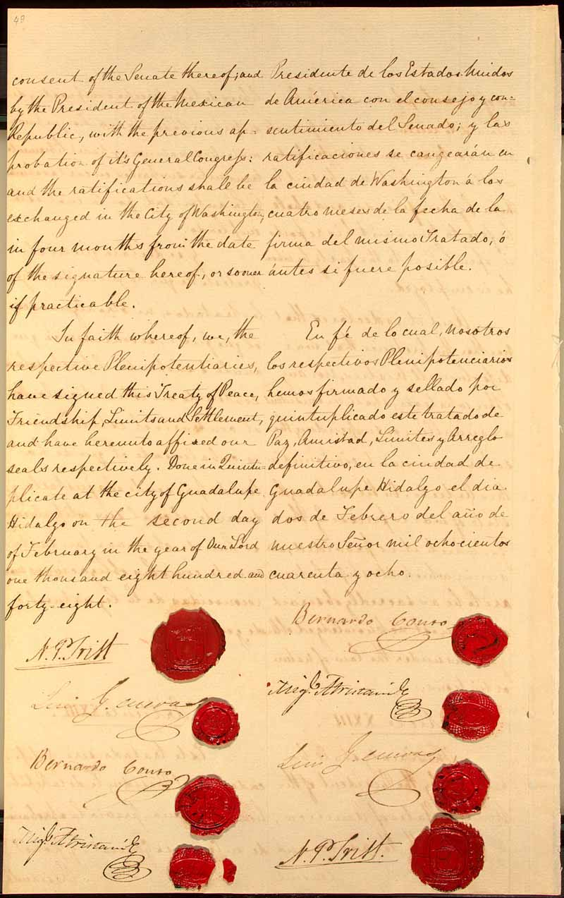
Mexican Cession
1848
Treaty of
Guadalupe Hidalgo

Slide 41
End of the war
With the fall of the capitol, Mexico signed the Treaty of Guadalupe Hidalgo
  Mexico ceded 500,000 square miles of territory to the U.S. (California, Utah, Nevada, and parts of New Mexico, Arizona, Colorado, Wyoming
  Accepted the Rio Grande as the southern border of Texas
  U.S. paid Mexico $15 million and agreed to take $3.25 million in debts Mexico owed to American citizens
Manifest Destiny was realized after the war

Slide 42
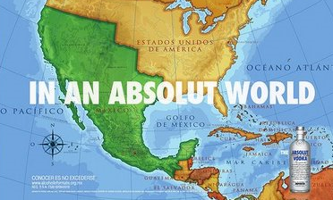
A Continuing Controversy...

Slide 43
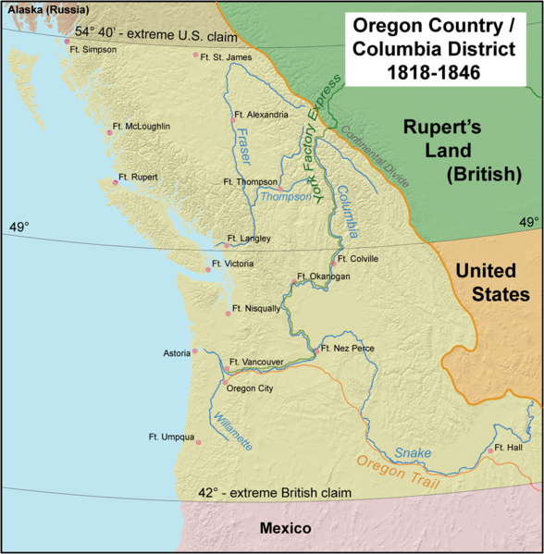
Oregon Treaty
1846
54°40’ (or fight)
U.S. compromises with Britain on Oregon border
49° (Britain Calls Bluff)
Map by Kmusser

