Slide 1
CRITICS OF THE NEW DEAL
Hostility toward FDR came from both the right and the left
New Deal proposed too many restrictions on business
Expanded power of federal government at expense of states’ rights
Deficit spending
More dramatic government intervention
Shift wealth from rich to middle income and poor Americans

Slide 2
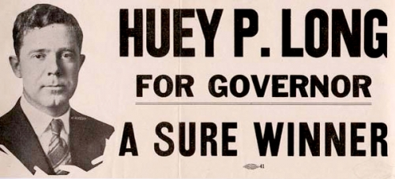
CRITICS OF THE NEW DEAL
Huey Long: “The King Fish”

Slide 3
CRITICS OF THE NEW DEAL
Huey Long: “The King Fish”
Democratic governor/senator (Louisiana)
Charismatic populist orator
“Everyman a King” “Share Our Wealth”

Slide 4
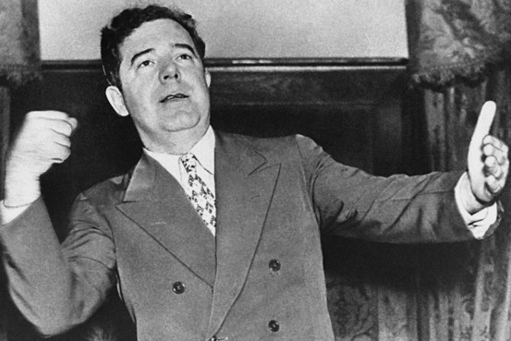
CRITICS OF THE NEW DEAL
Huey Long: “The King Fish”
Democratic governor/senator (Louisiana)
Charismatic populist orator
“Everyman a King” “Share Our Wealth”
Planned to challenge for the presidency in 1936

Slide 5
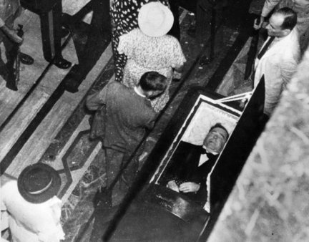
CRITICS OF THE NEW DEAL
Huey Long: “The King Fish”
Democratic governor/senator (Louisiana)
Charismatic populist orator
“Everyman a King” “Share Our Wealth”
Planned to challenge for the presidency in 1936
Shot by assassin on 09/08/35… died two days later

Slide 6
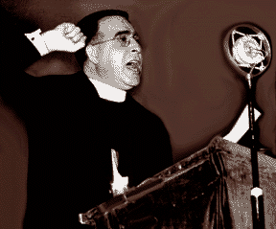
CRITICS OF THE NEW DEAL
Father Coughlin
Catholic priest from Detroit
Popular radio show (40 million weekly listeners)
Had become impatient with modest New Deal reforms
National Union for Social Justice

Slide 7
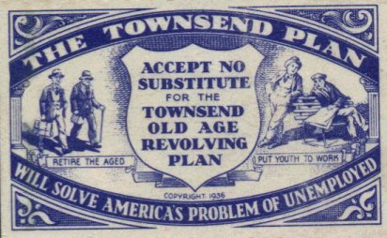
CRITICS OF THE NEW DEAL
The Townsend Plan: (Dr. Francis Townsend)
Forced retirement of all Americans 60 and over
Federal stipend of $200/month
Had to spend entire allotment each month

Slide 8
CRITICS OF THE NEW DEAL
The Townsend Plan: (Dr. Francis Townsend)
Forced retirement of all Americans 60 and over
Federal stipend of $200/month
Had to spend entire allotment each month
Free up jobs and thus lower the unemployment rate
Stimulate the economy

