Slide 1
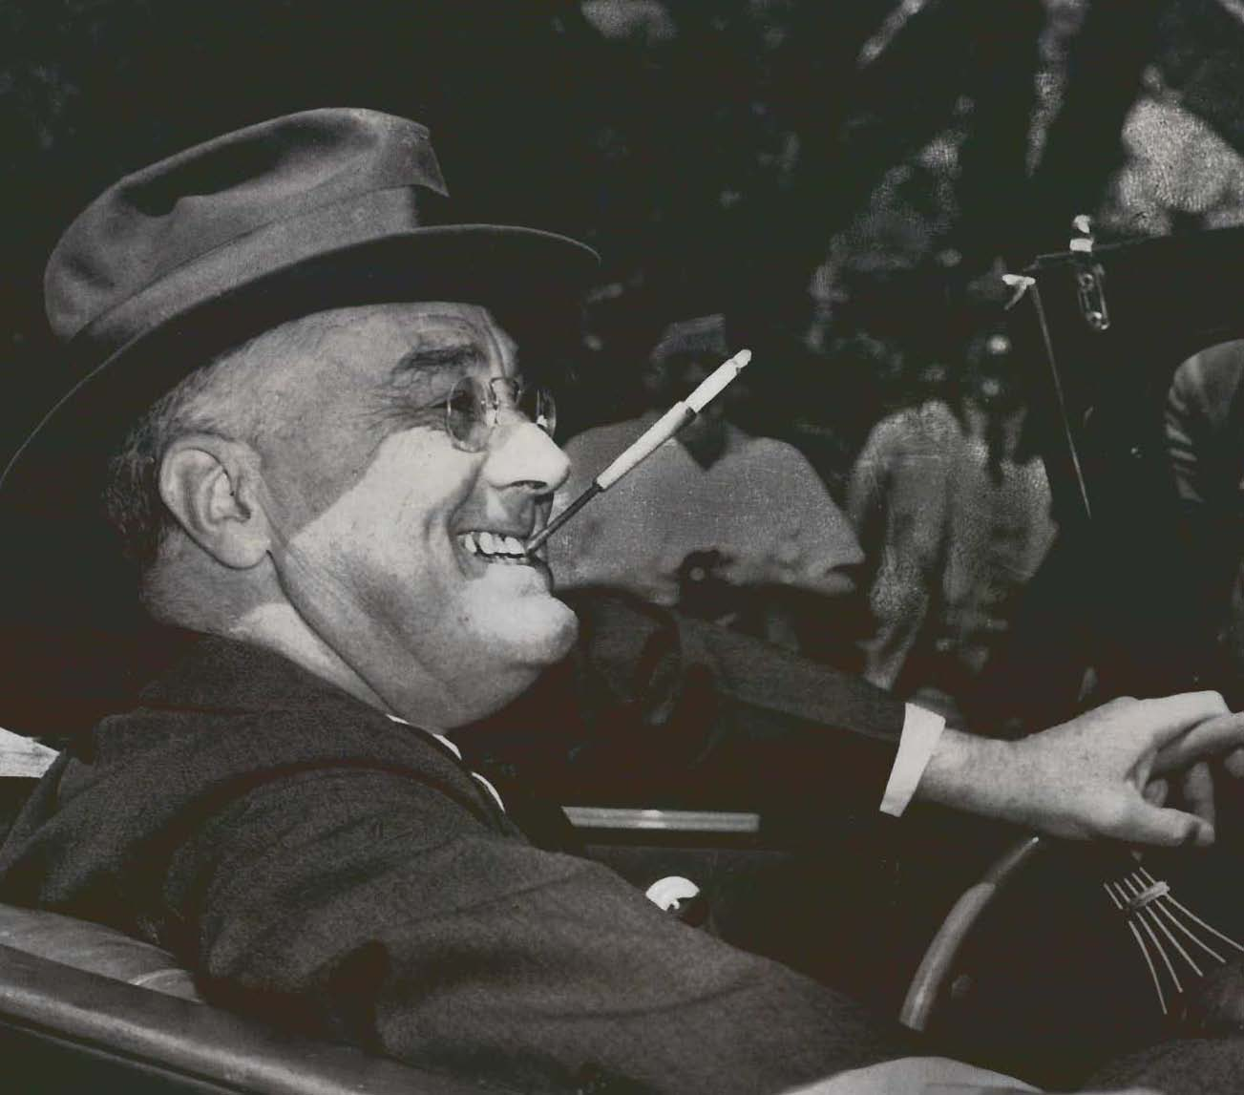
ROOSEVELT and THE NEW DEAL

Slide 2
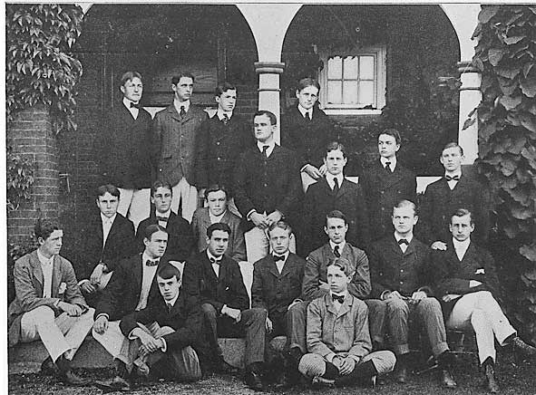
RISE TO POWER
Profile:
Born in 1882 to a wealthy New York Family (Hyde Park)
Distant cousin of Theodore
Undergraduate: Harvard / Graduate: Columbia
Married Teddy’s niece Eleanor

Slide 3
RISE TO POWER
Politics:
1910 won seat in NY State Senate
Progressive reformer
Supported Wilson in 1912
Appointed assistant secretary of the navy (WWI)
1920 Democrat nominee for VP

Slide 4
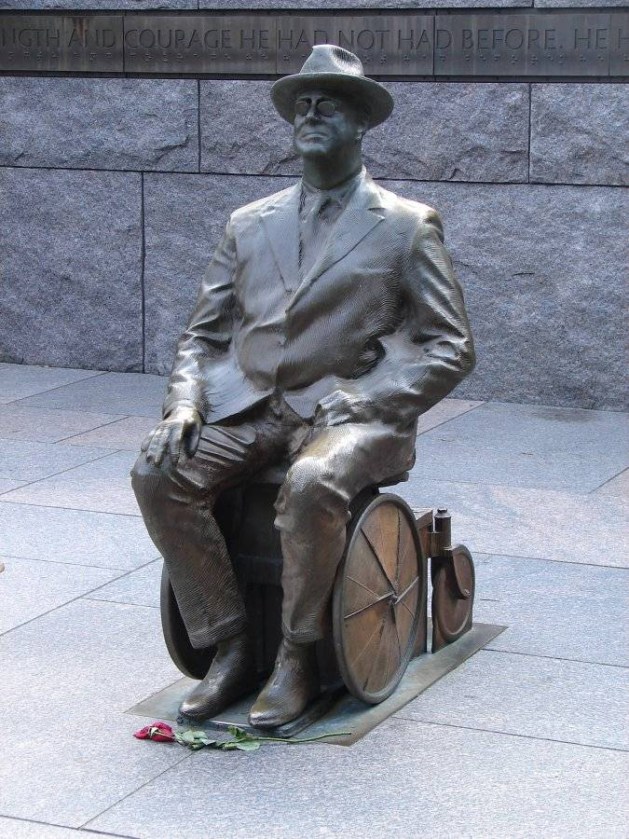
RISE TO POWER
Polio:
Eleanor’s role
Charity

Slide 5
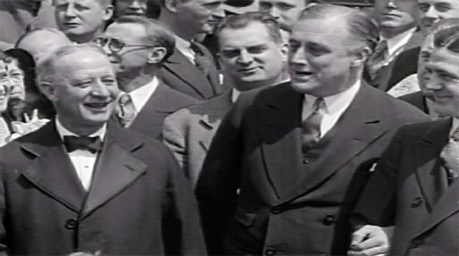
RISE TO POWER
Governor of New York:
1928 Governor of NY (replacement)
Used power to alleviate economic distress
Energy and optimism (popularity soared)

Slide 6
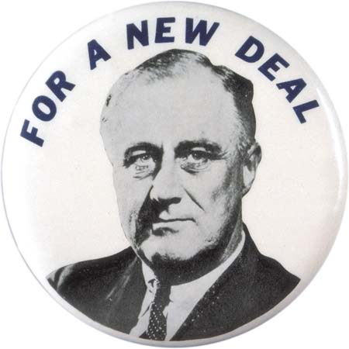
ELECTION OF 1932
National Convention:
“I pledge you, I pledge myself, to a new deal for the American People” – FDR

Slide 7
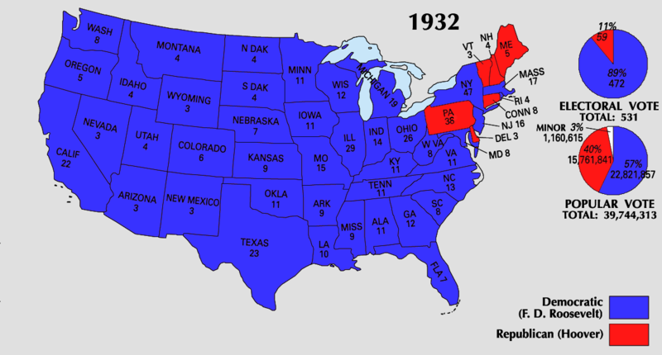
ELECTION OF 1932
National Convention:
“I pledge you, I pledge myself, to a new deal for the American People” - FDR
FDR defeated incumbent Herbert Hoover (electoral votes: 472-59)

Slide 8
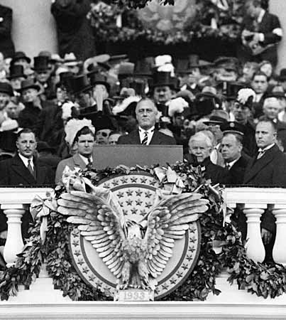
ELECTION OF 1932
Inauguration: March 4, 1933
Unemployment:
Continued to rise throughout the winter (1932-1933)
Reached 25%

Slide 9
ELECTION OF 1932
Inauguration: March 4, 1933
Unemployment:
Continued to rise throughout the winter (1932-1933)
Reached 25%
Bank runs had steadily increased:
Value of U.S. dollar decreased
4,000 banks closed (9 million accounts)
Bank Holidays

Slide 10
ELECTION OF 1932
Inauguration: March 4, 1933
Unemployment:
Continued to rise throughout the winter (1932-1933)
25%
Bank runs had steadily increased:
Value of U.S. dollar decreased
4,000 banks closed (9 million accounts)
Bank Holidays
“First of all… let me assert my firm belief
that the only thing we have to fear is fear itself”

Slide 11
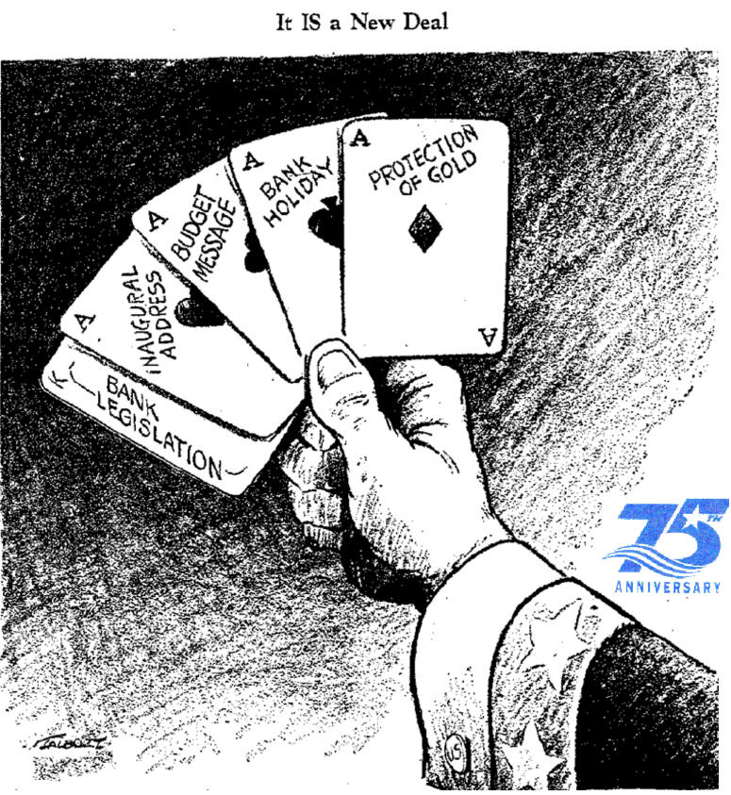
THE FIRST NEW DEAL
The First Hundred Days:
“Brain Trust”
Academics
Business
Agriculture
Government
Law
Social work
Bold experimentation and intervention
March-June:
Congress passes 15 major acts to combat
the depression (First New Deal)
Unprecedented legislative pace

Slide 12
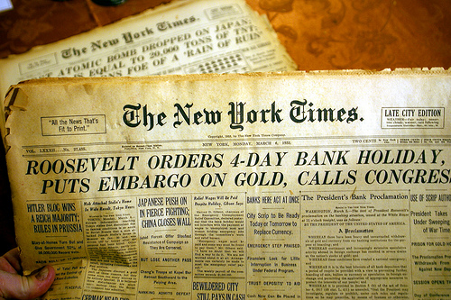
BANKING CRISIS
FDR’s top priority was to restore confidence in banking
National Bank Holiday
Special session of Congress (March 9, 1933)

Slide 13
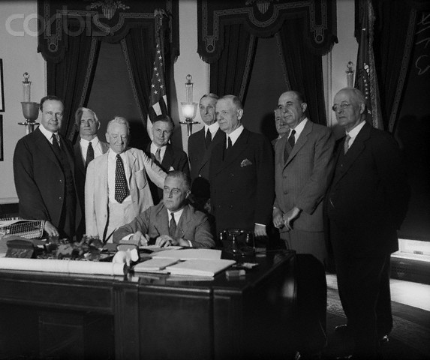
BANKING CRISIS
FDR’s top priority was to restore confidence in banking
National Bank Holiday
Special session of Congress (March 9, 1933)
Emergency Banking Relief Act
Federal review of all banks
Licenses issued by Treasury Department to sound banks

Slide 14
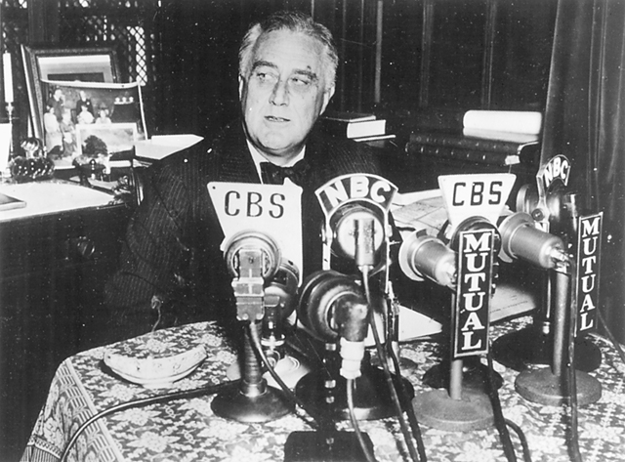
BANKING CRISIS
FDR’s top priority was to restore confidence in banking
National Bank Holiday
Special session of Congress (March 9, 1933)
Emergency Banking Relief Act
Federal review of all banks
Licenses issued by Treasury Department to sound banks
Fireside Chats:
First of many occurred on March 12, 1933
60 million listeners
Topic and method

Slide 15
BANKING CRISIS
FDR’s top priority was to restore confidence in banking
National Bank Holiday
Special session of Congress (March 9, 1933)
Emergency Banking Relief Act
Federal review of all banks
Licenses issued by Treasury Department to sound banks
Fireside Chats:
First of many occurred on March 12, 1933
60 million listeners
Topic and method
Result:
March 13, 1933 deposits far outweighed withdrawals
Banking crisis was over

Slide 16
INVESTMENTS
Securities Act of 1933: (stock market)

Slide 17
INVESTMENTS
Securities Act of 1933: (stock market)
Complete and truthful information to investors

Slide 18
INVESTMENTS
Security and Exchange Commission:

Slide 19
INVESTMENTS
Security and Exchange Commission:
Independent agency to regulate the market and prevent fraud

Slide 20
INVESTMENTS
Federal Deposit Insurance Corporation:

Slide 21
INVESTMENTS
Federal Deposit Insurance Corporation:
Government insurance for bank deposits

Slide 22
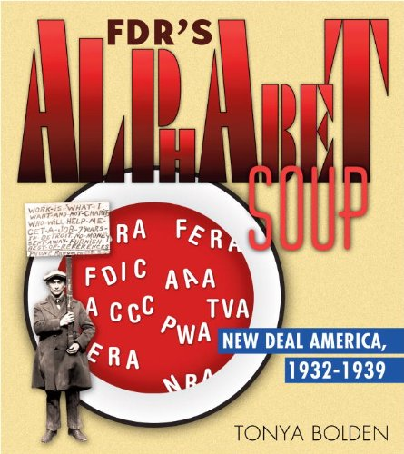

Slide 23
ALPHABET SOUP
AGENCY | AKA | FUNCTION
 | CCC
 | TVA
 | AAA
 | FERA
 | NRA
 | FDIC
 | PWA
 | HOLC
 | FCA
 | SEC
 | CWA

Slide 24
CHAPTER 23 QUIZ
U.S. President who gave FDR his first federal appointment.
In 1920, FDR lost his bid for this office.
For much of his adult life FDR battled this disease.
In 1928, FDR replaced this man as Governor of New York.
“I pledge you, I pledge myself, to a __________ for the American People.” - FDR
Strategy first used by FDR on March 12, 1933 to reach the American people in an attempt restore their confidence in the banking system.
Agency that provided government sponsored insurance to participating banks.
Agency that was created to regulate the stock market and reduce fraud.
Agency that provided subsidies to farmers who agreed to produce less.
Agency that helped Americans avoid foreclosure by refinancing their mortgages.

Slide 25
CRITICS OF THE NEW DEAL
Hostility toward FDR came from both the right and the left
New Deal proposed too many restrictions on business
Expanded power of federal government at expense of states’ rights
Deficit spending
More dramatic government intervention
Shift wealth from rich to middle income and poor Americans

Slide 26
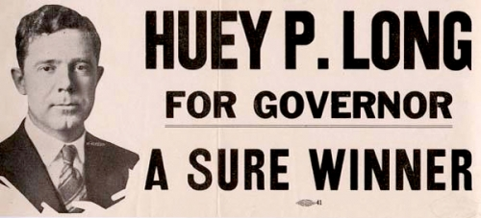
CRITICS OF THE NEW DEAL
Huey Long: “The King Fish”

Slide 27
CRITICS OF THE NEW DEAL
Huey Long: “The King Fish”
Democratic governor/senator (Louisiana)
Charismatic populist orator
“Everyman a King” “Share Our Wealth”

Slide 28
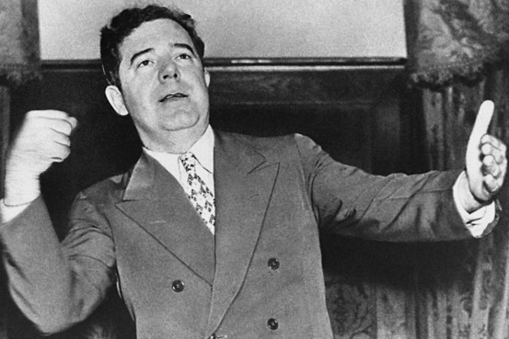
CRITICS OF THE NEW DEAL
Huey Long: “The King Fish”
Democratic governor/senator (Louisiana)
Charismatic populist orator
“Everyman a King” “Share Our Wealth”
Planned to challenge for the presidency in 1936

Slide 29
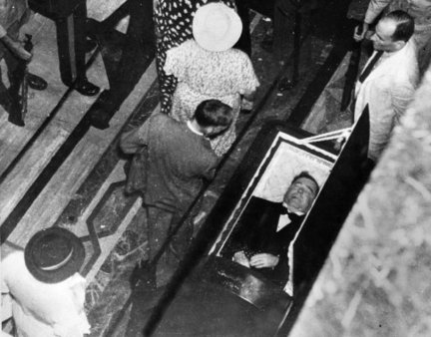
CRITICS OF THE NEW DEAL
Huey Long: “The King Fish”
Democratic governor/senator (Louisiana)
Charismatic populist orator
“Everyman a King” “Share Our Wealth”
Planned to challenge for the presidency in 1936
Shot by assassin on 09/08/35… died two days later

Slide 30
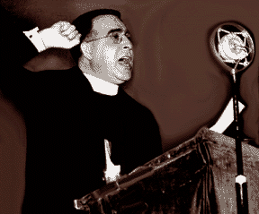
CRITICS OF THE NEW DEAL
Father Coughlin
Catholic priest from Detroit
Popular radio show (40 million weekly listeners)
Had become impatient with modest New Deal reforms
National Union for Social Justice

Slide 31
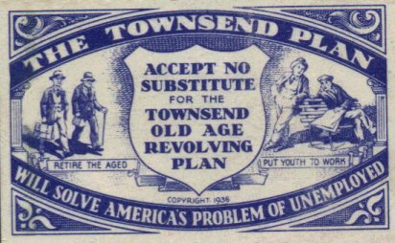
CRITICS OF THE NEW DEAL
The Townsend Plan: (Dr. Francis Townsend)
Forced retirement of all Americans 60 and over
Federal stipend of $200/month
Had to spend entire allotment each month

Slide 32
CRITICS OF THE NEW DEAL
The Townsend Plan: (Dr. Francis Townsend)
Forced retirement of all Americans 60 and over
Federal stipend of $200/month
Had to spend entire allotment each month
Free up jobs and thus lower the unemployment rate
Stimulate the economy

Slide 33
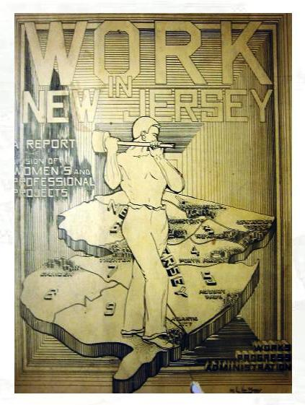
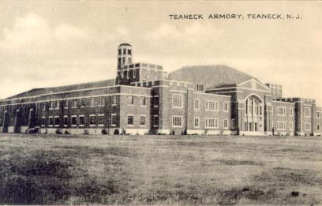
THE SECOND NEW DEAL
WPA: Works Progress Administration
$11 billion budget
8.5 million workers
650,000 miles of roads
125,000 public buildings
124,000 bridges
8,000 parks
853 airports

Slide 34
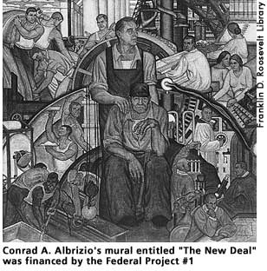
THE SECOND NEW DEAL
WPA: Works Progress Administration
$11 billion budget
8.5 million workers
650,000 miles of roads
125,000 public buildings
124,000 bridges
8,000 parks
853 airports
Federal Number One
Highly controversial program
Used federal money to offer work
to artists, musicians, etc

Slide 35
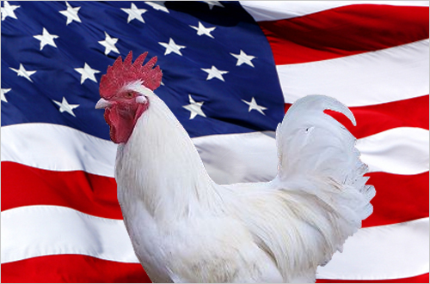
THE SECOND NEW DEAL
Schechter vs. United States: (The Sick Chicken Case)
May 27, 1935 Supreme Court struck down the NIRA (WPA funding)
Schechter brothers sued after violating NIRA code (poultry business)
Court ruled that the Constitution did not allow Congress to delegate its powers to the executive branch, thus the NIRA was illegal

Slide 36
THE SECOND NEW DEAL
Schechter vs. United States: (The Sick Chicken Case)
May 27, 1935 Supreme Court struck down the NIRA (WPA funding)
Schechter brothers sued after violating NIRA code (poultry business)
Court ruled that the Constitution did not allow Congress to delegate its powers to the executive branch, thus the NIRA was illegal
The entire New Deal platform was now in jeopardy

Slide 37
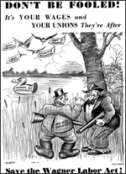
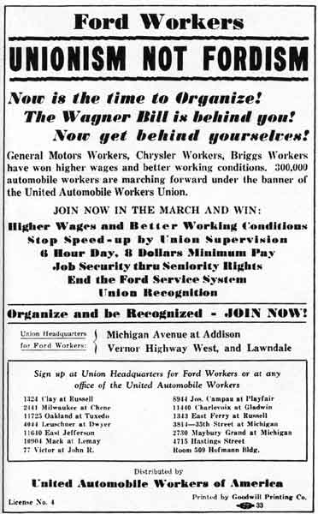
THE SECOND NEW DEAL
National Labor Restrictions Act: (Wagner Act)
Guaranteed workers the right to organize
Guaranteed workers the right to bargain collectively
National Labor Relations Board
Binding arbitration
“Cease and desist” orders against unfair practices

Slide 38
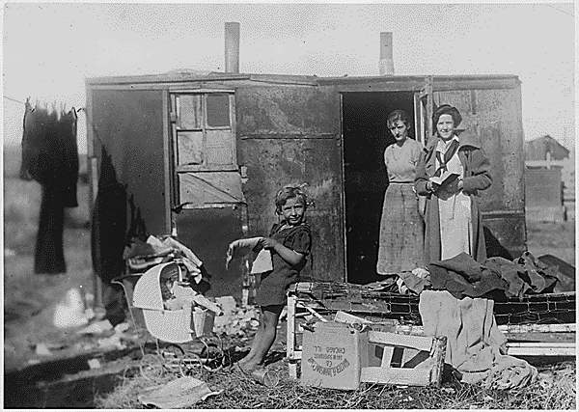
SOCIAL SECURITY
Social Security Act of 1935
Goal was to provide security for the elderly and unemployed
Also provided welfare for disabled and needy families

Slide 39
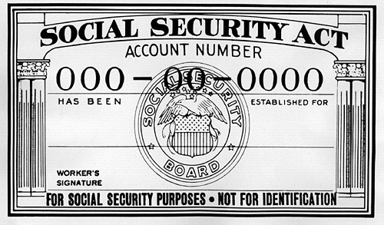
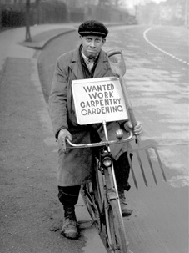
SOCIAL SECURITY
Social Security Act of 1935
Goal was to provide security for the elderly and unemployed
Also provided welfare for disabled and needy families
Monthly retirement benefit (65 and older)
Unemployment insurance – temporary benefit

Slide 40
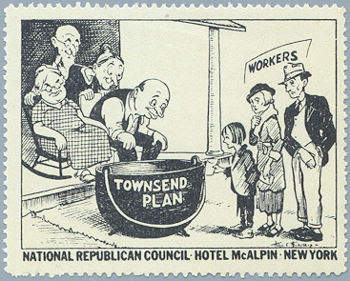
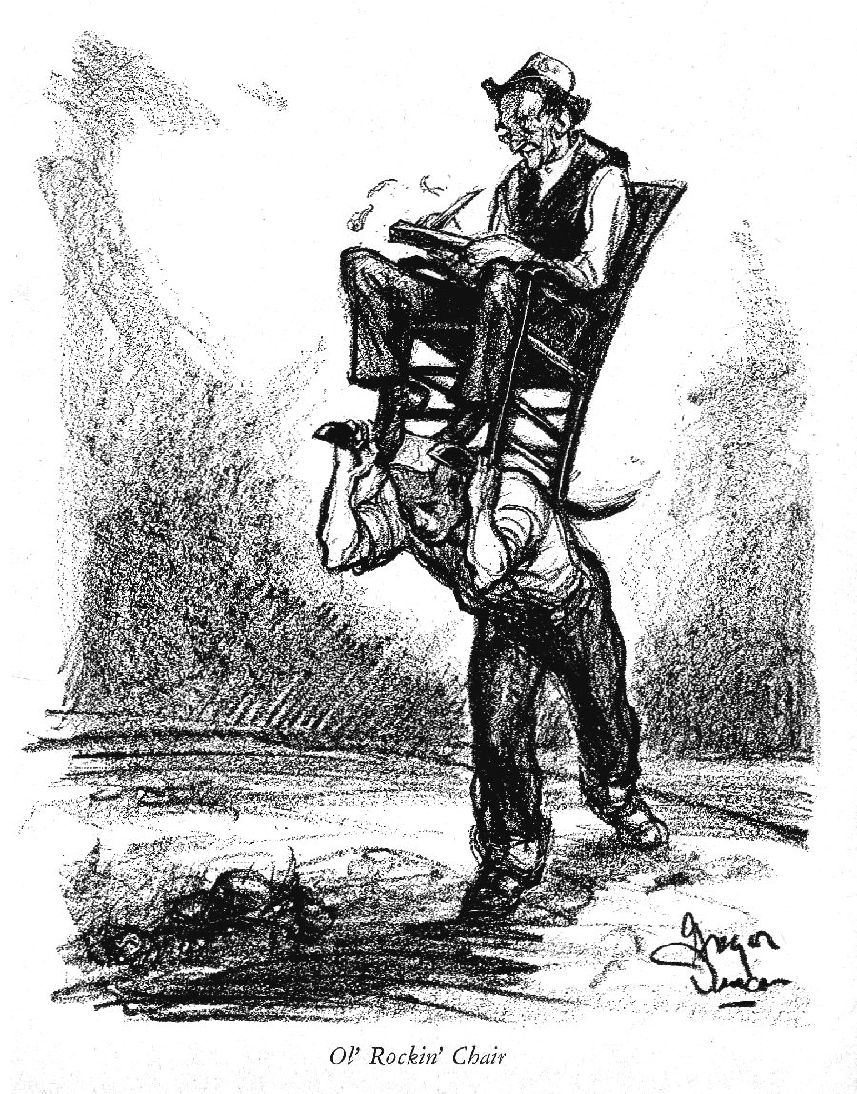
SOCIAL SECURITY
Social Security Act of 1935
Harsh criticism of funding plan (payroll taxes)
FDR argued that these taxes gave contributors a legal and moral right to collect in the future
“No politician can ever scrap my social security program” - FDR

Slide 41
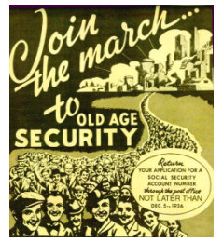
SOCIAL SECURITY
Social Security Act of 1935
Harsh criticism of funding plan (payroll taxes)
FDR argued that these taxes gave contributors a legal and moral right to collect in the future
“No politician can ever scrap my social security program” - FDR
S.S. firmly established the idea that the federal government should be responsible for those who, through no fault of their own, were unable to work

Slide 42
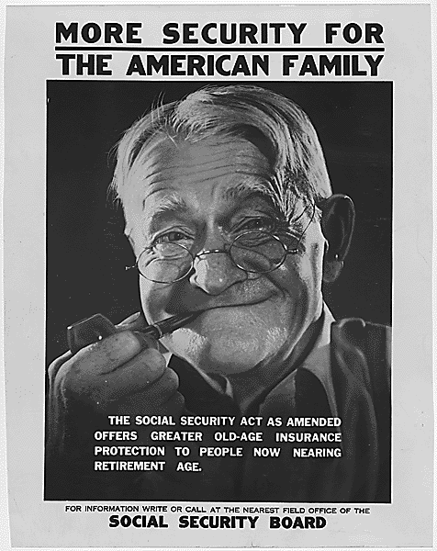
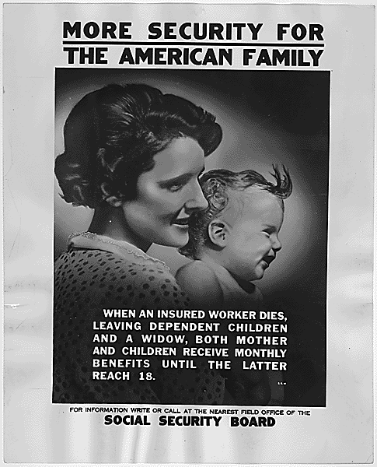
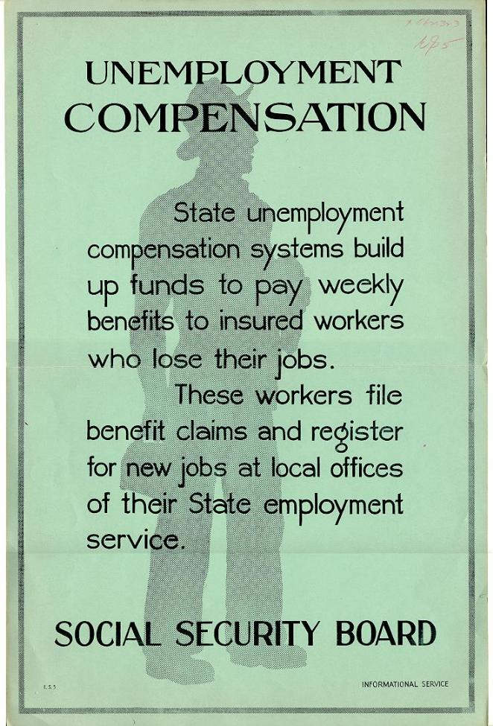
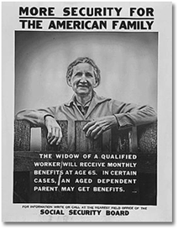
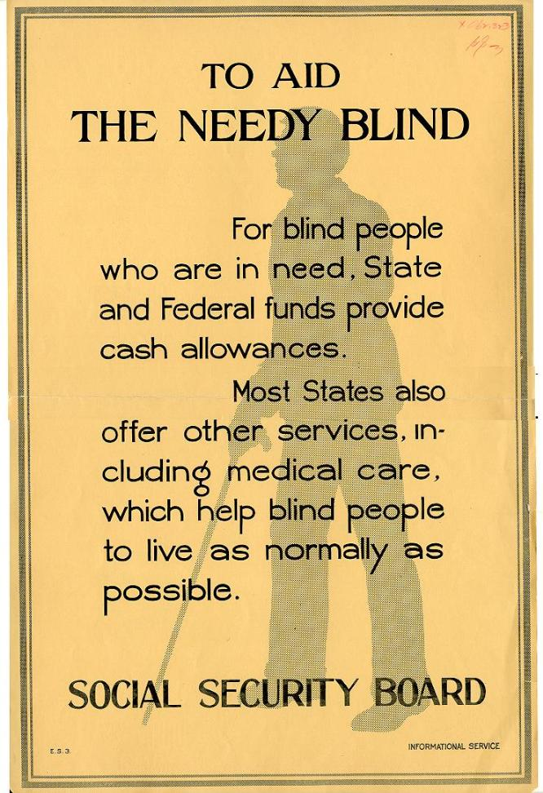

Slide 43
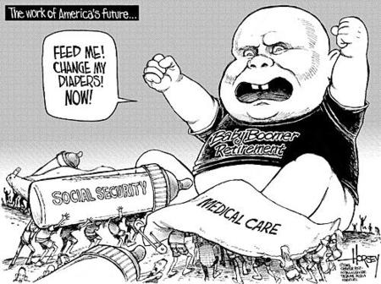
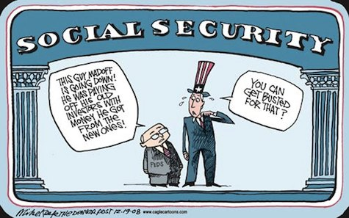
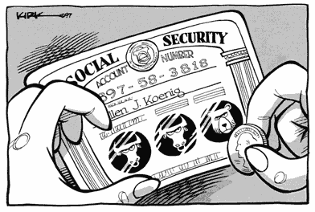
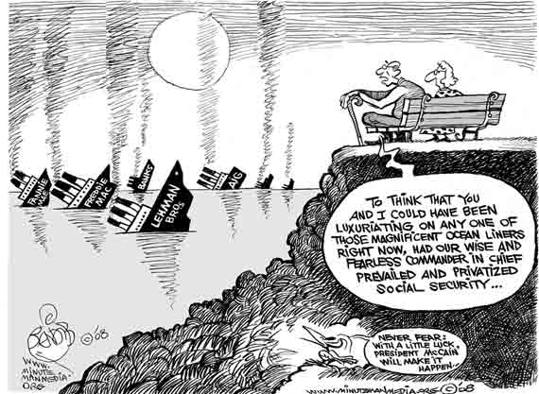
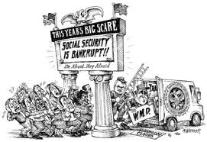

Slide 44
Social Security's future problems are equally predictable, even if their exact timing is uncertain. As millions of baby boomers approach retirement, the program's annual cash surplus will shrink and then disappear. Then, Social Security will not be able to pay full benefits from its payroll and other tax revenues. It will need to consume ever-growing amounts of general revenue dollars to meet its obligations--money that now pays for everything from environmental programs to highway construction to defense. Eventually, either benefits will have to be slashed or the rest of the government will have to shrink to accommodate Social Security.
The reason that Social Security's deficits are inevitable is fairly simple. Demographics are more predictable than most events. Millions of baby boomers began to retire in 2008, when those born in 1946 reached Social Security's retirement age of 65. From then until 2025, every year will see another crop of baby boomers reach the 65 year-old threshold. Because the baby boomers have not produced enough children to replace themselves, the number of taxpaying workers will shrink.
Demographic trends do not change rapidly. It takes about 25 years to grow a new taxpayer. We can estimate with surprising accuracy how many people born in a particular year will live to reach retirement. The retirees of 2070 were all born in 2005, and we can see and count them today.
This is critical, because a retiree's Social Security benefits are actually paid from the taxes of those who are still working. The program's finances are based on the relationship between the number of workers paying taxes and the number of retirees receiving benefits.
Back in 1950, as the baby boom was just getting started, each retiree's benefit was divided among 16 workers. Taxes could be kept low. Today, that number has dropped to 3.3 workers per retiree, and by 2025, it will reach--and remain at--about two workers per retiree. Each married couple will have to pay, in addition to their own family's expenses, Social Security retirement benefits for one retiree.

Slide 45
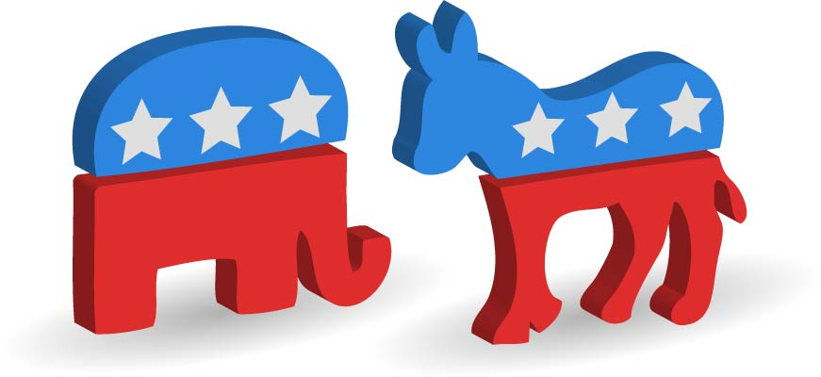
THE NEW DEAL COALITION
Party lines shift:

Slide 46
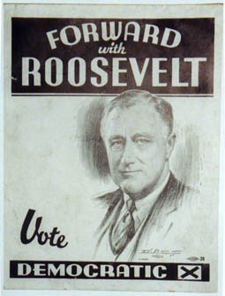
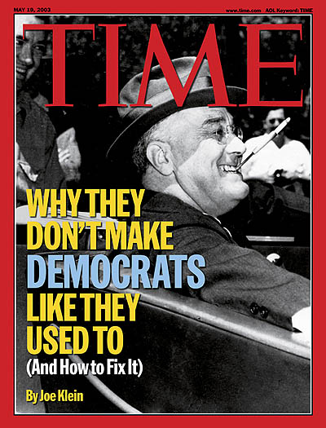
THE NEW DEAL COALITION
Party lines shift:
Millions of voters owed their jobs, mortgages, and bank accounts to the New Deal

Slide 47
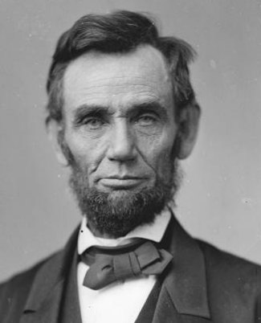
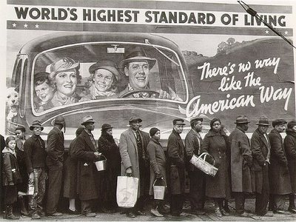
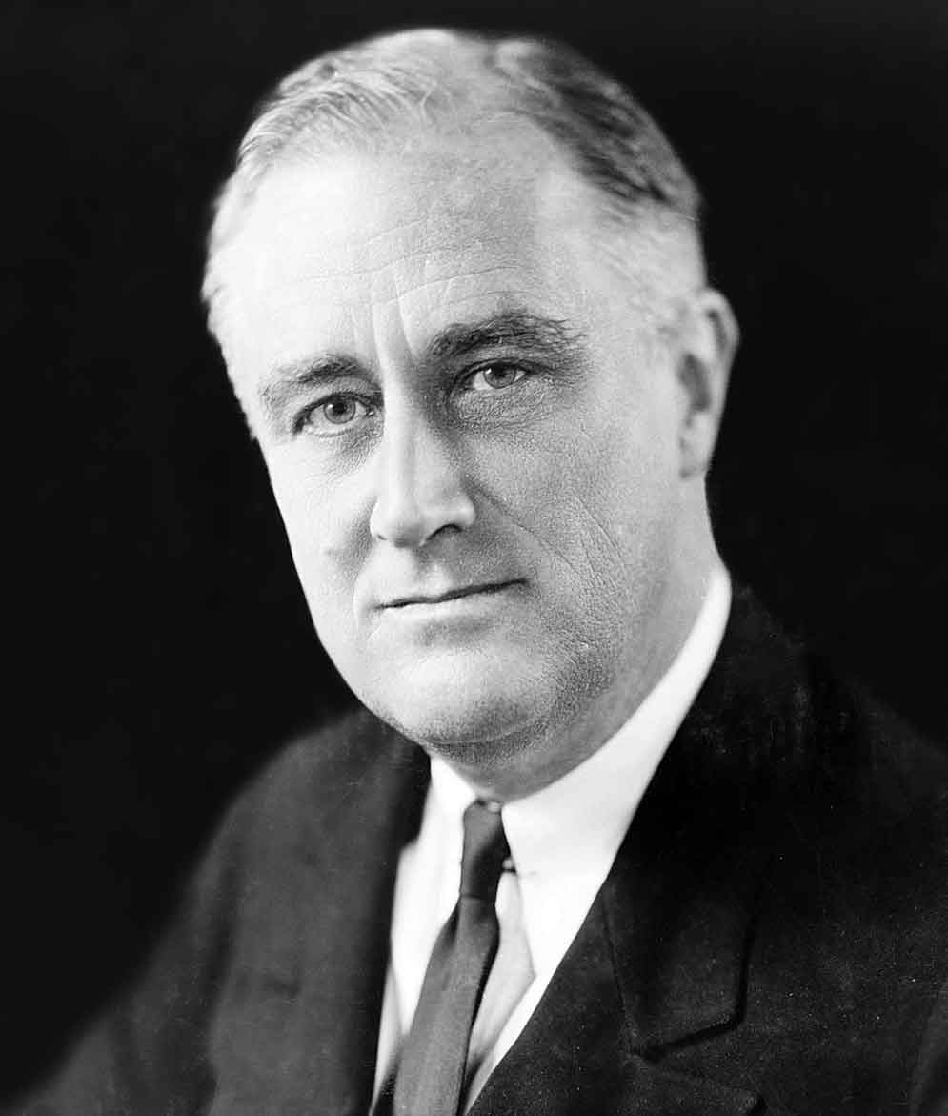
THE NEW DEAL COALITION
Party lines shift:
Millions of voters owed their jobs, mortgages, and bank accounts to the New Deal
African-Americans switch allegiance from the republican to the democratic party

Slide 48
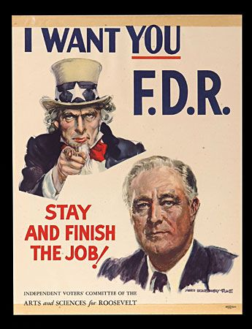
THE NEW DEAL COALITION
Party lines shift:
Millions of voters owed their jobs, mortgages, and bank accounts to the New Deal
African-Americans switch allegiance from republican to democratic party
The coalition included:
White southerners
African-Americans
Labor Unions
Farmers
Immigrants
Ethnic minorities
Women
Progressives
Intellectuals

Slide 49
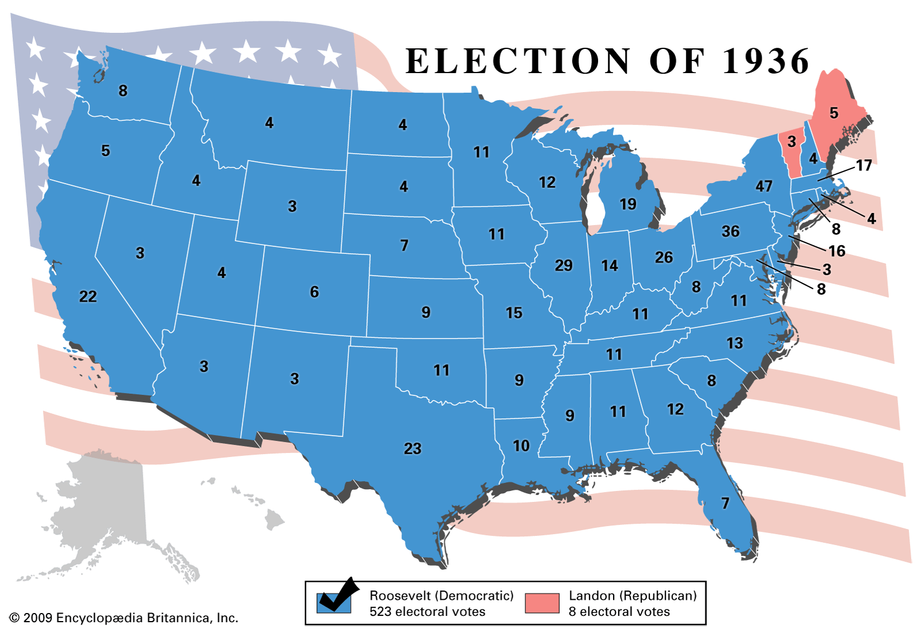
THE NEW DEAL COALITION
Party lines shift:
Millions of voters owed their jobs, mortgages, and bank accounts to the New Deal
African-Americans switch allegiance from republican to democratic party
The coalition included:
White southerners
African-Americans
Laborers
Farmers
Immigrants
Ethnic minorities
Women
Progressives
Intellectuals
Election of 1936
Landslide victory for FDR
60% of the popular vote
Carried every state except
Maine and Vermont

