Slide 1
CHAPTER 5 Socializing the Individual
Section 1: Personality Development
Section 2: The Social Self
Section 3: Agents of Socialization

Slide 2
Objectives:
Section 1: Personality Development
Identify the four main factors that affect the development of personality.
Explain how isolation in childhood affects development.

Slide 3
What is Personality??
The sum total of behaviors, attitudes, beliefs, and values that are characteristic of an individual.
Determines how we adjust to our environment, interacting with other people
At an older age, personality traits change at a slower rate.
However, development varies from individual to individual.

Slide 4
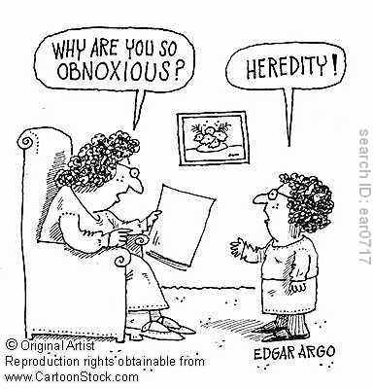
The Main Question: Whether personality is hereditary or environmental that gives rise to personality and social behavior
Heredity – is transmission of genetic characteristics from parents to child
Environment teaches you personality

Slide 5
HEREDITARY | ENVIRONMENTAL
NATURE | NURTURE
-much of human behavior is based on instinct- unchanging, biological inherited behavior pattern -biological basis of behavior | -behavior and personality attributed to environmental factors and social learning -Behavior is result of social environment. EX: Your friends can shape your personality.

Slide 6
Only Sociobiologists care of genetic basis of human behavior
Sociobiology: The systematic study of the biological basis of all social behavior.
Believe that cultural characteristics like religion, cooperation, competition, slavery, territoriality, and envy are rooted in the genetic makeup of human
Most human social life is determined by biological factors

Slide 7
What do most sociologists believe????
Assume that personality and social behavior result from a blending of hereditary and social environmental influences, with environmental factors having the most influence.

Slide 8
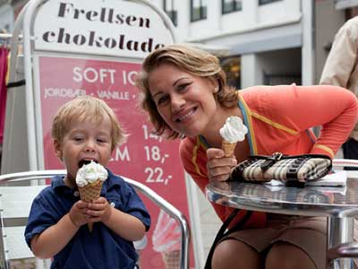
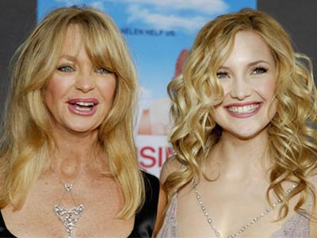
Factors That Shape Personality and behavior Development
#1 Parents – parental characteristics such as
Their age
Level of education
Religious orientation
economic status
Cultural heritage
Occupational background

Slide 9
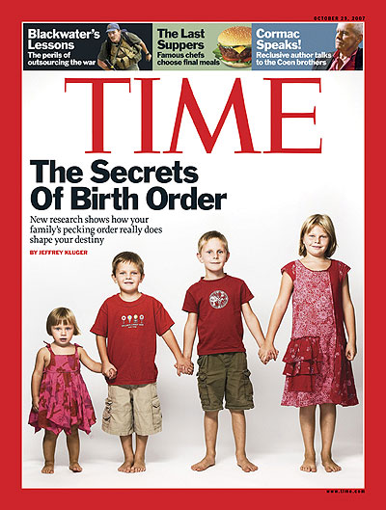
#2 Birth order – personalities are shaped by whether one has siblings because they have a different view of the world than do children who have no siblings
1st: more achievement-oriented, cooperative, cautious
Later children: better in social relationships, affectionate, friendly, creative

Slide 10
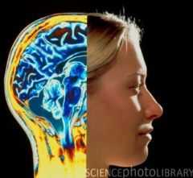
#3 Cultural environment – determines the basic personality types found in a society…certain cultures give rise to certain personality traits
US: competitiveness, assertiveness, individualism
The Ik of Uganda
Experiences as
Male/female, field of
Interest, clothing, types
Of activities, speech,
Habits, ideas, subculture
Notes:
Cultural Environment Influences Brain Function
By Rick Nauert PhDSenior News Editor Reviewed by John M. Grohol, Psy.D. on August 4, 2010
A new study extends the debate between the behavioral effects of nature vs. nurture — whether your upbringing influences the food you eat, the clothes you wear, and surprisingly, even how your brain works.
Researchers Denise C. Park and Chih-Mao Huang discuss ways in which brain structure and function may be influenced by culture in a report found in the journal Perspectives on Psychological Science.
According to the authors, there is evidence that the collectivist nature of East Asian cultures versus individualistic Western cultures affects both brain and behavior.
East Asians tend to process information in a global manner whereas Westerners tend to focus on individual objects.
There are differences between East Asians and Westerners with respect to attention, categorization, and reasoning. For example, in one study, after viewing pictures of fish swimming, Japanese volunteers were more likely to remember contextual details of the image than were American volunteers.
Experiments tracking participants’ eye movements revealed that Westerners spend more time looking at focal objects while Chinese volunteers look more at the background.
In addition, our culture may play a role in the way we process facial information. Research has indicated that when viewing faces, East Asians focus on the central region of faces while Westerners look more broadly, focusing on both the eyes and mouth.
Examining changes in cognitive processes (how we think) over time can provide information about the aging process as well as any culture-related changes that may occur. When it comes to free recall, working memory, and processing speed, aging has a greater impact than does culture—the decline in these functions is a result of aging and not cultural experience.
Park and Huang note that, “with age, both cultures would move towards a more balanced representation of self and others, leading Westerners to become less oriented to self and East Asians to conceivably become more self-focused.”
While numerous studies suggest that culture may affect neural function, there is also limited evidence for the effect of cultural experiences on brain structure.
A recent study conducted by Park and Michael Chee of Duke/National University of Singapore showed evidence for thicker frontal cortex (areas involved in reasoning) in Westerners compared to East Asians, whereas East Asians had thicker cortex in perceptual areas. Park and Huang observe that using neuroimaging to study the impact of culture on neuroanatomy faces many challenges.
They write, “The data are collected from two groups of participants who typically differ in many systematic ways besides their cultural values, rendering interpretation of any differences found quite difficult.”
In addition, for each study, it is important that the MRI machines use identical imaging hardware and software.
The authors conclude, “This research is an important domain for understanding the malleability of the human brain and how differences in values and social milieus sculpt the brain’s structure and function.”
Source: Association for Psychological Science
http://psychcentral.com/news/2010/08/04/cultural-environment-influences-brain-function/16380.html

Slide 11
#4 Heredity-
characteristics like physical traits
aptitudes (capacity to learn a particular skill or acquire a particular body of knowledge) like music or art
Inherit basic needs and capacities
Sets limits on individuals

Slide 12
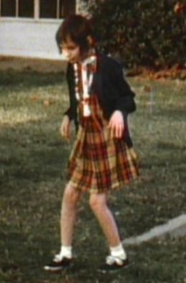
Isolation in Childhood and Development
Research shows that a healthy cultural environment is essential for a child’s full development
Isolation can lead to severe effects such as causing children to waste away and die or to have stunted development
Genie
Notes:
Nova video clip (8 minutes)
http://www.youtube.com/watch?v=dEnkY2iaKis

Slide 13
Isolation in Childhood:
Feral children:
Wild or untamed children.
Children isolated in their homes by parents/family members
Children had not reasoning ability or no manners, and no ability to control their bodily functions.
Few human characteristics

Slide 14
Anna:
Confined to an attic at 6 months old because her grandfather hated her for being illegitimate
Fed only enough milk to keep her alive; almost no human contact; not spoken to-held-bathed-or loved
Result: (age 6) Could not walk, talk, feed herself, expressionless face.
Later on: could eventually talk, feed herself, could talk in phrases…died at 11 years old with ability level of toddler

Slide 15
Isabelle:
She and her deaf mother confined to a dark closet because she was illegitimate
Result:
Used gestures to communicate
Did not learn to speak
Crawled on her hands and knees
Made grunting, animal-like sounds
Ate with hands
Later On…:
Able to overcome her early social deprivation due to the constant contact with her mother; learned to talk, reached level of social and mental development consistent with her age group after 2 years of training

Slide 16
Genie:
Discovered at age 13… Confined at age of 20 months to a small bedroom by her father who hated children
During the day, tied to an infant's potty-chair and nights wrapped in a sleeping bag in a mesh-covered crib
She was beaten if she made noise
Her dad acted like a dog when he interacted with her
Had only: potty chair, crib, 2 partially covered windows, bare light bulb, closet, toys [2 plastic raincoats-empty spools of threat and empty cottage cheese container]
Result:
Couldn’t stand up; social/psychological skills of a 1-year old
Later On…:
After 8 years of training, she did not progress past the level of a 4-year old

Slide 17
Institutionalization:
Children in orphanages and hospitals:
Children wasted away from lack of love and attention.
After Psychologist Rene Spitz studied an orphanage in 1945…
Fewer than 25% could walk by themselves, dress themselves, or use a spoon.

Slide 18
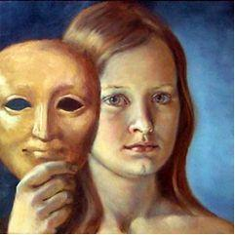
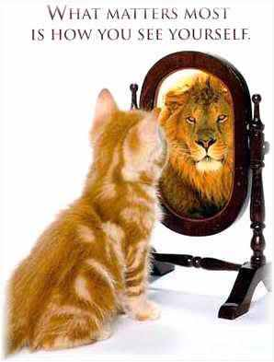
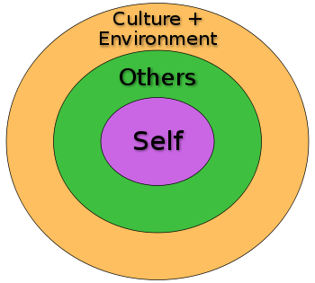
Objectives:
Section 2: The Social Self
Explain how a person’s sense of self emerges.
Identify and describe the theories that have been put forth to explain the process of socialization.

Slide 19
How Sense of Self Emerges
Through interaction with social and cultural environments people are transformed into members of society
The interactive process through which people learn the basic skills, values, beliefs, and behavior patterns of a society is called socialization
Self: Your conscious awareness of possessing a distinct identity that separates you and your environment from other members of society.

Slide 20
Three Theories of Socialization
John Locke – The Tabula Rosa
Charles Horton Cooley – The Looking Glass Self
George Herbert Mead – Role-Taking

Slide 21
John Locke – The Tabula Rosa
Each person is a blank slate at birth, with no personality.
People develop personality as a result of their social experiences.
Moreover, infants can be molded into any type of person.

Slide 22
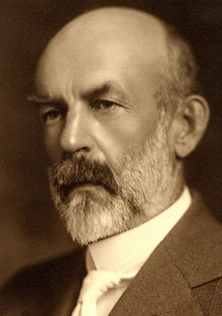
Charles Horton Cooley – The Looking Glass Self
Looking glass self- refers to the interactive process by which we develop an image of ourselves based on how we imagine we appear to others
Other people act as a mirror, reflecting back the image a child projects through their reactions to the child’s behavior.

Slide 23
Looking-glass self: 3 steps
Imagine how we appear to others
Based on their reactions to us, we attempt to determine whether others view us as we view ourselves
We use our perceptions of how others judge us to develop feelings about ourselves

Slide 24
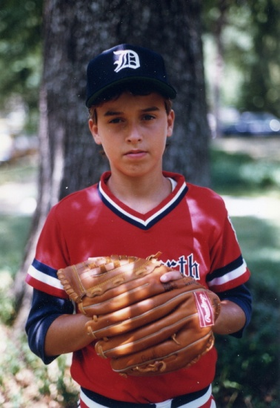
Need an Example????
A child will develop a sense of self by the way his/her primary group members act around them (EX: parents, brothers, sisters, aunts, uncles, etc….)
If parents treat a child as capable and competent ….then will produce a capable and competent child.

Slide 25
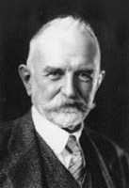
George Herbert Mead – Role-Taking
People not only come to see themselves as others see them but also take on or pretend to take on the roles of others through imitation, play, and games.
Role-taking: taking or pretending to take the role of others.
This process enables people to anticipate what others expect of them.

Slide 26
Through role-taking, we develop a sense of self that is made up of two parts
I: unsocialized, spontaneous, self-interested component of our personality and self-identity
Stronger when we are kids
Me: that part of our identity that is aware of the expectations and attitudes of society- our socialized self
Becomes stronger as you grow older
Both must exist to be well-rounded

Slide 27
Significant others:
Specific people, such as parents, brothers, sisters, other relatives, and friends, who have a direct influence on our socialization and we first internalize their expectations
Generalized other:
Internalized attitudes, expectations, and viewpoints of society that we use to guide our behavior and reinforce our sense of self.

Slide 28
Objectives:
Section 3: Agents of Socialization
Identify the most important agents of socialization in the United States.
Explain why family and education are important social institutions.
Notes:
There are a number of things that can affect an individual’s socialization process. The amount of impact that each of the agents has on an individual will depend on the situation, the individuals experiences, and the stage of life the individual is in.
What specific forces shape our personality?

Slide 29
Family Language acquisition, relationships, rules, initial social interactions, morals, role models, behaviour
Peers Activities trends
School Grammar Rules Social setting values
Religion Values, love for others, meaning of life, Guidelines on how to live
Agents of Socialization
Clubs/ Social Groups Social interaction rules governing activities
Government Laws, sense of security, Sanctions of punishment
Ethnic Background Beliefs Values Customs
Work Employment Money Rules Roles
Media Stereotypes Trends How to act

Slide 30
Family – most important socializer
Experiences within the family determines the type of person an individual becomes

Slide 31
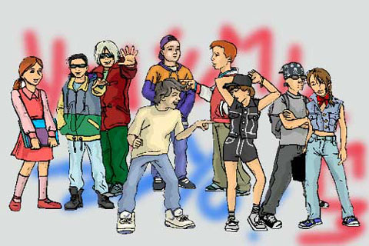
Peer group – primary group composed of individuals of roughly equal age and social characteristics, particularly influential during pre-teenage and early teenage years

Slide 32
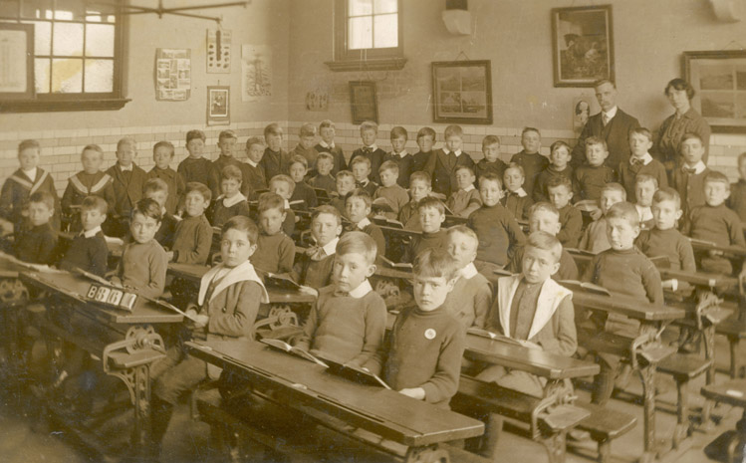
School – plays a major role because it occupies large amounts of time and attention
Teachers and students model expectations

Slide 33
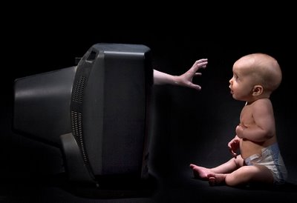
Mass media – books, films, the Internet, magazines, television, radio, films and other forms of communication that reach large audiences with no personal contact between the individuals sending the information and those that receive it

Slide 34
Mass Media #s
98% of homes in U.S. have TVs.
(Average: More than 2 per home)
6-17 years old:
TV is the primary after-school activity!
Spend twice as much time watching TV than in school!
Violence in the Media:
By age 18…
Witnessed 200,000 fictional acts of violence
16,000 murders
Studies suggest that violence encourages viewers to act in aggressive ways and to see aggression as a valid way to solve problems.

Slide 35
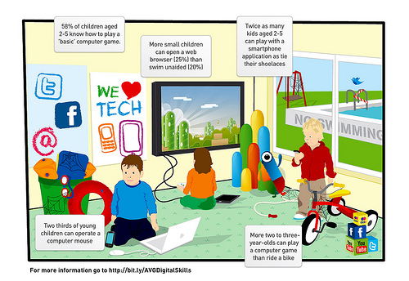
Notes:
http://www.pcmag.com/article2/0,2817,2376056,00.asp

Slide 36
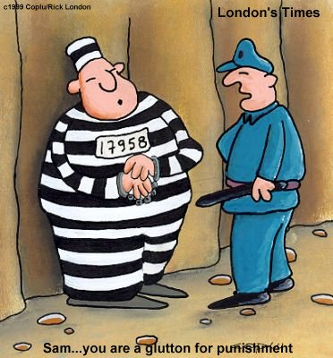
Total institution:
A setting in which people are isolated from the rest of society for a set period of time and are subject to tight control.
EX: Prisons, military boot camp,
and psychiatric hospitals.

Slide 37
Resocialization:
Involves a break with past experiences and the learning of new values and norms.
Goal:
To change an individuals personality and social behavior.
Individual identity taken away!
(EX: hair cut; uniforms; etc….)
Once self is weakened, then easier to convince others to conform to new patterns of behavior.

Slide 38
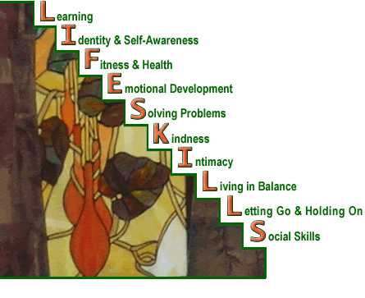
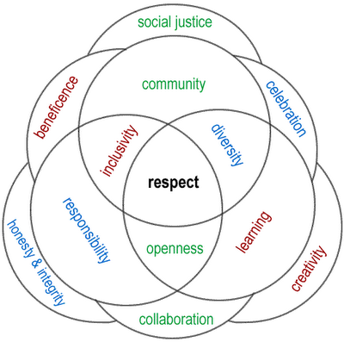
Importance of Family and Education
Section 3: Agents of Socialization
Teach children important life skills
Teach values, norms and beliefs

