Slide 1
Analyzing Documents for a DBQ (Document Based Question)
Mr. Tuttle
US History I

Slide 2
Objective: Utilize specific textual evidence to support conclusions drawn from text.
1. Please take your seats immediately.
2. Please open your notebooks and write today’s objective on the next clean page.
3. Please take a packet from the front of the room.

Slide 3
When I get a DBQ or RST (research Simulation Task) What, What should I do first?
Start at the beginning and READ THE DIRECTIONS!!!
Before you get to the documents, you might be told what you should be looking for. If not, look at the questions after the document.
Questions:
1. According to the reading above, why does Supreme Court Chief Justice Taney believe that Dred Scott is not a citizen?
PLEASE ANSWER ON YOUR OWN PAPER
2. Why did Taney consider it a problem for slaves to be citizens?
PLEASE ANSWER ON YOUR OWN PAPER

Slide 4
Let’s read The document
Document 1:
Taken from the Dred Scott Case Collection website: http://library.wustl.edu/vlib/dredscott/index.htm
"The decision was 7 to 2. Chief Justice Roger B. Taney delivered the opinion of the Court.
. . . Can a negro, whose ancestors were imported into this country, and sold as slaves, become a member of the political community formed and brought into existence by the Constitution of the United States, and as such become entitled to all the rights, and privileges, and immunities, guarantied by that instrument to the citizen? One of which rights is the privilege of suing in a court of the United States in the cases specified in the Constitution.
We think they [people of African ancestry] are not [citizens], and that they are not included, and were not intended to be included, under the word "citizens" in the Constitution, and can therefore claim none of the rights and privileges which that instrument provides for and secures to citizens of the United States.
. . . [T]he legislation and histories of the times, and the language used in the Declaration of Independence, show, that neither the class of persons who had been imported as slaves, nor their descendants, whether they had become free or not, were then acknowledged as a part of the people, nor intended to be included in the general words used in that memorable instrument.
For if they were so received, and entitled to the privileges and immunities of citizens, it would exempt them from the operation of the special laws and from the police regulations which they considered to be necessary for their own safety. It would give to persons of the negro race, who were recognized as citizens in any one State of the Union, the right to enter every other State whenever they pleased...to go where they pleased at every hour of the day or night without molestation, unless they committed some violation of law for which a white man would be punished; and it would give them the full liberty of speech in public and in private upon all subjects upon which its own citizens might speak; to hold public meetings upon political affairs, and to keep and carry arms wherever they went. And all of this would be done in the face of the subject race of the same color, both free and slaves, and inevitably producing discontent and insubordination among them, and endangering the peace and safety of the State."

Slide 5
How much should I write?
The questions are intended to help you write your essay, so the more complete your answer is, the better.
1. ANSWER THE QUESTION.
This may seem obvious, but many people get lost in their answer.
“ Justice Taney believes that Dred Scott is not a citizen because Scott is from African descent and Taney believes that means he cannot be a citizen”
2. Find an example from the TEXT that supports your answer.
In the second paragraph, Taney writes” We think they [people of African ancestry] are not [citizens]…”
3. Use a signal phrase like “THIS SHOWS THAT…” and tie the evidence to your answer.
This demonstrates Taney’s belief that people of African descent cannot be citizens.

Slide 6
But answer the question in One paragraph, not three
Justice Taney believes that Dred Scott is not a citizen because Scott is from African descent and Taney believes that means he cannot be a citizen. In the second paragraph, Taney writes” We think they [people of African ancestry] are not [citizens]…” This demonstrates Taney’s belief that people of African descent cannot be citizens.
This is a short answer and the minimum you should be writing!

Slide 7
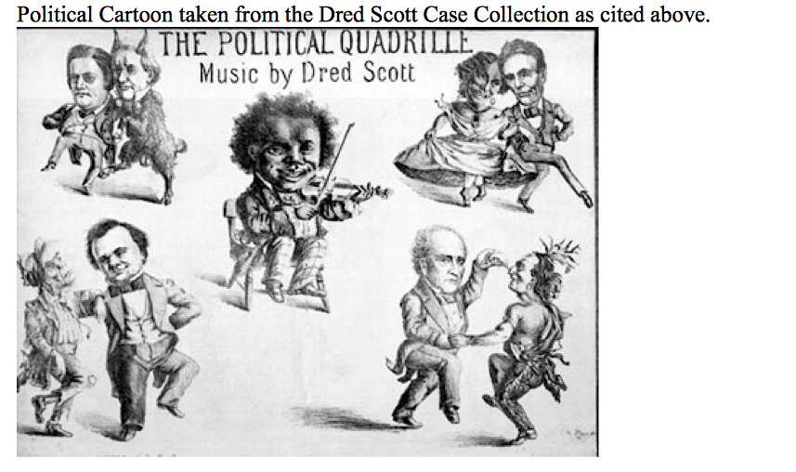
How do I use a document that’s a picture?
Figures left to right clockwise: John C. Breckinridge dances with James Buchanan.
Dred Scott seated plays the violin. Lincoln dances with African American woman. John Bell dances with Native American. Stephen Douglas dances with a sovereign in rags.
Question: 3. Interpret the above cartoon from the previous knowledge of the textbook chapter 10 in The American Vision (p334-335). Hint: What do you think the cartoonist is portraying as Dred Scott’s relationship to politicians of the day?

Slide 8
How do I use a document that’s a picture?
Figures left to right clockwise: John C. Breckinridge dances with James Buchanan.
Dred Scott seated plays the violin. Lincoln dances with African American woman. John Bell dances with Native American. Stephen Douglas dances with a sovereign in rags.
Answer the Question… but before you do,
Describe the picture in detail. Who is in the center, what is he doing? Who are the other characters and what are they doing? What does the writing say?

Slide 9
So how do I write an Essay after the Documents?
How did the Dred Scott decision further divide America prior to the Civil War?
First ANSWER THE PROMPT.
But don’t stop there. Write a thesis statement that goes BEYOND the prompt. Add a dependent clause that will set up your argument.
Because the moral issue of slavery was close to the hearts of people in both the North and the South, the Dred Scott Decision aggrevated a devisive atmosphere in the United States.
Look at the short answers you just wrote. How many of them support your thesis?
You can use those answers as paragraphs in your essay!

