Slide 1
Back to School Night in 5 minutes (or less)
Mr. Michael Tuttle
michael.tuttle@lodi.k12.nj.us
US History I
and AP US History II (APUSH)
Visit the website!!!!
www.michaeltuttle.net

Slide 2
The Past Matters; we learn from it and it shapes us.
Student Expectations
Respectful
Prepared
Focused
Teacher Expectations
To Challenge your child
To help your child see him/herself as a lifelong learner
To hold them to high standards as people and as students
To encourage independence and accountability

Slide 3
Methods of Delivery
Text-book and ONLINE Text
Class discussion
Student generated projects
Formal question-response exercises
Active viewing of curriculum related documentaries
Teacher generated materials
Student presentations
Art and poetry

Slide 4
Contact Information
Michael.Tuttle@lodi.k12.nj.us
PLEASE bookmark our class website
www.michaeltuttle.net

Slide 5
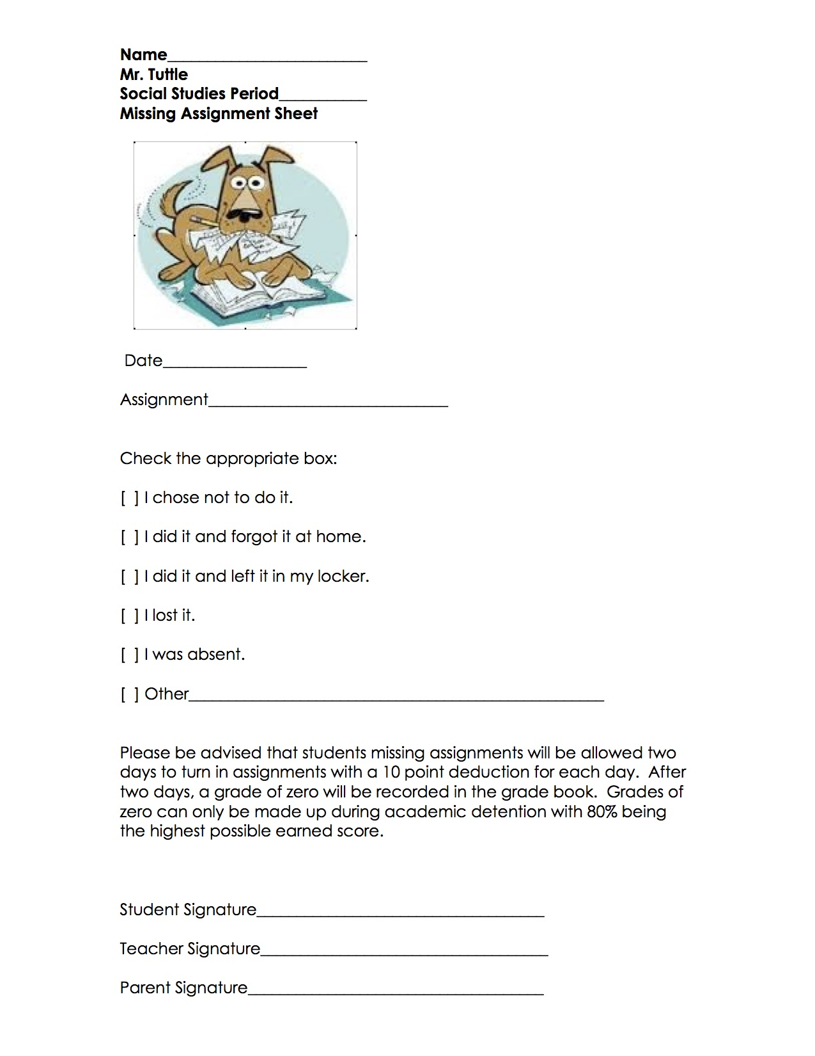
Every Day
Daily Procedures
DO NOW
Review Assignments
Class work/Group Work
Wrap up / Exit ticket
Homework Assignments

