Slide 1
Industrial Supremacy Brinkley Chapter 17
Industrialization
(1865 – 1901)

Slide 2
The Rise of Industry
American industry grew rapidly after the Civil War, bringing revolutionary changes to American society.
SWBAT:
Explain how an abundance of natural resources contributed to economic growth in the United States in the late 1800s.
Identify the effects of expanding population on industry.
Explain the effects of technological innovations such as the telephone and telegraph on American development.

Slide 3
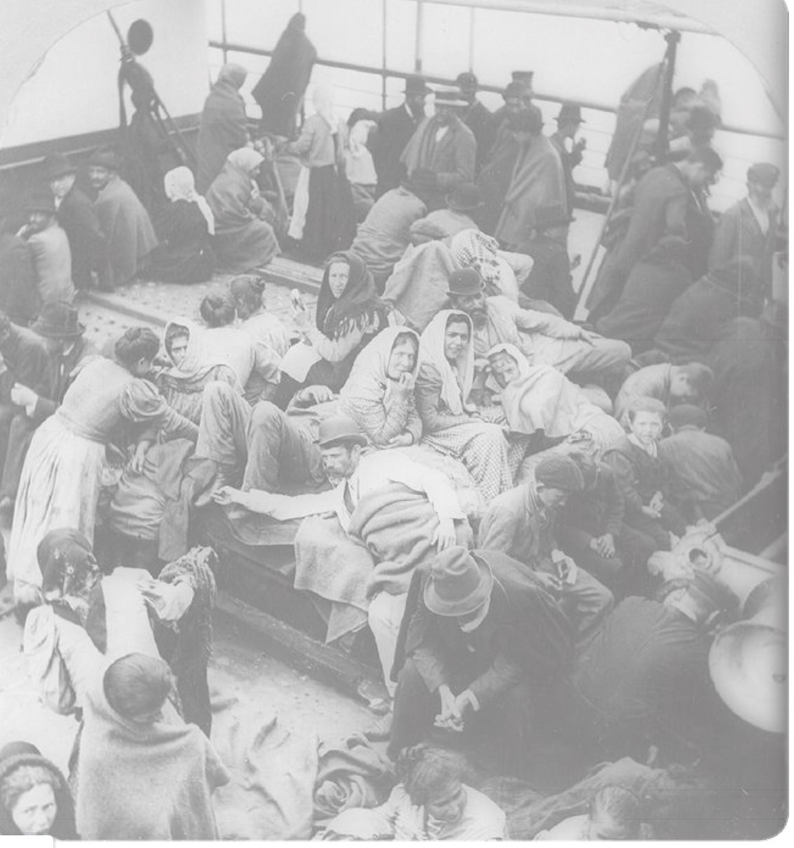
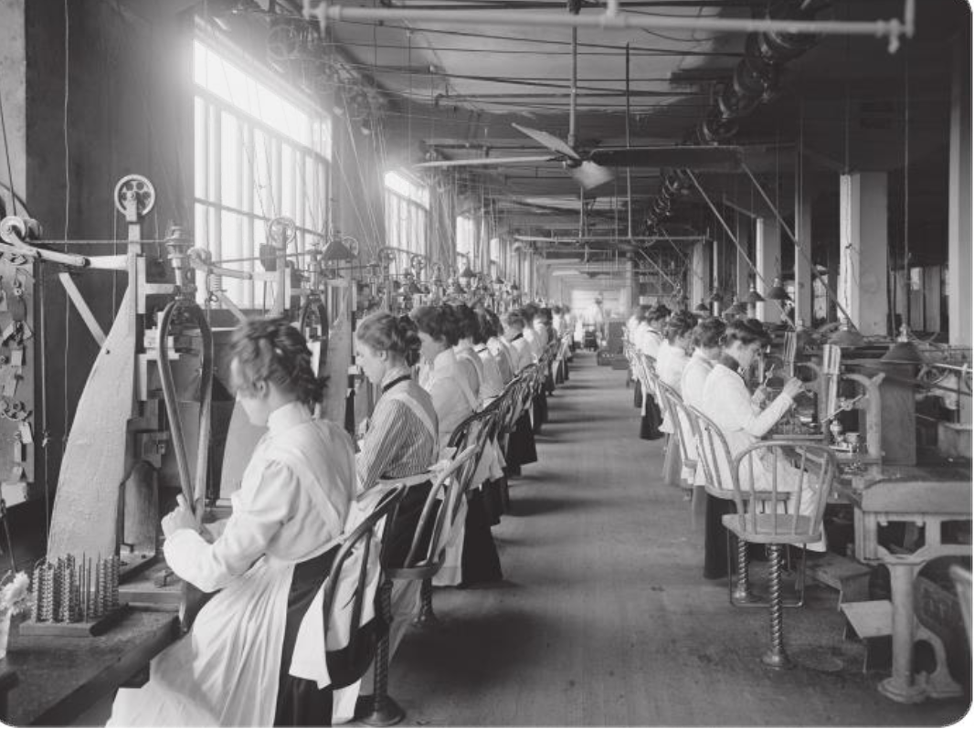
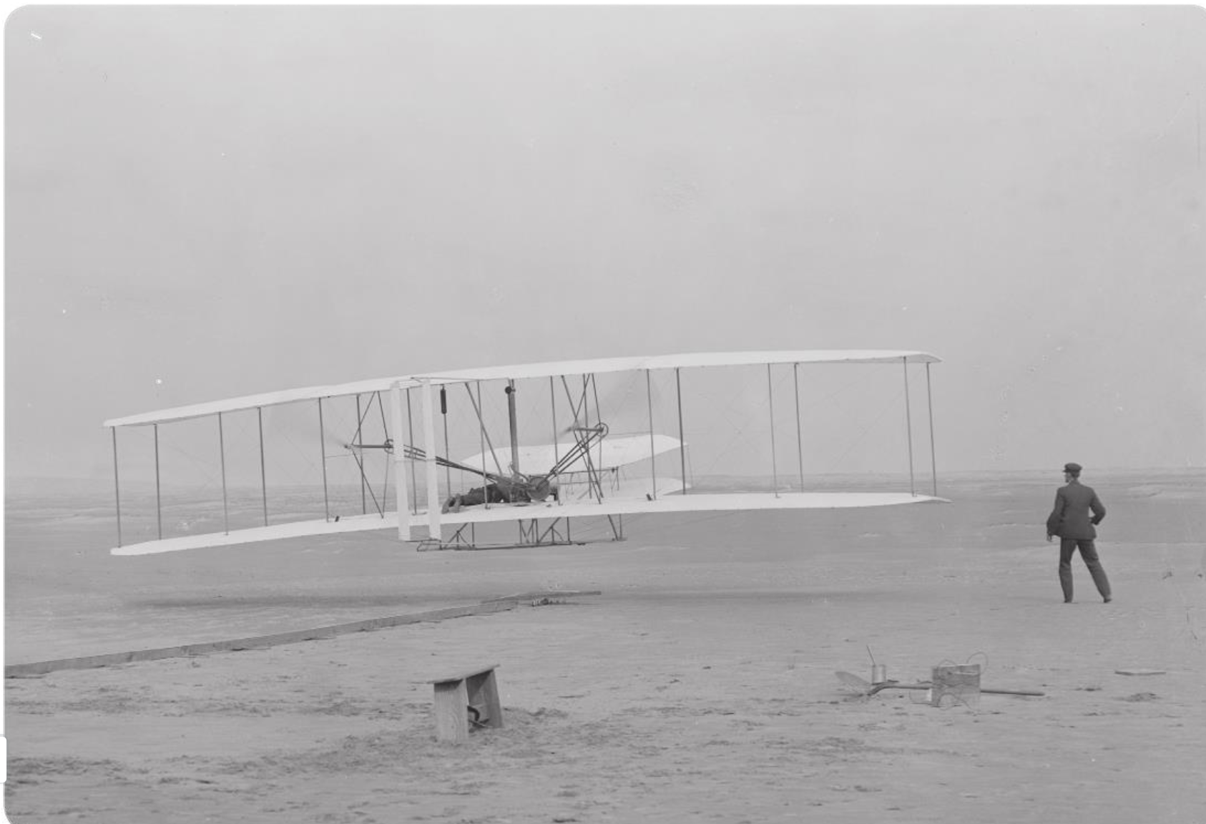
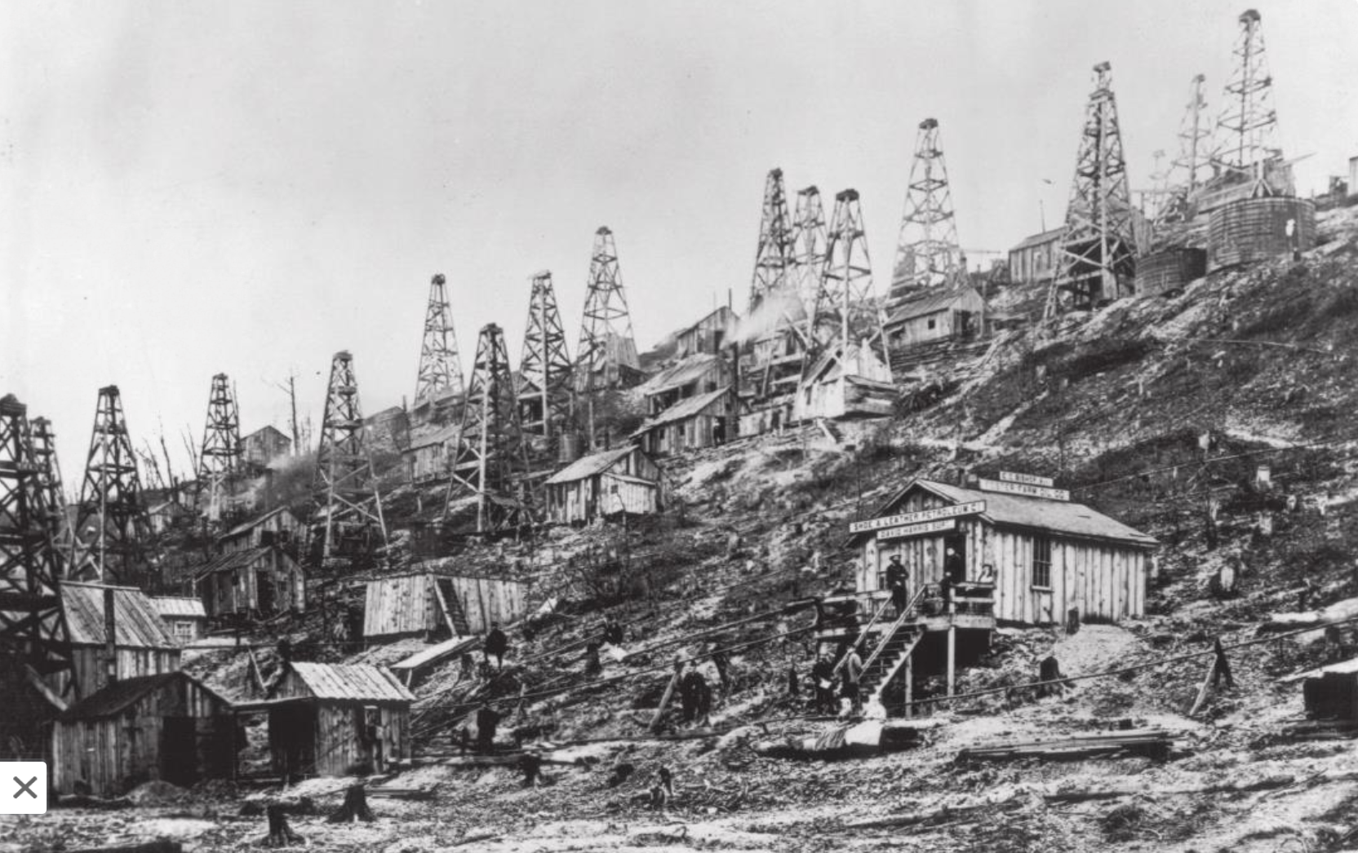
Factors that promoted Industry
Notes:
The rise of the United States as an industrial power began after the Civil War. Many factors promoted industry, including cheap labor, new inventions and technology, and plentiful raw materials. Railroads rapidly expanded. Government policies encouraged growth, and large corporations became an important part of the economy. As industry expanded, workers tried to form unions to fight for better wages and working conditions.

Slide 4
U.S. Industrializes
After Civil War, the U.S. rapidly expands
Millions left their farms to work in mines and factories
Early 1900s, the U.S. becomes the world’s leading industrial nation
By 1914, the GNP was 8 times greater than at the end of the Civil War
GNP (gross national product)- total value of all goods and services produced by a country

Slide 5
Industrialization
Causes of Industrialization
United States Becomes an Industrial Nation

Slide 6
Industrialization
Causes of Industrialization
Abundance of raw materials
Oil production
Large population
Free enterprise system
Large free trade area
New inventions
United States Becomes an Industrial Nation

Slide 7
Natural Resources
U.S. was fortunate to have an abundance of natural resources: water, timber, coal, iron, & copper
Could be obtained cheaply and not have to be imported from other countries
Mining and the Transcontinental RR helped spark the growth of industry
Oil was found. High demand for kerosene.
Edwin Drake (1859) drilled first oil well in PA, then spread all the way to TX by 1900, fueling economic expansion.

Slide 8
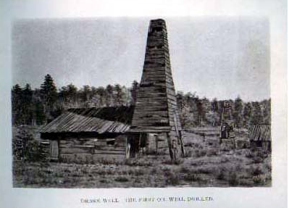

Slide 9
Large Work Force
Human resources were as important to industrialization as were natural resources
Between 1860 & 1910, U.S. population tripled
Large families
Large number of immigrants to U.S (About 20 million arrived between 1870 – 1910)
Led to a growing work force, allowing factories to increase production and increasing demand for products

Slide 10
Free Enterprise
Practice of “laissez-faire” (let people do as they choose)
Belief that government should not interfere with the economy
Relies upon supply & demand creating competition among businesses & lower prices
Many entrepreneurs (people willing to risk their money to start a business) appeared in late 1800s
Private capital from foreign investors (make more $ in U.S. than home countries) also helped spur industrial growth

Slide 11
Government’s Role in Industrialization
U.S. practiced laissez-faire in late 1800s: low taxes, low spending, little regulation of businesses, wages, and prices
During the Civil War the Morrill Tariff was passed to protect American businesses and to allow them to compete with Western Europe
Higher tariffs hurt American Farm trade as foreign countries raised tariffs on U.S. products also
Many left farms to work in factories
By early 1900s U.S. businesses were large and competitive and wanted more “laissez-faire”

Slide 13
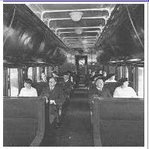
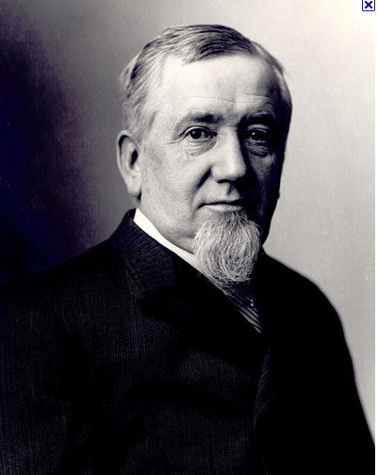
Pullman Sleeping Car
George Pullman

Slide 19
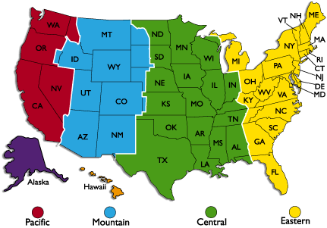
TIME ZONE

Slide 21
Graphic Organizer
Invention | Effects
Telephone
Light bulb
Automatic Loom

Slide 22
Graphic Organizer
Invention | Effects
Telephone | Better communication
Light bulb | Cheap lighting
Automatic Loom | Made cloth faster

Slide 23
14.2 The Railroads
This section focuses on how the growth of railroads affected the growth of industries. After the Civil War, the rapid construction of railroads accelerated the nation’s industrialization and linked the country together.
Section 2 Objectives: Following this section I will be able to:
Define: time zone, land grant.
Identify: Pacific Railway Act, Grenville Dodge, Leland Stanford, Cornelius Vanderbilt, Jay Gould, Credit Mobilier, James J. Hill.
Discuss ways in which the railroads spurred industrial growth.
Analyze how the railroads were financed and how they grew.

Slide 24
Effects of Rail Network on Nation
Nationwide Rail Network
Effects

Slide 25
Effects of Rail Network on Nation
Nationwide Rail Network
Effects
Development of time zones
Long-distance transportation speeded up
Longer & heavier trains used
Cost per mile declined
United America’s regions
Promoted a national market

Slide 26
Linking the Nation
1865 there was 35,000 miles of track in U.S.
1900 over 200,000 miles of track as the U.S. was becoming a booming industrial power
RR boom began in 1862 when President Lincoln signed the Pacific Railway Act
Transcontinental RR to be built by Union Pacific & Central Pacific
Land was offered along right-of-way that RR companies could sell for $$ (more track = more land)

Slide 27
Union Pacific
Grenville Dodge directed the UP westward from Omaha, NE in 1865
Labor, money, and engineering challenges along with weather, mountains, and NA complicated the task
Over 10,000 workers. Took supplies from 40 RR cars to build 1 mile of track
Life for workers was rough, dirty & dangerous

Slide 28
Central Pacific
Was the dream of engineer Theodore Judah. Need financial help
Sold stock to investors known as “Big Four”. All made fortunes on investment
Leland Stanford went on to become governor, an U.S. Senator from CA and founded Stanford University
Shortage of labor in CA; brought in 10,000 workers from China known as “Chinese Coolies”

Slide 29
Railroads Spur Growth
Transcontinental RR was first of many RR to span the U.S.
RR helped increase the size of markets
More products could be moved in U.S.
RR stimulated economy by large amounts of money on steel, coal, timber, etc.

Slide 30
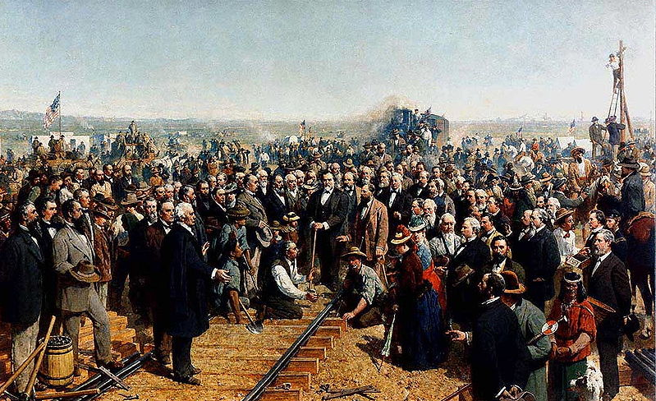
Driving Golden Spike (5-10-1869)

Slide 31
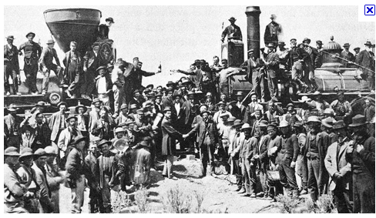
Promontory Point, Utah

Slide 32
Linking Other Lines
There was a maze of RR lines. Hundreds of small unconnected lines existed by 1865
Eastern capitalists wanted to create a single rail transportation system
Eventually, 7 giant systems with hubs in major cities emerged from consolidation
Cornelius Vanderbilt was one of most successful as he formed NY Central RR which eventually stretched from NY to Chicago

Slide 33
Benefits of a National System
1893, 4 time zones established in U.S. to make rail service safer and more reliable. Federal government ratified this change in 1918.
RR cars could be moved about the country as the seasons dictated
Air brakes allowed for longer & heavier trains
Very cost effective: 1860 cost was 2 cents /mile & in 1900 it was ¾ of a cent/mile
RR brought the country closer together, more homogenous, less sectionalism

Slide 34
The Land Grant System
RR were very expensive to build and operate
Gov’t gave land grants to the RR. The RR would sell this land to raise $$ they needed to build the railroad.
Gov’t gave over 120 million acres of land to the RR (area larger than New England, NY, PA)
Many RR earned enough $$ from land sales to finance the building of their lines

Slide 35
Robber Barons
Many RR entrepreneurs were accused of illegal dealings
Jay Gould had the worst reputation of all. Used “insider trading” practices with info he obtained from owning the RR to manipulate stock prices for his benefit.
Bribery of federal and state government officials to obtain land grants was common place

Slide 36
Credit Mobilier Scandal
It was a construction company set up by several stockholders of Union Pacific RR and a member of Congress
The decision-makers were from both companies. So, CM charged high fees to the RR for work it did & RR paid the fees from the $$ from the land grants.
Result: Investors made $millions and the RR was nearly bankrupt

Slide 37
Credit Mobilier Scandal
To continue the government giving land grants to the RR, a member of Congress gave other members of Congress shares in the Union Pacific RR at a much-below market value price
Eventually this scandal became public knowledge and was investigated. Many members of Congress were implicated.

Slide 38
Great Northern Railroad
James J. Hill owned Great Northern and built it from MN to WA without using any land grants
He strategically planned the development of his rail routes & gave low fares to homesteaders
Hauled supplies to WA to be shipped to China and brought back lumber & supplies. Train was loaded going both directions.
Became the most successful transcontinental RR and was the only one not forced into bankruptcy

Slide 39
Graphic Organizer
Ways Railroads Were Financed

Slide 40
Graphic Organizer
Land grants
Gifts of public lands
to railroads
Ways Railroads Were Financed
Money generated
from running the
railroads
Private
investments

Slide 41
14.3 Big Business
This section focuses on how big business became important in American life. After the Civil War, big business assumed a more prominent role in American life.
Section 3 Objectives: Following this section I will be able to:
Define: corporation, economies of scale, fixed costs, operating costs, pool, vertical integration, horizontal integration, monopoly, trust, holding company.
Identify: stockholder, stock, Andrew Carnegie, Bessemer process.
List the new methods of advertising and selling that helped promote consumer goods in the late 1800s.
Analyze how large corporations came to dominate American business.
Evaluate how Andrew Carnegie’s innovations transformed the steel industry.

Slide 42
Role of Corporations
Big business was dominating the economy. This was made possible by corporations.
Corporation- organization owned by many people but treated by law as if it were a single person
Stockholders- people who own stock in the corporation
Stocks- shares of ownership that can be purchased. Helps raise $$ to fund big building projects by spreading out the risk factor.

Slide 43
Economics
Economies of scale- corporations make goods more cheaply because they produce so much so quickly using large manufacturing facilities
Businesses have 2 costs:
Fixed- costs that have to paid whether business is operating or not (loans, taxes, mortgages, etc.)
Operating- costs that occur when running a company (wages, shipping, supplies & materials)

Slide 44
Economics
Small businesses- low fixed costs but high operating costs. If sales dropped it was cheaper to shut down & wait for better times.
Large businesses- high fixed costs but low operating costs. If sales went down it was better to keep operating.

Slide 45
Business Competition Results
Corporations could:
Produce more goods cheaply and efficiently
Lower prices in recessions to keep operating
Negotiate rebates from RR, lowering costs further
Small business:
Could not do what the corporations did
Many were forced to close
Pools- companies joined together in an effort to keep prices from falling by agreeing to keep the prices the same. Did not last long as they had no legal protection in court.

Slide 46
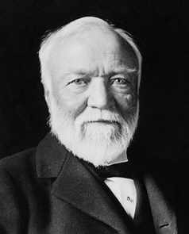
Andrew Carnegie and Steel
Got his start in the railroad business
Invested in companies that served the RR industry (iron mills, sleeping cars, locomotives, RR bridges)
Opened a steel company in Pittsburgh, PA (1875) using the Bessemer process (method of making high quality steel efficiently & cheaply)

Slide 47
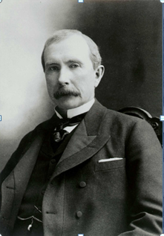
John D. Rockefeller & Standard Oil
Heavily involved in oil industry in 1860s
Bought out many competitors; by 1880s owned 90% of oil industry
Shipped huge amounts of oil on RR and was able to negotiate favorable rebates
He gained a big price advantage and began to pressure other oil companies to sell out to him

Slide 48
Vertical & Horizontal Integration
Vertical integration- a company owns all of the different businesses on which it depends for its operation (i.e. meat packing industry, Carnegie steel industry)
Horizontal integration- combining many firms engaged in the same type of business into one large corporation. Pac-man effect: large company buys up smaller companies thus creating an even larger company (a monopoly) and gains control of an entire market (i.e. Standard Oil)

Slide 50
Make this on your paper
 | John D. Rockefeller | Andrew Carnegie
Product | Oil | Steel
Date/Place | 1880s - Ohio | 1880s – Pittsburgh
$$$ | Horizontal integration | Vertical integration
Company | Standard Oil Company | Carnegie Steel Company

Slide 51
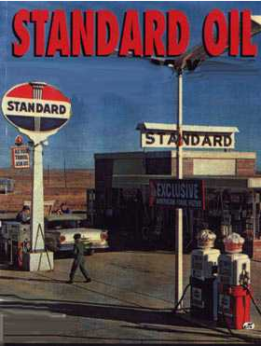
Trusts
Americans feared monopolies / States passed laws to prevent 1 company from owning stock in another company w/o state’s permission
A trust is a way of controlling someone else’s business or property legally.
Standard Oil formed the first trust, which was a new way of merging someone’s business that did not violate the laws against owning other businesses. Trustee is now “managing” someone else’s businesses legally.

Slide 52
Holding Companies
NJ implemented a new law for incorporation of businesses. It accelerated the growth of industry.
A holding company is a company or firm that owns other companies' outstanding stock. It usually refers to a company which does not produce goods or services itself; rather, its purpose is to own shares of other companies.
A holding company controls all of the companies it owns thus creating one large enterprise.

Slide 53
What techniques did corporations use to consolidate their industries and try to eliminate competition?
1.
2.
3.
4.
5.
6.

Slide 54
What techniques did corporations use to consolidate their industries and try to eliminate competition?
Vertical Organization
Horizontal Organization
Monopolies
Trusts
Holding Companies
Pools

Slide 55
Selling Products
Advertising changed from small newspaper line ads to large illustrated displays
Department stores developed offering glamor and excitement to the shopping experience
Chain stores appeared offering thrift and low prices
Mail-order catalogs were sent to the rural population that was far away from the chain or department stores

Slide 56
14.4 Unions
This sections focuses on the formation of labor unions during the late 1800s. In an attempt to improve their working conditions, industrial workers came together to form unions in the late 1800s.
Section 4 Objectives: Following this section I will be able to:
Define: deflation, trade union, industrial union, lockout, Marxism, arbitration, closed shop.
Identify: blacklist, Knights of Labor, injunction.
Describe industrial working conditions in the United States in the late 1800s.
List the barriers to labor union growth.

Slide 57
Working in the U.S.
Working conditions were:
difficult, monotonous, dangerous & unhealthy
Even though difficult, there was a rise in the standard of living: 50% increase in wages from 1860 – 1890
Uneven distribution of income between the wealthy and the working class (workers got .22/hr; 59 hrs/week)
Deflation- a decline in available money that results in lower prices, and, therefore, increases the buying power of money
Wages were cut by companies; workers felt companies were going to pay even less for the same work
Workers felt only way to improve wages and working conditions was to organize unions so they could collectively bargain

Slide 58
Early Unions
Two basic types of workers in U.S. in 1800s:
Craft workers: held special skills & training (machinists, iron molders, stonecutters, glass blowers, shoemakers, printers, carpenters, etc.) Usually got higher wages and had more control over their time
Common laborers: had few skills and received lower wages
Trade unions formed (limited to people with specific skills) such as iron workers, typographical workers, shoe makers, etc.

Slide 59
Industry Opposes Unions
Industry forced to recognize unions because the workers had skills that they needed
Employers did not like industrial unions which organized all craft workers & common laborers in a particular industry

Slide 60
Union Opposition
Companies used a variety of techniques to prevent unions from forming:
Workers had to sign oaths promising not to join unions
Undercover detectives were used to identify union organizers
Workers involved in union activity were fired or blacklisted (other employers would not hire someone on this list)
Lockout- if workers formed a union, the employers would not let them work and refused to pay them; workers were replaced with strikebreakers or scabs

Slide 61
Political and Social Opposition
Workers wanting to organize faced many problems
No laws giving workers the right to organize
No laws requiring owners to negotiate with workers
Courts frequently ruled in favor of owners
Suffered from perception of ideas of Karl Marx, known as Marxism

Slide 62
Marxist Thought
Basic force in our society of capitalism was the struggle between workers and owners
Marx believed the workers would eventually revolt, seize control of the factories & overthrow the government
Marxist thought that after the revolution the government would seize all private property and evenly divide the wealth (creating a socialist society)
Marx believed the state would disappear and a Communist society, where classes did not exist, would evolve

Slide 63
Other Political Thoughts
Many European labor leaders agreed with Marx.
Others supported anarchy (society does not need government to exist) and thought they could ignite a few acts of violence in the late 1800s which would spark a revolution
Marxist and anarchist ideas were spreading throughout Europe and started spreading to the U.S. as immigrants arrived

Slide 64
Nativism
With the spread of Marxist and anarchist ideas in the U.S, a feeling against immigrants began to emerge known as “Nativism”
Many immigrants became involved in union activity and people began to associate violence and revolution with immigrants and unions
Employers used the courts, police, called upon the government to maintain law and order and to use the army to break up strikes and crush unions

Slide 65
The Struggle to Organize
Even though workers tried to organize into unions they had very little success
Many confrontations with workers & employers happened and many resulted in violence and bloodshed.

Slide 66
The Great Railroad Strike of 1877
Severe panic of 1873 led to wages being cut
1877 the recession continued and the RR was making another wage cut
Triggered the first nationwide labor protest
RR workers in Martinsburg, WV walked off the job and blocked the tracks
RR workers around the country joined the struggle: 80,000 workers in 11 states took part

Slide 67
The Great Railroad Strike of 1877
Angry strikers tore up track, smashed equipment, & blocked tracks in New York, Baltimore, Pittsburgh, St. Louis, & Chicago
Governors of many states called out militia
President Hayes ordered the army to open the rail lines in PA and Chicago
Troops restored order but over 100 people were killed and millions of $$ in property damage

Slide 68
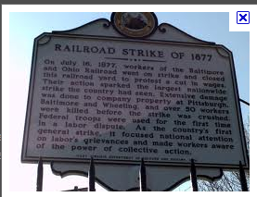

Slide 69
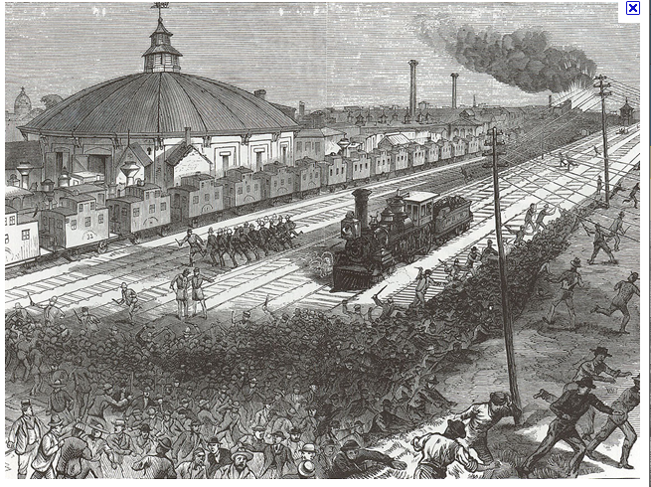

Slide 70
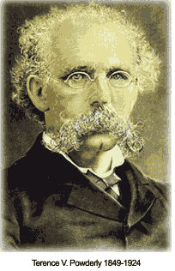
Knights of Labor
After the Great RR Strike of 1877 workers realized they needed to be better organized
Knights of Labor became the first nationwide industrial union
Terrence Powderly was the founder
By 1886 had 700,000 members

Slide 71
Knights of Labor
Called for 8 hour workday
Supported equal pay for women
Do away with child labor
Wanted worker-owned factories
Initially opposed to strikes
Favored the use of boycotts
Supported arbitration (a 3rd party helps workers & owners reach an agreement)
Eventually turned to the successful use of strikes
Convinced one of Jay Gould’s RR to reverse the pay cut decision

Slide 72
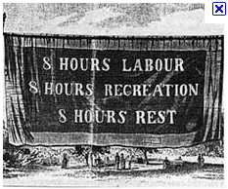

Slide 73
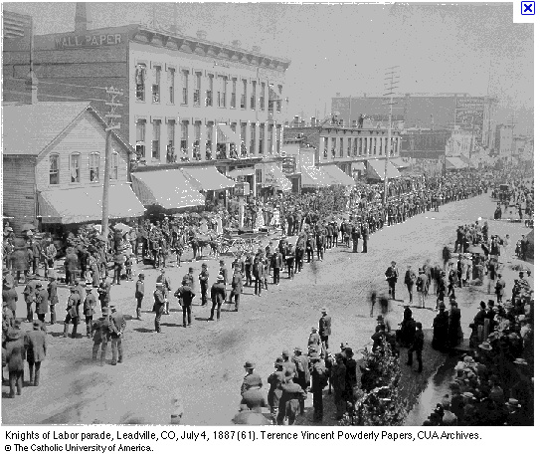

Slide 74
Haymarket Riot
http://historymartinez.wordpress.com/2010/12/16/haymarket-riots-powerpoint/
This incident hurt the efforts of labor unions to organize at this time.

Slide 75
The Pullman Strike
American Railway Union organized under Eugene V. Debs (1893)
Pullman Car Company was one of the businesses unionized.
Pullman started its own town and stores. Workers required to live in town and buy from company stores.
1893 economic depression; wages were cut by Pullman but rent and store prices stayed high

Slide 76
The Pullman Strike
3 workers complained and were fired by Pullman
In support of workers, ARU quit handling Pullman cars. Blocked up the rail lines and threatened the economy.
RR managers got U.S. Postal cars to be attached to Pullman cars. If strikers did not handle Pullman cars they would not be handling the postal cars and would be in violation of federal law.
President Grover sent in troops to keep the mail running
Court ordered an injunction against strikers demanding the boycott be stopped. The strike and the ARU collapsed.

Slide 77
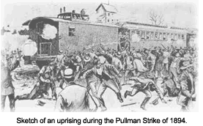

Slide 78
The American Federation of Labor
Samuel Gompers organized over 20 trade unions
3 main goals:
Get companies to recognize unions and agree to collective bargaining
Pushed for closed shops (companies could only hire union members)
Promoted the 8 hour work day
Union representation was only to a small % of Americans (AFL had 15%, all unions had 18%)

Slide 79
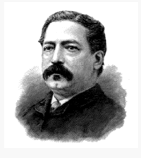
Samuel Gompers

Slide 80
Working Women
The number of women wage earners began to grow after Civil War. By 1900 women made up about 18% of the work force.
“Women’s work” was about
1/3 domestic workers
1/3 teachers, nurses, sales clerks, secretaries
1/3 industrial workers in light industry (garment industry and food processing plants)

Slide 81
Working Women
Regardless of the job, women were paid less than men, even if the same type of job
It was assumed that a man was helping support the woman (father, husband, etc.)
Men were considered the main wage earners and needed more money to support their family
For this reason, most unions excluded women

Slide 82
Women’s Trade Union League
Started in 1903 by 4 women (Mary Kenney O’Sullivan, Leonora O’Reilly, Jane Addams, Lillian Wald) to promote women’s issues
Goals:
Educate women about the advantages of trade union membership
Pushed for an 8 hour work day
Create a minimum wage
End evening work for women
Abolish child labor

Slide 83
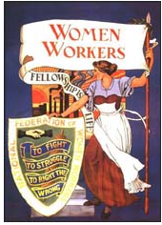

Slide 84
What factors led to an increase in unions in the late 1800s?
Factors Contributing to Unionization

Slide 85
What factors led to an increase in unions in the late 1800s?
Concern about pay
Concerns about working conditions
Factors Contributing to Unionization
Economic challenges such as deflation
Concerns about job security

