Slide 1
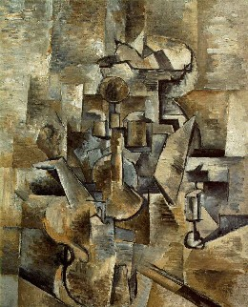
The Lost Generation
Buffalo Bill's defunct who used to ride a watersmooth-silver stallion and break onetwothreefourfive pigeonsjustlikethat Jesus he was a handsome man and what i want to know is how do you like your blueeyed boy Mister Death
From "Buffalo Bill's" (1920)
ee cummings
George Braque
Notes:
What do you notice about the poem on the left and the painting on the right?
They both seem to break conventional rules about how we think things should be organized.

Slide 2
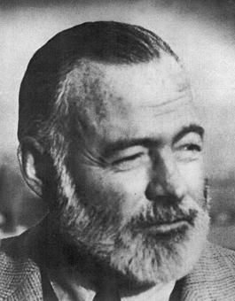
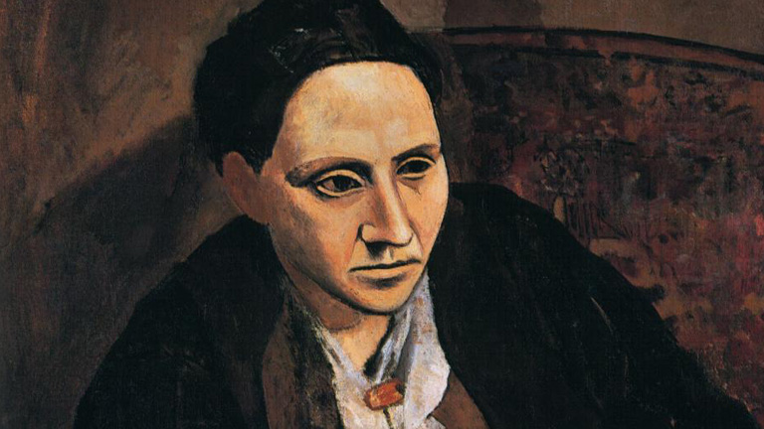
The Lost Generation
Ernest Hemingway
Gertrude Stein: “You are a lost generation”!
Notes:
In The Sun Also Rises, Hemingway gives two epigraphs, one from Gertrude Stein and one from Ecclesiastes.
Give the Quote from Ecc.

Slide 3
“What profit hath a man of all his labour which he taketh under the sun? One generation passeth away, and another generation cometh: but the earth abideth for ever. The sun also ariseth, and the sun goeth down, and hasteth to his place where he arose...” -Ecclesiastes

Slide 4
How did they get “Lost”?
The Horrors of World War
Rejection of Societies Values
Survivors of the War questioned the “Meaning of Life”.
Less “Happy Endings in Literature”.
Less structure and realism in Art.
Stein coined the term when waiting for gas. The workers were not helping her fast enough.
"You are all a "génération perdue."
People embraced Nihilism, Pessimism, Existentialism…
What do these terms mean?

Slide 5
The "Lost Generation" defines a sense of moral loss or aimlessness apparent in literary figures during the 1920s.
World War I seemed to have destroyed the idea that if you acted virtuously, good things would happen.
Many good, young men went to war and died, or returned home either physically or mentally wounded (for most, both), and their faith in the moral guideposts that had earlier given them hope, were no longer valid...they were "Lost."

Slide 6
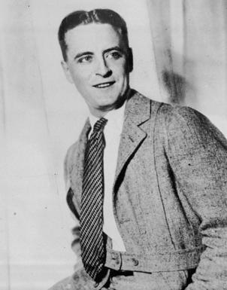
The Great Gatsby
F. Scott Fitzgerald
.
SPOILER ALERT!!!
The Book is a commentary on American Society.
One needs connections to succeed (Wolfsheim).
The constant theme is the immorality of all characters.
Nick Carraway- Carried Away
Wilson – ineffectual except for Destruction, murder and Suicide.

Slide 7
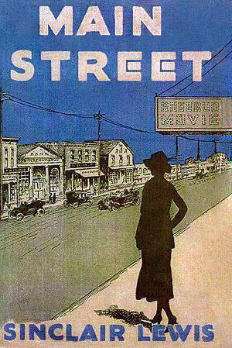
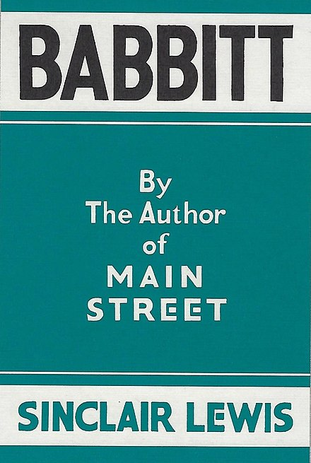
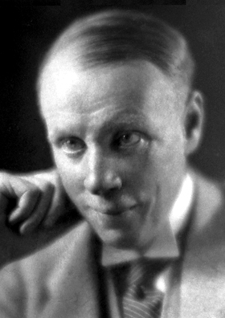
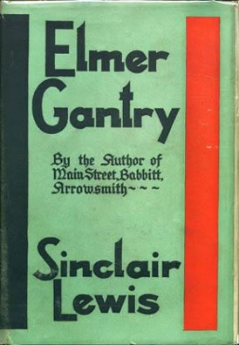
Sinclair Lewis
Critique of the Middle Class

