Slide 1
Powers of Congress

Slide 2
Legislative Branch: Job Description
Crafts bills (laws)
Can override a Presidential veto with 2/3 vote
Can impeach (put on trial) a President or judge for misconduct
Approves President’s choice of judges
Approves budget and treaties
Collecting/raising taxes and borrowing/making money
Declares war
Maintaining the armed forces
Regulates trade
Grants copyrights and patents
Maintaining the highway systems
Setting uniform weights and measures
Administering the postal services

Slide 3
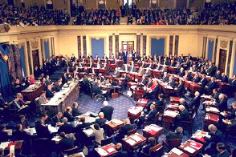
Congressional Power
1. Power is granted to Congress in 3 ways
1. Expressed Powers
2. Implied Powers
3. Inherent Powers
Senate

Slide 4
Expressed Powers
1. Expressed Powers
1. Powers that are specifically listed in the Constitution
1. Article 1, Section 8

Slide 5
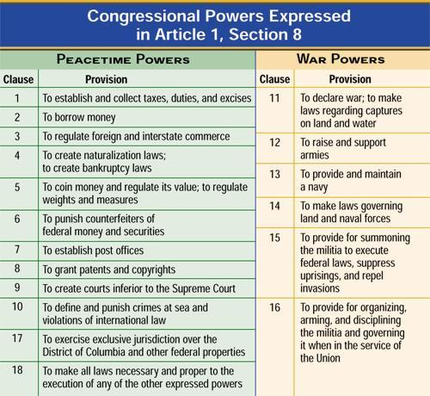

Slide 6
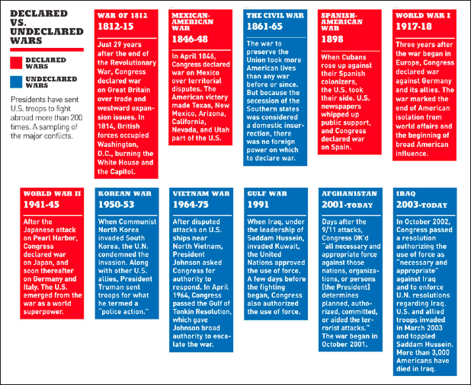

Slide 7
Implied Powers
Implied Powers
Powers deducted from the clearly stated powers
Necessary and Proper Clause (Article 1, Section 8, Clause 18)
Congress has the power “…to make all laws which shall be necessary and proper for carrying into execution the foregoing (expressed) powers…”
Does this give too
much power to
Congress?

Slide 8
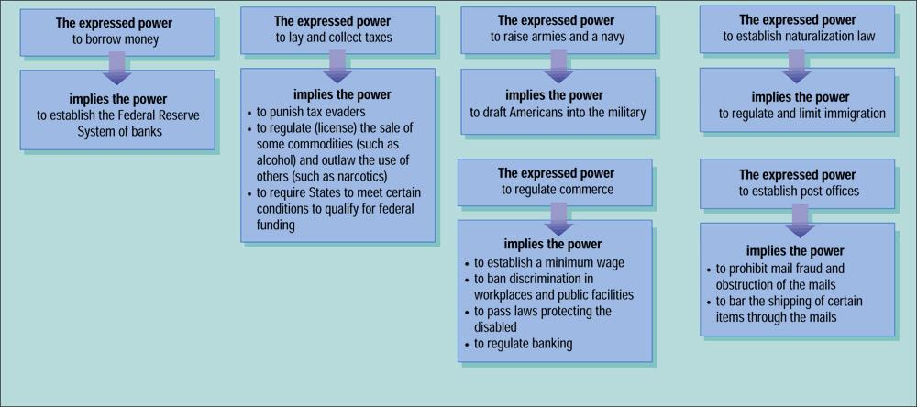

Slide 9
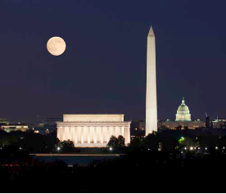
Inherent Powers
1. Inherent Powers
1. Those held to belong to all world governments
2. Include things like the power to control the nation's borders or expand its boundaries

Slide 10
ASSIGNMENT
For THURDAY:
Bring in a small paper bag (lunch-bag size)
Find one small, school appropriate item to represent as many powers of congress as you can.

Slide 11
Activity: Classifying Powers of Congress
1. Get out your Constitution outline!!
2. With a partner, decide whether each situation is an Expressed Power, an Implied Power, or a Denied Power.
3. If it is an Expressed Power, you must cite the Article, Section, and Clause of the Constitution that you found that Expressed Power.
4. If it is an Implied Power, you must cite Article 1, Section 8, Clause 18.
5. If it is a Denied Power, you must cite the Article, Section and Clause that forbids that particular action by Congress.

