Slide 1
Chapter 24: A World in Flames
1931-1941

Slide 2
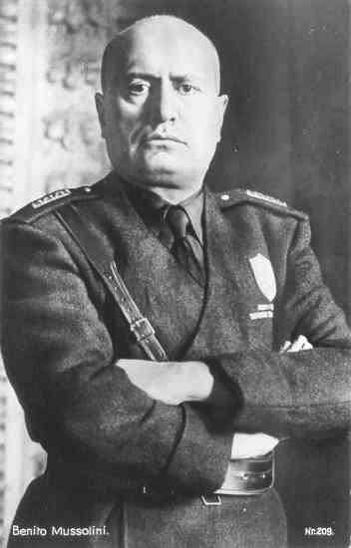
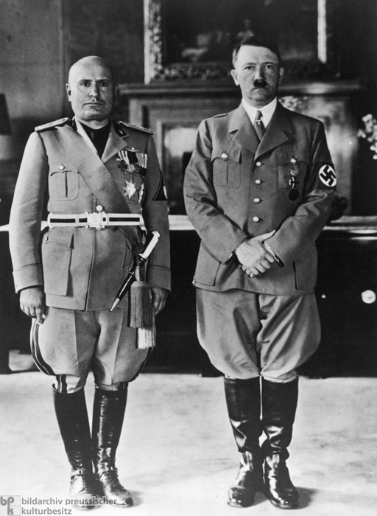
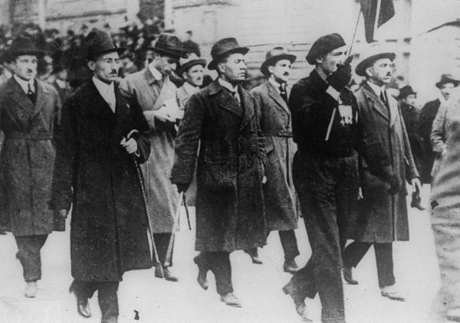
Section 1: America and the World
I. The Rise of Dictators
The treaty that ended World War I and the economic depression that followed contributed to the rise of dictatorships in Europe and Asia.
Italy developed the first major dictatorship in Europe.
Benito Mussolini
Fascism
Blackshirts

Slide 3
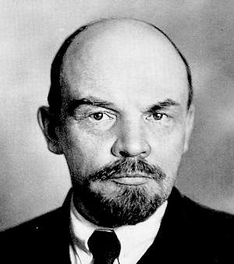
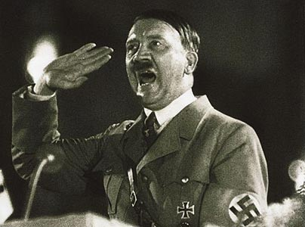
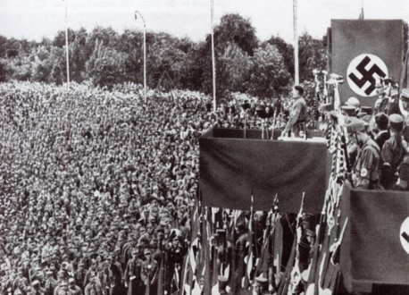
The Rise of Dictators (cont)
Communism in the Russian Empire.
Vladimir Lenin and the Bolshevik Party
1926 Joseph Stalin became the new Soviet dictator
Germany and the Nazi Party
Political and economic chaos
Adolf Hitler
Unification of all Germans
The “master-race”

Slide 4
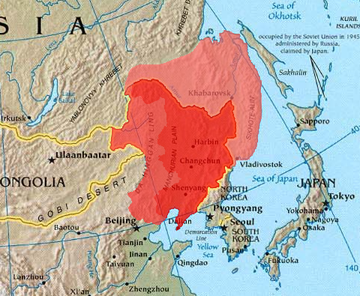
The Rise of Dictators (cont)
Military control in Japan
Difficult economic times
Manchuria
II. America Turns to Neutrality
Why Americans support neutrality?
Rise of dictatorships in Europe
Refusal of European countries to repay war debt to U.S
Findings of the Nye Committee
The Neutrality Act of 1935

Slide 5
Amer. Turns to Neutrality (cont)
The Spanish Civil War
The forming of alliances
Rome-Berlin Axis to the Axis Powers
The Neutrality Act of 1937
“Cash and Carry”
President Roosevelt and internationalism
Japan attacks China
America sells arms to China

Slide 6
Section 2: World War II Begins
I. “Peace in Our Time”
Germany’s and Hitler’s aggression
Austria and Anschluss, March 1938
The Sudetenland in Czechoslovakia
The Munich Conference
France, Soviet Union, and Britain
Appeasement
March 1939

Slide 7
Peace in Our Time (cont)
Hitler’s demands continue into Poland
Danzig, highways, and railroads across the Polish Corridor.
Britain and France wake-up
May 1939, Hitler orders the invasion of Poland
Nonaggression Treaty between Germany and the USSR
II. The War Begins
Britain and France declare war

Slide 8
The War Begins (cont)
The German assault on Poland
Blitzkrieg
Polish defeated on October 5
April 9, 1940 Norway and Denmark attacked
Defeated within a month
The French defense
Maginot Line
Hitler’s alternative approach
Netherlands, Belgium, and Luxembourg

Slide 9
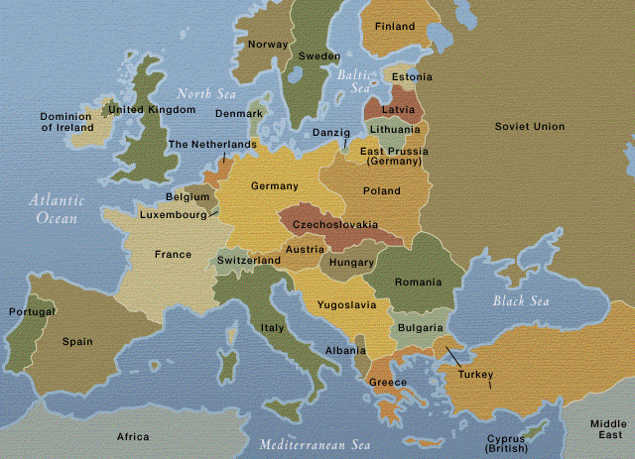
Europe After WWI

Slide 10
The War Begins (cont)
British and French troops become trapped
French miscalculate German approach
The Miracle at Dunkirk
June 22, 1940 France surrenders
Ironically the surrender happened in the same railway car in which German had surrendered at the end of WWI
Germany installed a puppet government

Slide 11
Britain Remains Defiant (cont)
Churchill’s determination
Speech rallies British people and alerts America of Britain’s state
The invasion of Britain
The difficulties faced by Germany
Had to cross the English channel
Only had a few transport ships
British Royal Air Force was a great threat
German victory depended on Royal Air Force defeat

Slide 12
Britain Remains Defiant (cont)
The Battle of Britain
Began in August 1940
Luftwaffe attempt to eliminate British Royal Air Force
Air battle lasted into the fall of 1940
The accidental bombing of London
August 23, 1940
The British retaliate
Hitler’s new goal

Slide 13
Britain Remains Defiant (cont)
Britain’s advantage versus it’s disadvantage in the air battle
Germany’s numbers versus British innovative technology
Radar
British fighters triumph
Churchill, “Never in the field of human conflict was so much owed by so many to so few.”
October 12, 1940, Hitler cancelled the invasion of Britain

Slide 14
Section 3: The Holocaust
I. Nazi Persecution of the Jews
During the Holocaust the 6 million Jews were killed
Nazi ideology
Hitler’s Mein Kampf
Political racial policies
Aim of persecution
Those who oppose them, the disabled, Gypsies, homosexuals, and Slavic people

Slide 15
Nazi Persecution of the Jew (cont)
Strongest hatred reserved for the Jews
They saw all Jewish people as evil no matter their religion, occupation, or education.
The Nuremberg Laws of 1935
Took citizenship away from Jewish Germans
Banned marriage between Jews and other Germans
Jews could not hold public office or vote

Slide 16
Passports marked with a red “J”
By 1936 at least half of Germany’s Jew were jobless
Could not work as journalist, civil servants, farmers, teachers, or actors, and could not practice law, medicine, or operate businesses.
Kristallnacht
November 7, 1938
Infuriated Hitler responds
Propaganda

Slide 17
Nazi Persecution of the Jew (cont)
Kristallnacht, “the night of broken glass”
Occurred throughout Germany and Austria
The terror continued into the next day
The Gestapo
Insult to injury

Slide 18
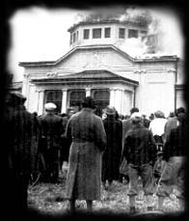
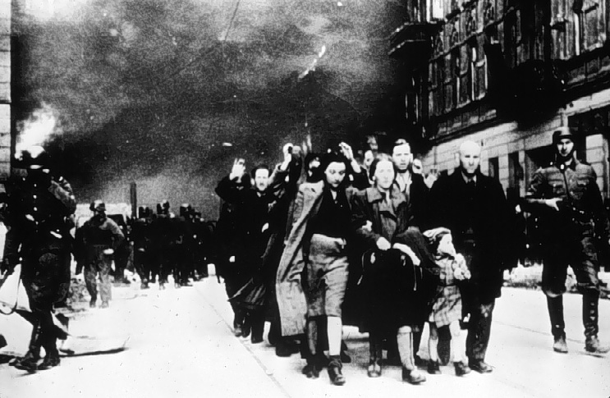

Slide 19
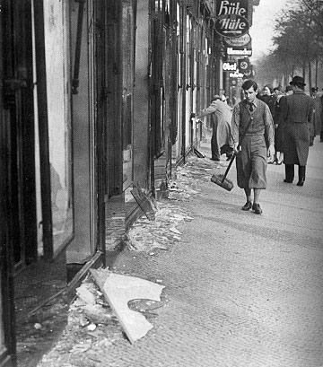
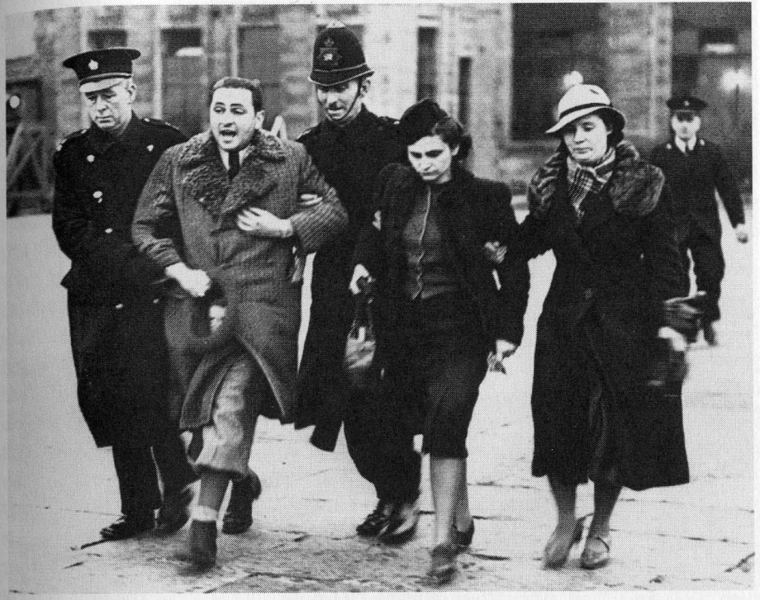

Slide 20
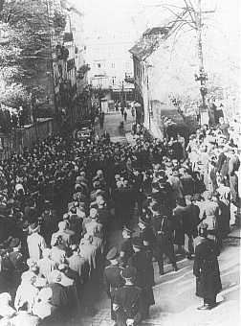
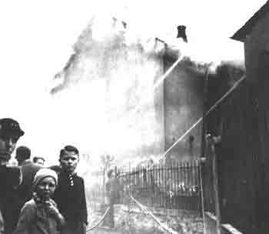

Slide 21
Nazi Persecution of the Jew (cont)
Jewish Refugees Try to Flee
Escalation of persecution following Kristallnacht
1933 to 1939
350,000 Jews escaped Nazi controlled Germany
Included Albert Einstein and Otto Frank

Slide 22
Nazi Persecution of the Jew (cont)
Jewish refugees overwhelm other countries
Especially following the Nazi Anschluss
Visas to the United States
3,000 applications a day from Jews in Austria
Many never received visas and remained trapped

Slide 23
Nazi Persecution of the Jew (cont)
Factors limiting Jewish immigration to the U.S
Jews were prohibited from taking more then $4 out of Germany
They would be depended on the country they arrived at
The economic depression
Unemployment was high and this would not help
Immigration quotas

Slide 24
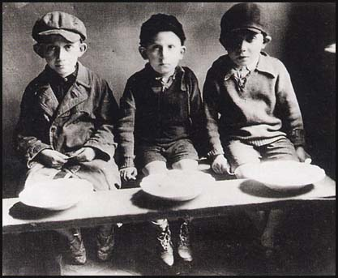
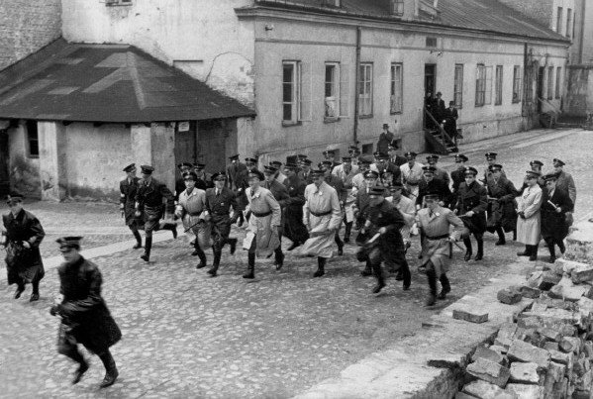

Slide 25
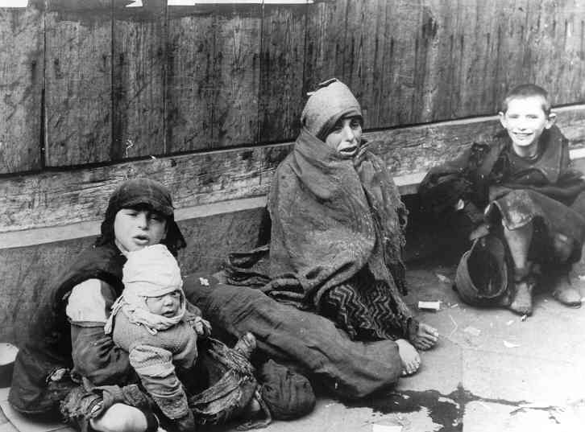
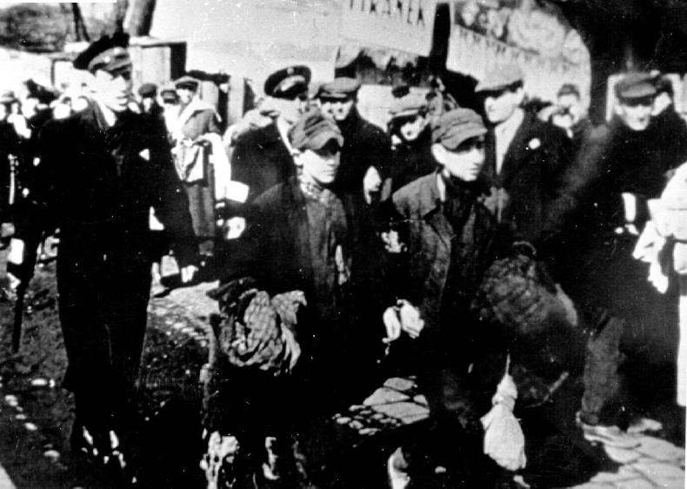

Slide 26
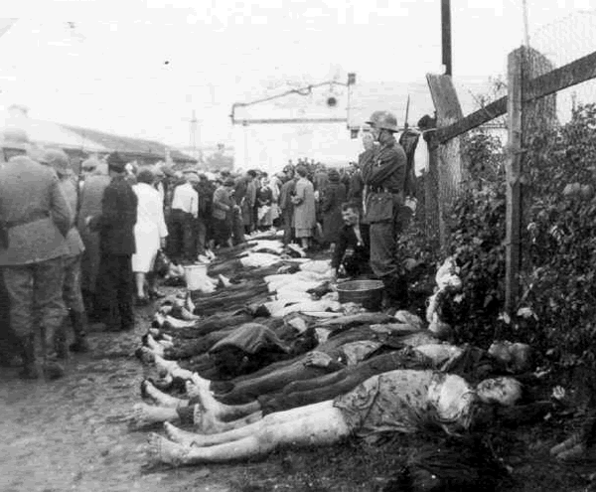
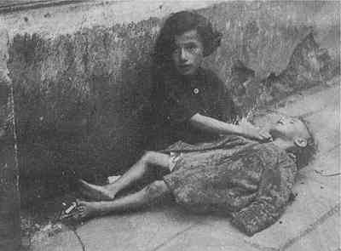
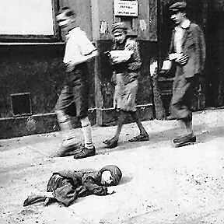

Slide 27
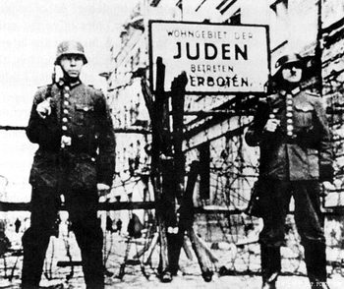
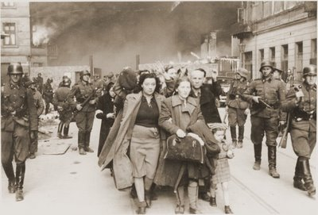

Slide 28
II. The Final Solution
The Wannsee Conference, January 20, 1942
Solution of the Jews and undesirables
Round up the Jews and undesirables
Concentration Camps
First built in 1933 to hold political opponents
Work as slaves until drop dead
Extermination Camps
Built into concentration camps following Wannsee Conference

Slide 29
The Final Solution (cont)
Purpose was to have an efficient way to kill the elderly, sick and young Jews and undesirables, usually through the use of gas chambers.
Crematoriums
Ex: Auschwitz- housed 100,000 people in 300 structures, gas chambers built to kill 2,000 people at a time, 12,000 people killed on a daily basis, about 1.6 million people died at Auschwitz.

Slide 30
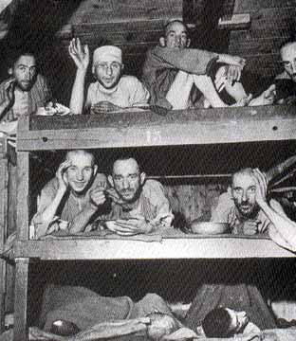
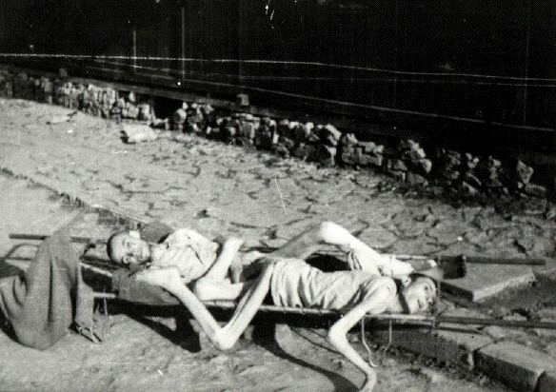
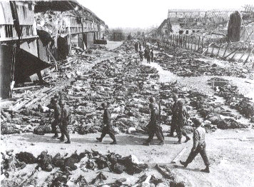

Slide 31
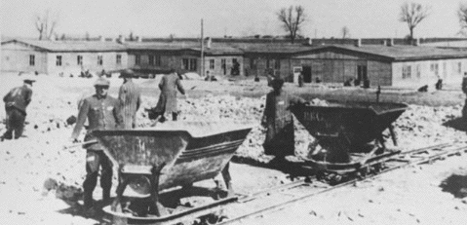
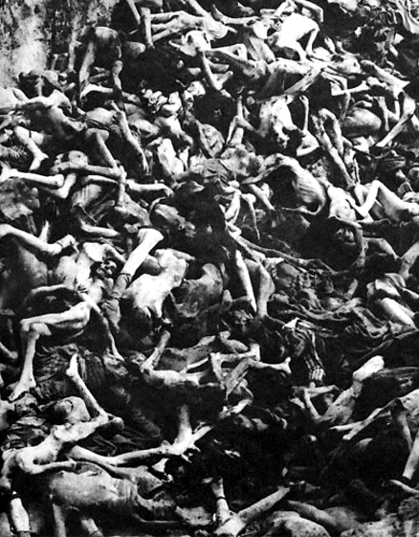
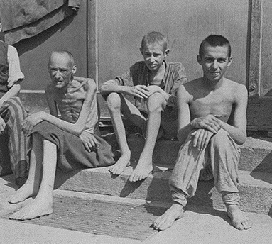

Slide 32
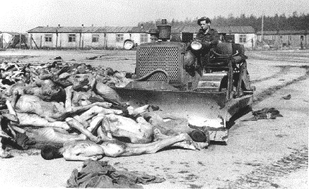
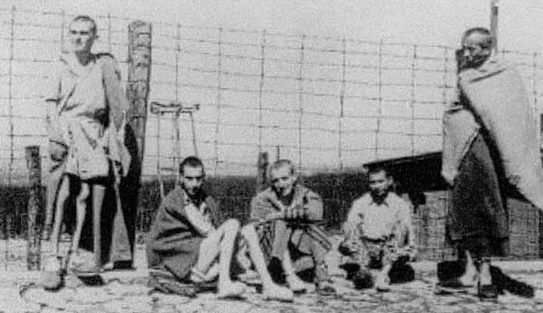

Slide 33
The Final Solution (cont)
Cultural Devastation
Jewish cultural around for over 1,000 years
Controversy over why and how such an event could happen.
German people’s sense of injury after WWI
Severe economic problems
Hitler’s control over the German nation
German fear of Hitler’s secret police
Long history of anti-Jewish prejudice and discrimination in Europe

Slide 34
Section 4: America Enters the War
I. FDR Supports England
The Neutrality Act of 1939
FDR declared that the U.S was neutral
Revised the original neutrality acts
Could now sale arms to nations at war
Done to aid Britain
“Cash and Carry”
Test of American Neutrality
Britain’s need for destroyers
To protect cargo ships and repel possible invasion

Slide 35
FDR Supports England (cont)
Neutrality loopholes
Destroyers-for-Bases
Exchanged 50 old American destroyers for opportunity to build U.S bases on British land.

Slide 36
II. The Isolationist Debate
American opinion shifts
Now supports aid to the Allies
Range of opinions
More involvement versus neutrality
Fight for Freedom Committee
Committee to Defend America by Aiding the Allies
America First Committee

Slide 37
The Isolationist Debate (cont)
The election of 1940
The debate carries over
FDR’s and Willkie’s view
Both dance a fine line
FDR wins his unprecedented third term as president

Slide 38
III. Edging Toward War
Roosevelt Pushes for Involvement
Britain is fighting for democracy
Four Freedoms: freedom of speech, freedom of worship, freedom from want, freedom from fear
Lend-Lease Act
Allowed U.S to lend or lease arms to any country considered “vital to the defense of the U.S.”
Used to keep Britain strong

Slide 39
Edging Toward War (cont)
By the end we gave over $40 billion in weapons, vehicles, and supplies to the allies.
Hitler betrays nonaggression pact
June 1941
Soviet Union welcomed into the Allies
The hemispheric defense zone
Lend-Lease program did not solve British problems
British Navy required more help

Slide 40
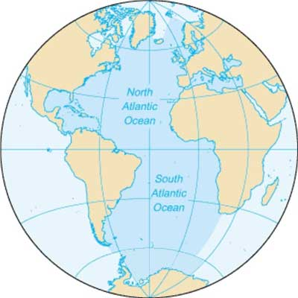

Slide 41
Edging Toward War (cont)
Western half of the Atlantic
The Atlantic Charter
Roosevelt’s and Churchill’s commitments
FDR’s pledge
Standoff in the North Atlantic
IV. Japan Attacks the United States
America Embargoes Japan
Japan becomes a threat to Britain
Export Control Act

Slide 42
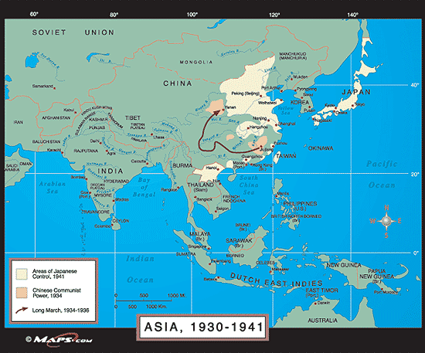

Slide 43
Japan Attacks the U.S. (cont)
Lend-lease aid to China
Japan spreads further and the U.S. responds
FDR’s deal and Japan’s response
Japan Attacks Pearl Harbor
Why?
U.S. error in judgment
December 7, 1941
The Damage
FDR’s and the U.S. reaction

Slide 44
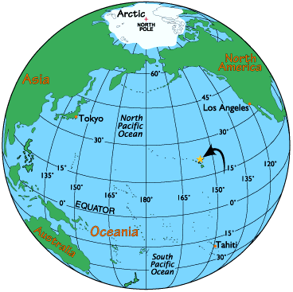

Slide 45
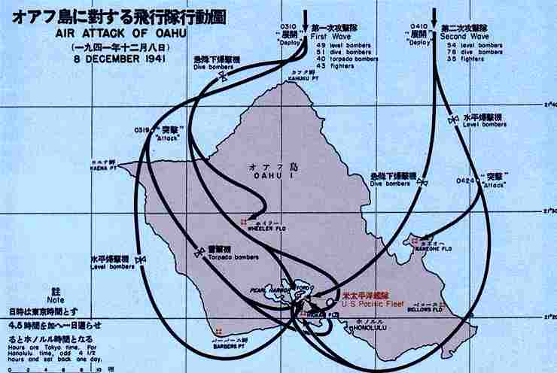

Slide 46
