Slide 1
The First New Deal
US History II
Mr. Tuttle
Lodi HS

Slide 2
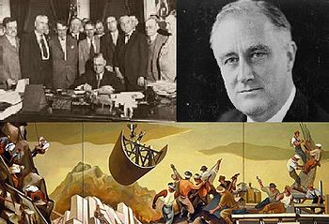
The First Hundred Days
Between his inauguration on March 9th and June 16th, Roosevelt sent Bill after Bill to Congress. 15 such bills were passed by Congress that focused on RELIEF, RECOVERY and REFORM.

Slide 3
What did Roosevelt mean by relief, recovery and reform?
1. Relief - Immediate action taken to halt the economies deterioration.
2. Recovery - "Pump - Priming" Temporary programs to restart the flow of consumer demand.
3. Reform - Permanent programs to avoid another depression and insure citizens against economic disasters.

Slide 4
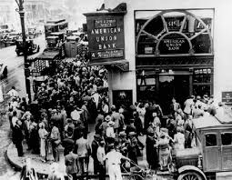
RELIEF
Bank Holiday declared so that the panic would be stopped.
Emergency Banking Act
Closed the insolvent banks and
only reopened the solvent ones.
Civilian Conservation Corp. (CCC) Put people directly to work earning $30 a month.

Slide 5
RECOVERY
Agricultural Adjustment Act (AAA) Taxed food processors and gave the money directly to farmers as a payment for not growing food. This decreased supply so price would go up.
National Industrial Recovery Act (NIRA) Created the NRA (National Recovery Administration) a consortium of businesses organized by the government and given the power to set rules and regulations for the economy. Members of the NRA displayed a blue eagle.
. Home Owners Loan Corp. Gave loans to home owners so they could pay their mortgages. This prevented people from going homeless and prevented banks from going under.

Slide 6
REFORM
Securities & Exchange Commission (SEC) Permanent Agency set up to monitor stock market activity and ensure that no fraud or insider trading was taking place.
Federal Deposit Insurance Corporation (FDIC) Permanent Agency designed to insure depositors money in savings banks. Originally insured up to $5,000 per depositor today it has increased to $100,000.

Slide 7
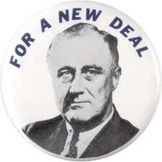
Assignment- Due Wednesday
Use the chart on page 687 to explain the "alphabet Soup" of Agencies created during the First New Deal. (day two) Students will use the model on page 701 to outline section two of chapter 23.Finish for Homework.

