Slide 1
Spanish, French and British Colonies (1491 - 1607)

Slide 2
European Exploration Goals
Technological Improvements that helped promote contact and trade?
Sextant, Compass
Joint-stock companies (British)
Reasons for Exploration?
Wealth (gold), Power and status (glory), and spread Christianity (God)

Slide 3
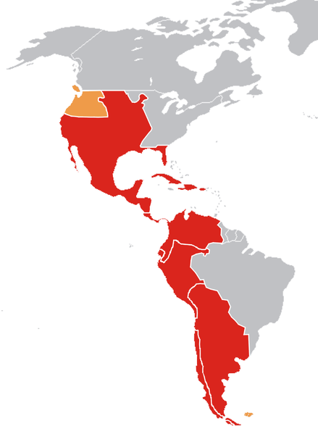
The Transformation of the Americas
Impacts of Spanish contact:
New caste system and racially diverse populations
Mestizo - mixed Spanish and Native ancestry
Mulatto - mixed Spanish and African ancestry
Encomienda System (16th Century):
Royal grants of land from Spanish crown to Spaniards
Spanish settlers promised to Christianize Natives
Spanish gained tribute
How were Natives impacted?
Many were treated harshly
Heavy manual labor - building roads and infrastructure
Eventually, the system was replaced by African slave labor

Slide 4
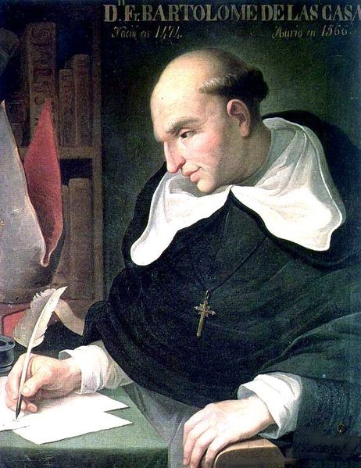
The Transformation of the Americas
The Valladolid Debates over treatment of Natives:
Bartolome de Las Casas vs Juan Sepulveda
How was treatment of Africans and Natives justified?
White superiority, religion, “uncivilized” view of groups
Conflict with Natives:
Europeans sought to change Natives’ way of life and worldview
Natives sought to preserve **autonomy** (independence or self-rule)
Africans adapt to the Western Hemisphere:
Sought to preserve **autonomy**
Combined Christianity with African religions
Maroon communities - made up of runaway slaves
Bartolomé de las Casas

Slide 5
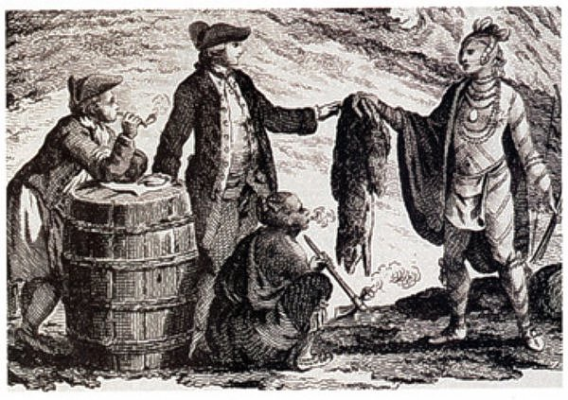
French/Dutch Colonies in North America
Did not want to invest Troops to conquer areas. But still wanted Benefits of Trade.
Dutch and French Imperial Goals:
Sent fewer settlers, established trade alliances with Natives, often intermarried, traded furs

Slide 6
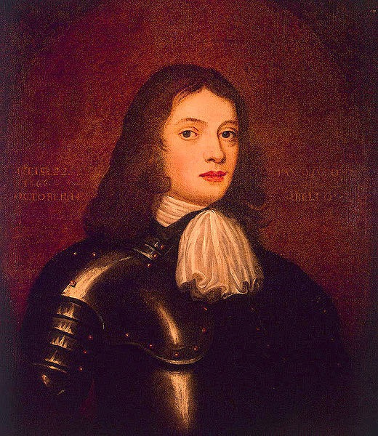
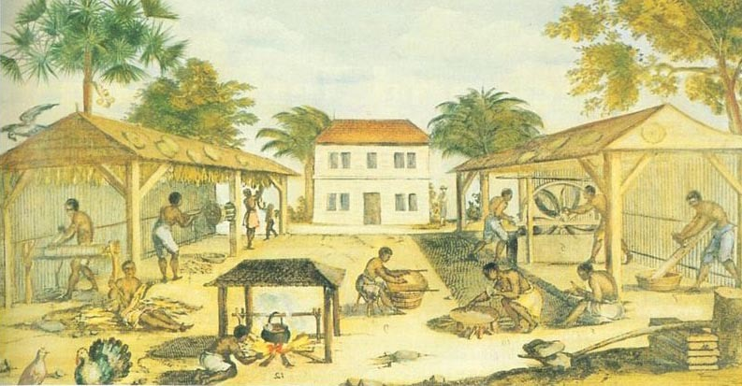
British Colonies
New England:
Puritans that sought to establish a like-minded (homogeneous) community
Mixed economy - agriculture and trade
Longer life-expectancy, more families
Middle Colonies:
Religiously, ethnically, and demographically diverse
Crops - cereal (grains)
Southern:
Chesapeake (MD and VA) and North Carolina - tobacco - labor-intensive
Relied on indentured servants initially, later slavery (Post-Bacon’s Rebellion)
Atlantic seaboard (South Carolina) and West Indies:
Long growing season, heavy use of slave labor
Staple crops - (rice), as well as sugar
Slaves often made up most of the population

Slide 7
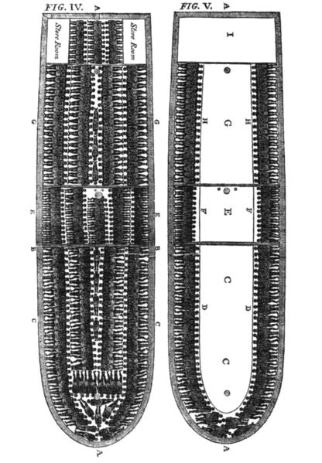
British Colonies
British colonists rarely intermarried with Natives and Africans
Rigid social hierarchy developed
Emergence of the Atlantic Slave Trade was caused by:
Racial superiority, lack of indentured servants (post-Bacon’s Rebellion in 1676), Natives were harder to enslave, and European demand for goods
Impacts of African Slavery?
Desire for more land - conflicts with Natives
Africans used covert (passive) and overt forms of resistance

Slide 8
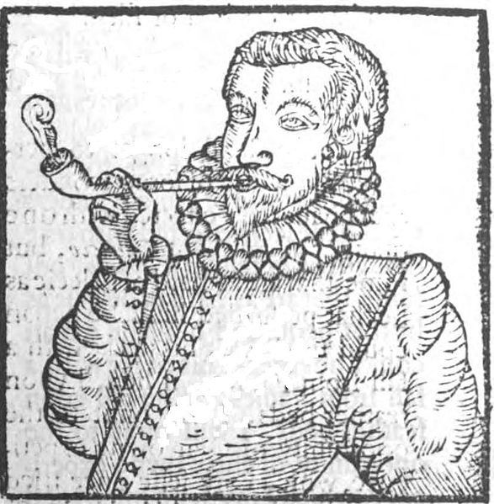
European Imperial Goals
Spanish:
Tight control, sought to convert Natives and gain gold
Dutch and French:
Sent fewer settlers, established trade alliances with Natives, often intermarried, traded furs
English:
Colonies heavily relied on agriculture (tobacco - Chesapeake), many men and women populated the colonies, often hostile relationships with Natives

Slide 9
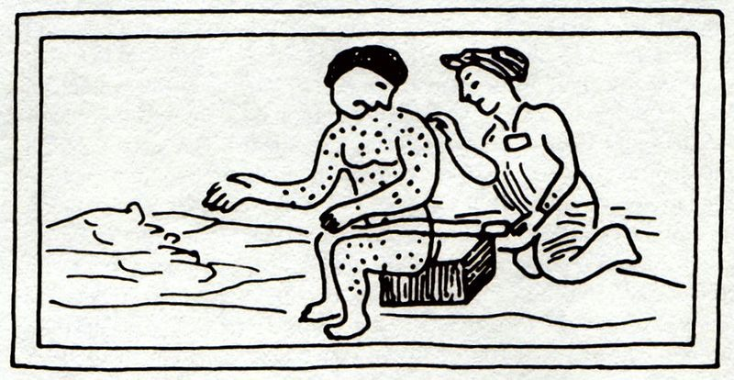
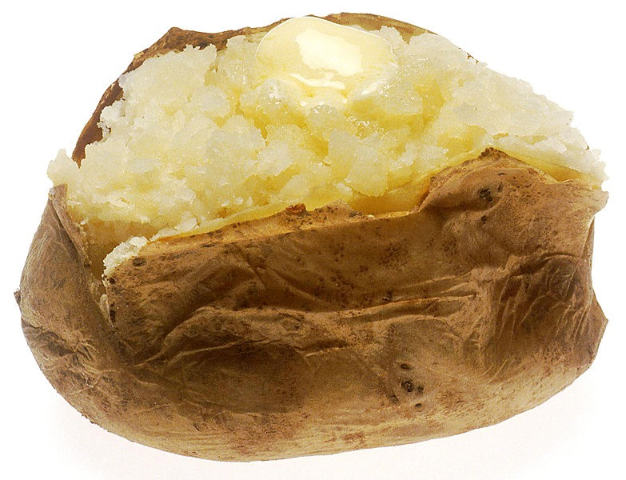
European Contact
Columbian Exchange:
Exchange of goods, ideas, people, and diseases between Europe, Africa, and the Americas
Impact on Europe?
Population growth (corn, potatoes)
Shift from feudalism to capitalism
Impact on Natives?
Diseases killed many
Horse and guns transformed way of life (hunting, warfare)
Impact on Africans?
Increase in slave trade (Portuguese and Spanish in West Africa)

Slide 10
How Were They Different?
Spanish- EMPIRE- change the natives and rule them by ENCOMIENDA system.
French/Dutch- Trade with natives– it’s cheaper than Armies.
English- Displace the natives and bring in indentured servants and slaves.

