Slide 1
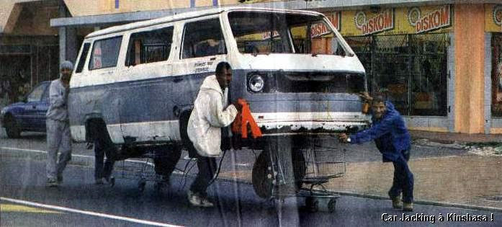
Warm Up 10/15/13
If someone was vandalizing and breaking into a car….what would you do? Would it matter what they looked like?
http://www.youtube.com/watch?v=sqqMNhzcpTc&safety_mode=true&persist_safety_mode=1&safe=active

Slide 2
What is your reaction to this film(the one we wa? Does race really affect how people act in your opinion?

Slide 3
Warm Up- 10/16/13
1) Why do role conflict and role strain occur?
2) Give an example of role conflict, role strain and role exit that has taken place with you life.
To help you out……(DO NOT NEED TO COPY)
Role Conflict, Role Strain, and Role Exit
A role set- is the different roles associated with a particular status.
Role conflict- occurs when fulfilling the role expectations of one status interferes with a second status.
Role strain- occurs when a person has difficulty fulfilling the role of one status.
Role exit- is the process people go through to detach from a role that was previously central to their social identity.

Slide 5
Warm Up 10/18/13
Create a drawing like the one on the left but fill in 6 ascribed statuses and 6 achieved statuses that you have.

Slide 6
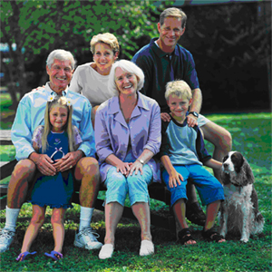
Warm Up 10/11/11
What is a Social Institution? What purpose do social institutions serve?
Answer: provide physical and emotional support for members, transmit knowledge, produce goods and services, maintain social control
Examples include: schools, workplace, religious institutions, family, politics, and economy. Read more:
Family

Slide 7
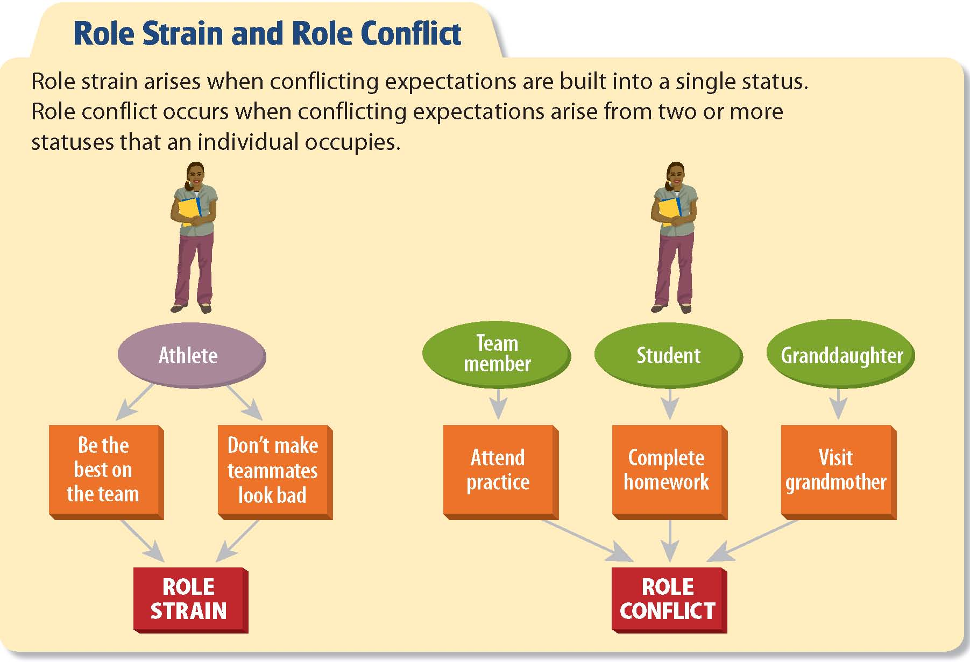
Create a drawing like the one on the above but fill Role Strain and Role conflict that you experience.

Slide 8
BOP 10/22/13
How is social structure demonstrated in the movie Mean Girls?

Slide 9
Questions for Discussion
What did you think of Mean Girls? Does it reflect your own experience of being a teenager?
What do you think of Cady? Do you think she is a likeable character? Why/why not?
What do you think this film has to say about teen culture?
How would you describe the atmosphere in the high school?
Why are the Plastics so concerned with their appearance? Why do you think our modern society is so obsessed with appearance and image?
How does Mean Girls portray those who aren't part of the popular crowd at school? What do you think the film has to say about such people?
Why does Cady start to act like the Plastics? How much of an influence do you think our friends and culture are on the way that we behave?
What role does jealousy play in this film? Why do we get jealous of other people?

Slide 10
Warm Up- 10/23/13
Remember the 5 types of social interaction:
Cooperation
Social exchange
Coercion
Conflict
conformity
1) What part of social interaction are the following
Blood donors expect payment.
Students read what the teacher assigns.
The United States invades Iraq.
Flood victims help each other.
Employees are forced to work overtime or be fired.

Slide 11
Cooperation
Social exchange
Coercion
Conflict
Conformity
Culture
Master Status
Role
In Group
Out Group
Relationship

Slide 12
Warm Up 10/25/13
Is social conflict necessarily a bad thing? Explain your position and give examples.

Slide 13
IT CAN BE BUT…
Not necessarily….conflict can be purposeful and bring about positive change
Examples: American Revolution, Civil Rights, Group Loyalty (9/11 Pearl Harbor)

Slide 14
WARM UP 10/15/12
1) What developments lead to a more settled life in horticultural and pastoral Societies?
2) What feature do sociologists tend to use to classify societies?
3) List at least 3 countries that are currently Pre-Industrial, Industrial and Post-Industrial or Information Age.

Slide 15
BOP 3/5/12
Complete the following chart:
Primary Groups and Secondary Groups
Primary Group Secondary Group
Quality of Relationship
Duration of Relationship
Scope of Relationship
Perception of Relationships
Examples

Slide 16
BOP 3/10/11
Complete the following chart:
Primary Groups and Secondary Groups
Primary Group Secondary Group
Quality of Relationship | Personal orientation | Goal Orientation
Duration of Relationship | Usually long-term | Variable; often short term
Scope of Relationship | Broad; usually involving many activities | Narrow; usually involving few activities
Perception of Relationships | Ends in themselves | Means to an end
Examples | Families; circles of friends | Co- Workers; Political Organizations

Slide 17
Warm Up 3/14/13
State whether each of the following is or is not a major feature of a postindustrial society:
A. emphasis on technical knowledge
B. employment of the majority of the labor force in service industries
C. Reliance on advanced technology
D. increased dependence on skilled blue collar workers
E. shift toward the employment of white collar workers

Slide 18
Survey Results
Did your results end up how you thought they would?
Discuss how the change in technology was shown in your results?
Did the age of the individual matter in the results? Why or Why not?
Give examples how technology has impacted your everyday life?

