Slide 1
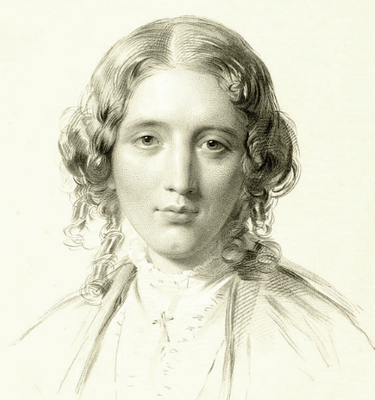
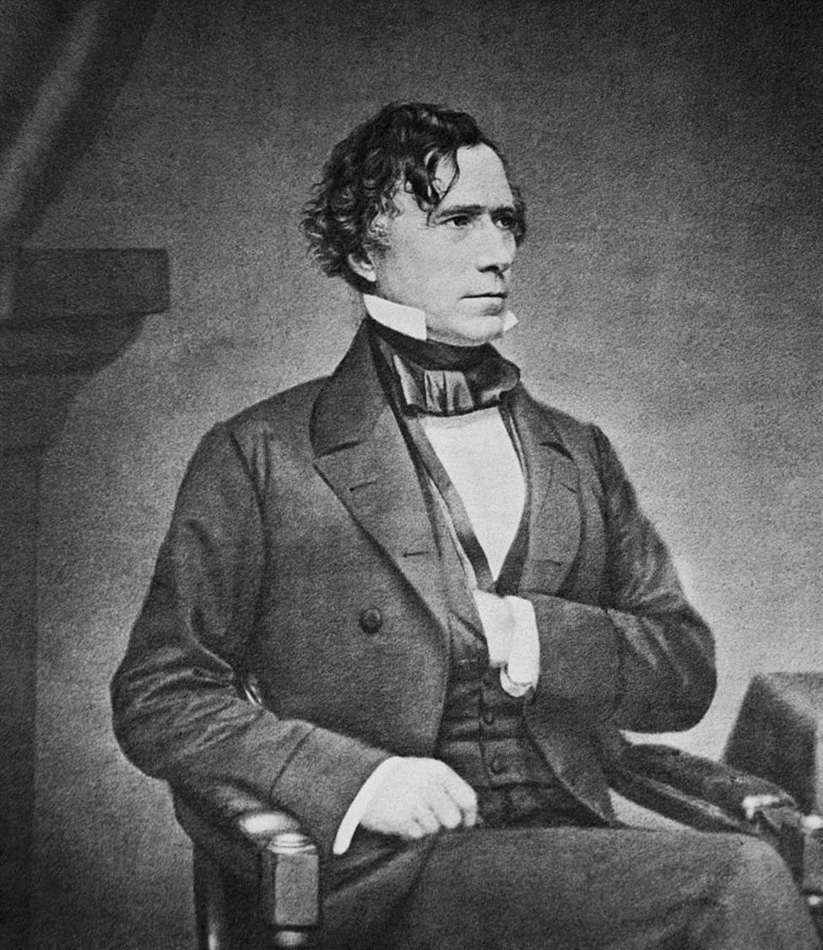
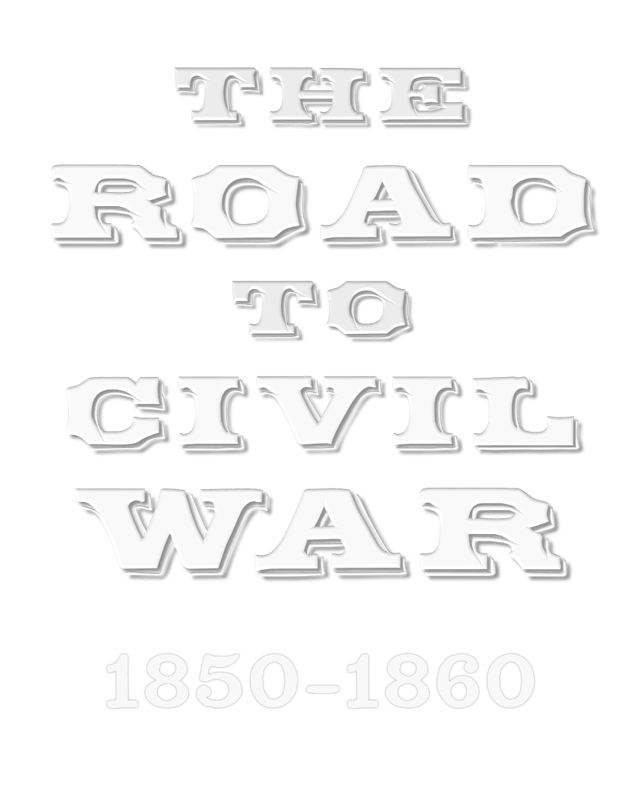
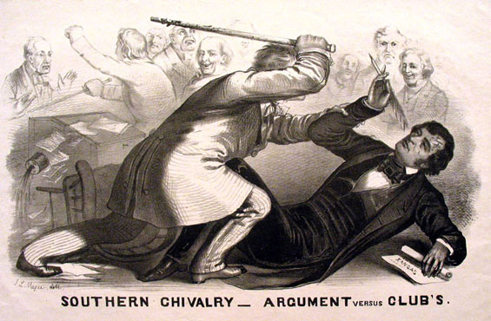
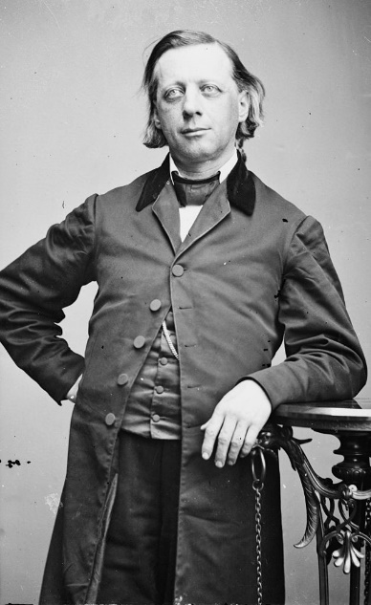
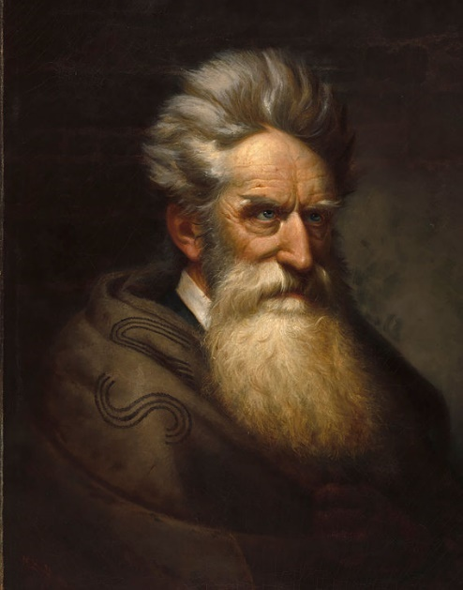

Slide 2
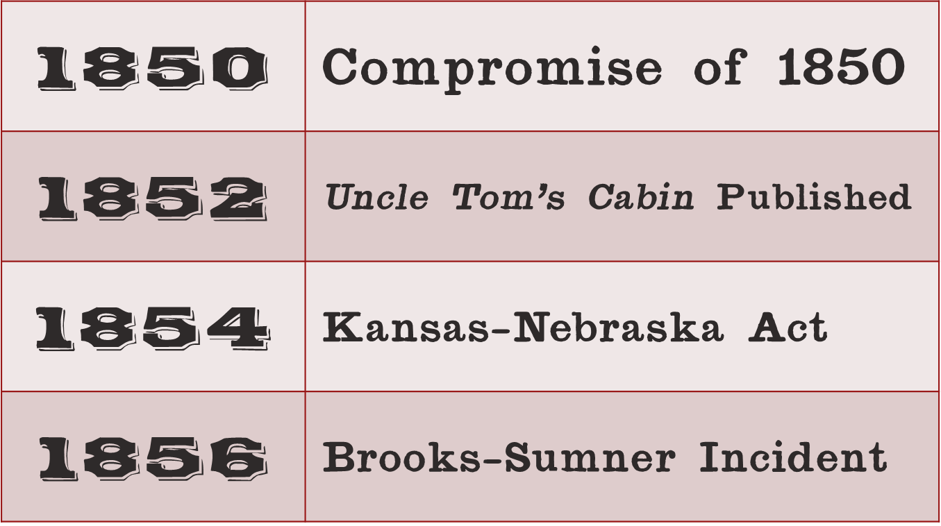

Slide 3
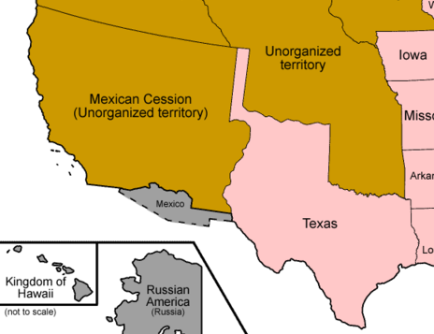
Notes:
The purpose of the Compromise of 1850 was to resolve sectional differences regarding slavery in the Western territories – specifically in regard to California’s request to enter the Union as a free state, the status of slavery in the rest of the Mexican Cession, and a border dispute between Texas and the federal government regarding its Western land claims.

Slide 4
Notes:
As a result of the Compromise, California was admitted as a free state and a stronger Fugitive Slave law was passed in order to gain support from congressmen from the Upper South who opposed California’s admission. Slavery in the Mexican Cession would be decided by a vote of the settlers (popular sovereignty) rather than by Congress, while Texas ceded land to the New Mexico Territory in return for the federal government assuming the state’s $10 million war debt. While they were at it, they compromised on slavery in Washington, D.C., outlawing the slave trade while still stopping short of outlawing slavery, altogether.

Slide 5
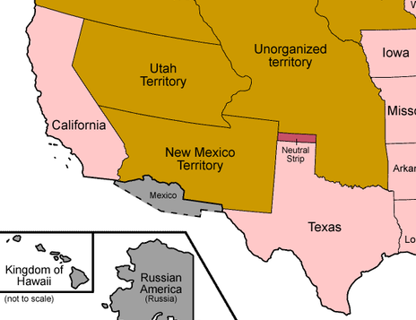
Notes:
The West after the Compromise of 1850

Slide 6
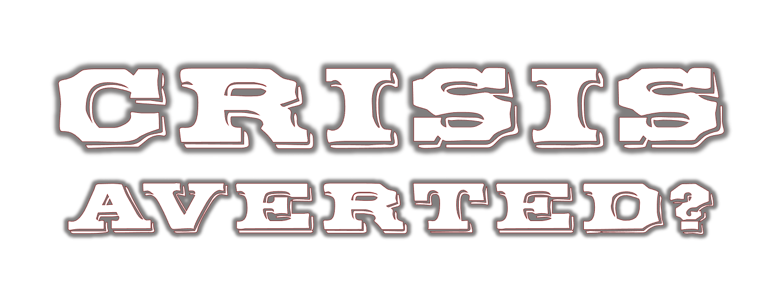

Slide 7
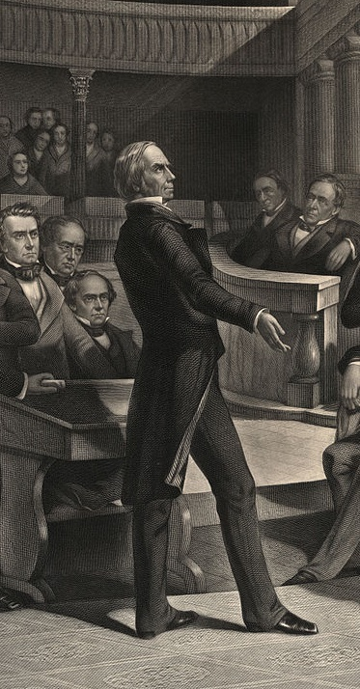
Notes:
In hindsight, the Compromise of 1850 was a miserable failure. While the compromise was intended to bring peace to the sections, it ended up causing even more controversy.

Slide 8
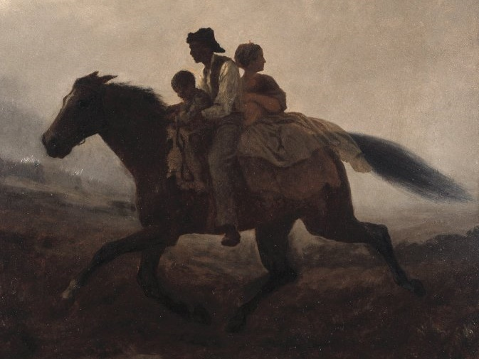
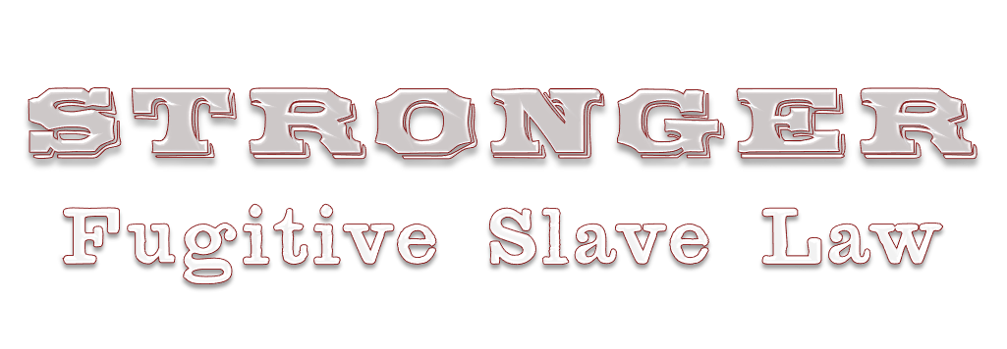
Notes:
The stronger Fugitive Slave Law became the most controversial part of the Compromise of 1850, immediately causing outrage and resistance in the North.

Slide 9
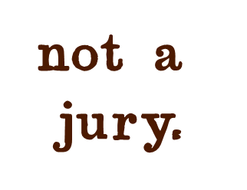
Notes:
The law provided for a bench trial (by a judge – not a jury) for those who were accused of being fugitive slaves, which presumed guilt and deprived the accused, if innocent, of constitutional rights to a jury trial.

Slide 10
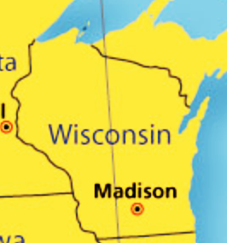
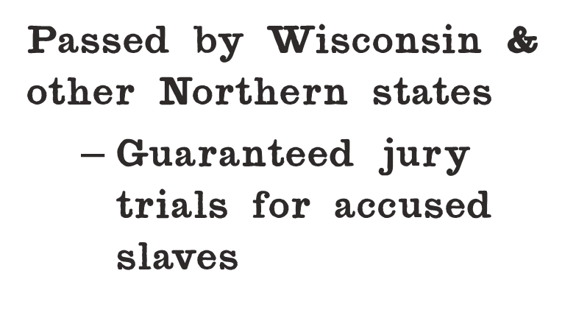
Notes:
Wisconsin and several other Northern states passed Personal Liberty Laws, which guaranteed a jury trial for anyone accused of being a fugitive slave. Some states forbade state officials from aiding federal authorities. While these laws did not explicitly nullify the Fugitive Slave Law, these laws are an example of de facto nullification (nullification in fact or in effect) since they rendered the federal law more difficult to enforce in those states.

Slide 11
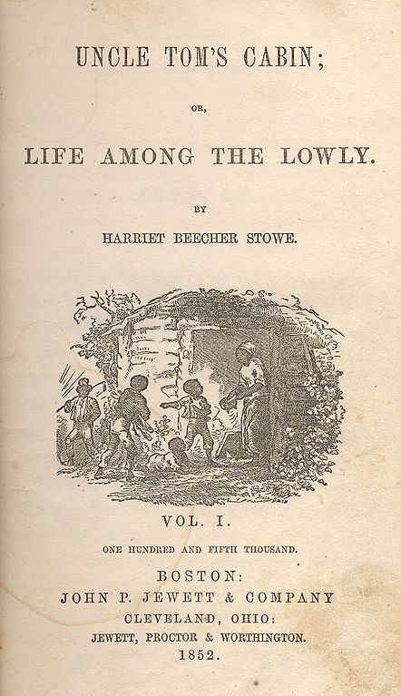
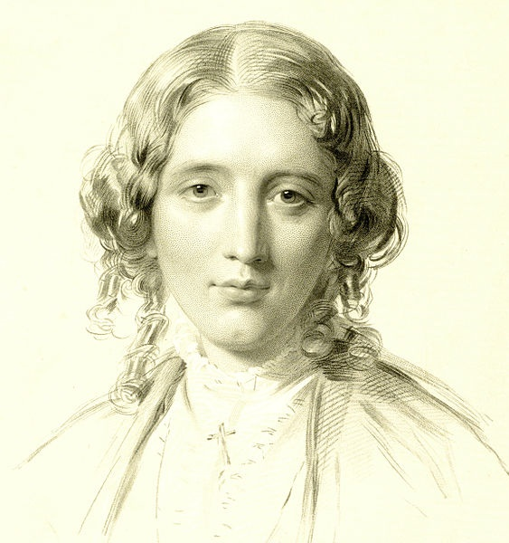
Notes:
The publication of Harriet Beecher Stowe’s novel, Uncle Tom’s Cabin, sparked a wave of anti-slavery sentiment in the North, as it made the horrors of slavery seem more real to Northerners who had never had any experience with it.

Slide 12
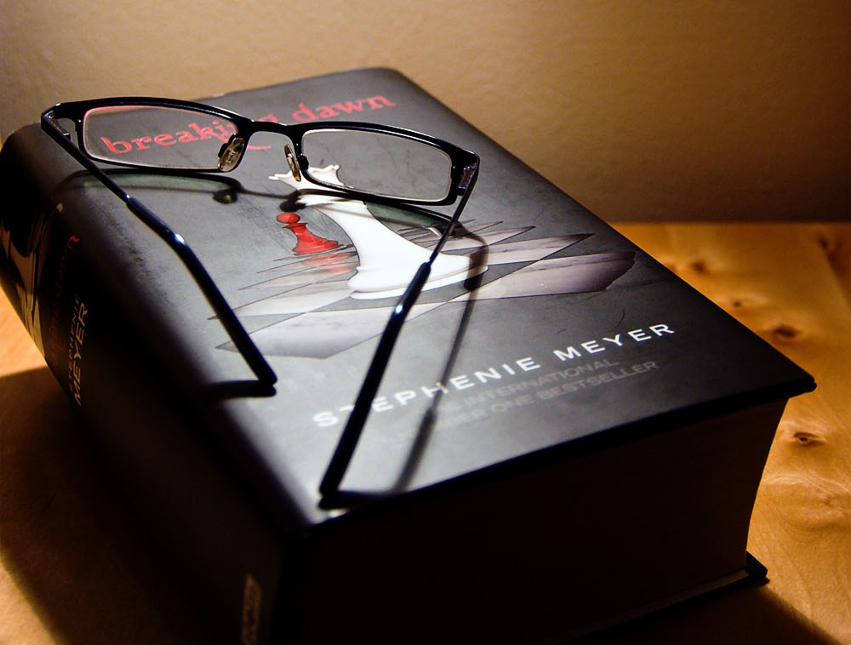
Notes:
Often, popular books can change the way we think about things. When I was growing up, people were afraid of vampires and Dracula came to mind when a vampire was mentioned. Now, because of a wave of books, movies, and TV shows, young people’s thoughts about vampires are more nuanced. Maybe some vampires are good… and they’re all so good looking!

Slide 13
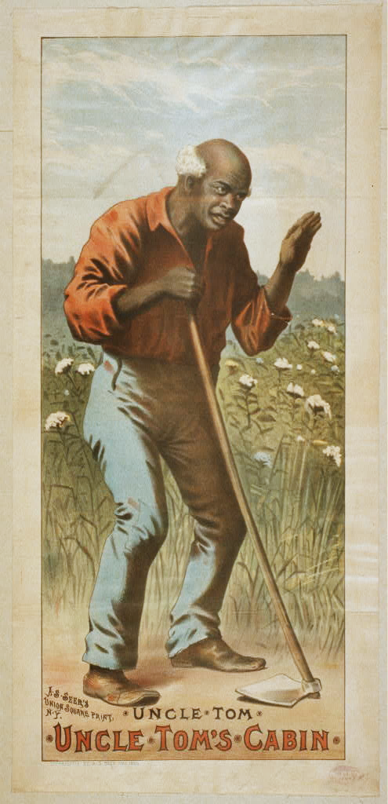
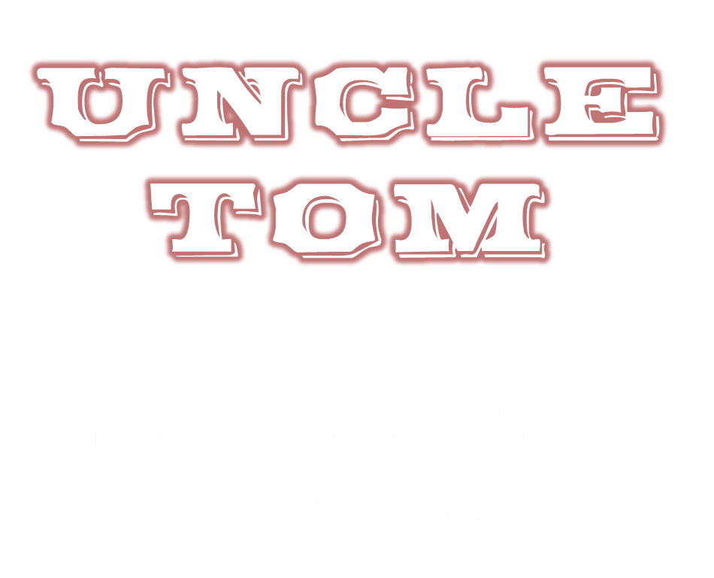
Notes:
Uncle Tom has survived as a personification of subservience, although this is partially due to other books that were written in later years that featured the character.

Slide 14
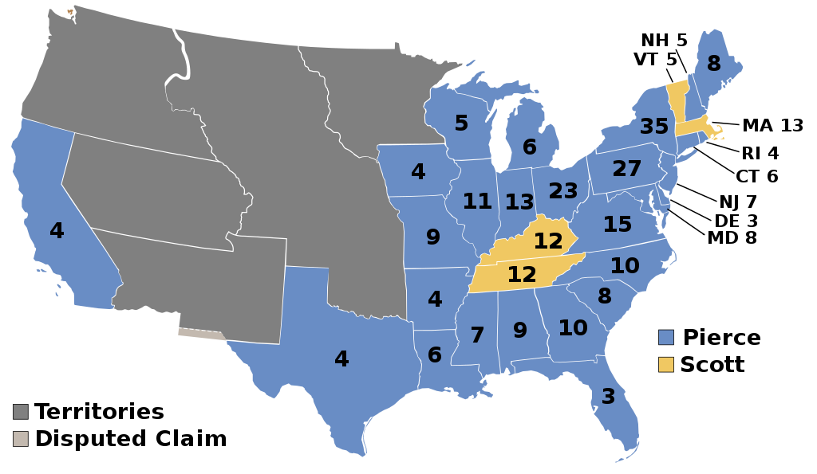

Slide 15
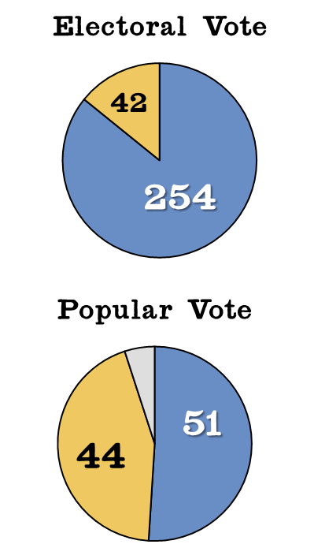
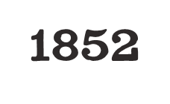
Notes:
The 1852 presidential election was an overwhelming electoral victory for the Democratic Party. This election spelled the beginning of the end for the Whig Party, which would never again compete in a presidential election. A Free Soil candidate got five percent of the popular vote – not a large percentage but enough to foreshadow that the Free Soil issue would soon become a major rallying cry for voters in the North.

Slide 16
Notes:
Franklin Pierce of New Hampshire was elected as the Fourteenth President of the United States. He was known by some as “Handsome Frank” and he had great hair. Having great hair is usually an asset for presidents, but it would not save Pierce, whose presidency would go down as a colossal failure.

Slide 17
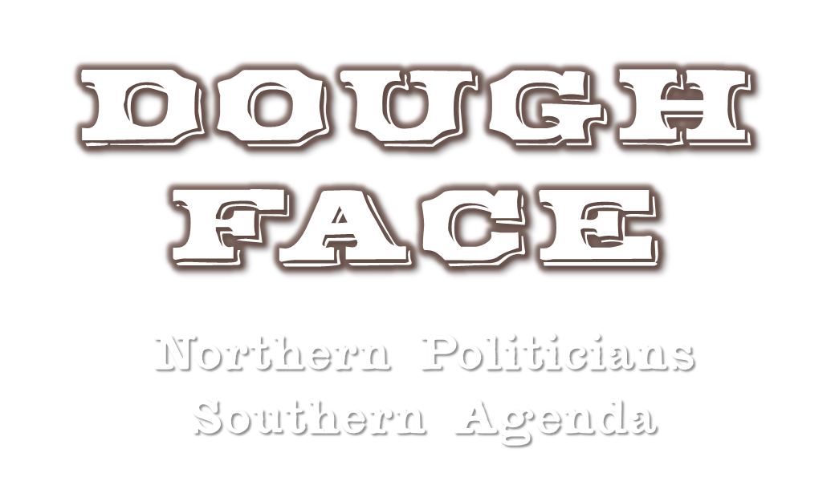
Notes:
Pierce was a “dough face,” a Northern politician who was friendly to the Southern political agenda regarding slavery in the territories.

Slide 18
Notes:
The conflicts over slavery in the 1850s were primarily between advocates of the Free Soil doctrine – opposing the expansion of slavery into the Western territories while not opposing its existence in the South – and Southern congressmen who wanted to see slavery expand into the territories.

Slide 19
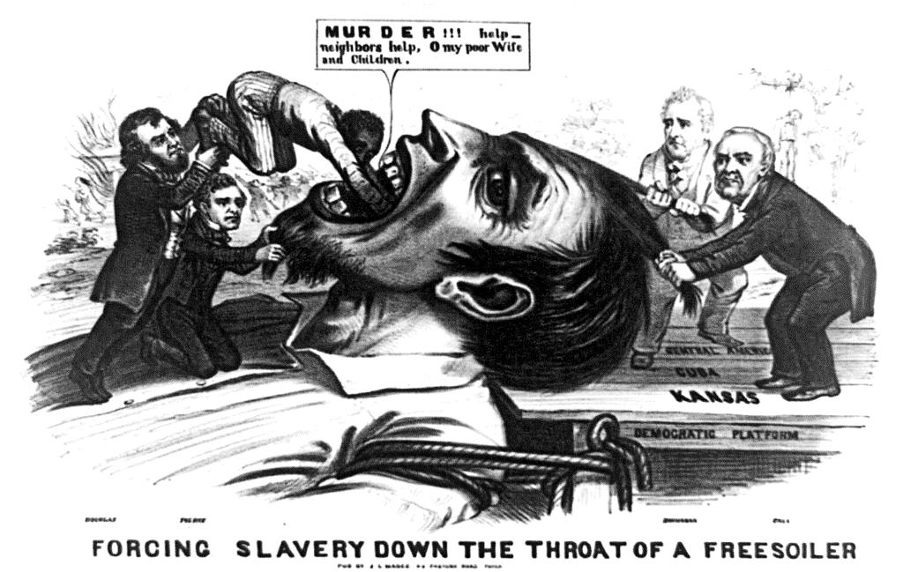
Notes:
Unlike abolitionists, Free Soilers were far less concerned about the morality of slavery in the abstract than they were the practical implications of wanting a “White West” without slavery. In this political cartoon, it is the white farmer who is cast as the victim – not the faceless slave that is being shoved down his throat.

Slide 20
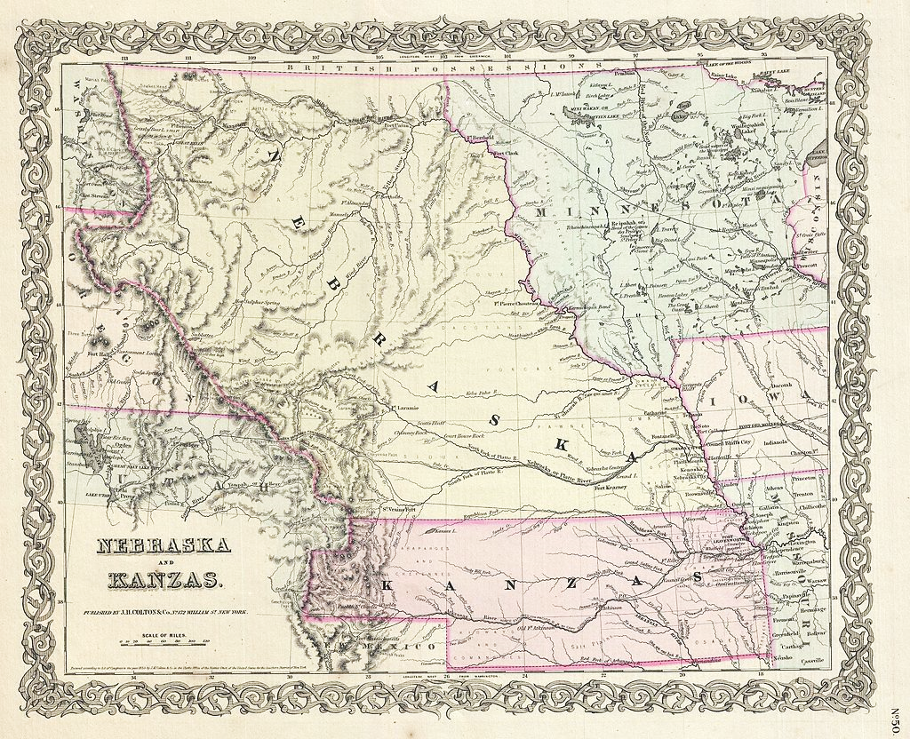
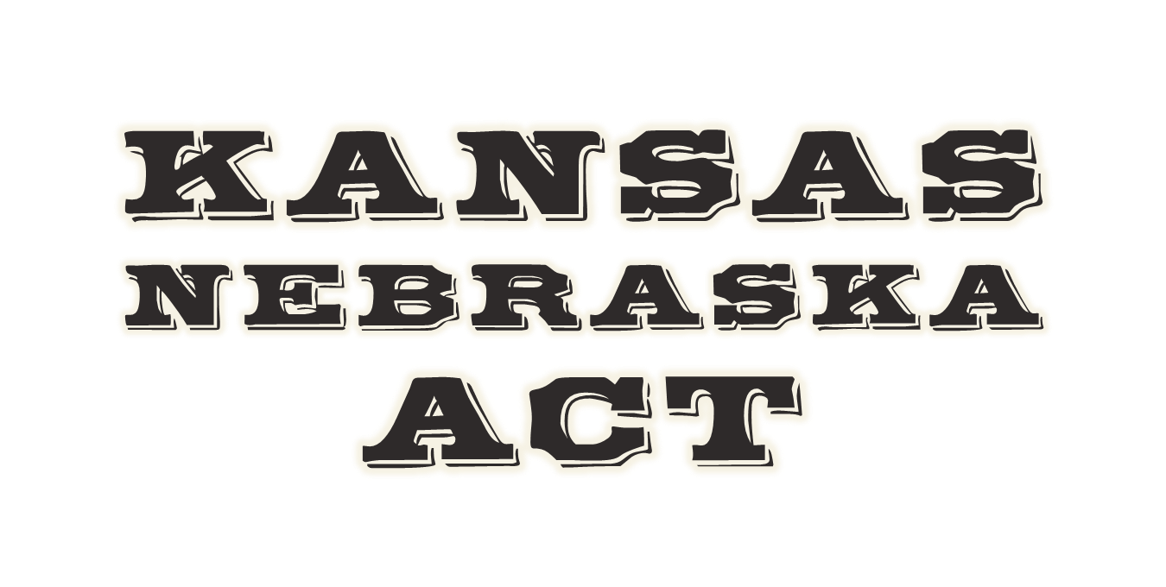

Slide 21
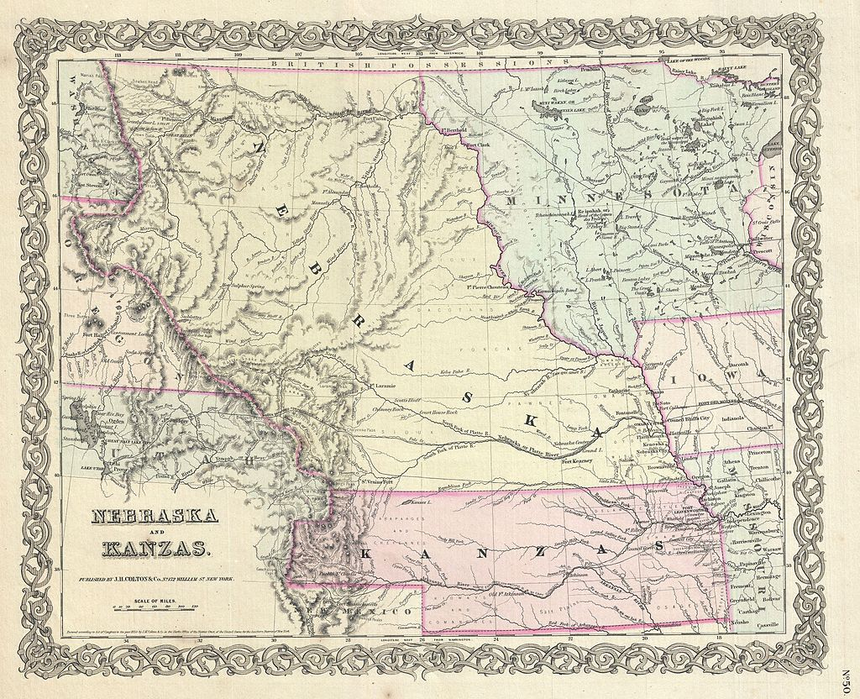
Notes:
The Kansas-Nebraska Act, passed in 1854, legislated that slavery in the newly-created Kansas and Nebraska Territories would be decided by popular sovereignty, letting the settlers determine the status of slavery rather than Congress.

Slide 22
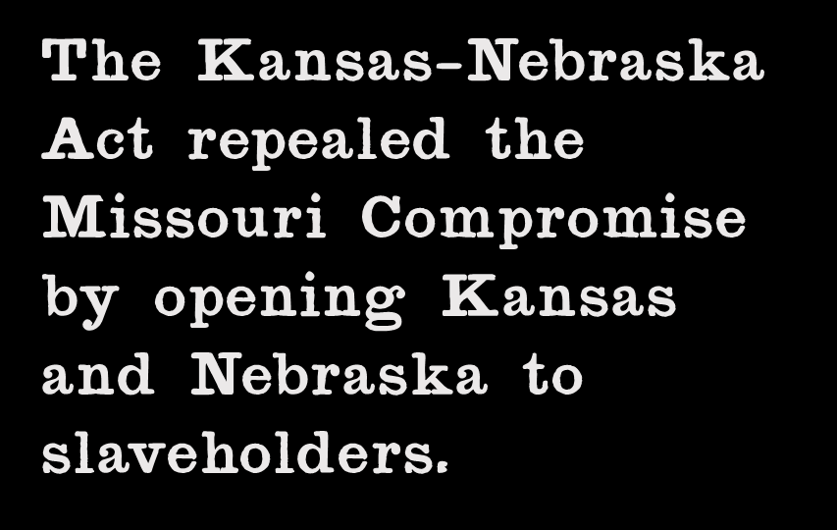
Notes:
The Kansas-Nebraska Act repealed the Missouri Compromise, which had closed territories of the Louisiana Purchase north of the 36°60′ parallel.

Slide 23
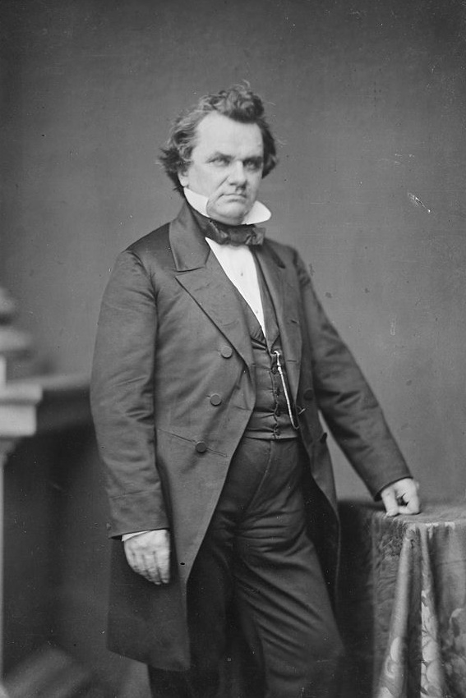
Notes:
Sen. Stephen A. Douglas of Illinois was the principal author and promoter of the Kansas-Nebraska Act. He had presidential aspirations and sought support from Southern senators who refused to support the organization of the Kansas and Nebraska Territories if those territories would be closed to slavery.

Slide 24
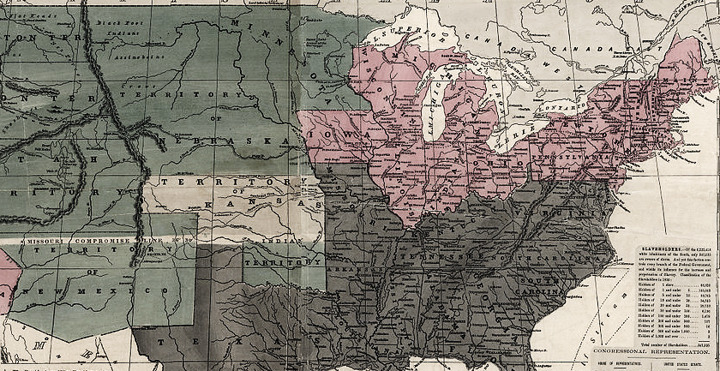
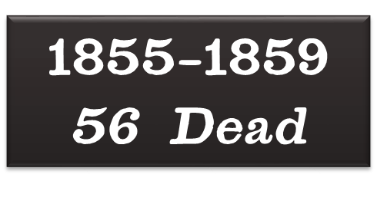
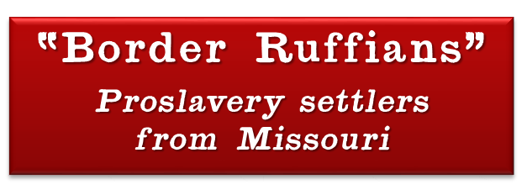
Notes:
The popular sovereignty provisions of the Kansas-Nebraska Act sparked a race to Kansas between pro-slavery settlers (many from right across the border in Missouri) and anti-slavery settlers (coming from as far away as New England). Fighting would occasionally break out between the hostile pro-slavery and anti-slavery settlers in what would become known as Bleeding Kansas.

Slide 25
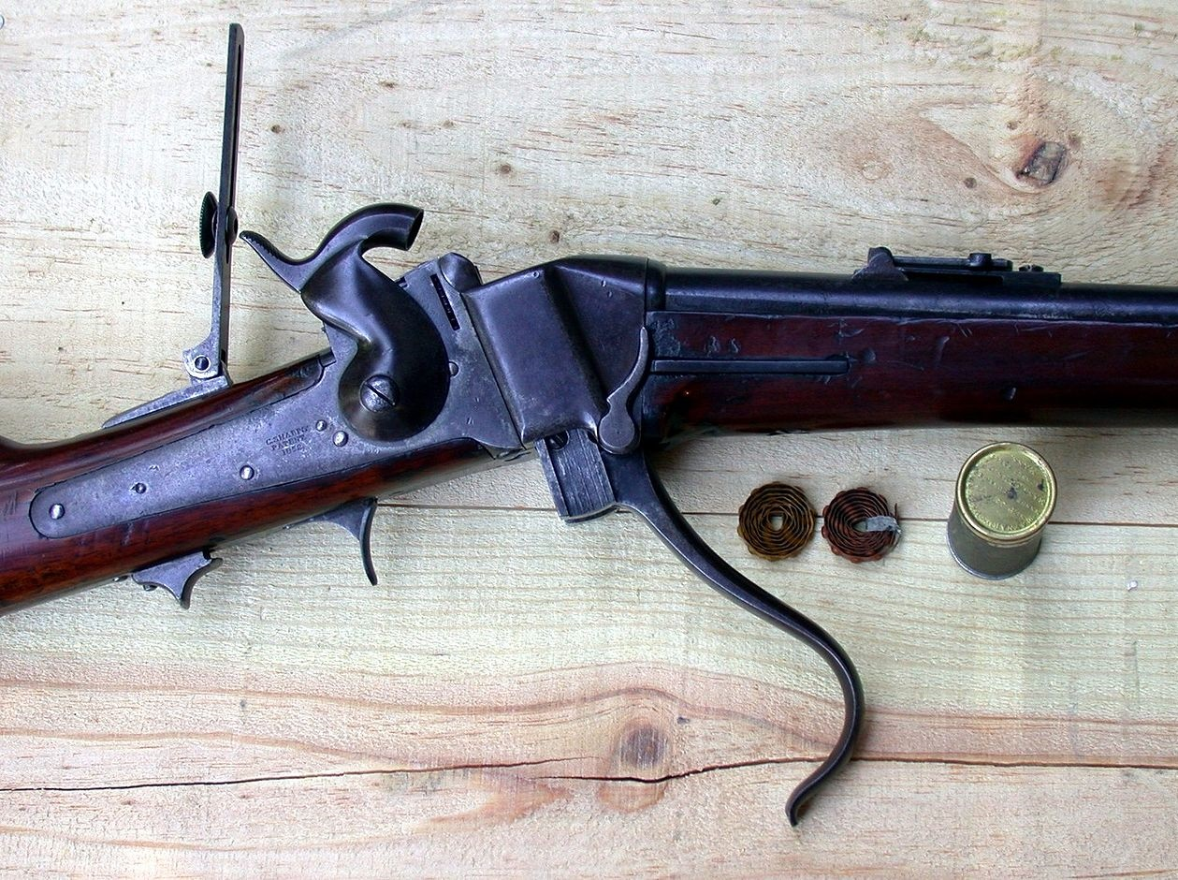
Notes:
Henry Ward Beecher, an abolitionist preacher from New England (and brother of Harriet Beecher Stowe), raised money to buy Sharps rifles for anti-slavery settlers heading to Kansas. These rifles became known as “Beecher’s Bibles.”

Slide 26
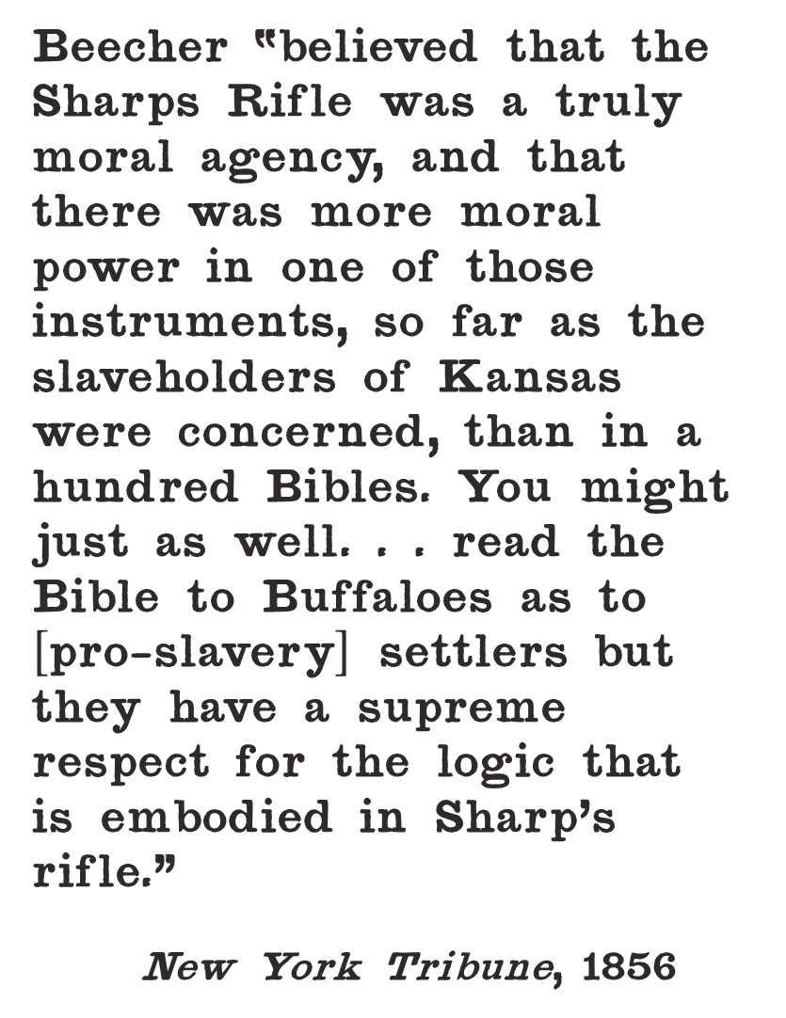

Slide 27
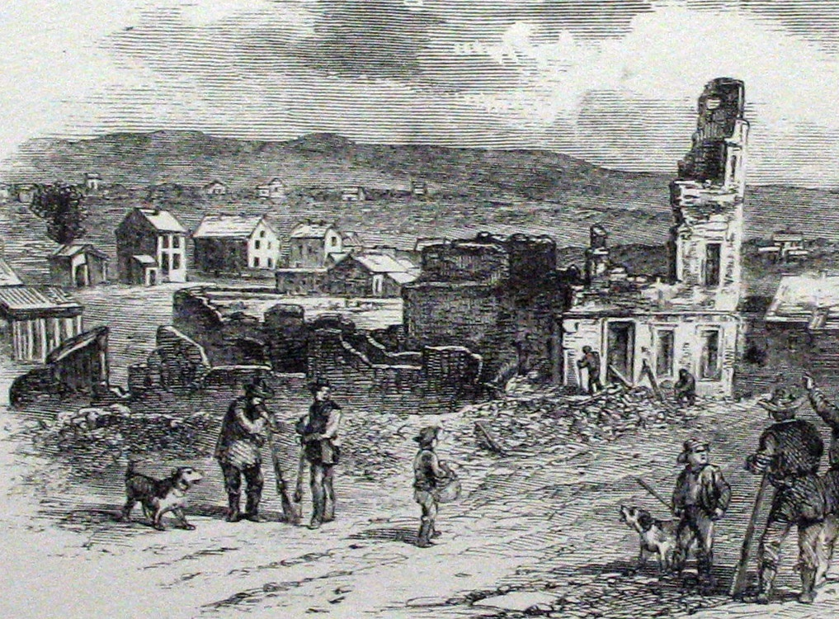
Notes:
In 1856, a proslavery militia sacked the antislavery settlement of Lawrence, provoking outrage among abolitionists.

Slide 28
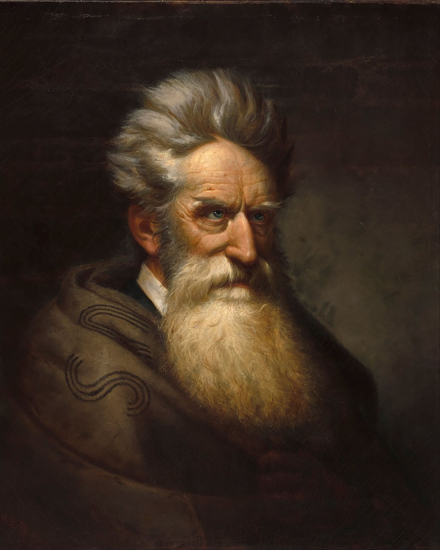
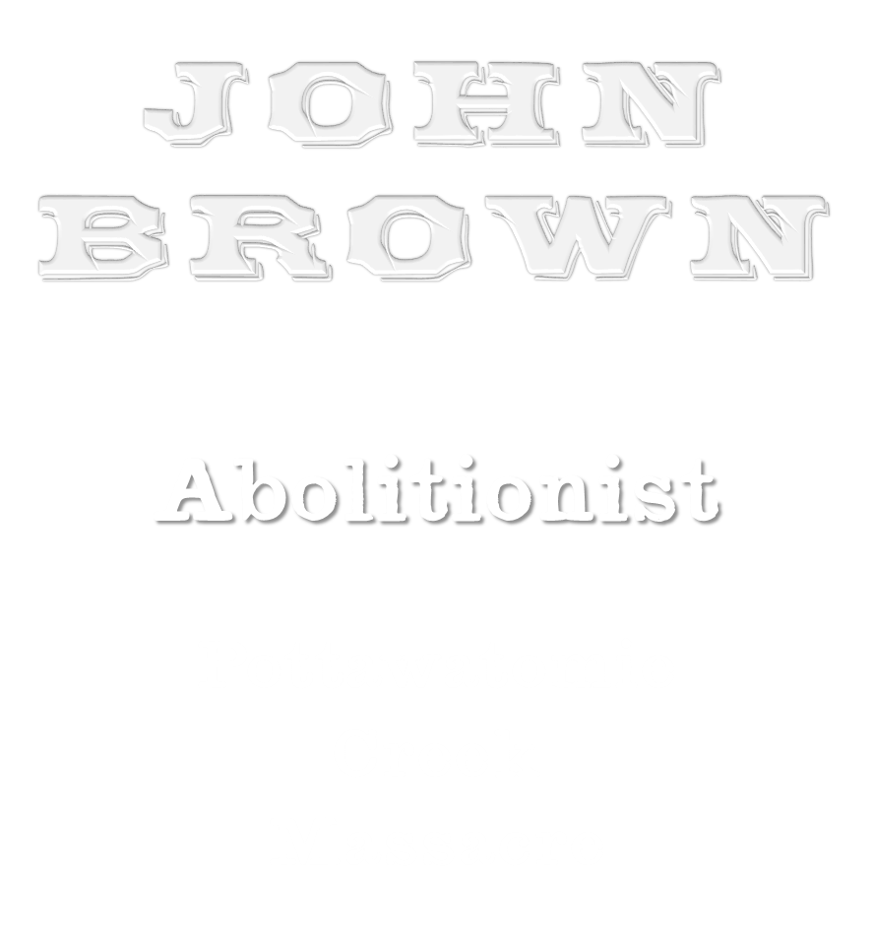
Notes:
In retaliation for the sack of Lawrence, John Brown and his sons attacked proslavery settlers at Pottowatomie Creek, killing five men. Some of the men were hacked to pieces with broadswords.

Slide 29
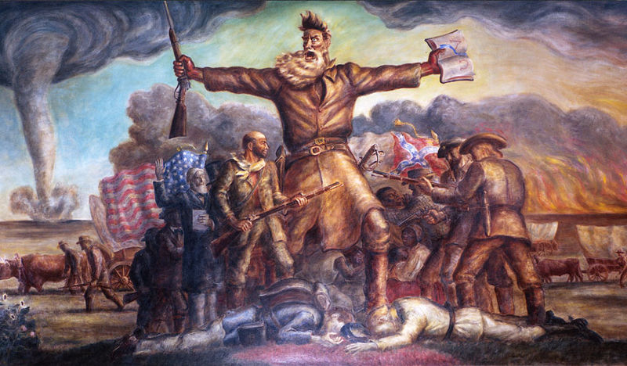
Notes:
John Brown was commemorated by John Steuart Curry in a mural that is still on display at the Kansas State House.

Slide 30
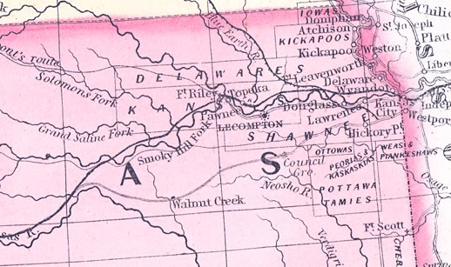
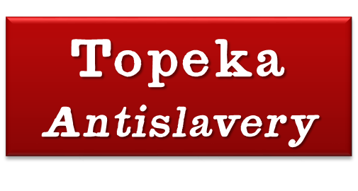
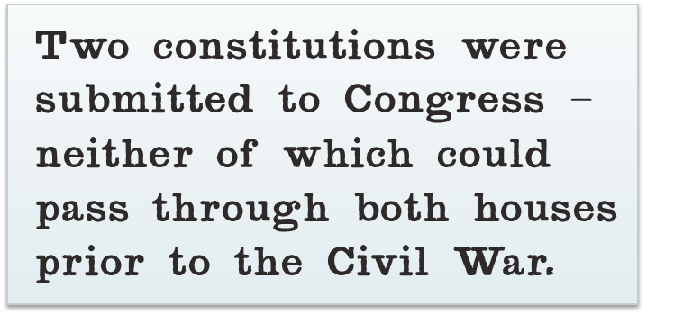
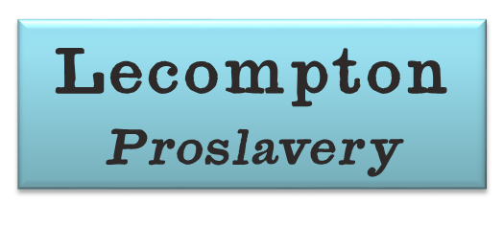
Notes:
Proslavery and antislavery settlers submitted separate state constitutions for approval by Congress: a proslavery constitution from Lecompton and an antislavery constitution from Topeka. Congress wouldn’t approve either constitution before the Civil War.

Slide 31
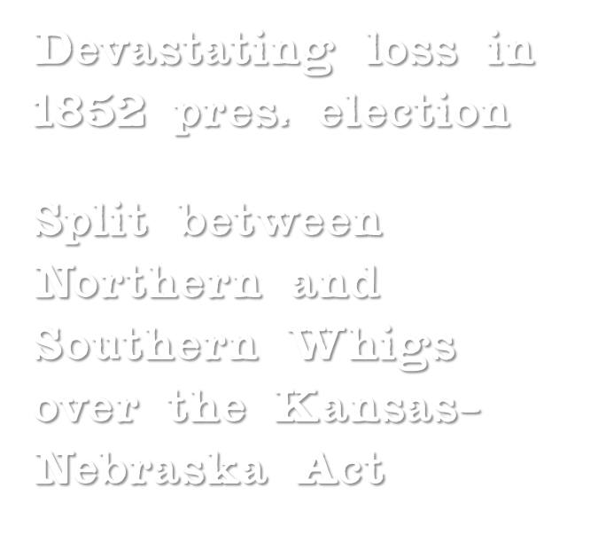
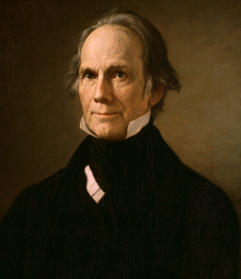
Notes:
The controversy over Kansas was the final nail in the coffin for the Whig Party, which had already suffered a devastating loss in the 1852 presidential election. Northern Whigs favored Free Soil policies while Southern Whigs favored the expansion of slavery into the West.

Slide 32
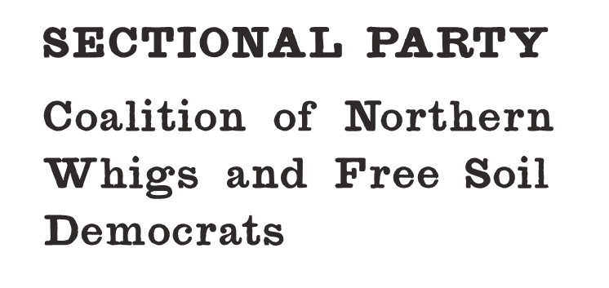
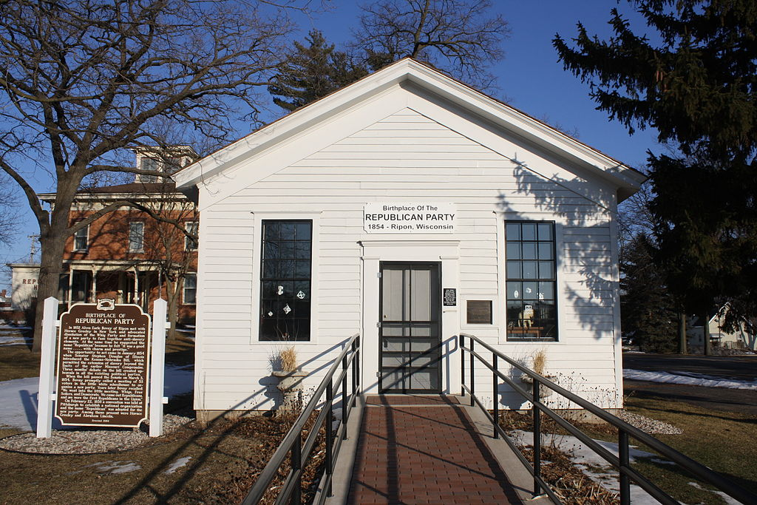
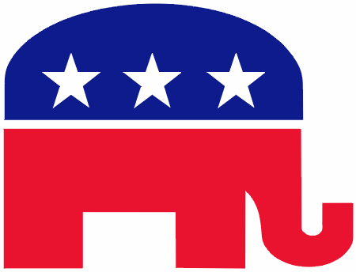
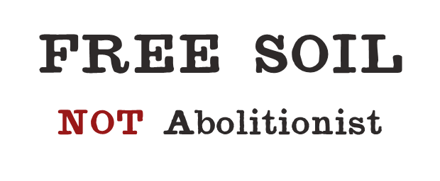
Notes:
Northern Whigs joined the new Republican Party, which was founded in 1854. They were joined by Northern Free Soil Democrats. Although there were abolitionists in the Republican Party, the Free Soil faction was dominant and the party platform advocated Free Soil – NOT abolitionism.

Slide 33
Notes:
The Brooks-Sumner incident brought the Kansas controversy into the halls of Congress.

Slide 34
Notes:
Sen. Charles Sumner, a Republican from Massachusetts, delivered a speech titled, “The Crime Against Kansas,” in which he eviscerated Sen. Andrew Butler of South Carolina and Sen. Stephen Douglas of Illinois as the Don Quixote and Sancho Panza of slavery.

Slide 35
Notes:
Sumner’s speech can best be described as a philippic – a style of speaking made famous by the Athenian orator, Demosthenes. The U.S. Senate had longstanding traditions of courtesy that made this speech unprecedented, where a senator personally attacked other senators – one of whom was not even present in the chamber due to illness.

Slide 39
Notes:
To add insult to injury, Sumner had thousands of copies of his inflammatory speech printed for distribution in the North.

Slide 40
Photo by alvaroreguly
Notes:
Sumner made references to chivalry in his speech. Southern gentlemen are known for their sense of chivalry, but the same code that prompts a gentleman to open a door for a lady or pay for her dinner mandates that he avenge any dishonor to his lady, his family, or his community.

Slide 41
Notes:
Rep. Preston Brooks, a relative of Sen. Butler, considered challenging Sumner to a duel, but a friend talked him out of this as the vulgar manner of Sumner’s attack rendered him less than a gentleman (and a duel can only take place between gentlemen).

Slide 42
CASH ME OUSSIDE
HOWBOW DAH
Notes:
So Brooks went with Plan B, walking into the Senate Chamber with a few friends, who held onlookers back while Brooks beat Sumner mercilessly with a cane for a full minute. Brooks then walked calmly out of the chamber.

Slide 43
Notes:
A House committee recommended that Brooks be expelled from the House, but the House chose to censure him rather than to expel him.

Slide 44
Brooks
Notes:
Brooks chose to resign from Congress rather than accept the censure.

Slide 45
Notes:
In the North, Preston Brooks became a personification of the enraged and violent Southern slaveholder stereotype. Cartoons like this one appeared all over the North, portraying Brooks as a faceless animal assaulting the defenseless Sumner.

Slide 46
Hit Him Again!
Notes:
In the South, Brooks became a hero. When a rumor started that he had broken his cane while beating Sumner, people from all over the South sent him replacement canes. One of them had a famous etching: Hit him again!

Slide 47
Notes:
So… suffice to say that things were really messed up at this point.

Slide 48
Notes:
So messed up that the Democrats declined to nominate President Pierce for a second term.

Slide 49
Notes:
Pierce, quite famous for his alcoholism and personal tragedies in his family life, allegedly said upon hearing that he’d been abandoned by his party, “There’s nothing left to do but get drunk.” He died of liver failure in 1869.

Slide 50
Notes:
Aside from the slavery issue, the United States experienced a wave of immigration during the Antebellum era, with a massive wave of immigration from Ireland hitting the United States in the 1840s. There were also many immigrants from Germany at this time. Both immigrant groups had a tendency to be Catholic and had a reputation for heavy drinking at a time when the Temperance Movement was at a high tide.

Slide 51
Notes:
The wave of immigration provoked a nativist response.

Slide 52
Notes:
The American Party, popularly known as the “Know Nothing” Party, was organized as an anti-immigration party. Many Whigs – especially Southern Whigs – joined this party, which vied with the Republican Party to replace the Whigs as the opposition to the Democrats.

Slide 54
Notes:
In the 1856 election, the Whigs won 22 percent of the popular vote but only managed to win one state’s electoral votes (ironically, Maryland, which was originally founded as a haven for Catholics). The Republicans put up a strong showing with 33 percent of the popular vote, but were not able to get the support they needed in Illinois, Indiana, or Pennsylvania. James Buchanan was elected with the support of only five free states.

Slide 55
Notes:
In this cartoon, the Republican nominee, John C. Fremont, finds himself stuck in an Abolition Bog with radical elements of the Republican Party, such as Rev. Henry Ward Beecher. Millard Fillmore, the Know Nothing Party nominee, stands upon a cracking Union Rock with his gun aimed at Buchanan, but the competition for the Republicans and the Know Nothings for the Whig vote led to James Buchanan (portrayed as a buck) capturing the White House with only 45 percent of the popular vote.

Slide 56
Notes:
If Pierce’s presidency was awful, Buchanan’s presidency was worse than awful. Granted, much of it was probably outside of his control. This was NOT a good time to be president.

Slide 57
Notes:
FUN FACT: James Buchanan was the only bachelor ever to occupy the White House.

Slide 58
Notes:
Sectional turmoil continued to spin out of control during Buchanan’s presidency, which started with the Supreme Court handing down the controversial Dred Scott decision.

Slide 59
Notes:
Dred Scott and his wife lived with his master in Illinois and Wisconsin for four years. He sued for his freedom on the grounds that his master, by taking him into places where slavery was illegal, had made him a free man.

Slide 60
.
Notes:
The Supreme Court handed down one of its most controversial decisions in history, ruling that Scott, being a person of African descent, could not be a citizen of the United States. Furthermore, the Court ruled that Congress could not forbid slavery in the territories. This rendered the Missouri Compromise (which had already been repealed by Congress) and any other prohibition of slavery in federal territories unconstitutional.

Slide 61
Photo by Martin Falbisoner
Photo by UpstateNYer
Photo by 350z33
Notes:
The Dred Scott case is an example of judicial activism, which occurs when judges make decisions that have no basis in law, but are more of a reflection of a judge’s opinion or personal philosophy. At the time, the Supreme Court was stacked with Southern appointees.

Slide 62
Notes:
The Dred Scott decision gave rise to a wave of paranoia in the North, where Republican politicians alleged the existence of a “Slave Power” conspiracy to spread slavery throughout the United States – even to the free states!

Slide 63
Notes:
In 1858, Abraham Lincoln, a Republican, challenged Sen. Stephen Douglas for his Illinois Senate seat. The debates between Lincoln and Douglas became legendary as people read about them throughout the nation. The debates pitted Lincoln’s Republican Free Soil philosophy against Douglas’ Democratic popular sovereignty doctrine.

Slide 64
Notes:
Douglas won the Senate election (which was decided by the state legislature) but Abraham Lincoln became a national figure and also forced Douglas to say some things that would come back to haunt his presidential ambitions.

Slide 65
Notes:
During the campaign, Lincoln delivered his famous “House Divided” speech, in which he said that the United States could not continue to exist indefinitely as half slave and half free. He contended that one side must eventually win. This speech contributed to fears that Southern slaveholders had of Lincoln and the Republican Party.

Slide 66
Notes:
In 1859, John Brown seized a federal arsenal in Harpers Ferry, VA, with the intent of arming slaves for a rebellion.

Slide 67
Notes:
John Brown was found guilty of treason in a federal court and sentenced to be hanged.

Slide 68
The Last Moments of John Brown by Thomas Hovenden
Notes:
Like Preston Brooks, Brown became a polarizing figure, thoroughly vilified in the South and praised in the North by radical abolitionists.

Slide 69
Notes:
The paranoia felt by many Americans on both sides of the Mason-Dixon Line can’t be understated. While Northerners imagined a South full of Preston Brookses who were conspiring to spread slavery throughout the nation, Southerners imagined that the North was full of John Browns who sought to start a massive slave rebellion and extinguish Southern society as they knew it.

Slide 71
Notes:
In 1860, it was the Democrats’ turn to be divided, as three candidates opposed Abraham Lincoln, who was able as a result to win a majority of the electoral vote with only 40 percent of the popular vote.

Slide 72
Notes:
By the time Abraham Lincoln was sworn in as the Sixteenth President of the United States, seven states in the Deep South had already seceded from the Union and formed the Confederate States of America.

